Slide 1
CS 111: Introduction to Computer Science
Dr. Tom Stephens
Fall 2023

Slide 2
Dr. Tom Stephens

Slide 3
Who is Dr. Stephens Anyway?
Education
  BS Physics 1996 – BYU
  MS Astronomy 1999 – NMSU
  Ph.D. Astronomy 2003 – NMSU
  MS Library and Information Science – 2016 – UNT
Work
  Assistant Professor – BYU – Dec 2020 – present
  Software Developer & Manager – NASA – 2003-15, 2017-20, now part-time
  Physical and Mathematical Sciences Librarian – 2014-17

Slide 4

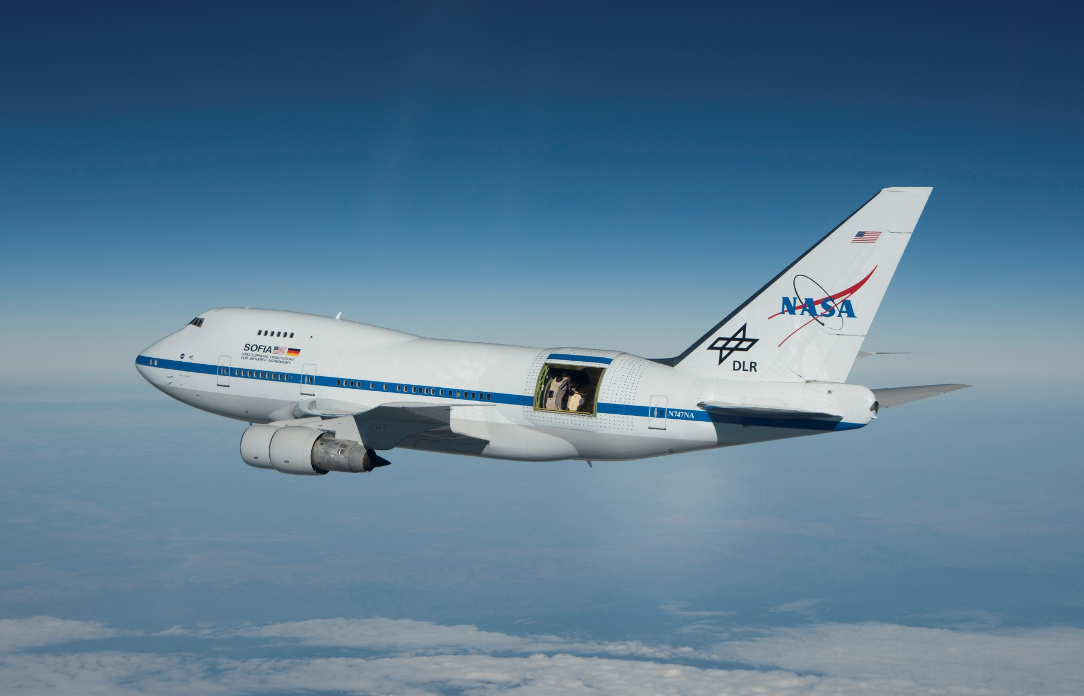
Who is Dr. Stephens Anyway?

Slide 5
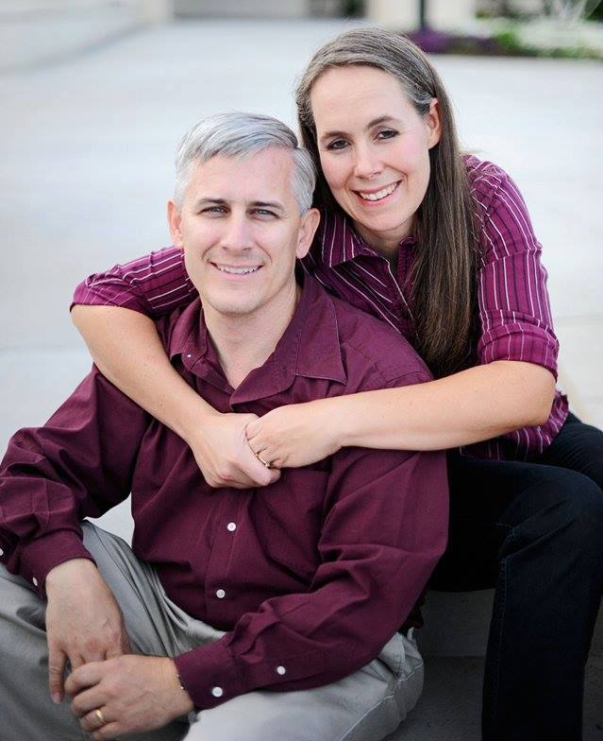
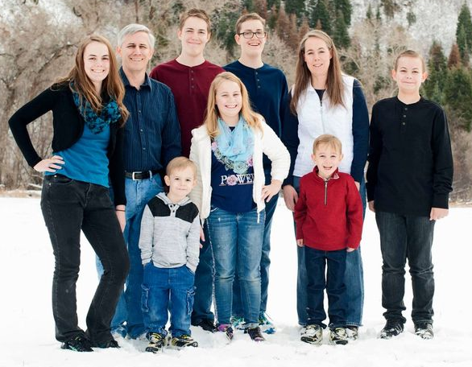
Who is Dr. Stephens Anyway?
Father of 7
Current Calling: Ward Temple & Family History Leader
Hobbies
  Hiking/Camping
  Reading & Writing (1 self-published sci-fi novel)
  Role-Playing Games – published a quarterly game magazine & more general blog
  3D Modeling and Printing
  Playing Minecraft and Roblox with the little guys (and their cousins)

Slide 6
Contacting Dr. Stephens
Office – 2256 TMCB – feel free to drop in anytime I’m there.
E-mail – tstephen@cs.byu.edu – This is the best way to reach me.
Office Hours – MWF 2:30-3:30 pm or by appointment
Stalk me on-line
  I'm on the class Discord
  @dagorym on most online sites
  Tom Stephens on Facebook

Slide 7
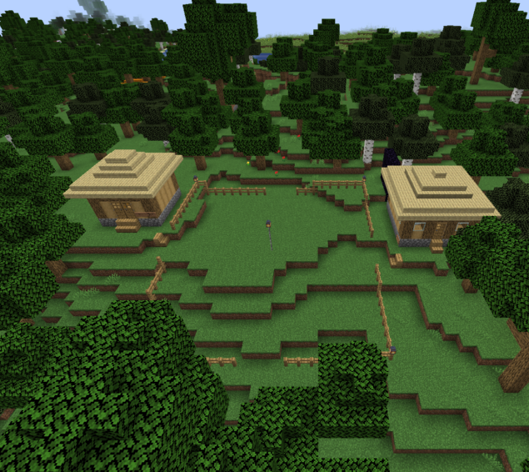
CS Minecraft server
For those Minecraft players in the class, I have a server set up you’re welcome to join.
Details can be found at:
https://expandingfrontier.com/cs-minecraft-server/

Slide 8
TAs
We have an awesome group of TAs 😎. See the course website for information about them.
Course website - https://cs111.byu.edu

Slide 9
A Very Brief Introduction to Computer Science

Slide 10
What is Computer Science?
What problems can be solved using computing
The study of …
How to solve these problems
What techniques lead to effective solutions
Systems
Graphics
Security
Decision Making
Answering Questions
Artificial Intelligence
Robotics
Translation
Networking
Ethics & Safety
…
Programming Languages
Natural Language Processing
Theory
…
Scientific Computing
Human Computer Interaction
…

Slide 11
About this Course

Slide 12
Course Origin
We borrowed and adapted an initial version of this course from UC Berkely’s CS61a course – with their permission and help.
After teaching that course for a year, we decided it wasn’t quite meeting the needs of our students in our program
We’ve been redesigning it since the end Winter Semester. We piloted the new version in Summer.
  Some of the assignments are still under development
  Bear with us as we make changes and adapt

Slide 13

Course topics
Managing complexity in programs (procedural abstractions, data abstractions, programming paradigms)
Deep understanding of programming concepts (using Python)
How computers interpret computer programs
Different types of languages (Regex, Scheme)
Problem solving techniques (both iterative and recursive approaches)
HTML, HTTP, & the web
Plotting
Software design and testing
This course is challenging and often mind-blowing! 🤯

Slide 14
Course Prerequisites
This is not an introductory programming class.
You should have prior coding experience with branching, loops, and functions.
If you do not think you have enough programming experience, consider taking CS 110 and joining us next term.

Slide 15
Course Format

Slide 16
Course Components
Lectures
Labs
Homework assignments
Projects
Exams 😱
Textbook (composingprograms.com)
Office hours
Everything is linked from https://cs111.byu.edu

Slide 17
Weekly Schedule
Monday | Tuesday | Wednesday | Thursday | Friday | Saturday
Lecture |  | Lecture |  | Lecture
 | Lab Section |  | Lab Section
 |  | Homework/ Project assignments due

Slide 18
Lab Sections
Make sure you are signed up for a Lab section (004-012 & 015-019) as well as the lecture.
Each lab section has a pair of TAs that will lead the activities in those sections. You’ll have the same TAs all semester.
Labs will focus on small coding challenges that provide practice with materials covered in lecture
They are a place to “Take chances, make mistakes, and get messy!” – Miss Frizzle.
Attendance is not required, but STRONGLY encouraged. If you attend and participate, you get full credit. If you don’t, you have to submit working code to the auto-grader by the end of the day.

Slide 19
Homeworks & Projects
Homework and Projects are due on Wednesday nights. See the course website for exact due dates. Start early, code often!
These often build on and use code from your labs and previous homework assignments.
The course moves fairly fast. Start early. The earlier you find you need help, the better!
You can discuss the assignments at a high-level, but don't copy anyone else's code (unless it's your project partner).

Slide 20
Exams 😱
Midterm 1: Wed, Oct 11 – Mon, Oct 16
Midterm 2: Wed, Nov 15 – Mon, Nov 20
Final Exam: finals week (Dec 16-21)
All exams are scheduled to be held in the Testing Center.

Slide 21
Office Hours
Dr. Stephens
  Scheduled office hours: MWF – 2:30-3:30pm, 2256 TMCB
  Or by appointment
  I’m typically in my office all day when I'm not teaching so you can drop by anytime, but I won’t guarantee I’ll be in.
TAs
  The TAs are regularly available five days per week in the help lab at TMCB 1121. Check the schedule at https://cs111.byu.edu/staff/#ta-lab.

Slide 22
Getting Help
Post questions on the class Discord (invite link: https://discord.gg/3aCYJDqPJn)
Visit the TA lab (1121 TMCB)
Use the help queue: https://students.cs.byu.edu/~cs111ta/helpqueue/
Check out our contact page for how to get in touch https://cs111.byu.edu/staff/#contact/).

Slide 23
Course Policies

Slide 24
Course Policies
Read the syllabus. You are responsible for knowing the information there (https://cs111.byu.edu/articles/about/).

Slide 25
Collaboration
Asking questions is highly encouraged
  Discuss everything with each other; learn from each other!
  Some projects can be completed with a partner
  Choose a partner from your discussion section
The limits of collaboration
  Please don’t look at someone else's code!
    Exceptions: lab, your project partner, or after you already solved the problem
  Please don't tell other people the answers! You can point them to what is wrong and describe how to fix it, but don't tell them what to type, and don't type for them
  Copying project solutions causes people to fail the course
  We really do catch people who violate the rules, and we're getting better at it. (🫙🎵)

Slide 26
Community Guidelines
Your goal should be to learn and help others learn.
Even if everyone here has programming experience, there is still a wide range of experience levels. All are welcome!
🧑🏻‍💻🧑🏼‍💻👩🏻‍💻🧑🏽‍💻🧑🏾‍💻👩🏽‍💻🧑🏿‍💻👩🏾‍💻👨🏻‍💻👩🏿‍💻👨🏼‍💻👨🏽‍💻👩🏼‍💻👨🏾‍💻👨🏿‍💻
There are no "stupid" questions. Ask all your questions and welcome everyone else's questions.
🙋🏻🙋🏼🙋🏿‍♀️🙋🏽🙋🏾‍♀️🙋🏾🙋🏿🙋🏽‍♀️🙋🏻‍♂️🙋🏼‍♀️🙋🏼‍♂️🙋🏽‍♂️🙋🏻‍♀️🙋🏾‍♂️🙋🏿‍♂️🙋🏻‍♀️

Slide 27
Questions?

