Slide 1
Higher-order Functions

Slide 2
Designing Functions

Slide 3
Describing Functions
def square(x):
"""Returns the square of X."""
return x * x
Aspect | Example
A function's domain is the set of all inputs it might possibly take as arguments. | x is a number
A function's range is the set of output values it might possibly return. | square returns a non-negative real number
A function's behavior is the relationship it creates between input and output. | square returns the square of x

Slide 4
Designing a function
Give each function exactly one job, but make it apply to many related situations.
Don't Repeat Yourself (DRY): Implement a process just once, execute it many times.
round(1.23) # 1
round(1.23, 0) # 1
round(1.23, 1) # 1.2
round(1.23, 5) # 1.23

Slide 5
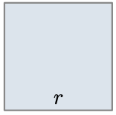
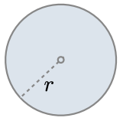
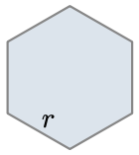



Generalizing patterns with arguments
Geometric shapes have similar area formulas.
Shape
$$\frac{3\sqrt{3}}{2}∗r^{2}$$
Area
$$1∗r^{2}$$
$$π∗r^{2}$$

Slide 6
A non-generalized approach
from math import pi, sqrt
def area_square(r):
return r * r
def area_circle(r):
return r * r * pi
def area_hexagon(r):
return r * r * (3 * sqrt(3) / 2)
How can we generalize the common structure?

Slide 7
Generalized area function
from math import pi, sqrt
def area(r, shape_constant):
"""Return the area of a shape from length measurement R."""
if r < 0:
return 0
return r * r * shape_constant
def area_square(r):
return area(r, 1)
def area_circle(r):
return area(r, pi)
def area_hexagon(r):
return area(r, 3 * sqrt(3) / 2)

Slide 8
Higher-order Functions

Slide 9
What are higher-order functions?
A function that either:
  Takes another function as an argument
  Returns a function as its result
All other functions are considered first-order functions.

Slide 10
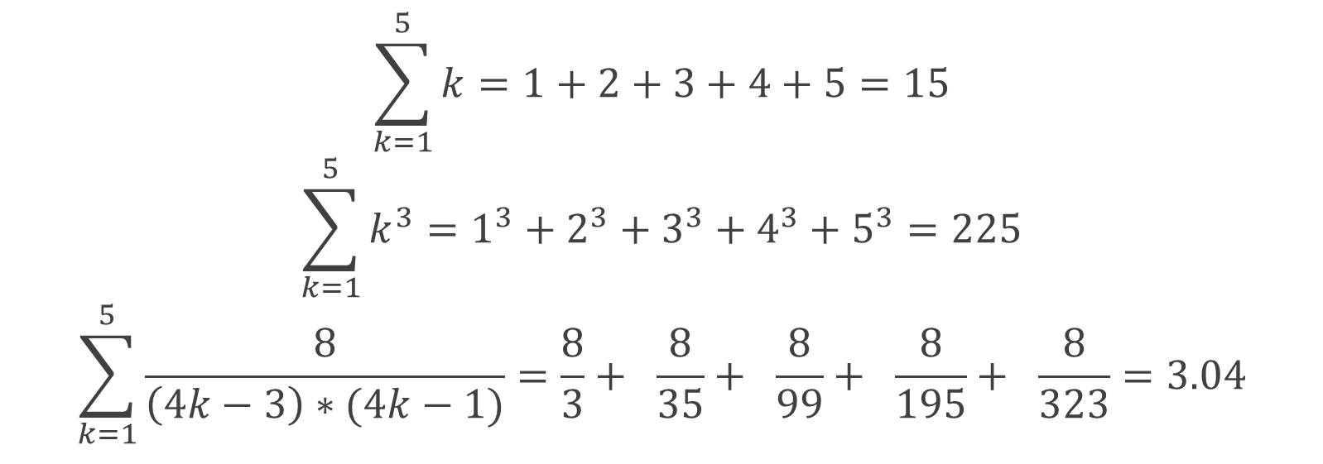
Generalizing over computational processes
$$\sum_{k=1}^{5}{k}=1+2+3+4+5=15$$
$$\sum_{k=1}^{5}{k^{3}}=1^{3}+2^{3}+3^{3}+4^{3}+5^{3}=225$$
$$\sum_{k=1}^{5}{\frac{8}{\left(4k−3\right)∗(4k−1)}}=\frac{8}{3}+ \frac{8}{35}+ \frac{8}{99}+ \frac{8}{195}+ \frac{8}{323}=3.04$$
The common structure among functions may be a computational process, not just a number

Slide 11
Functions as arguments
def cube(k):
return k ** 3
def summation(n, term):
"""Sum the first N terms of a sequence. TERM is a function
that takes a single argument and returns a result.
>>> summation(5, cube)
225
"""
total = 0
k = 1
while k <= n:
total = total + term(k)
k = k + 1
return total

Slide 12
Functions as return values

Slide 13

Locally defined functions
Functions defined within other function bodies are bound to names in a local frame.
def make_adder(n):
"""Return a function that takes one argument k
and returns k + n.
>>> add_three = make_adder(3)
>>> add_three(4)
7
"""
def adder(k):
return k + n
return adder
View in PythonTutor

Slide 14
Call expressions as operator expressions
3
make_adder(1)( 2 )
Operator
Operand
func adder(k)
make_adder(1)
2
func make_adder…
1
make_adder(n)
def adder(k):
return k + n
return adder
func adder(k)

Slide 15
Lambda expressions

Slide 16
Lambda Syntax
A lambda expression is a simple function definition that evaluates to a function.
The syntax:
A function that takes in parameters and returns the result of expression.
A lambda version of the square function:
A function that takes in parameter x and returns the result of x * x.
lambda <parameters>: <expression>
square = lambda x: x * x

Slide 17
square = lambda x: x * x
A lambda expression does not contain return statements or any statements at all.
Incorrect:
Correct:
square = lambda x: return x * x
square = lambda x: x * x

Slide 18
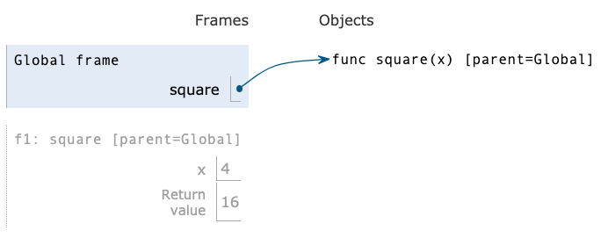
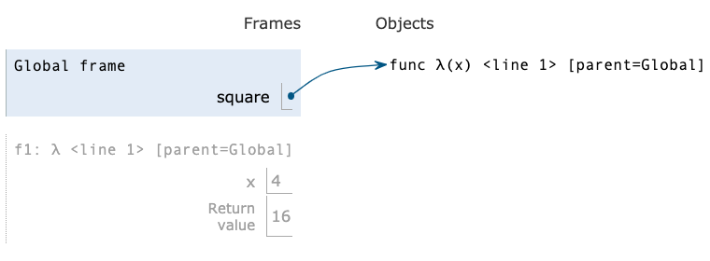
Def statements vs. Lambda expressions
def square(x):
return x * x
vs
square = lambda x: x * x
Both create a function with the same domain, range and behavior
Both bind that function to the name square.
Only the def statement gives the function an intrinsic name, which shows up in environment diagrams but doesn't affect execution (unless the function is printed).

Slide 19
Lambda as argument
It's convenient to use a lambda expression when you are passing in a simple function as an argument to another function.
Instead of...
We can use a lambda
def cube(k):
return k ** 3
summation(5, cube)
summation(5, lambda k: k ** 3)

Slide 20
Conditional expressions
A conditional expression has the form:
Evaluation rule:
  Evaluate the <predicate> expression.
  If it's a true value, the value of the whole expression is the value of the <consequent>.
  Otherwise, the value of the whole expression is the value of the <alternative>.
<consequent> if <predicate> else <alternative>

Slide 21
Lambdas with conditionals
This is invalid syntax:
Conditional expressions to the rescue!
lambda x: if x > 0: x else: 0
lambda x: x if x > 0 else 0

