Slide 1
Exceptions and Decorators

Slide 2
Exceptions

Slide 3
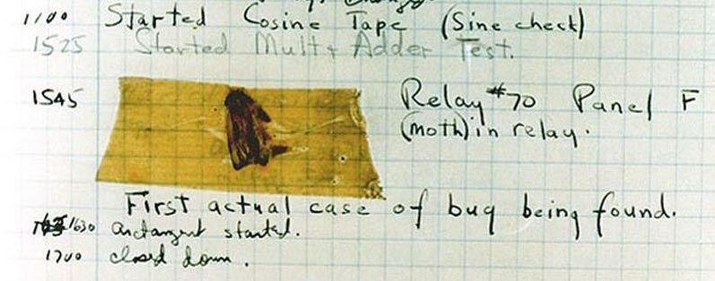
Handling errors
Sometimes, computer programs behave in non-standard ways.
A function receives an argument value of an improper type
Some resource (such as a file) is not available
A network connection is lost in the middle of data transmission
Moth found in a Mark II Computer (Grace Hopper's Notebook, 1947)

Slide 4
To Err is Human
What to do with an error:
Return a special value.
Use a Boolean return value to indicate success or failure.
Set a global variable.
Print an error message.
Print an error message and exit the program.
Put an input or output stream in a fail state.
The first three options allow the user of a function to respond to the error

Slide 5
Exceptions
An exception is a built-in mechanism in a programming language to declare and respond to "exceptional" conditions.
A program raises an exception when an error occurs.
If the exception is not handled, the program will stop running entirely.
But if a programmer can anticipate when exceptions might happen, they can include code for handling the exception, so that the program continues running.
Many languages include exception handling: C++, Java, Python, JavaScript, C#, etc.

Slide 6
Handling Exceptions
If exceptions are not caught and handled, they will cause the program to crash.
If we catch an exception, we can decide what to do about it
Record it - log it to a file, print it out, send an e-mail, page someone, etc.
Rethrow it so another part of the program can address it as well
Retry the operation that caused the failure
Ignore it and not pass it on (not a good idea) – called swallowing the exception

Slide 7
Exceptions
Python raises an exception whenever a runtime error occurs.
How an unhandled exception is reported:
If an exception is not handled, the program stops executing immediately.
>>> 10/0
Traceback (most recent call last):
File "<stdin>", line 1, in
ZeroDivisionError: division by zero

Slide 8
Types of exceptions
A few exception types and examples of buggy code:
See full list in the exceptions docs.
Exception | Example
OverflowError | pow(2.12, 1000)
TypeError | 'hello'[1] = 'j'
IndexError | 'hello'[7]
NameError | x += 5
FileNotFoundError | open('dsfdfd.txt')

Slide 9
The try statement
To handle an exception (keep the program running), use a try statement.
The <try suite> is executed first. If, during the course of executing the <try suite>, an exception is raised that is not handled otherwise, and If the class of the exception inherits from <exception class>, then the <except suite> is executed, with <name> bound to the exception.
try:
<try suite>
except <exception class> as <name>:
<except suite>
...

Slide 10

Try statement example
try:
quot = 10/0
except ZeroDivisionError as e:
print('handling a', type(e))
quot = 0
View in PythonTutor

Slide 11
Try inside a function
def div_numbers(dividend, divisor):
try:
quotient = dividend/divisor
except ZeroDivisionError:
print("Function was called with 0 as divisor")
quotient = 0
return quotient
div_numbers(10, 2)
div_numbers(10, 0)
div_numbers(10, -1)
View in PythonTutor

Slide 12
What would Python do?
def invert(x):
inverse = 1/x # Raises a ZeroDivisionError if x is 0
print('Never printed if x is 0')
return inverse
def invert_safe(x):
try:
return invert(x)
except ZeroDivisionError as e:
print('Handled', e)
return 0
invert_safe(1/0)
try:
invert_safe(0)
except ZeroDivisionError as e:
print('Handled!')
inverrrrt_safe(1/0)

Slide 13
Raising exceptions

Slide 14
Assert statements
Assert statements raise an exception of type AssertionError:
where <expression> should evaluate to True and if it doesn't, <string> is the message passed with the AssertionError
Assertions are designed to be used liberally. They can be ignored to increase efficiency by running Python with the "-O" flag; "O" stands for optimized.
Put assertions in your code wherever your code is checking input or conditions that you as the programmer have control over. If an assertion is raised, it means you have a bug that you can fix.
If you don't have control over the input, raise an exception.
assert <expression>, <string>
python3 -O

Slide 15
Raise Statements
Any type of exception can be raised with a raise statement
<expression> must evaluate to a subclass of BaseException or an instance of one
Exceptions are constructed like any other object. e.g.,
raise <expression>
TypeError('Bad argument!')

Slide 16
When we should not use exceptions
When an error event happens routinely and could be considered part of normal execution, handle without throwing exceptions.
Generate error codes or return values
Use if() statements to check and handle errors

Slide 17
When we should use exceptions
When we don't have control of the input or processing state, we should use exceptions to report errors
Use try-catch blocks
Around code that can potentially (and unexpectedly) generate an exception.
Prevent and recover from application crashes.
Throw an exception when your program can identify an external problem that prevents execution.

Slide 18
Advantages of using exceptions
Compared to error reporting via return-codes and if statements, using try / catch / throw is likely to result in code
that is easier to read,
that has fewer bugs,
is less expensive to develop,
and has faster time-to-market (time-to-submission for students ☺).

Slide 19
Input validation
Input validation is a form of defensive programming.
Whenever a function or method receives input from a user, it is a good practice to validate that the input provided is in the function's domain.
If the arguments are provided by the user, we should raise exceptions or return error codes.
If the arguments are provided by the developer, we should use assertions.
def sqrt(x):
if x < 0:
raise ValueArgument ("Negative numbers not allowed.")
# code to compute square root

Slide 20
Decorators

Slide 21
A tracing function
Let's make a higher-order tracing function
def trace1(f):
"""Return a function that takes a single argument, x, prints it,
computes and prints F(x), and returns the computed value.
>>> square = lambda x: x * x
>>> trace1(square)(3)
-> 3
<- 9
9
"""
def traced(x):
print("->", x)
r = f(x)
print("<-", r)
return r
return traced

Slide 22
A tracing decorator
What if we always wanted a function to be traced?
That's equivalent to..
@trace1
def square(x):
return x * x
def square(x):
return x * x
square = trace1(square)

Slide 23
General decorator syntax
The notation:
is essentially equivalent to:
ATTR can be any expression, not just a single function name.
@ATTR
def aFunc(...):
...
def aFunc(...):
...
aFunc = ATTR(aFunc)

