Slide 1
Language & Syntax

Slide 2
Syntax Trees

Slide 3
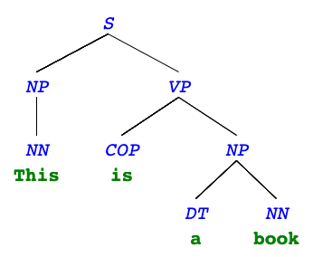
Syntax trees
Both programming languages and spoken languages can be parsed into syntax trees.
For a spoken language, a syntax tree reveals the syntactic structure of a single sentence.
"This is a book"

Slide 4
Syntax tree terminals
The leaves are also called terminals: they contain both a syntactic identifer (tag) and the actual world.
  NN: singular noun (e.g. "This", "book")
  COP: copula (e.g. "is")
  DT: determiner (e.g. "the")
Other terminals: NNS (plural noun), NNP (proper noun), PRP (personal pronoun), JJ (adjective), IN (preposition), CC (coordinating conjunction), AUX (auxillary verb), RB (adverb), VBN (verb, past participle), ...

Slide 5
Syntax tree non-terminals
The other nodes are called non-terminals and contain only tags (typically a phrase type). The tag describes the phrase in the leaves under them.
  S: sentence (e.g. "This is a book")
  NP: noun phrase (e.g. "This", "a book")
  VP: verb phrase (e.g. "is a book")
Other non-terminals: SQ (question), PP (prepositional phrase), ADVP (adverb phrase)...

Slide 6
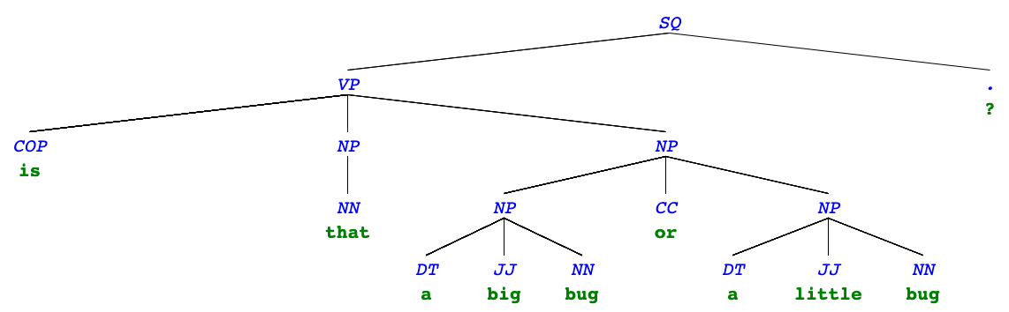
More syntax trees
"Is that a big bug or a little bug?"

Slide 7
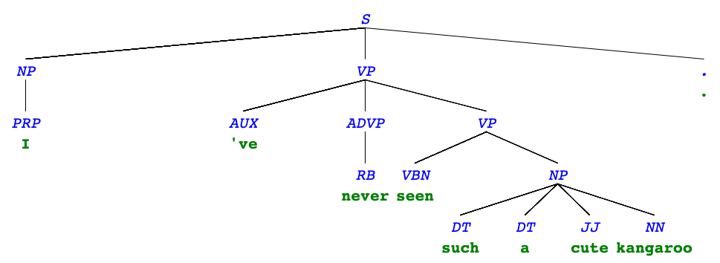
More syntax trees
"I've never seen such a cute kangaroo."

Slide 8
Syntax tree representation

Slide 9
Using the tree abstraction
The label of non-terminals will be just the tag: "S", "NP", "VP".
The label of terminals will be a list of the tag and the word itself:
  ["NN", "This"]
  ["COP", "is"]
  ["DT", "a"]
  ["NN", "book"]

Slide 10
A tree() version
t = tree("S", [
tree("NP", [tree(["NN", "this"])]),
tree("VP", [
tree(["COP", "is"]),
tree("NP", [
tree(["DT", "a"]),
tree(["NN", "book"])
])
])
])

Slide 11
Additional abstractions
def phrase(tag, branches):
return tree(tag, branches)
def word(tag, text):
return tree([tag, text])
def text(word):
return label(word)[1]
def tag(t):
"""Return the tag of a phrase or word."""
if is_leaf(t):
return label(t)[0]
else:
return label(t)

Slide 12
Programming Languages

Slide 13
Levels of languages
High-level programming language
(Python, C++, JavaScript)
⬇
Assembly language
(Hardware-specific)
⬇
Machine language
(Hardware-specific)

Slide 14
Machine language
The language of the machine is all 1s and 0s, often specifying the action and the memory address to act on:
Code is executed directly by the hardware.
00000100 10000010 # Load data in 10000010
00000001 10000001 # Subtract data at 10000001
00000101 10000100 # Store result in 10000100
00001011 10000100 # Etc..
00001101 00010000
00010100 00000010
00000101 10000011
00001111 00000000
00010100 00000011
00000101 10000011
00001111 00000000

Slide 15
Assembly language
Assembly language was introduced for (slightly) easier programming.
Machine code |  | Assembly code
00000100 10000010 00000001 10000001 00000101 10000100 00001011 10000100 00001101 00010000 00010100 00000010 00000101 10000011 00001111 00000000 00010100 00000011 00000101 10000011 00001111 00000000 |  | LOD Y SUB X STO T1 CPL T1 JMZ 16 LOD #2 STO Z HLT LOD #3 STO Z HLT

Slide 16
Higher-level languages
Higher level languages:
  provide means of abstraction such as naming, function definition, and objects
  abstract away system details to be independent of hardware and operating system
Statements & expressions are either interpreted by another program or compiled (translated) into a lower-level language.
a = y – x
if a > y:
z = 2
else:
z = 3

Slide 17
Compiled vs. interpreted
When a program is compiled, the source code is translated into machine code, and that code can be distributed and run repeatedly.
  Source code → Compiler → Machine code → Output
When a program is interpreted, an interpreter runs the source code directly (without compiling it first).
  Source code → Interpreter → Output
In its most popular implementation (CPython), Python programs are interpreted but have a compile step:
  Source code → Compiler → Bytecode → Virtual Machine → Output

Slide 18
Phases of an interpreter/compiler
In order to either interpret or compile source code, a program must be written that understands that source code.
Typical phases of understanding:
  Source code → Lexing → Parsing → Abstract Syntax Tree
We'll come back to this after we talk about the Calculator Language

Slide 19
The Calculator Language

Slide 20
What's in a language?
A programming language has:
  Syntax: The legal statements and expressions in the language
  Semantics: The execution/evaluation rule for those statements and expressions
To create a new programming language, you either need a:
  Specification: A document describe the precise syntax and semantics of the language
  Canonical Implementation: An interpreter or compiler for the language

Slide 21
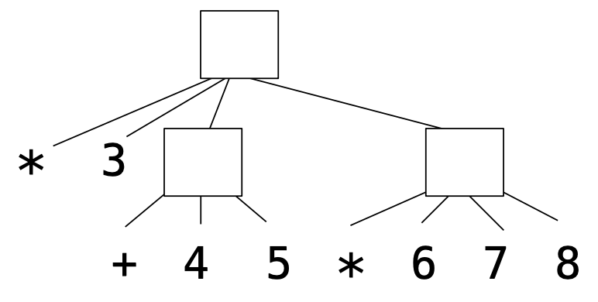
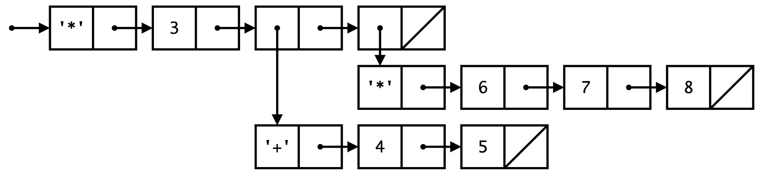
Calculator language syntax
The Calculator language has primitive expressions and call expressions. (That's it!)
A primitive expression is a number: 2 -4 5.6
A call expression is a combination that begins with an operator (+, -, *, /) followed by 1 or more expressions and is surrounded by parentheses:
(+ 1 2 3) (/ 3 (+ 4 5))
Expression | Expression tree | Representation as Links
(* 3 (+ 4 5) (* 6 7 8))

Slide 22
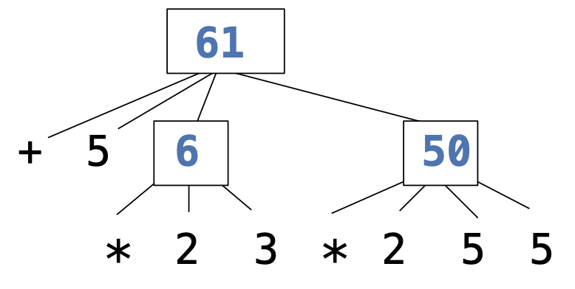
Calculator language semantics
The value of a calculator expression is defined recursively.
  Primitive: A number evaluates to itself.
  Call: A call expression evaluates to its argument values combined by an operator.
    +: Sum of the arguments
    *: Product of the arguments
    -: If one argument, negate it. If more than one, subtract the rest from the first.
    /: If one argument, invert it. If more than one, divide the first by the rest.
Expression | Expression tree
(+ 5 (* 2 3) (* 2 5 5))

Slide 23
Interactive interpreters

Slide 24
REPL: Read-Eval-Print Loop
The user interface for many programming languages is an interactive interpreter
  Print a prompt
  Read text input from the user
  Parse the text input into an expression
  Evaluate the expression
  If any errors occur, report those errors, otherwise
  Print the value of the expression and repeat

Slide 25
Raising exceptions
Exceptions can be raised during lexical analysis, syntactic analysis, eval, and apply.
Example exceptions
  Lexical analysis: The token 2.3.4 raises ValueError("invalid numeral")
  Syntactic analysis: An extra ) raises SyntaxError("unexpected token")
  Eval: An empty combination raises TypeError("() is not a number or call expression")
  Apply: No arguments to - raises TypeError("- requires at least 1 argument")

Slide 26
Handling exceptions
An interactive interpreter prints information about each error.
A well-designed interactive interpreter should not halt completely on an error, so that the user has an opportunity to try again in the current environment.

