Slide 1
Conclusion

Slide 2
What did we learn?

Slide 3
Programming paradigms
Imperative programming: using statements to change a program's state.
Functional programming: expressions, not statements; no side-effects; use of higher-order functions.
nums = [1, 2, 4]
for i in range(0, len(nums)):
nums[i] = nums[i] ** 2
list(map(lambda x: x ** 2, [1, 2, 4]))
(+ 3 (* 2 6) (- 10 7))

Slide 4
Programming paradigms #2
Data-centric and object-oriented programming.
Declarative programming: State goals or properties of the solution rather than procedures.
t = tree(3, [tree(1), tree(2, [tree(1), tree(1)])])
[b.label for b in branches(t)
innocent_bee = Bee(5)
horrible_ant = Ant(10)
innocent_bee.fend_off(horrible_ant)
(.+)@(.+)\.(.{3})
<body>
<p>This is a paragraph with <em>something emphasized</em>
and <a href="cs111.byu.edu">a link</a></p>
</body>

Slide 5
Programming Concepts
Data storage:
  Primitive/simple types: booleans, numbers, strings
  Compound types: lists, linked lists, trees
Environments: rules for how programs access and modify named objects
Higher-order functions: Functions as data values, functions on functions
Recursion: approaching a problem recursively, general recursive patterns
Mutability: mutable objects, mutation operations, dangers of mutation
Exceptions: Dealing with errors
Efficiency: Different programs have different time/space needs

Slide 6
Software Engineering
Abstractions, separation of concerns
Specification of a program vs. its implementation
  Syntactic spec (header) vs. semantic spec (docstring).
  Example of multiple implementations for the same abstract behavior
Testing: for every program, there is a test.
Coding style (Composition)

Slide 7
Some useful tools
Images and how to manipulate them
Introduction to HTML
How to surf the web programmatically
How to generate plots

Slide 8
What's next?

Slide 9
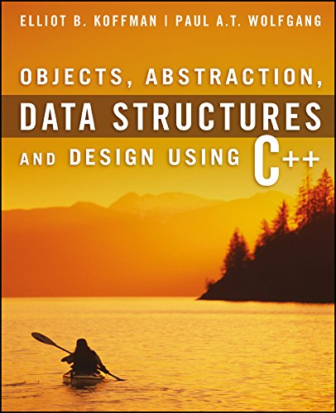
What's next?
After passing CS 111, you can now take the following CS courses:
  CS 235: Data Structures
    Next course needed for CS major or minor
    Language: C++
    Test Book: Objects, Abstraction, Data Structures and Design: Using C++
      Amazon.com: Can rent paperback
  CS 260: Web Programming
    Required for CS major, elective for CS minor
    Language: JavaScript (similar to Python)

Slide 10
Specialized CS Courses
Here are some other CS courses you could take:
  CS 202: Software Engineering Lab 1
    1 credit course for Software Engineering Emphasis
    Language: Java
  CS 180: Intro to Data Science
    Language: Python

Slide 11
CS Courses Prerequisites
CS 235
CS 224
CS 236
CS 240
(All these courses are required for the CS Major. CS Minor requires 236 and 240. See BYU catalog for more course details: https://catalog.byu.edu/physical-and-mathematical-sciences/computer-science/

Slide 12
Teaching Assistants
Opportunity to be a TA for CS 111
  Run a Section 💻
  Build your peer network 👥
  Share your knowledge and enthusiasm 🎉
  Help other students succeed and feel they belong ⚓
  Details 👇
    Work from 4-15 hours per week
    Flexible office hours
    Contact your TA Section leaders or Dr. Stephens
Don't forget to thank this semester's TAs 👏

Slide 13
Thank you!

