Slide 1
CS 111: Introduction to Computer Science
Dr. Tom Stephens

Slide 2


Slide 3
Who is Dr. Stephens Anyway?
Education
  BS Physics 1996 – BYU
  MS Astronomy 1999 – NMSU
  Ph.D. Astronomy 2003 – NMSU
  MS Library and Information Science – 2016 – UNT
Work
  Assistant Professor – BYU – Dec 2020 – present
  Software Developer & Manager – NASA – 2003-15, 2017-20, now part-time
  Physical and Mathematical Sciences Librarian – 2014-17

Slide 4
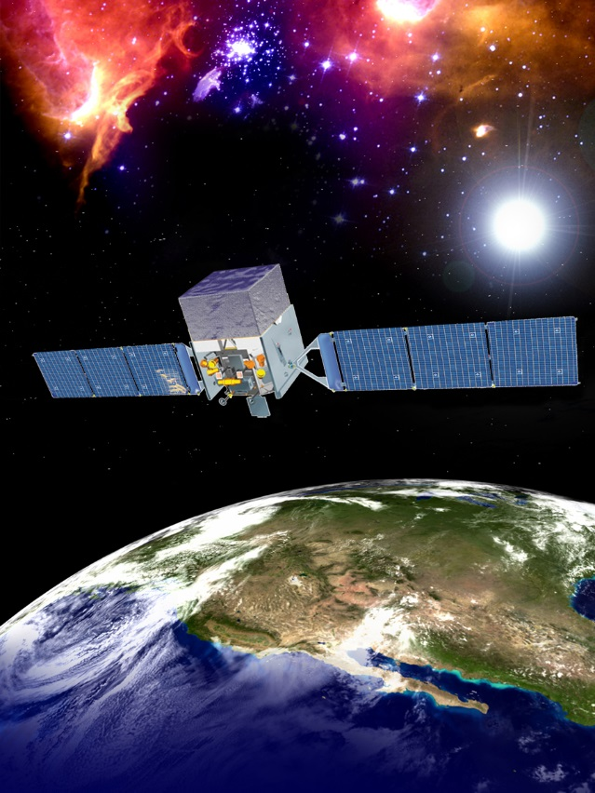
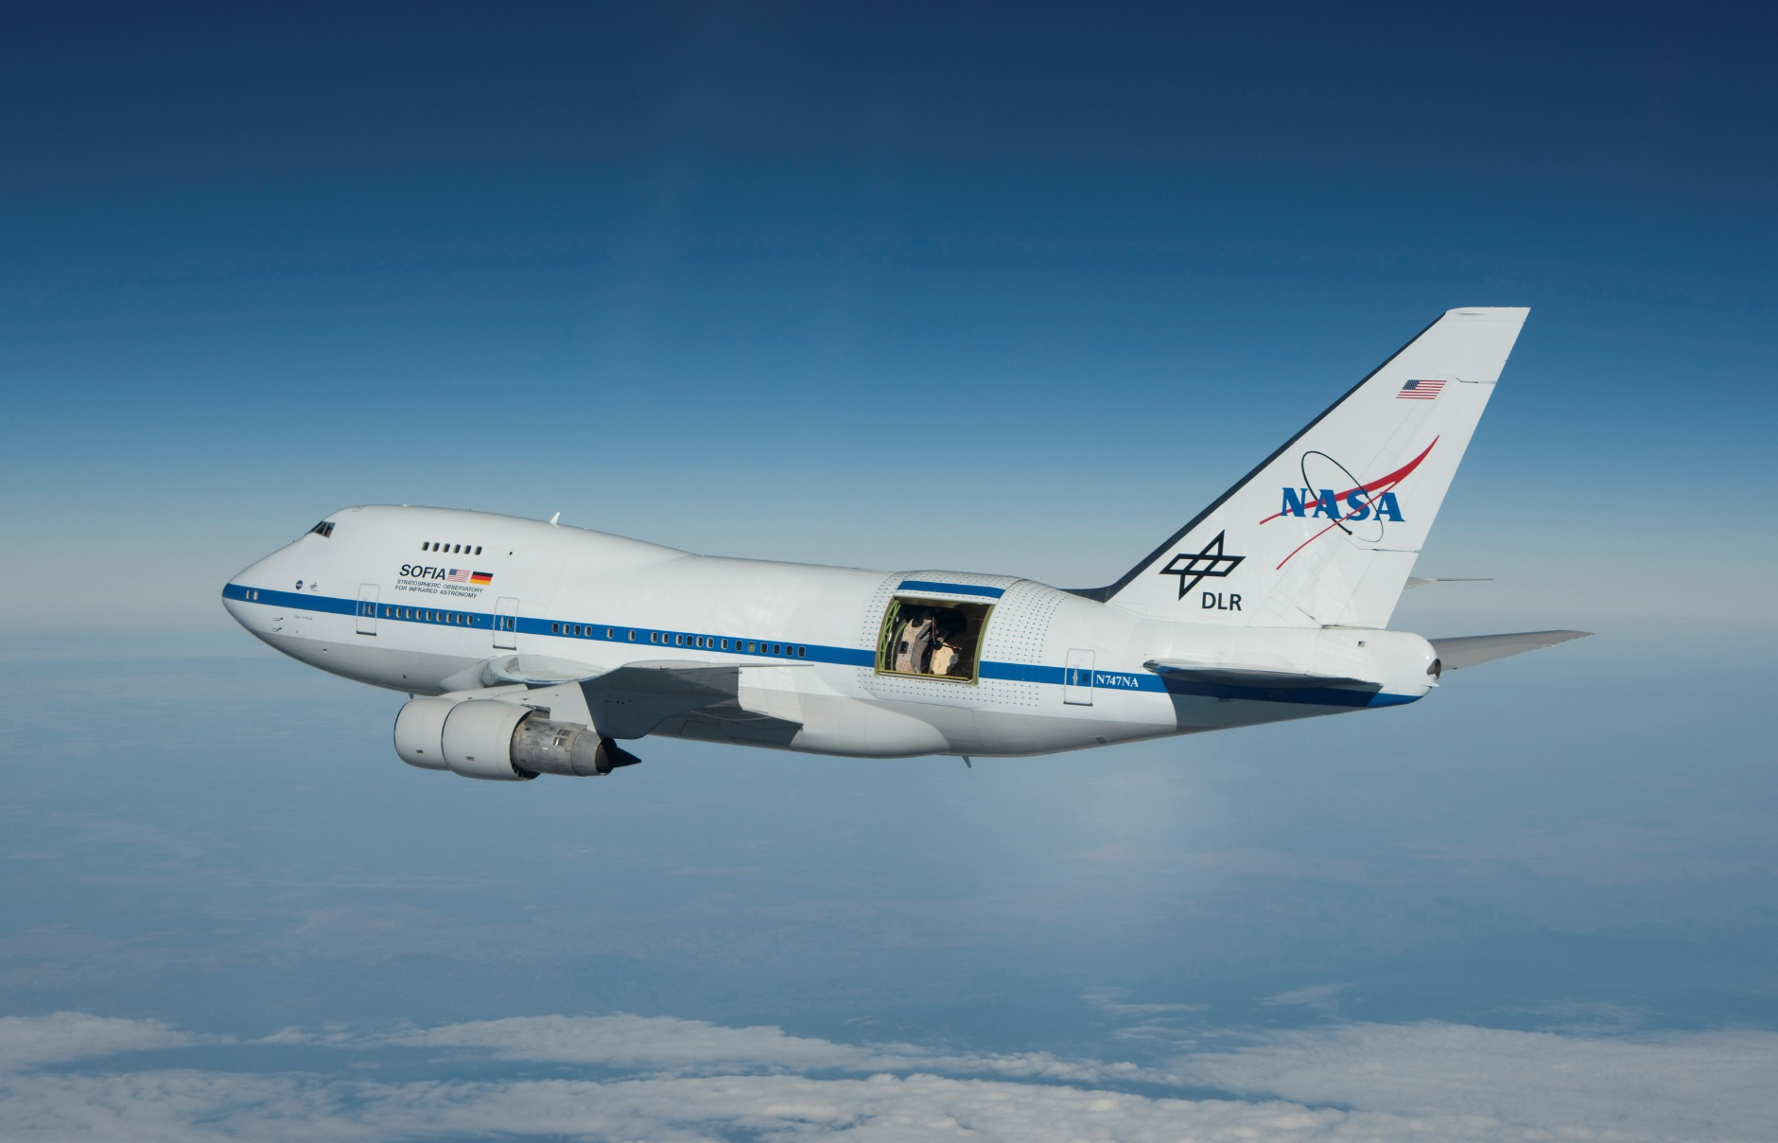
Who is Dr. Stephens Anyway?

Slide 5
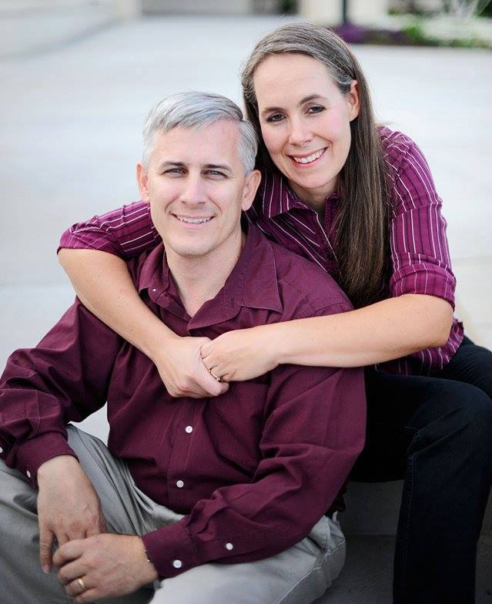

Who is Dr. Stephens Anyway?
Father of 7
Current Calling: Deacons Quorum Specialist
Hobbies
  Hiking/Camping
  Reading & Writing (1 self-published sci-fi novel)
  Role-Playing Games – published a quarterly game magazine & more general blog
  3D Modeling and Printing
  Playing Minecraft and Roblox with my younger boys

Slide 6
Contacting Dr. Stephens
Office – 2256 TMCB – feel free to drop in anytime I’m there.
E-mail – tstephen@cs.byu.edu – This is the best way to reach me.
Office Hours – https://calendly.com/byu-cs-tstephen/office-hours
Stalk me on-line
  I'm on the class Discord
  @dagorym on most online sites
  Tom Stephens on Facebook

Slide 7

BYU Minecraft Club
I'm also the Faculty Advisor for the BYU Minecraft Club
Club Discord: https://discord.gg/cx2PuAmR23
The club runs multiple servers including
  The main survival world
  An anarchy server
  The Campus Creation world where they are recreating BYU Campus
There is also a coding group that works on mods and resource packs for the server.

Slide 8
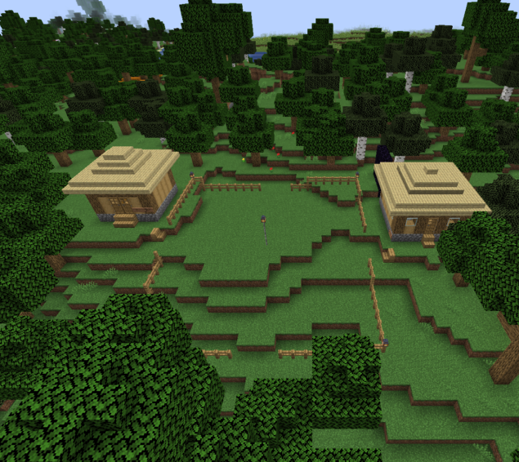
My Minecraft Server
For those Minecraft players in the class, I have a server set up you’re welcome to join.
Details can be found at:
https://expandingfrontier.com/cs-minecraft-server/

Slide 9
Questions?

Slide 10
Let's Learn a bit about you

Slide 11
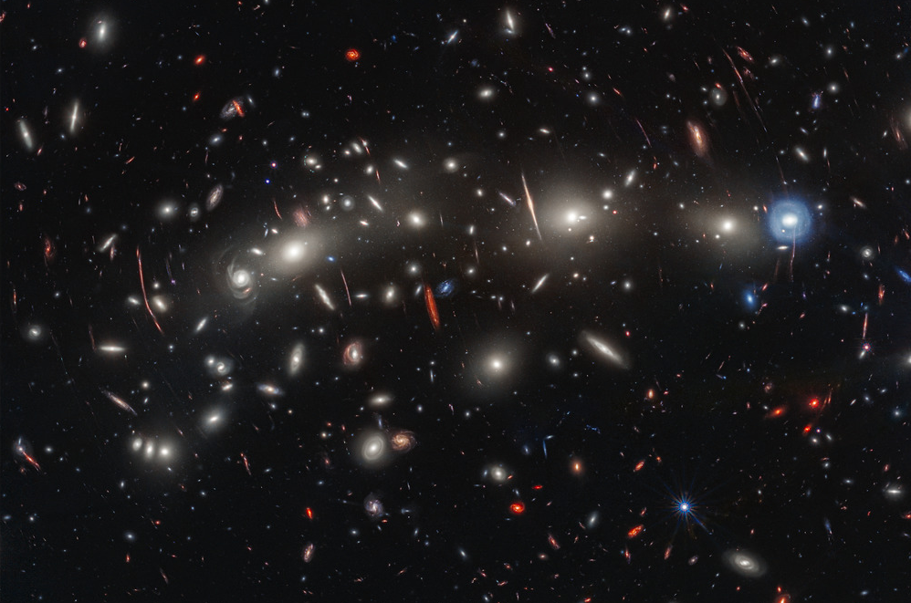
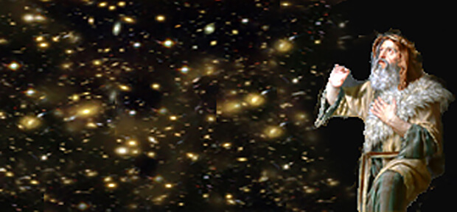
Your Intimate Relationship with the Great Creator of the Universe
“Given all of the vastness, the myriad of objects, the great distances involved in this massive universe, would you be surprised to learn that you – one small individual on one planet with 8 billion other individuals, in a small corner of a large galaxy containing billions of stars, part of other galaxy supergroups, containing billions of galaxies, spread across the universe – are allowed to talk directly to the creator?”
“What an astonishing doctrine exists in prayer! The individual is so important to our Heavenly Father that he wants us to talk to him! Now! All of the time!”
  Dr. Jani Radebaugh, BYU Devotional, Sept 3, 2024

