Slide 1
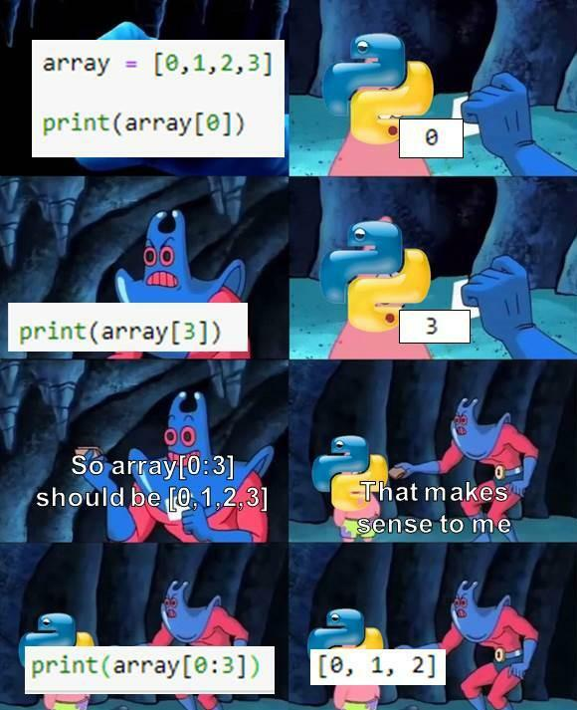

Slide 2
Environments & Debugging

Slide 3
Environments and Frames

Slide 4
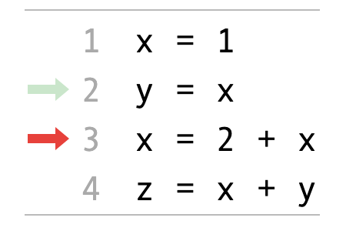
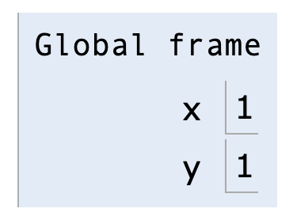
Environment Diagrams
An environment diagram is a visualization of how Python interprets a program. Use the free website PythonTutor to generate diagrams. View example
Code (left) | Frames (right)
Arrows indicate the order of execution. Green = just executed, red = up next. | Each name is bound to a value. Within a frame, each name cannot be repeated.

Slide 5
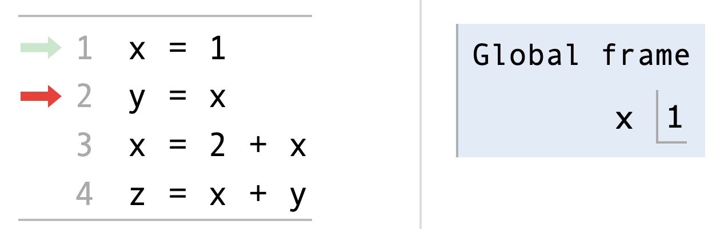
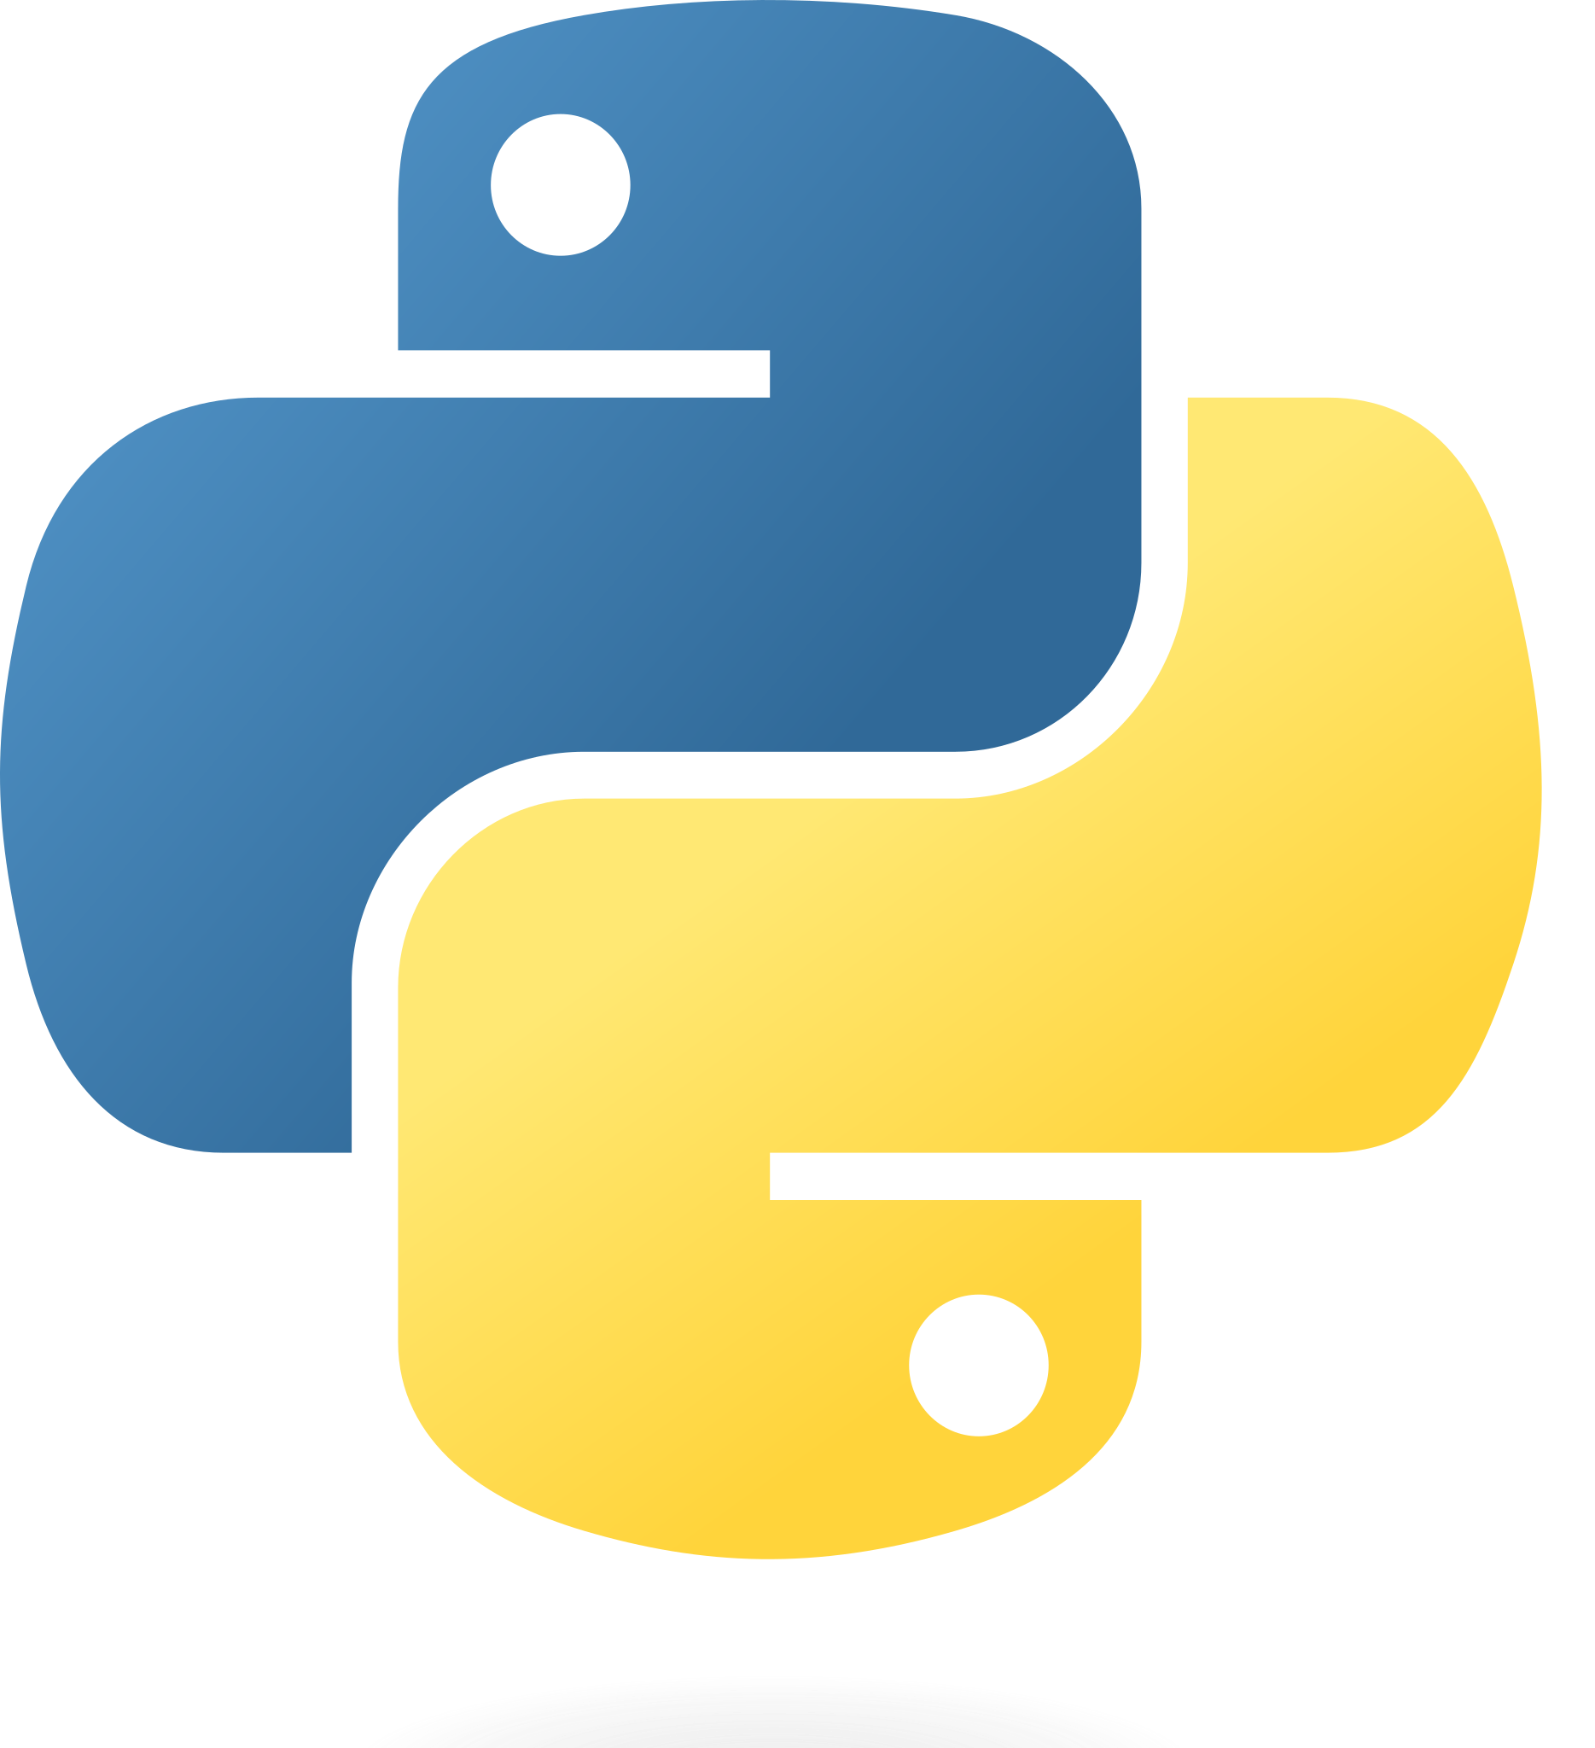
Assignments in Environment diagrams
How Python interprets an assignment statement:
  Evaluate the expression to the right of =.
  Bind the expression's value to the name that's on the left side of the = sign.
View in PythonTutor

Slide 6
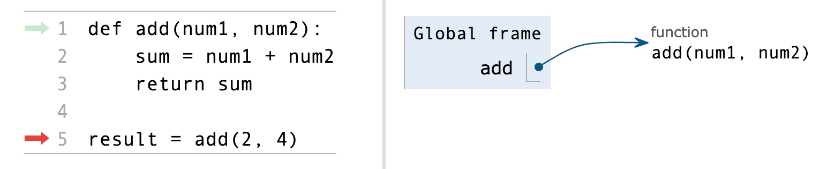
Functions in environment diagrams
How Python interprets a def statement:
  It creates a function with the name and parameters
  It sets the function body to everything indented after the first line
  It binds the function name to that function body (similar to an assignment statement)
View in PythonTutor

Slide 7
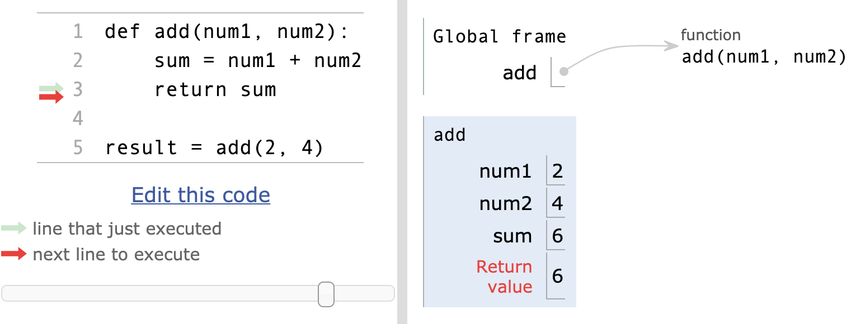
Function calls in environment diagrams
How Python interprets a function call:
  It creates a new frame in the environment
  It binds the function call's arguments to the parameters in that frame
  It executes the body of the function in the new frame
View in PythonTutor

Slide 8
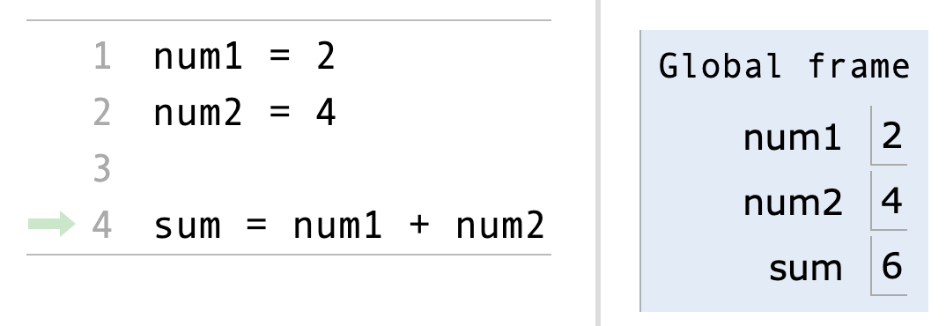
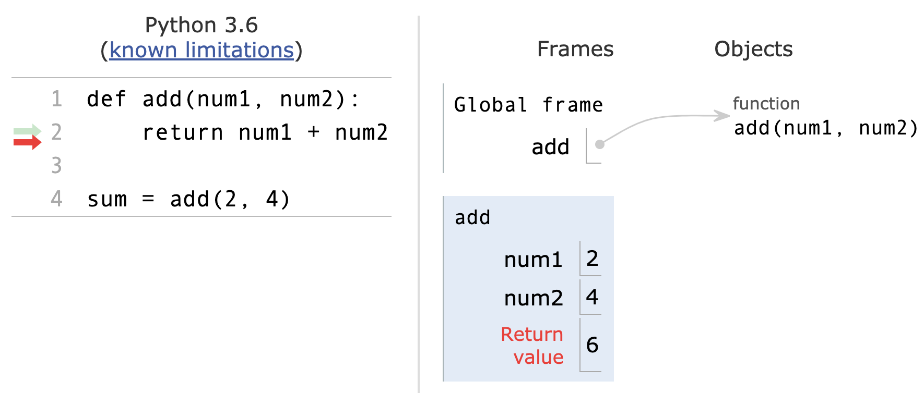
Names and environments
All Python code is evaluated in the context of an environment, which is a sequence of frames.
We've seen two possible environments:
Global Frame
Function's local frame, child of Global frame

Slide 9
Name lookup rules
How Python looks up names in a user-defined function:
  Look it up in the local frame
  If name isn't in local frame, look it up in the global frame
  If name isn't in either frame, throw a NameError
*This is simplified since we haven't learned all the Python features that complicate the rules.

Slide 10
Name lookup example #1
def exclamify(text):
start_exclaim = "¡"
end_exclaim = "!"
return start_exclaim + text + end_exclaim
exclamify("the snails are eating my lupines")
On line 4, which frame is start_exclaim found in?
  The local frame for exclamify
On line 4, Which frame is text found in?
  The local frame for exclamify
On line 6, which frame is exclamify found in?
  The global frame
View in PythonTutor

Slide 11
Name lookup example #2
start_exclaim = "¡"
end_exclaim = "❣️"
def exclamify(text):
return start_exclaim + text + end_exclaim
exclamify("the voles are digging such holes")
On line 5, which frame is start_exclaim found in?
  The global frame
On line 5, Which frame is text found in?
  The local frame for exclamify
On line 6, which frame is exclamify found in?
  The global frame
View in PythonTutor

Slide 12
Name lookup example #3
def exclamify(text):
end_exclaim = "⁉️️️"
return start_exclaim + text + end_exclaim
exclamify("the voles are digging such holes")
Which name will cause a NameError?
  The start_exclaim name, since it was never assigned.
When will that error happen?
  It will happen when exclamify is called and Python tries to execute the return statement.
View in PythonTutor

Slide 14
Debugging

Slide 15
Debugging
If you do any amount of coding, you will have errors (bugs) in your code.
If you update code, the changes may introduce errors or expose errors that may have been hidden
Adding new features changes the way the code behaves and interacts which may produce problems
and the list goes on …
Debugging, finding and removing errors, is a critical skill that every programmer needs to develop.
The good?? news is, we usually get lots of practice. How can we do it efficiently.

Slide 17
Debugging Tools & Techniques
There are lots of different ways to examine code and look for errors. We are going to talk about 4 of them:
Read/Explain the Code
Be the CPU
Print Statements
Integrated Debugger in your IDE

Slide 19
Reading the Code

Slide 20
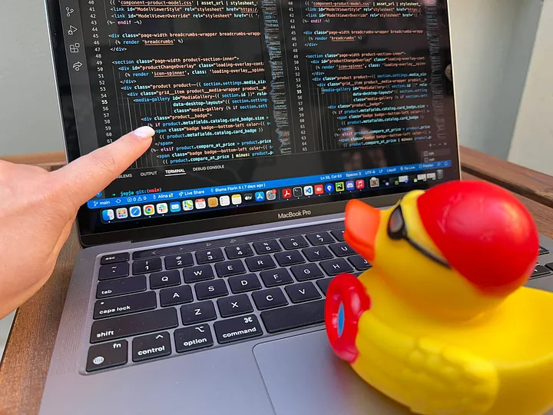
Reading/Explaining the Code
It may seem obvious, but the first step is to really look at the code in question.
  The trick is to read what it actually says, and not what you think it should be doing – Don’t make assumptions!
  Ask yourself "What does this line of code actually say and do?"
  Read the documentation on functions if you're not sure.
Even better than just reading is explaining your code out loud
  The act of verbalizing what your code is doing (again, not what you think it should be doing) focuses more of your brain on the problem.
  And you don't have to explain it to another person, it can be an inanimate object – it's the vocalization process that is important
  Explaining to an inanimate object is known as Rubber Duck Debugging
Photo credit: Alina Dumitru, April 2022

Slide 22
Be the CPU

Slide 23
Be The CPU
Sometimes, just reading and explaining the code isn't enough. You need the actual values the computer is working with.
For smaller programs or parts of programs, you can do this manually
  Get a piece of paper and pencil
  Working through the code writing down variables and their values
  Update them as they change
  Evaluate the expressions by hand
This is really just reading your code but at a much more detailed level
Allows you to try different inputs quickly without having to modify any code.

Slide 25
Using Print Statements

Slide 26
Print Statements
As programs get bigger, you are working with larger portions of a program, or the computations become more complex, it's not practical to "Be the CPU"
Instead, we let the CPU do the computations and liberally sprinkle our code with print statements
  Display values at certain points in the program
  Trace the flow of the program through the code
Despite memes and advice to the contrary, this is a viable and valuable way to find errors in your code
This may require breaking up statements in your code to generate intermediate values you want printed.
Another downside is that you often need to go back and remove all the print statements when you are done. ☹

Slide 27
Print Statement Debugging Demo

Slide 29
Using the IDE’s Debugger

Slide 30
Your IDE's debugger
Even more powerful than print statements, the debugger interface in your IDE allows you to see everything* in the program as it is running
  All variables in the current frame
  All variables in earlier frames in the program stack
  Allows you to set watches which specify statement/variables not part of your code
The debugger allows you to step through your program one line, expression, or function at a time and see the state of the program as they execute
You can also set breakpoints in your code that tell the debugger to run until it hits that point and then stop.
The * on everything above is because some programming languages optimize certain operations, and they are hard to visualize in the debugger

Slide 31
Using the IDE's Debugger
Every IDE has a slightly different interface, but they all have the same functionality
The most common functions are:
  Setting a breakpoint
  Launching the debugger
  Looking at variable values
  Setting a watch
  Stepping over a line of code
  Stepping into a function
  Stepping out of a function
  Continuing to the next breakpoint
  Looking at values in other frames

Slide 32
Pycharm Debugger Demo

Slide 34
Final Thoughts

Slide 35
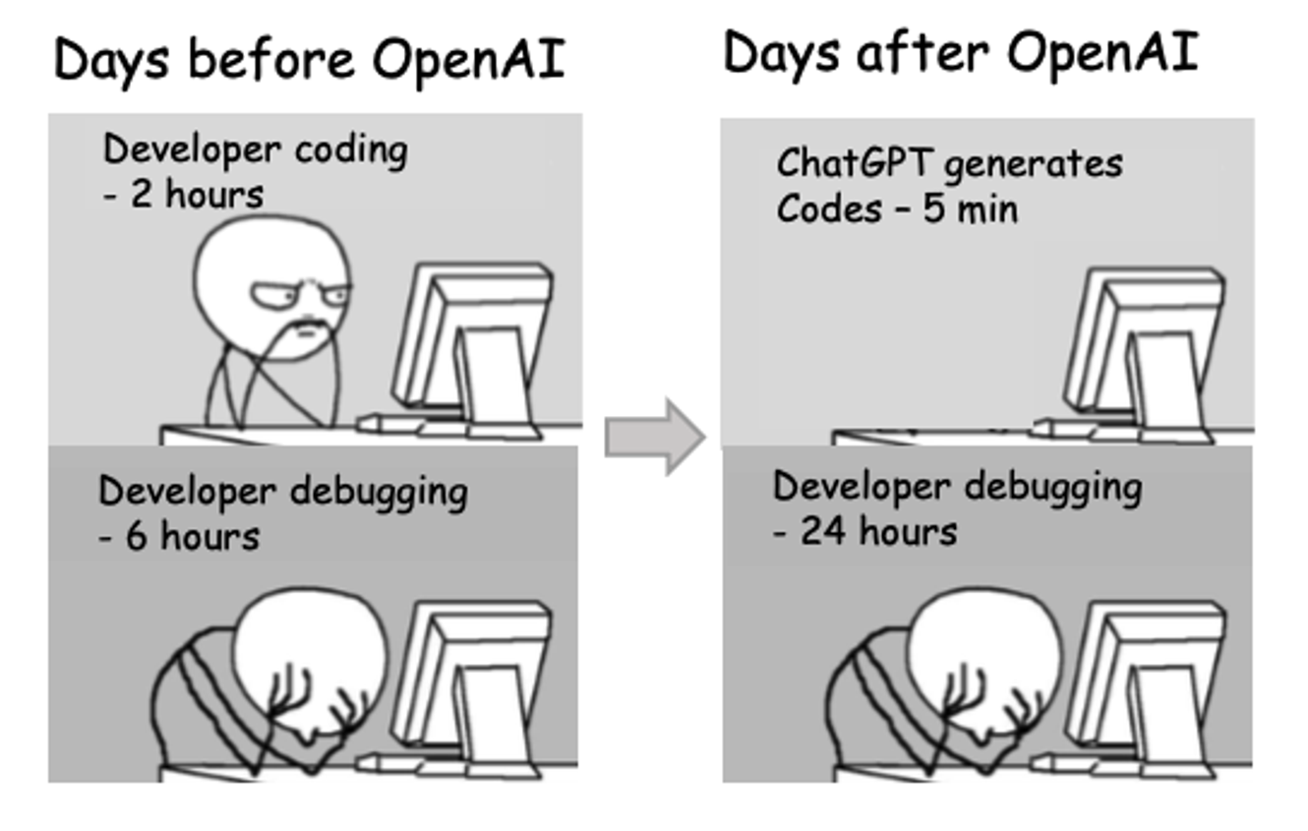
Debugging and LLMs

Slide 36
