Slide 1
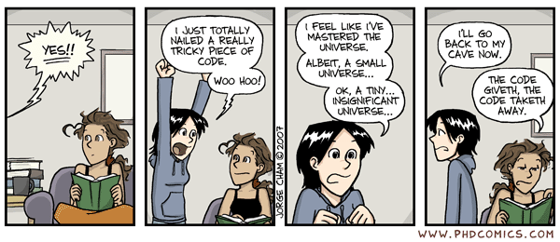

Slide 2
Dunder Functions & Random Numbers

Slide 3
Dunder Functions

Slide 4
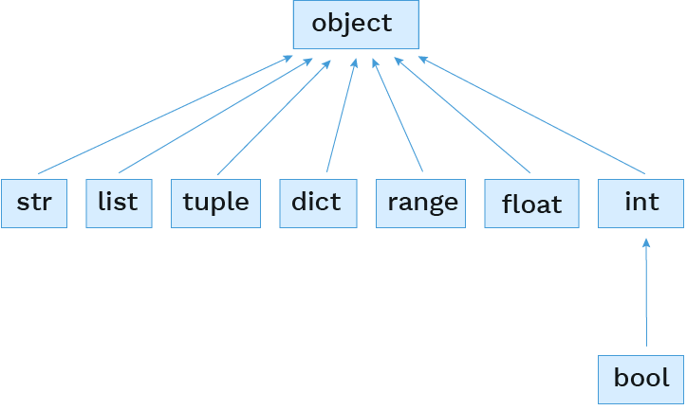
It's all objects
All the built-in types inherit from object:

Slide 5
Built-in object attributes
If all the built-in types and user classes inherit from object, what are they inheriting?
Just ask dir(), a built-in function that returns a list of all the attributes on an object.
For string representation: __repr__, __str__, __format__
For comparisons: __eq__, __ge__, __gt__, __le__, __lt__, __ne__
Related to classes: __bases__, __class__, __new__, __init__, __init_subclass__, __subclasshook__, __setattr__, __delattr__, __getattribute__
Others: __dir__, __hash__, __module__, __reduce__, __reduce_ex__
Python calls these methods behind these scenes, so we are often not aware when the "dunder" methods are being called.
💡 Let us become enlightened! 💡
dir(object)

Slide 7
Representation

Slide 8
__str__
The __str__() method returns a human readable string representation of an object.
from fractions import Fraction
one_third = 1/3
one_half = Fraction(1, 2)
float.__str__(one_third)
Fraction.__str__(one_half)
# '0.3333333333333333'
# '1/2'

Slide 9
__str__ usage
The __str__() method is used in multiple places by Python: print() function, str() constructor, f-strings, and more.
from fractions import Fraction
one_third = 1/3
one_half = Fraction(1, 2)
print(one_third)
print(one_half)
str(one_third)
str(one_half)
f"{one_half} > {one_third}"
# 0.3333333333333333
# 1/2
# '0.3333333333333333'
# '1/2'
# '1/2 > 0.3333333333333333'

Slide 10
Custom __str__ behavior
When making custom classes, we can override __str__() to define our human readable string representation.
class Lamb:
species_name = "Lamb"
scientific_name = "Ovis aries"
def __init__(self, name):
self.name = name
def __str__(self):
return "Lamb named " + self.name
lil = Lamb("Lil lamb")
str(lil)
print(lil)
lil
# 'Lamb named Lil lamb'
# Lamb named Lil lamb
# ⟨__main__.Lamb object at 0x7fc1489b82d0⟩

Slide 11
__repr__
The __repr__() method returns a string that would evaluate to an object with the same values.
If implemented correctly, calling eval() on the result should return back that same-valued object.
from fractions import Fraction
one_half = Fraction(1, 2)
Fraction.__repr__(one_half)
# 'Fraction(1, 2)'
another_half = eval(Fraction.__repr__(one_half))

Slide 12
__repr__ usage
The __repr__() method is used multiple places by Python: when repr(object) is called and when displaying an object in an interactive Python session.
from fractions import Fraction
one_third = 1/3
one_half = Fraction(1, 2)
one_third
one_half
repr(one_third)
repr(one_half)
# 0.3333333333333333
# Fraction(1, 2)
# '0.3333333333333333'
# 'Fraction(1, 2)'

Slide 13
Custom __repr__ behavior
When making custom classes, we can override __repr__() to return a more appropriate Python representation.
class Lamb:
species_name = "Lamb"
scientific_name = "Ovis aries"
def __init__(self, name):
self.name = name
def __str__(self):
return "Lamb named " + self.name
def __repr__(self):
return f"Lamb({repr(self.name)})"
lil = Lamb("Lil lamb")
repr(lil)
lil
# "Lamb('Lil lamb')"
# Lamb('Lil lamb')

Slide 15
Other Special Methods

Slide 16
Special methods
Certain names are special because they have built-in behavior. Those method names always start and end with double underscores.
See all special method names.
Name | Behavior
__init__ | Method invoked automatically when an object is constructed
__repr__ | Method invoked to display an object as a Python expression
__str__ | Method invoked to stringify an object
__add__ | Method invoked to add one object to another
__bool__ | Method invoked to convert an object to True or False
__float__ | Method invoked to convert an object to a float (real number)

Slide 17
Special method examples
zero = 0
one = 1
two = 2
🍭 Syntactic sugar 🍩 | Dunder equivalent
one + two # 3 | one.__add__(two) # 3
bool(zero) # False | zero.__bool__() # False
bool(one) # True | one.__bool__() # True

Slide 18
Adding together custom objects
Consider the following class:
Will this work?
🚫 TypeError: unsupported operand type(s) for +: 'Rational' and 'Rational'
from math import gcd
class Rational:
def __init__(self, numerator, denominator):
g = gcd(numerator, denominator)
self.numer = numerator // g
self.denom = denominator // g
def __str__(self):
return f"{self.numer}/{self.denom}"
def __repr__(self):
return f"Rational({self.numer}, {self.denom})"
Rational(1, 2) + Rational(3, 4)

Slide 19
Implementing dunder methods
We can make instances of custom classes addable by defining the __add__() method:
Now try …
class Rational:
def __init__(self, numerator, denominator):
g = gcd(numerator, denominator)
self.numer = numerator // g
self.denom = denominator // g
def __add__(self, other):
new_numer = self.numer * other.denom + other.numer * self.denom
new_denom = self.denom * other.denom
return Rational(new_numer, new_denom)
# The rest...
Rational(1, 2) + Rational(3, 4)

Slide 21
Polymorphism

Slide 22
Polymorphic functions
Polymorphic function: A function that applies to many (poly) different forms (morph) of data
str() and repr() are both polymorphic; they apply to any object
repr() invokes a zero-argument method __repr__() on its argument:
str() invokes a zero-argument method __str__() on its argument:
one_half = Rational(1, 2)
one_half.__repr__() # 'Rational(1, 2)'
one_half = Rational(1, 2)
one_half.__str__() # '1/2'

Slide 23
Generic functions
A generic function can apply to arguments of different types.
What could a and b be?
Anything summable!
The function sum_two() is generic in the type of a and b.
def sum_two(a, b):
return a + b

Slide 24
Generic function #2
def sum_em(items, initial_value):
"""Returns the sum of ITEMS,
starting with a value of INITIAL_VALUE."""
sum = initial_value
for item in items:
sum += item
return sum
What could items be?
Any iterable with summable values.
What could initial_value be?
Any value that can be summed with the values in iterable.
The function sum_em() is generic in the type of items and the type of initial_value.

Slide 25
Type dispatching
Another way to make generic functions is to select a behavior based on the type of the argument.
What could month be?
Either an int or string.
The function is_valid_month() is generic in the type of month.
def is_valid_month(month):
if isinstance(month, str) and len(month) == 1:
return month in ["J", "F", "M", "A", "S", "O", "N", "D"]
if isinstance(month, int):
return month >= 1 and month <= 12
elif isinstance(month, str):
return month in ["January", "February", "March", "April",
"May", "June", "July", "August", "September",
"October", "November", "December"]
return False

Slide 26
Type coercion
Another way to make generic functions is to coerce an argument into the desired type.
What could nums be?
Any iterable with ints or Rationals.
The function sum_numbers() is generic in the type of nums.
def sum_numbers(nums):
"""Returns the sum of nums"""
sum = Rational(0, 1)
for num in nums:
if isinstance(num, int):
num = Rational(num, 1)
sum += num
return sum

Slide 28
Random Numbers

Slide 29
Random numbers
There are many cases where we might need to generate a random number in a program
Games
Simulations
Cryptography
…
If you think about it, program are deterministic
So how does a computer generate a random number?

Slide 30
Pseudo-random numbers
Except in special cases with special hardware, computers don't generate truly random numbers
Instead, they generate what we call pseudo-random numbers
Determined algorithmically
Appear to be random
How?
Start with a "seed" value
Perform some mathematical computation on the seed
This relies on "overflow" with the computer's representation of numbers
Store the seed for the next random number request
Convert the seed value to a number in the range requested and return that value

Slide 31
Simple random numbers in Python
Basic random numbers in Python are provided by the random library
Commonly used functions:
seed(n) – sets the initial seed value. If no argument given or n=None, uses the system time
randrange(stop) – generate a random number from 0 to stop-1
randrange(start,stop) – generate a random number from start to stop-1
randint(a,b) – generate a random number from a to b (inclusive)
random() – generate a floating-point number between 0.0 and 1.0
uniform(a, b) – generate a floating-point number between a and b
choice(seq) – randomly select an item from the sequence seq
import random

Slide 32
Random number demo
from random import randrange, seed, random
from math import sqrt
def calc_pi(n):
count = 0;
for i in range(n):
x = random()
y = random()
if sqrt(x * x + y * y) <= 1.0:
count += 1
print(f"With n={n:9}, pi = {4 * count / n}")
if __name__ == "__main__":
for s in [1,1,2,3]:
seed(s)
print(f"seed = {s}:", end=" ")
for i in range(10):
print(randrange(1, 100), end=" ")
print()
print()
for i in range(1, 9):
calc_pi(10 ** i)
seed = 1: 18 73 98 9 33 16 64 98 58 61
seed = 1: 18 73 98 9 33 16 64 98 58 61
seed = 2: 8 12 11 47 22 95 86 40 33 78
seed = 3: 31 76 70 17 48 78 61 81 75 9
With n= 10, pi = 3.2
With n= 100, pi = 3.16
With n= 1000, pi = 3.248
With n= 10000, pi = 3.1488
With n= 100000, pi = 3.14748
With n= 1000000, pi = 3.14196
With n= 10000000, pi = 3.1410592
With n=100000000, pi = 3.14151612

