Slide 1
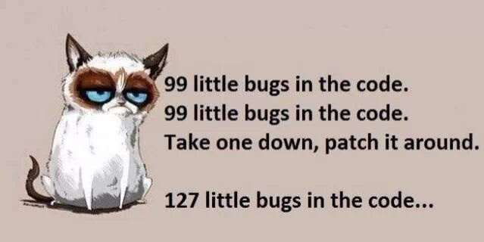

Slide 2
Parsing & Evaluation

Slide 3
REPL: Read-Eval-Print Loop (review)
The user interface for many programming languages is an interactive interpreter
  Print a prompt
  Read text input from the user
  Parse the text input into an expression
  Evaluate the expression
  If any errors occur, report those errors, otherwise
  Print the value of the expression and repeat
This is what you'll be building in Project 3 for the Calculator Language

Slide 4
Reading Calculator Expressions
A Calculator expression is written as elements in parentheses:
Each <element> can be another expression or a primitive.
The task of parsing a language involves turning a string representation of an expression into a structured object representing the expression.
(<element_0> <element_1> ... <element_n>)
(+ (* 3 (+ (* 2 4) (+ 3 5))) (+ (- 10 7) 6))

Slide 5
Parsing
A parser takes text and returns an expression object.
Text | Lexical Analysis | Tokens | Syntactic Analysis | Expression
'(+ 1' | → | '(', '+', 1 | → | Pair('+', Pair(1, ...)) printed as (+ 1 (- 23) (* 4 5.6))
' (- 23)' | → | '(', '-', 23, ')' | →
' (* 4 5.6))' | → | '(', '*', 4, 5.6, ')', ')'

Slide 7
Lexing

Slide 8
Lexical analysis
' (* 4 5.6))' → '(', '*', 4, 5.6, ')', ')'
  Iterative process
  Checks for malformed tokens
  Determines types of tokens
  Processes one line at a time

Slide 9
Useful string methods
str.strip() returns a string without whitespace (spaces, tabs, etc.) on the ends
str.split(sep) returns a list of strings that were separated by sep (if not specified, sep is any whitespace).
str.replace(a, b) returns a string with all instances of string a replaced by string b
' hello '.strip() '
# 'hello'
# ['hi', 'there']
'hi there '.split()
'2+2'.replace('+', ' + ')
# '2 + 2'

Slide 10
Tokenizing sentences
Here's an example using sentences
Input data: parsed2.txt
Desired output: tree()s!
File comes from:
MacWhinney, B. (2000). The CHILDES Project: Tools for analyzing talk. Third Edition. Mahwah, NJ: Lawrence Erlbaum Associates.
(ROOT (S (NP (NN this)) (VP (COP is) (NP (DT a) (NN book))) (. .)))
(ROOT (S (NP (PRP I))
(VP (AUX 've)
(ADVP (RB never))
(VP (VBN seen) (NP (DT such) (DT a) (JJ cute) (NN kangaroo))))
(. .)))

Slide 11
From lines to tokens
['(ROOT (S (NP (NN this)) (VP (COP is) (NP (DT a) (NN book))) (. ?)))\n',
'\n',..
  to
  A function, read_sentences() takes care of this:
[['(', 'ROOT', '(', 'S', '(', 'NP', '(', 'NN', 'this', ')', ')',
'(', 'VP', '(', 'COP', 'is', ')', '(', 'NP', '(', 'DT', 'a', ')',
'(', 'NN', 'book', ')', ')', ')', '(', '.', '?', ')', ')', ')'],
...]
lines = open('parsed2.txt').readlines()
tokens = read_sentences(lines)

Slide 13
Parsing

Slide 14
Syntactic analysis
'(', '+', 1, ... → Pair('+', Pair(1, ...))
  Tree-recursive process
  Balances parentheses
  Returns tree structure
  Processes multiple lines
In your project, each call to parse() consumes the input tokens for exactly one expression.
  Base case:
  Recursive case:
operators and numbers
read subexpressions and combine them

Slide 15
Pair class
The Pair class represents Cacluator expressions and lists. A list is a pair whose second element is either pair or an empty list.
Improper lists:
class Pair:
s = Pair(1, Pair(2, Pair(3, nil)))
print(s)
len(s)
# (1 2 3)
# 3
# (1 . 2)
# (1 2 . 3)
Error!
print(Pair(1, 2))
print(Pair(1, Pair(2, 3)))
len(Pair(1, Pair(2, 3)))

Slide 16
From tokens to trees
[..., '(', 'NP', '(', 'DT', 'a', ')', '(', 'JJ', 'big', ')', '(', 'NN', 'bug', ')', ')', ...]
# i
def read_parse_tree(tokens, i):
# Read the tag, which is tokens[i], then advance i.
# While the current item is a '(',
# call read_parse_tree to construct a branch.
# Once the current item is a ')',
# return a phrase from the tag and branches.
# Base case: there is no '(' or ')'
# because there is just text after the tag.
read_parse_tree() will return the tree it read and what to read next.
tree = read_parse_tree(tokens[0], 1)

Slide 18
Evaluation

Slide 19
The eval() function
The eval function computes the value of an expression.
It is a generic function that behaves according to the type of the expression (primitive or call).
  You'll use isinstance() to check the type
It recursively calls itself when it encounters sub-expressions
If you have just an operator and operands as values, you call the apply() function to apply the operator to the operands
(/ 3 (+ 4 5))
this generates a recursive call

Slide 20
Applying built-in operators
The apply function applies some operation to a (Calculator) list of argument values
In calculator, all operations are named by built-in operators: +, -, *, /
Implementation | Language semantics
def calc_apply(operator, args): if operator == '+': return reduce(add, args, 0) elif operator == '-': ... elif operator == '*': ... elif operator == '/': ... else: raise TypeError | + Sum of the arguments - ... * ... / ...

Slide 21
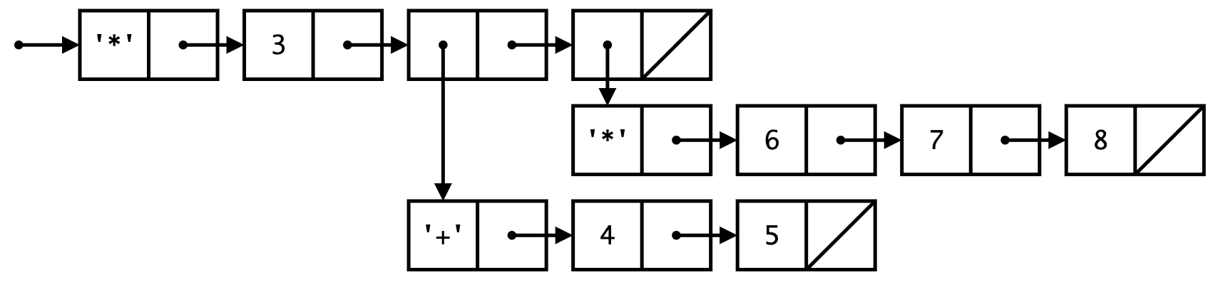
The Calculator eval() algorithm
(/ 3 (+ 4 5))
Pair('/', Pair(3, Pair(Pair('+',
Pair(4, Pair(5, nil))), nil)))
(* 3 (+ 4 5) (* 6 7 8))
If the expression is a primitive (int or float), we just return the value
If the expression is a Pair object it is some sort of expression
  Get the operator from the first item of the Pair object
  Call eval() on the first item of each Pair in the rest of the expression, building a Pair list with the operands as the values.
  Call the apply() function passing in the operator and the results of step 2.2.
  Return the result of the apply() function from the previous step.
If the expression is not a primitive or a Pair, raise a TypeError exception.
Notes:
walk through this process with the expression (/ 3 (+ 4 5 ))
Pair('/', Pair(3, Pair(Pair('+', Pair(4, Pair(5, nil))), nil)))

