Slide 1
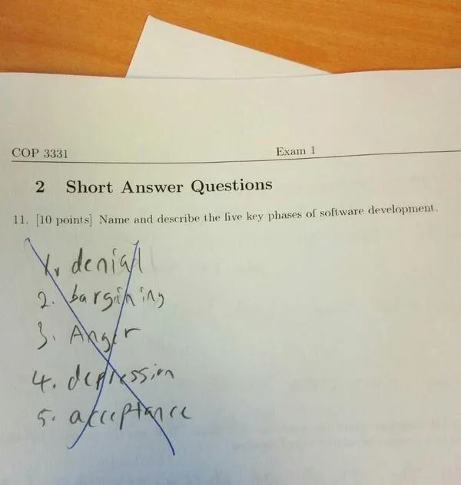

Slide 2

Burying Our Weapons of Rebellion Elder D. Todd Christofferson Oct 2024 Gen. Conf.
"Perhaps the more insidious form of rebellion against God, however, is the passive version—ignoring His will in our lives. Many who would never consider active rebellion may still oppose the will and word of God by pursuing their own path without regard to divine direction."
"Certainly in life there is plenty of room for personal preference and individual choice, but when it comes to matters of salvation and eternal life, our theme song ought to be “I did it God’s way,” because truly there is no other way."

Slide 3
Hyperlinks

Slide 4
Default URLs
Default URLs are URLs that don't have an actual page name as part of the path:
They may or may not have a trailing forward slash (/).
When a web server receives a URL like this, it appends its default filename to the URL to get the correct file to load.
This default filename is usually index.html
https://byu.edu
https://cs111.byu.edu
https://cs111.byu.edu/lab/lab04/
...

Slide 5
Types of Hyperlinks
The content of the href attribute in an <a> tag can have several different formats.
Absolute links – these contain complete URLs
Relative links – these are links relative to the current domain or page and don't contain complete URLs
Section links – these are a form of relative link that point at another part of the same page.
mailto: links – trigger the creating of an email message
The src attribute in an <img> tag can only have absolute and relative links

Slide 7
Absolute Links

Slide 8
Absolute Links
When a hyperlink contains an absolute link, the value of the href or src attribute is a complete URL containing the protocol, the domain, and the path (which may be just /).
For example, all of the following contain absolute links:
<a href="https://byu.edu">BYU homepage</a>
<a href="https://cs111.byu.edu/hw/hw07">Homework 7</a>
<a href="https://frontierexplorer.org/data/FrontierExplorer036.pdf"> Issue 36</a>
<img src="https://expandingfrontier.com/wp-content/uploads/2021/06/MS2-rotated-e1624401676511-1024x737.jpg">

Slide 10
Relative Links

Slide 11
Relative links
There are two types of relative links
Domain relative
Page relative
All of these links are part of the same domain as the page you are currently visiting.
The only difference is the starting point for finding the path

Slide 12
Domain Relative Links
Domain relative links do not contain a protocol or domain and start with a leading forward slash (/)
These are relative to the domain of the website.
To get the full URL to the resource you append the link body to the domain.
For example, if we are on the https://cs111.byu.edu domain and see the following link:
the full URL that we should load is
<a href="/hw/hw02">Homework 2</a>
https://cs111.byu.edu/hw/hw02

Slide 13
Page Relative Links
Like Domain relative links, page relative links do not begin with a protocol and domain.
Additionally, they do not have a leading forward slash (/).
These links are relative to the current page's directory, not the domain.
To generate the full URL
Start with the current page's URL
If it has a page name (i.e. <something>.htm or .html), remove the page name and forward slash before the page name.
Append a forward slash and the link contents to the URL

Slide 14
Example of generating URL from page relative links (1)
If you were on a page with the URL of
and you had this link:
The resultant URL would be:
This example uses a default URL that doesn’t have an explicit page name (ending in .html or .htm, or .<something>) so we just append the link reference (the value of the src attribute in this case) to the current page's URL
https://cs111.byu.edu/lab/lab03
<img src="assets/iron.png">
https://cs111.byu.edu/lab/lab03/assets/iron.png

Slide 15
Example of generating URL from page relative links (2)
If you were on a page with the URL of
and you had this link:
The resultant URL would be:
This example has an explicit page name (index.html) so we just drop the page name and append the link reference get the full URL.
https://cs111.byu.edu/lab/lab04/index.html
<a href="lab04.zip">lab04.zip</a>
https://cs111.byu.edu/lab/lab04/lab04.zip

Slide 17
Section Links

Slide 18
Section links
If a tag in an HTML document has an id attribute:
then we can create a hyperlink to that specific point in the document using the pound (or hashtag) symbol (#)
This can be done to link to content on a different page
or to link to id attributes in our current page
You can see these types of links in the table of contents sections in the left sidebar on the lab, homework, and project pages
<h2 id="starter-files">Starter Files</h2>
<a href="https://cs111.byu.edu/lab/lab07/index.html#starter-files">Lab 7 Starter Files</a>
<a href="#starter-files">Starter Files</a>

Slide 20
Mailto Links

Slide 21
mailto links
As the WWW was designed to connect research scientists and collaborators, the ability to send email was built into the HTTP protocol
This is done with a mailto: link
The format for this type of link is the text mailto: followed by an email address
Clicking on this type of link opens your system's default email client and starts composing a new email with the email address in the To: field
This is not used as much today as spammers like to harvest these links and use them to feed their spambots.
You can email <a href="mailto:tstephen@cs.byu.edu">Dr. Stephens</a>

Slide 23
Finding Hyperlinks

Slide 24
Finding Hyperlinks in an HTML document
We can use Beautiful Soup to find all the hyperlinks in a given HTML document.
You'll be doing this as part of Project 4.
Unfortunately, we can't just search for attributes
We have to search for tags, and then look at the attributes on those tags.
But that's okay, since we know all links (hrefs) are in the <a> tag

Slide 25
Finding Hyperlinks in an HTML document
You start by finding all the <a> tags in the document
Then loop over each tag and get its href attribute value
Then you can process the link
import requests
from bs4 import BeautifulSoup
URL = "https://cs111.byu.edu"
resp = requests.get(URL)
soup = BeautifulSoup(resp.text,"html.parser")
aTags = soup.find_all("a")
for tag in aTags:
link = tag.get("href") #or tag.attrs["href"]
#do something with the link here

Slide 27
PageRank and Project 4

Slide 28
PageRank
In 1998 when Google was created, it used the PageRank algorithm to determine which pages were most relevant for a given search
This worked by analyzing hyperlinks
A simplified form of PageRank works like this:
Crawl and read every page on the web.
For every page, count the number of other web pages that link to that page
That count (or some mathematical formula applied to that count) is the page's PageRank
For a given search, find all the pages that match and list them in descending order of their PageRank.
If you're interested in exactly how it worked, you can read the PageRank Wikipedia article.

Slide 29
Link Counting in Project 4
You will be doing a similar type of calculation in Project 4
You will crawl the CS111 website and keep track of how many times each link was referenced.
Every time you encounter a link you either
add it to the list of links with a count of 1 if it's not in the list
increment its count by one if it is in the list
You'll want to use a dictionary to do this with the link as the key and the count as the value
You'll need to construct the full URL to use as the key so you don't have different entries for relative and absolute links.
You also need to remove section tags so all the links to a page are counted together and not individually.

Slide 30
Link Counting with a Dictionary
link_counts = {} # create an empty dictionary
# the variable link contains a full URL
if link in link_counts:
link_counts[link] += 1 # add 1 if it is already there
else:
link_counts[link] = 1 # add an initial count of 1 if not
When done, the dictionary will contain every full URL found as its keys and for each URL, a count of how many times it was referenced.
You could then use this to do different types of analysis. We're going to use it to make a plot but more about that in a future lecture.

