Slide 1
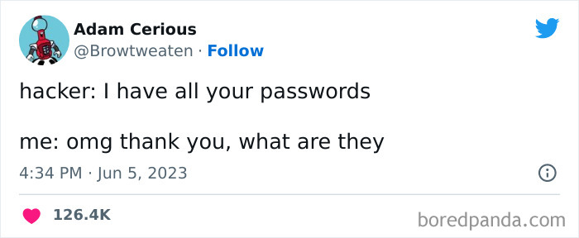

Slide 2
Data Scraping- Part II

Slide 3
Reading Tables

Slide 4
Reading Tables
We've looked at reading arbitrary tags, let's look specifically at reading tabular data on a web page
Imagine a table of degrees granted per year at a university
We want a list with the data from each column and a list of column headings.
How do we read this if it is rendered on a webpage
Academic Year | Bachelors | Masters | Doctoral | Total
2021-2022 | 6406 | 1128 | 233 | 7767
2020-2021 | 6683 | 959 | 192 | 7834
2019-2020 | 6684 | 1033 | 212 | 7929
…
1896-1897 | 1 | 0 | 0 | 1

Slide 5
The table as HTML
<table id="degrees" border="1">
<tr><th>Academic Year</th><th>Bachelors</th>
<th>Masters</th><th>Doctoral</th><th>Total</th></tr>
<tr><td>2021-2022</td><td>6406</td>
<td>1128</td><td>233</td><td>7767</td></tr>
<tr><td>2020-2021</td><td>6683</td><td>959</td>
<td>192</td><td>7834</td></tr>
<tr><td>2019-2022</td><td>6684</td>
<td>1033</td><td>212</td><td>7929</td></tr>
<tr><td>1896-1897</td><td>1</td>
<td>0</td><td>0</td><td>1</td></tr>
</table>

Slide 6
Exercise: Read the table's data
How do we find the table?
How to we get the column headers?
How do we read data from each column/row?

Slide 7
Exercise: Read the table's data
(one possible solution)
table = soup.find_all('table',{'id':'degrees'})[0]
heads = table.find_all('th')
headers = []
for item in heads:
headers.append(item.string)
data = [[], [], [], [], []] # make a list of 5 lists, one for each column
rows = table.find_all('tr')
for row in rows:
columns = row.find_all("td")
index = 0
for col in columns:
data[index].append(col.string)
index += 1
for col in data:
print(col)

Slide 9
Handling Images

Slide 10
Reading and Saving Images
What if you want to save all the images on the page to a local directory?
What information do you need to do this?
  The URL to the image
  The directory you want to save the image in
  The output filename
How do we do this?

Slide 11
Finding the URLs
How would we find the URLs to all the images on a page?
Remember these could be relative links so you'll need to construct the full URL from the current page/domain before you try to access the images.
images = soup.find_all('img')
img_srcs = []
for img in images:
img_srcs.append(img['src'])

Slide 12
Requesting the images
Once you have the URL for the image, you can just make a GET request to have the server send it to you:
The .text attribute on the response object is not going to give us what we need.
There is another attribute, .raw, that gives us the raw bytes of the data in the response.
Note: to properly use the data via the .raw attribute, your GET request needs to include an additional parameter: stream=True
We've got the raw data, what do we do with it?
image_response = requests.get(imageURL)
image_response = requests.get(imageURL, stream=True)

Slide 13
Saving binary data to a file
We can use Python's copyfileobj() function (from the shutil library) to write the raw file contents directly to disk
  output_filename is the path+filename of the output file
  The 'wb' parameter says to open the file to write in binary format
  The copyfileobj() function takes a source of binary data and a destination
    you could use this to copy a file: open one file to read and use that as the source, and the second to write and use that as the destination
  The del command deletes the named object immediately instead of waiting for Python to do it. Can help to save memory.
import shutil
with open(output_filename, 'wb') as out_file:
shutil.copyfileobj(image_response.raw, out_file)
del image_response # this frees up the memory (optional)

Slide 14
Using the image in the program
You could also use the image directly in your program if you needed to.
You'd access it using the response object's .content attribute which allows you to access the content as binary data.
from PIL import Image #PIL is the library under byuimage
from io import BytesIO #a built-in Python library
image = Image.open(BytesIO(image_response.content)))

