Slide 1
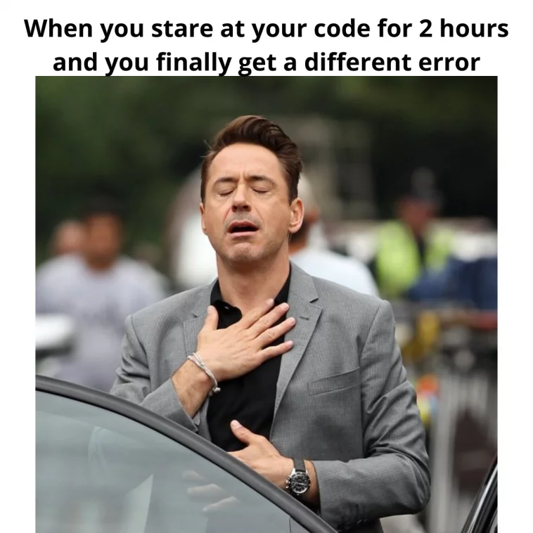

Slide 2
Cryptography

Slide 3

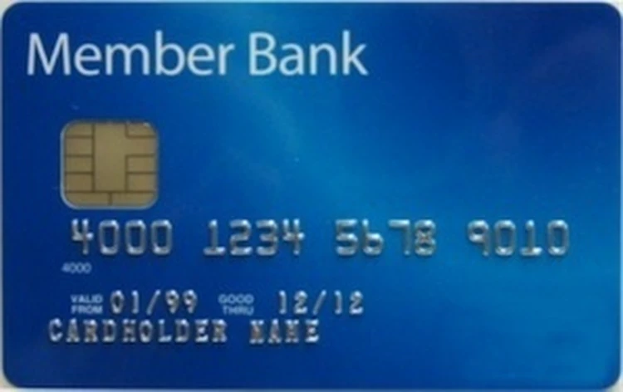

Why is it safe to share your credit card to Amazon over the internet?

Slide 4

What stops eavesdroppers from capturing your information?

Slide 5
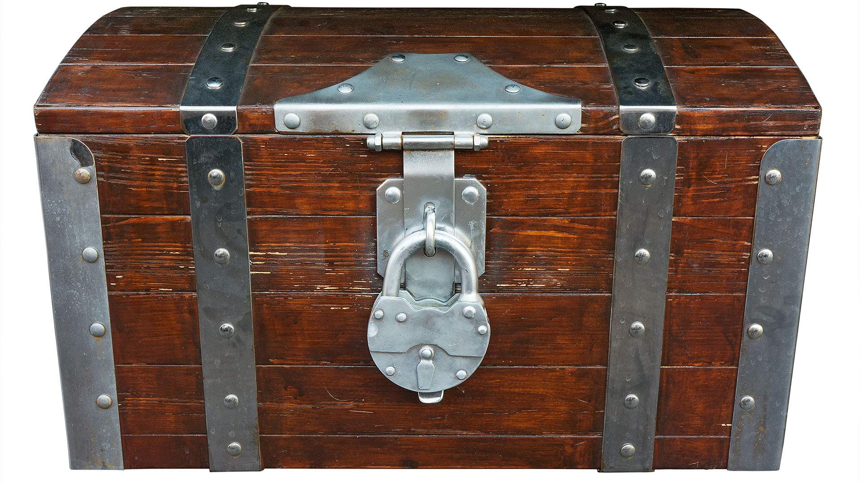

Encryption!
Encryption lets us use a “key” to essentially lock up our message

Slide 6
How does encryption work?
Essentially you have some “function” and a “key” and that modifies data into something unreadable to people without the code.
function(message, key) = encrypted_message

Slide 7
How does decryption work?
To decrypt, you use the key to unlock or undo the encryption.
function(encrypted_message, key) = message

Slide 8
Simple example
Say we have a function that encrypts a string.
Our function “shifts” the letters by the amount specified by the key.
So a shifted “a” by ‘1’ would become “b”.
For example, for a key of ‘1’ our function would change “hello” to “ifmmp”
To decrypt we’d unshift an encrypted message by the key.

Slide 9
Simple example
Encrypt
encrypt(message, key) = encrypted_message
encrypt(“hello”, 1) == “ifmmp”
Decrypt
decrypt(encrypted_message, key) = message
decrypt(“ifmmp”, 1) == “hello”

Slide 10
A Simple Encryption
def simple_encrypt(message, key):
encrypted_letters = []
for letter in message:
encrypted_letters.append(chr(ord(letter) + key))
return ''.join(encrypted_letters)
print(simple_encrypt("hello", 0))
print(simple_encrypt("hello", 1))
print(simple_encrypt("hello", 2))
# "hello"
# "ifmmp"
# "jgnnq"

Slide 11
Is our simple example secure?
How could you crack it?
Maybe just try all possible keys and see what the resulting message would look like?
For our specific code there are really about 150,000 possible “letters” you could shift to. So a computer could easily run through all 150,000 “possible keys” to find the answer.
Maybe just figure out where the “spaces” are between words since it should be a letter that repeats in word sized intervals.

Slide 12
Secure Encryption Example
def encryption_example(message):
key = Fernet.generate_key()
fernet = Fernet(key)
encypted_message = fernet.encrypt(message.encode())
decrypted_messsage = fernet.decrypt(encypted_message).decode()
print("message: ", message)
print("encrypted: ", encypted_message)
print("decrypted string: ", decrypted_messsage)
message: hello
encrypted: b'gAAAAABlb1NmiBwzZ0Jj4z3MCtAyEGy9KW_6lBbwl8n3_XXzt2kqNLJ9ns35EWMXy4dZ8S06c5DsViIlWhsyL5sZyJ-CcZZMeQ=='
decrypted string: hello
Does not use a letter shift/swap/map. Uses current cryptography.
Take Math 485 for more details.

Slide 13
Back to our example….

Slide 14
Problem! How does Amazon “unlock” or “decrypt” the message and see what is in the box?

Slide 15
Amazon needs the same key!

Slide 16
How do we give Amazon a copy of the key?

Slide 17
If you sent the key over the internet
the eavesdropper could just store a
copy of the key
when they see it…

Slide 18
How can you securely give a key to someone else?
You could walk over to them and hand them the key?
You could send it in the mail?
You could use “Diffie-Hellman Key Exchange” and agree on a shared secret key!

Slide 20
Diffie-Hellman Key Exchange

Slide 21
Diffie-Hellman Key Exchange
This is a mathemagical process that lets two parties agree on a key in front of others, but nobody else but the two people agreeing know the resulting key.
This took years to figure out how to do. The mathematician who first thought of the idea didn’t actually figure out a solution. Later Whitfield Diffie and Martin Hellman figured out a solution on how to do this.

Slide 22
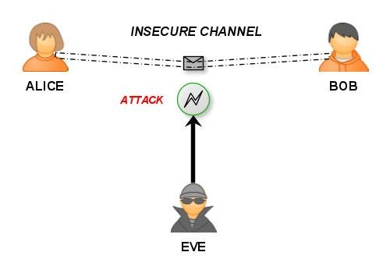
Introducing characters in the cryptography world
When talking about people in cryptography they usually refer to “Alice” and “Bob”. For this scenario they also would add “Eve” (for eavesdropper).

Slide 23
Activity
Two “volunteers” are going to come up from the class (you’ll need a computer/python).
They are going to agree on a secret key in front of all of us.
We will hear everything they say (we are “Eve” and will “eavesdrop”).
At the end the two volunteers will have a shared secret key, all the eavesdroppers will not have it!

Slide 24
https://en.wikipedia.org/wiki/Diffie%E2%80%93Hellman_key_exchange
Need two volunteers who can run a bit of python code.
First step agree on a “p” and a “g”. To speed this up let’s say “p=23” and “g=5”
Each volunteer secretly picks a number! Don’t tell anyone this number - but write it down. Calculate: (5**secret_number) % 23
Volunteers share the result of your calculation (5**secret_number) % 23, this is called your “public key”. They share with each other in front of everyone.
Each volunteer takes the other’s “public key” and does the following calculation: (other_volunteers_public_key ** secret_number) % 23
Each volunteer calculated result is a “shared key”, a secret number that only they know. It will be the *same* for both volunteers!
Can anyone guess what the shared number is? Have the volunteers both write the number on the board or something and reveal at same time.

Slide 25
Key values (g=5, p=23)
In real cryptography we need bigger numbers to make this secure.
  A ‘p’ value of 23 only allows for 23 unique shared keys.
An example 128-bit key could be 322057384927381029384759283747348193829 in decimal. Imagine raising that to a big power?
With bigger numbers we need to “modulo as we go” so the numbers don’t get too big (and to hide the original secret).
Python helps us with the pow() function!
  pow(123, 567, 123923) == (123 ** 567) % 123923

Slide 26
Try the example with a neighbor?

Slide 27
Diffie-Hellman Example
alice_secret = 12381283 # secret (not shared)
print(f"Alice's secret: {alice_secret}")
bob_secret = 83492833 # secret (not shared)
print(f"Bob's secret: {bob_secret}")
p = 23482348
print(f'p = {p} (seen by Eve)')
g = 5
print(f'g = {g} (seen by Eve)')
alice_public_key = pow(g, alice_secret, p) # shared to everyone
print(f"Alice's public key: {alice_public_key} (seen by Eve)")
bob_public_key = pow(g, bob_secret, p) # shared to everyone
print(f"Bob's public key: {bob_public_key} (seen by Eve)")
shared_key_via_alice = pow(bob_public_key, alice_secret, p) # result is secret
print(f"Shared key calculated and kept secret by Alice: {shared_key_via_alice}")
shared_key_via_bob = pow(alice_public_key, bob_secret, p) # result is secret
print(f"Shared key calculated and kept secret by Bob: {shared_key_via_bob}")
Alice's secret: 12381283
Bob's secret: 83492833
p = 23482348 (seen by Eve)
g = 5 (seen by Eve)
Alice's public key: 17214849 (seen by Eve)
Bob's public key: 4747437 (seen by Eve)
Shared key calculated and kept secret by Alice: 22803693
Shared key calculated and kept secret by Bob: 22803693

Slide 28
Khan Academy explanation on the math
https://www.youtube.com/watch?v=M-0qt6tdHzk

Slide 30
Final thoughts

Slide 31
SSL (HTTPS)
SSL (HTTPS) will use Diffie-Hellman key exchange to agree on a key. Then it will use less expensive encryption methods using the shared key to send all your data in securely encrypted packets.
There is more to this such as authentication and how setup the “handshake”. These details are captured in the TLS protocol standard.

Slide 32
Conclusion - Use SSL (HTTPS) to invoke a modern implementation of the Diffie-
Hellman Key exchange so Eve can’t see your
data!

Slide 33
Other interesting notes…
With big enough computers or data centers you can brute force your way to guessing what the secret keys are by trying lots of different keys+.
With encryption you’ll hear “64-bit encryption” or “128-bit encryption”. As computers get more powerful, they have to increase the “bits” so that contemporary computers cannot “crack” the code.
You can generally decrypt all messages using “brute force” from 10 years ago. So, if you “eavesdrop” on the internet now, you can decrypt saved messages about 10 years later without a key assuming computing power continues its growth.

