Slide 1
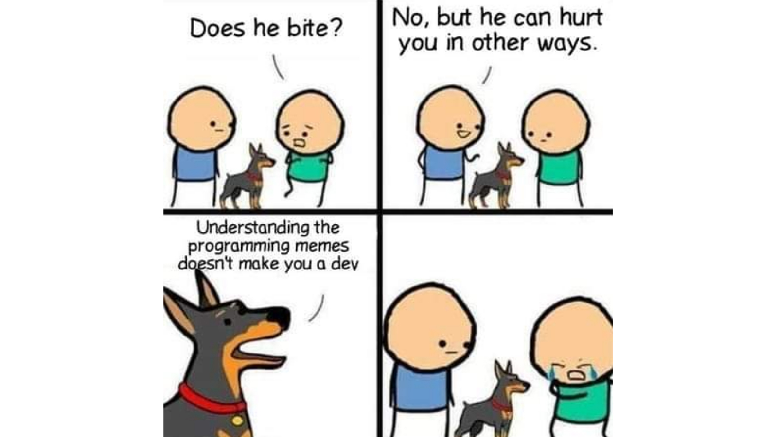

Slide 2
Conclusion

Slide 3
What did we learn?

Slide 4
Programming paradigms
Imperative programming: using statements to change a program's state.
Functional programming: expressions, not statements; no side-effects; use of higher-order functions.
nums = [1, 2, 4]
for i in range(0, len(nums)):
nums[i] = nums[i] ** 2
list(map(lambda x: x ** 2, [1, 2, 4]))
(+ 3 (* 2 6) (- 10 7))

Slide 5
Programming paradigms #2
Data-centric and object-oriented programming.
Declarative programming: State goals or properties of the solution rather than procedures.
t = tree(3, [tree(1), tree(2, [tree(1), tree(1)])])
[b.label for b in branches(t)
innocent_bee = Bee(5)
horrible_ant = Ant(10)
innocent_bee.fend_off(horrible_ant)
(.+)@(.+)\.(.{3})
<body>
<p>This is a paragraph with <em>something emphasized</em>
and <a href="cs111.byu.edu">a link</a></p>
</body>

Slide 6
Programming Concepts
Data storage:
  Primitive/simple types: booleans, numbers, strings
  Compound types: lists, linked lists, trees
Environments: rules for how programs access and modify named objects
Higher-order functions: Functions as data values, functions on functions
Recursion: approaching a problem recursively, general recursive patterns
Mutability: mutable objects, mutation operations, dangers of mutation
Exceptions: Dealing with errors
Efficiency: Different programs have different time/space needs

Slide 7
Software Engineering
Abstractions, separation of concerns
Specification of a program vs. its implementation
  Syntactic spec (header) vs. semantic spec (docstring).
  Example of multiple implementations for the same abstract behavior
Testing: for every program, there is a test.
Coding style (Composition)

Slide 8
Some useful tools
Images and how to manipulate them
Introduction to HTML
How to surf the web programmatically
How to generate plots

Slide 9
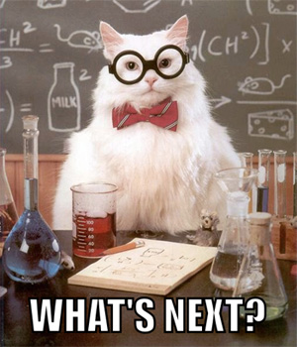
Congratulations!
You Survived CS 111.
Now what???

Slide 10
What's next?
In the short term

Slide 11
General CS Classes
After passing CS 111, you can now take the following CS courses:
  CS 235: Data Structures
    Next course needed for CS major or minor
    Language: C++
  CS 260: Web Programming
    Required for CS major, elective for CS minor
    Language: JavaScript (similar to Python)

Slide 12
Specialized CS Courses
Here are some other CS courses you could take:
  CS 202: Software Engineering Lab 1
    1 credit course for Software Engineering Emphasis
    Language: Java
  CS 180: Intro to Data Science
    Language: Python
  CS 270: Intro to Machine Learning
    Neural networks, decision trees, data mining, clustering, deep learning
    Language: Python

Slide 13
CS Courses Prerequisites
CS 235
CS 224
CS 236
CS 240
(All these courses are required for the CS Major. CS Minor requires 236 and 240. See BYU catalog for more course details: https://catalog.byu.edu/physical-and-mathematical-sciences/computer-science/

Slide 14
Emphases
Software engineering
Machine learning
Security
Graphics
HCI
Programming languages
Systems engineering

Slide 15







CS Emphases
Animation and Games
Software Engineering
Machine Learning
Bioinformatics
Computer Science
Computer/Human Interaction

Slide 16
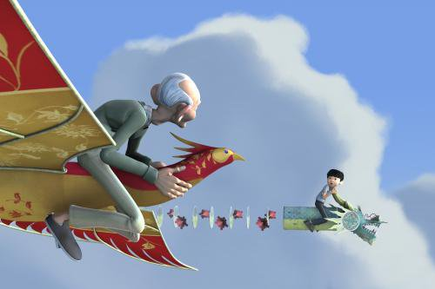




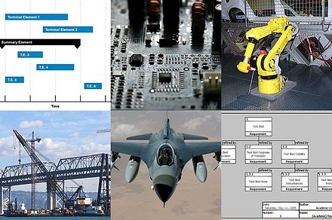
Other CS Areas
Graphics/Vision
Programming Languages
Security
Computational Linguistics
Data Science
Systems Engineering

Slide 17
What’s next?
In the long term

Slide 18

Internships!

Slide 19
Internships!
Why apply for an internship?
  $$$
  Experience
  Resume
  Perspective (would you like this job?)
  First step toward a full-time position

Slide 20

What if I don’t plan to work full-time?
Maybe you are planning to start a business…
Maybe you are planning to start a family…
An internship might still be a good idea!
  Keeps doors open
  Augments your education
  $$$
Also, it might be fun!

Slide 21
How do I get an internship?

Slide 22

Step 1:
Build a portfolio of personal projects
The number 1 comment we hear from recruiters is,
“Students need to work on something real”.
Assignments are artificial and we all know it.
Recruiters want students who know how to deal with real problems and all the messiness that goes with them.

Slide 23
Step 1:
Build a portfolio of personal projects
DON’T post solutions to class assignments
  It doesn’t help you, and professors don’t like it
DO collect your work on Github
  Code on individual projects, or on group projects that go beyond class assignments.
  Join clubs, volunteer in research labs, HAVE FUN.
DON’T wait until you’re a senior to think about your future.
DO apply to jobs even if you don’t match every qualification.

Slide 24

Step 2:
Create and maintain a resume

Slide 25
Rule #1: Your resume matters

Slide 26
Put time into your resume
On average, recruiters spend 7-10 seconds looking at each resume.
You, therefore, should spend 7-10 hours to make sure it’s perfect.
No typos, strong wording, use a good template. Make it fantastic.

Slide 27
Rule #2: Don’t sand-blast the internet

Slide 28
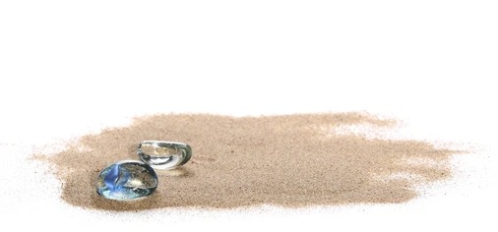
Don’t be one of 10,000 generic grains of sand.
Be the diamond by customizing your resume to each opportunity.
Resist the temptation to send out 500 resumes to random positions. Instead, send 5 carefully customized resumes to jobs that you are a really good match for. Be shiny, not noisy.

Slide 29
Step 2:
Create and maintain a resume
DO get feedback on your resume
  Try to get input from at least three people
  Ask your professors, the CS Mentors, and people who have jobs
DO watch for internship postings
  Ask the CS Mentors
  Watch bulletin boards in the TMCB
  Join #job-hunting channels in class Slack or Web sites
DO attend job fairs, mock interviews, and industry events
  Industry recruiters will give you job-hunting advice
  Many hires come directly from these recruiting events - you skip the line.
  Talk to people. Learn everything you can.

Slide 30
Step 3:
You’ll need letters of recommendation
DO work closely with professors
  The best recommend writers can speak about you as an employee, not just as a student
  Work as a TA, research assistant, or be an officer in a club the professor advises
  Be responsible and reliable! Professors can’t testify of attributes they didn’t observe.

Slide 31
Last Bits

Slide 32
Course Evaluation Survey
Please fill out the Course Completion Survey on Canvas.
Also don't forget to do your Student Evaluations for the course.

Slide 33
Free Coding Extra Credit
There is still time to submit the Free Coding assignment for extra credit.
Detail are on Canvas.

Slide 34
Final Exam
Don't forget to take the final.
Take it in the Testing Center anytime during Finals Week.
It's the same format as the midterms, just larger.
Yes, it is comprehensive.

Slide 35
Thank you!

