Slide 1
CS 111: Introduction to Computer Science
Dr. Steve Richardson

Slide 2
Elder Clark Gilbert Church Commissioner of Education
“To apply President Nelson’s words to this university, I believe the Lord will use BYU to ‘help prepare a people who will help prepare the world for the Second Coming of the Lord’. In many ways, this is the mission of BYU.”

Slide 3
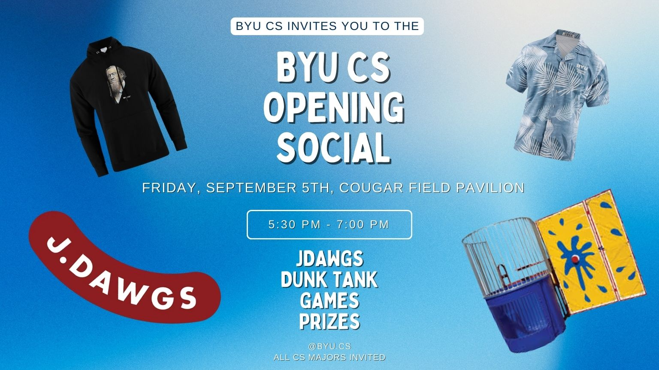

Slide 4
Who is Dr. Richardson?
Brazil South Mission RM
BS in CS/Linguistics/Portuguese – BYU
MA in Linguistics/CS – BYU
PhD in CS/Computational Linguistics emphasis – CUNY (while at IBM and Microsoft Research)
Worked on BYU Machine Translation project as student researcher in the late 1970’s!
IBM: 11 years, incl. 5 years at TJ Watson Research Center in NLP group – parsers, grammar checkers, and Machine Translation
Microsoft Research: 17 years – parsers, first Word grammar checkers, partner researcher & manager of Machine Translation group that created the Microsoft Translator
Brazil São Paulo South Mission President: 3 yrs
Taught UVU institute class for RM’s for the past 12 years
Manager of Translation Systems and Machine Translation at the Church: 10 years
Former President and current Councilor of Association for Machine Translation in the Americas
Joined CS Department in Nov. 2021 – CS111, CS479, CS601R, & MATRIX Lab
Involved with Machine Translation for 50 years - it is my passion!

Slide 5

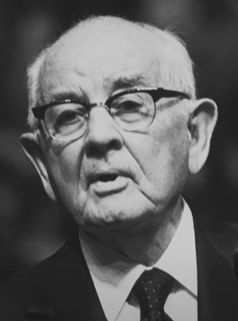


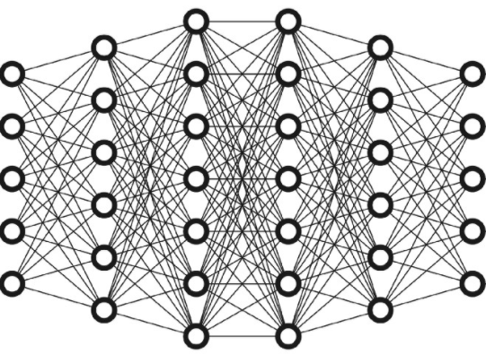
MATRIX Lab MAchine Translation Research and Interlingual eXperimentation
“I believe that the Lord is anxious to put into our hands inventions of which we laymen
have hardly had a glimpse… We look forward to developments in your computer-assisted translation projects <at BYU>…” - President Spencer W. Kimball (BYU Second Century Address, 1975) 1975)
We work on cool Machine Translation (MT) research projects, such as:
Massively Multilingual MT - translate between any two of 100’s of languages with one neural model
Speech to Speech MT – enable real-time interpretation, automatic video dubbing, etc.
Multimodal MT – use images to provide visual context to translate ambiguous language
Low-Resource MT – translate underserved languages that have minimal training data
Hola
Bonjour
你好
Hello
Computer
Science
Language
Translation
Machine
Translation

Slide 6
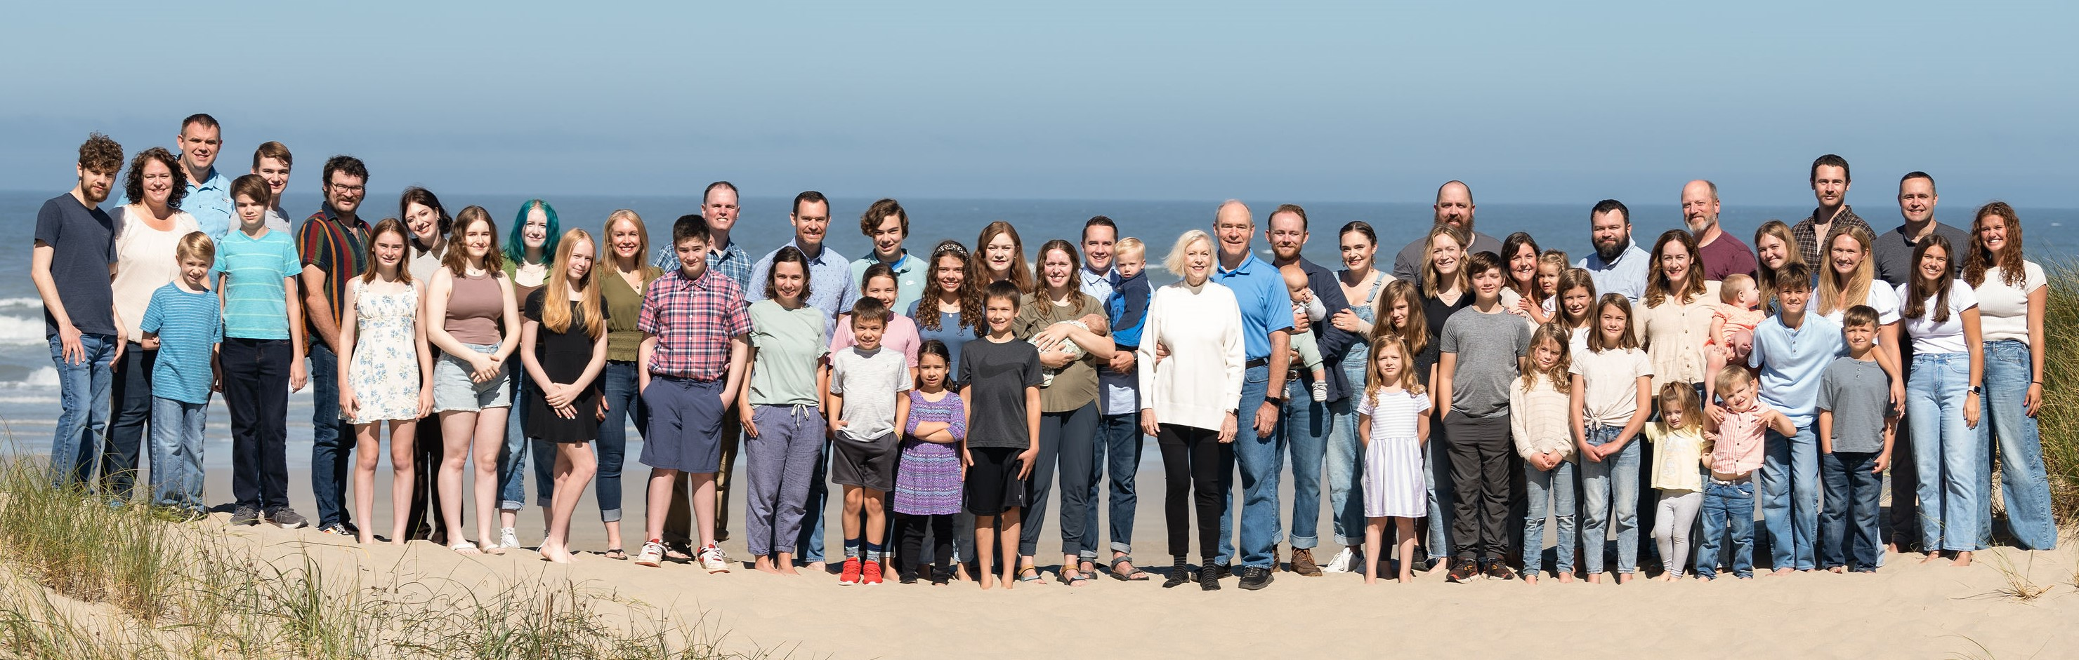
Who is Dr. Richardson?
Family: 12 Children, 33 Grandchildren
Church: Stake Patriarch, Temple Sealer
Hobbies: Racquetball (I have my own court!), Biking, Jeeping

Slide 7
Contacting Dr. Richardson
Office – 3372 TMCB – feel free to drop in anytime I’m there.
E-mail – srichardson@byu.edu – This is the best way to reach me.
I'm on the class Discord
Office Hours
1:00pm-3:00pm Tuesdays and Thursdays
Or email me to set up another time!

Slide 8
How will we incorporate spiritual principles into this class?
We will start class with a prayer and a brief spiritual thought
I have emailed you all this link and invite you to sign-up:
Sign-up sheet for prayer and optional thought
This is optional, of course, but please sign up if you are willing!
You are encouraged to pray when you need help and understanding
We will have brief discussions about devotionals on the following day
I am completely open to discuss any gospel questions you may have
I am also happy to talk with you about any other topics you may want to discuss, e.g., careers, fitting in at BYU, transition home after a mission, and anything else!

Slide 9
My goal and sincere desire is that each of you will come to understand:
How you can pray for and receive the guidance of the Spirit as you learn about CS and work on your labs, homeworks, projects & exams.
How you can apply the principles and technology taught in this class and in related classes to help build the kingdom of God on the earth.
How you can create a Zion-like society by actively participating and helping one another to be successful in this class.
I will be praying for you!

Slide 10

Turn and Greet Time!
Name
Year in School
Major
Months or years of programming experience
Something you love to do outside of school
YOU
There will be opportunities and motivation to help one another!
“…that they may be one, even as we are one” (John 17:22)

Slide 11
Questions?

