Slide 1
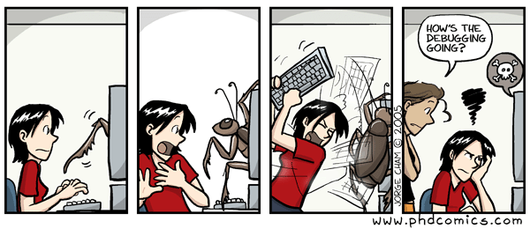

Slide 2
Testing, Dictionaries, Tuples, & Exceptions

Slide 3
Test Driven Development

Slide 4
Test driven development
Test driven development (TDD) is a programming paradigm that focus on incremental development and testing.
Developed or "rediscovered" by Kent Beck in 2003, it encourages simple software design and helps inspire confidence in the code.
In this programming paradigm you write the test first, and then write the code that passes the tests.
And you do this for every piece of functionality in your program.

Slide 5
Test driven development cycle
Add a test - The test should pass if the code properly performed some piece of its functionality – properly computes a value, properly throws an error, etc.
Run all tests – The new test should fail since you haven't written the code yet.
Write the simplest code that passes the test – It doesn't need to be pretty, efficient, or easy to understand. It just needs to work and shouldn't do anything beyond the bare minimum.
Run all tests – Now they should all pass if the code is correct.
Refactor as needed – Go back an make the code more efficient, easier to read, easier to maintain, etc. Run the tests after each change to make sure it is still working.
Repeat – now move on to the next bit of functionality

Slide 7
Writing Tests

Slide 8
Testing frameworks
Tests are usually written using a testing framework that provides us with tools to create meaningful and useful tests.
The testing framework provides a way to run all the tests written
  Makes it easier to run tests
  Allows for automation
Typically, test run through the harness only report errors, if everything works, nothing happens
  "No news is good news" philosophy. Only report the things the developer needs to worry about.
  Also, if successes and failures are reported, it's often hard to find the failures.

Slide 9
doctest and pytest
You've already been exposed to two different testing frameworks in this class
doctests
  This is probably the one you thought of first.
  simple tests you can put in the doc strings of functions
  tests how the functions respond in the interpreter
pytest framework
  This is a much more extensive framework for building tests
  The auto-grader tests that we give you as part of your assignments are written using the pytest framework library.
We're going to talk about how to write tests using both of these frameworks

Slide 11
doctests

Slide 12
Doctests
The functionality for doctests is built into the standard Python library
Doctests are written in the doc string at the beginning of a function
They mimic an interactive Python interpreter session
They describe a series of commands to be executed
  each command is proceeded by ">>>", the Python interpreter prompt
After each command, the expected output of that command is listed
def square(x):
  """ returns the square of x for any value.
  >>> square(10)
  100
  >>> square(3.1415)
  9.86902225
  """
return x * x

Slide 13
Running doctests
Doctests are invoked by running the script with the –m doctest flag
This runs the doctest for every function in the file that has tests defined.
If all goes well and all tests pass, nothing is printed.
If you want to see what is being done and have output even for passed cases, you can use the "-v" flag
The full library documentation can be found at https://docs.python.org/3/library/doctest.html
python –m doctest <filename>
python –m doctest –v <filename>

Slide 14
Doctest error output
If the doctest fails, you'll get output like the following:
**********************************************************************
File "C:\Users\dagor\PycharmProjects\demo\test.py", line 16, in test.square
Failed example:
square(3.1415)
Expected:
9.86902224
Got:
9.86902225
**********************************************************************
1 items had failures:
1 of 2 in test.square
***Test Failed*** 1 failures.
Failed example and line number
Expected and actual results
Items with failures (and how many)
Total failures in entire file

Slide 16
pytest

Slide 17
The pytest library
To use pytest, you first need to install the pytest library as it is not part of the standard Python installation
However, you've already installed it as it was installed when you installed the byu_pytest_utils library.
Full documentation on the pytest library can be found at https://docs.pytest.org
pytest provides a more versatile and powerful set of tools than are available from doctests
python –m pip install pytest

Slide 18
Running pytests
If you've run the tests we've provided for the assignments, you've seen the basic way to invoke pytest that runs all tests in the directory:
You can additionally just have pytest run a single test file by giving the name of the file you want it to run
You can also have it run just a single test within the file by giving it the name of the test function after the filename separated by "::"
For other ways to invoke pytest, see the documentation at https://docs.pytest.org/en/7.4.x/how-to/usage.html
pytest
or
python –m pytest
pytest <filename>
pytest <filename>::<testname>

Slide 19
What does pytest actually run?
When you invoke pytest without a filename, it looks in the current directory for any files that match either of the following patterns
  test_<name>.py
  <name>_test.py
If you invoke it with a filename, it just runs the file specified.
Within that file, it looks for functions of the form test_<name>() and runs each of those functions in turn.
  These functions should take no arguments

Slide 20
Pytest output - success
If all the tests pass, you'll see something like this
========================== test session starts ==========================
platform win32 -- Python 3.9.13, pytest-7.4.0, pluggy-1.2.0
rootdir: C:\Users\dagor\PycharmProjects\demo
plugins: byu-pytest-utils-0.7.2
collected 2 item
test_demo.py .. [100%]
=========================== 2 passed in 0.25s ===========================
All the tests ran
green means no failures
How long it took

Slide 21
Pytest output - failure
When test fails, there is a bit more output:
========================= test session starts ==========================
platform win32 -- Python 3.9.13, pytest-7.4.0, pluggy-1.2.0
rootdir: C:\Users\dagor\PycharmProjects\demo
plugins: byu-pytest-utils-0.7.2
collected 2 items
test_demo.py .F [100%]
=============================== FAILURES ===============================
______________________________ test_error ______________________________
def test_error():
> assert func(3) == 5
E assert 4 == 5
E + where 4 = func(3)
test_demo.py:9: AssertionError
======================= short test summary info ========================
FAILED test_demo.py::test_error - assert 4 == 5
===================== 1 failed, 1 passed in 0.18s ======================
One entry per test:
. = succuss
F = failure
All the tests ran
red means failures
Test that failed
Actual line that failed
Values that failed

Slide 22
Writing tests - naming
Typically, our tests will go in a separate file and import the functions or classes we want to test
Inside that file, we write our test functions
  Function names are of the form test_<name>() and take no parameters
  <name> should be something descriptive that makes clear what is being tested
    test_square_returns_valid_value()
    test_sqrt_throws_exception_for_negative()

Slide 23
Writing tests - content
What goes inside our test functions?
  Anything we want
The most common statement is an assertion
  We call the function we are testing with known input values
  We then assert that all we received all the expected outputs
assert <Boolean expression>
def test_square_valid():
assert square(3) == 9

Slide 24
A more complicated example
def test_grid_constructions():
grid = Grid(2,2)
assert grid.height == 2
assert grid.width == 2
for x in range(grid.width):
for y in range(grid.height):
assert grid.get(x,y) == None
With multiple asserts, all must pass for the test to pass
The test will stop on the first failure.

Slide 25
Checking floating point numbers
What happens if we run the following in the Python interpreter?
Surprisingly, we get False
This is due to the imprecision of floating-point number representation in computers
  You may have already seen this a few times this semester, noticeably on Homework 1
To make comparisons like this safely, we must do something like this:
where val1 (0.1+0.2 from above) and val2 (0.3 from above) are the values we ant to compare and tolerance is some small value like 1e-6
0.1 + 0.2 == 0.3
abs(val1 – val2) < tolerance

Slide 26
Checking floating point numbers
But that's a pain to write
pytest gives us an approx() method that allows us to write this more cleanly:
This would return True.
If you want to change the tolerance, for example when working with large or small numbers, there are additional parameters to approx() that you can set.
The full documentation is here: https://docs.pytest.org/en/7.4.x/reference/reference.html#pytest-approx
val1 == approx(val2)
i.e.
0.1 + 0.2 == approx(0.3)

Slide 28
Tuples

Slide 29
Tuples
A tuple is an immutable sequence. It's like a list, but no mutation allowed!
An empty tuple:
A tuple with multiple elements:
A tuple with a single element: 🙀
empty = ()
# or
empty = tuple()
conditions = ('rain', 'shine')
# or
conditions = 'rain', 'shine'
oogly = (61,)
# or
oogly = 61,

Slide 30
Creating a tuple from another sequence
Just like the list() function creates a list from an iterable sequence (like a list or string), the tuple() functions creates a tuple from an iterable sequence
digit_list = [0,1,2,3,4,5,6,7,8,9]
digit_tuple = tuple(digit_list)
# (0,1,2,3,4,5,6,7,8,9)

Slide 31
Tuple operations
Many of a list's read-only operations work on tuples.
Combining tuples into a new tuple:
Checking containment:
Accessing elements:
Slicing:
# ('come', '☂', 'or', '☼')
('come', '☂') + ('or', '☼')
'wally' in ('wall-e', 'wallace', 'waldo')
# False
conditions = ('rain', 'shine')
conditions[1]
# 'shine'
digits = (0,1,2,3,4,5,6,7,8,9)
numbers = digits[3:8]
# (3,4,5,6,7)

Slide 33
Dictionaries

Slide 34
Dictionaries
A dict is a mapping of key-value pairs
states = {
"CA": "California",
"DE": "Delaware",
"NY": "New York",
"TX": "Texas",
"WY": "Wyoming"
}
>>> len(states)
5
>>> "CA" in states
True
>>> “Texas" in states
False
Notes:
The dictionary slides need to move to an earlier lecture

Slide 35
Dictionary selection
words = {
"más": "more",
"otro": "other",
"agua": "water"
}
Select a value:
>>> words["otro"]
'other'
>>> first_word = "agua"
>>> words[first_word]
'water'
>>> words["pavo"]
KeyError: pavo
>>> words.get("pavo", "🤔")
'🤔'

Slide 36
Dictionary rules
A key cannot be a list or dictionary (or any mutable type)
All keys in a dictionary are distinct (there can only be one value per key)
The values can be any type, however!
spiders = {
"smeringopus": {
"name": "Pale Daddy Long-leg",
"length": 7
},
"holocnemus pluchei": {
"name": "Marbled cellar spider",
"length": (5, 7)
}
}

Slide 37
Dictionary iteration
insects = {"spiders": 8, "centipedes": 100, "bees": 6}
for name in insects:
print(insects[name])
What will be the order of items?
Keys are iterated over in the order they are first added.
8 100 6

Slide 38
Dictionary comprehensions
General syntax
  Notice the curly braces {} instead of brackets []
  There are two items before the for keyword: the key and the value separated by a colon
Example
{key: value for <name> in <iter exp>}
{x: x*x for x in range(3,6)}
# {3: 9, 4: 16, 5: 25}

Slide 40
Exceptions
Notes:
Maybe this should go up with errors?

Slide 41
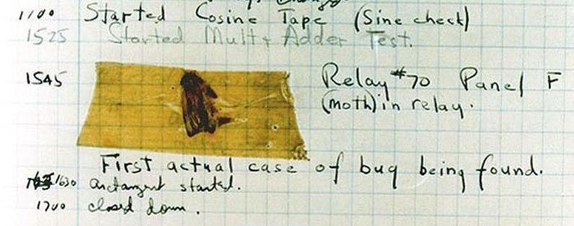
Handling errors
Sometimes, computer programs behave in non-standard ways.
  A function receives an argument value of an improper type
  Some resource (such as a file) is not available
  A network connection is lost in the middle of data transmission
  Moth found in a Mark II Computer (Grace Hopper's Notebook, 1947)

Slide 42
To Err is Human
What to do with an error:
  Return a special value.
  Use a Boolean return value to indicate success or failure.
  Set a global variable.
  Put an input or output stream in a fail state.
  Print an error message.
  Print an error message and exit the program.
The first four options allow the user of a function to respond to the error

Slide 43
Exceptions
An exception is a built-in mechanism in a programming language to declare and respond to "exceptional" conditions.
A program raises an exception when an error occurs.
If the exception is not handled, the program will stop running entirely.
But if a programmer can anticipate when exceptions might happen, they can include code for handling the exception, so that the program continues running.
Many languages include exception handling: C++, Java, Python, JavaScript, C#, etc.

Slide 44
Handling Exceptions
If exceptions are not caught and handled, they will cause the program to crash.
If we catch an exception, we can decide what to do about it
  Record it - log it to a file, print it out, send an e-mail, page someone, etc.
  Rethrow it so another part of the program can address it as well
  Retry the operation that caused the failure
  Ignore it and not pass it on (not a good idea) – called swallowing the exception

Slide 45
Exceptions
Python raises an exception whenever a runtime error occurs.
How an unhandled exception is reported:
If an exception is not handled, the program stops executing immediately.
>>> 10/0
Traceback (most recent call last):
File "<stdin>", line 1, in
ZeroDivisionError: division by zero

Slide 46
Types of exceptions
A few exception types and examples of buggy code:
See full list in the exceptions docs.
Exception | Example
OverflowError | pow(2.12, 1000)
TypeError | 'hello'[1] = 'j'
IndexError | 'hello'[7]
NameError | x += 5
FileNotFoundError | open('dsfdfd.txt')

Slide 48
The try Statement

Slide 49
The try statement
To handle an exception (keep the program running), use a try statement.
The <try suite> is executed first. If, during the course of executing the <try suite>, an exception is raised that is not handled otherwise, and If the class of the exception inherits from <exception class>, then the <except suite> is executed, with <name> bound to the exception.
Note that when an exception is raised, the try suite ends immediately and none of the later code is executed.
try:
<try suite>
except <exception class> as <name>:
<except suite>
...

Slide 50
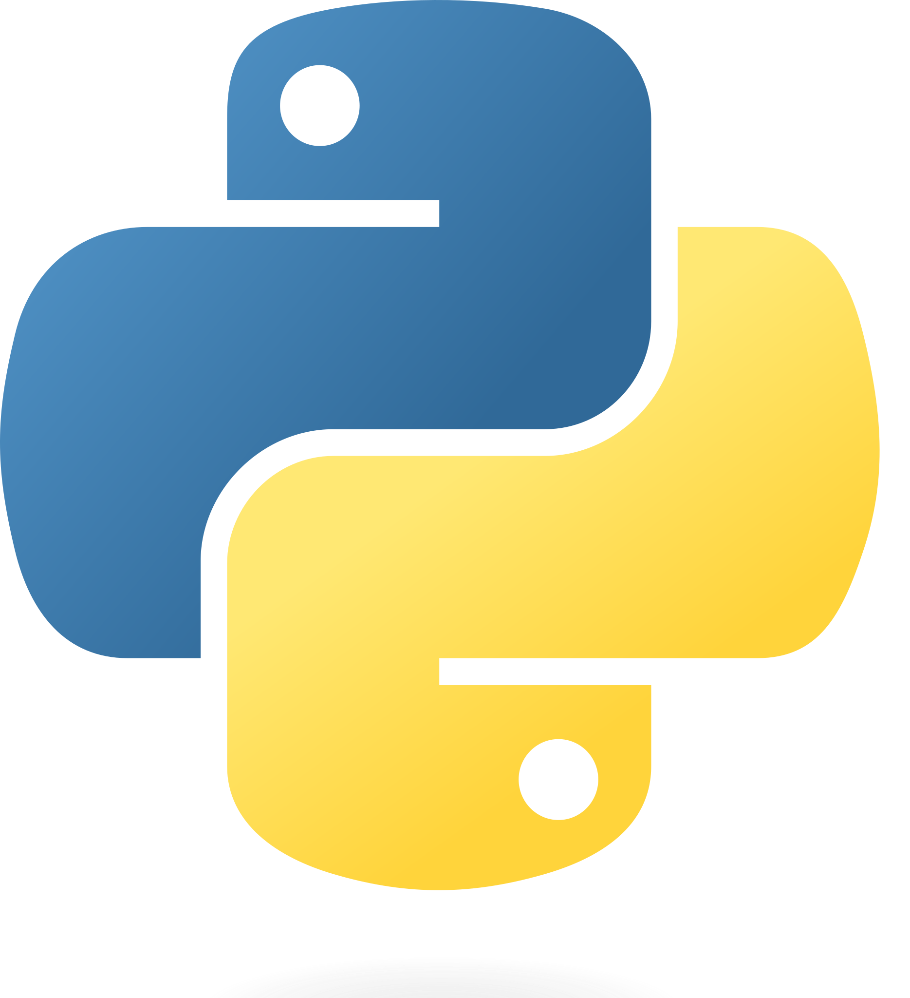
Try statement example
try:
quot = 10/0
except ZeroDivisionError as e:
print('handling a', type(e))
quot = 0
View in PythonTutor

Slide 51
Try inside a function
def div_numbers(dividend, divisor):
try:
quotient = dividend/divisor
except ZeroDivisionError:
print("Function was called with 0 as divisor")
quotient = 0
return quotient
div_numbers(10, 2)
div_numbers(10, 0)
div_numbers(10, -1)
View in PythonTutor

Slide 52
What would Python do?
def invert(x):
inverse = 1/x # Raises a ZeroDivisionError if x is 0
print('Never printed if x is 0')
return inverse
def invert_safe(x):
try:
return invert(x)
except ZeroDivisionError as e:
print('Handled', e)
return 0
invert_safe(1/0)
try:
invert_safe(0)
except ZeroDivisionError as e:
print('Handled!')
inverrrrt_safe(1/0)

Slide 54
Raising exceptions

Slide 55
Assert statements
Assert statements raise an exception of type AssertionError:
  where <expression> should evaluate to True and if it doesn't, <string> is the message passed with the AssertionError
Assertions are designed to be used liberally. They can be ignored to increase efficiency by running Python with the "-O" flag; "O" stands for optimized.
Put assertions in your code wherever your code is checking input or conditions that you as the programmer have control over. If an assertion is raised, it means you have a bug that you can fix.
If you don't have control over the input, raise an exception.
assert <expression>, <string>
python3 -O

Slide 56
Raise Statements
Any type of exception can be raised with a raise statement
<expression> must evaluate to a subclass of BaseException or an instance of one
Exceptions are constructed like any other object. e.g.,
raise <expression>
TypeError('Bad argument!')

Slide 57
Pytest Note: Testing for exceptions
While assertion is the most common thing we do in the tests, pytest provides a number of other checks we can make
A common one is to see if an exception is raised where it is expected
This uses the raises() function from pytest
def square_root(x):
if x < 0:
raise ValueError("Negative numbers not allowed")
return sqrt(x)
def test_square_root_raises_exception():
with pytest.raises(ValueError):
square_root(-4)

Slide 58
When we should not use exceptions
When an error event happens routinely and could be considered part of normal execution, handle without throwing exceptions.
  Generate error codes or return values
  Use if() statements to check and handle errors

Slide 59
When we should use exceptions
When we don't have control of the input or processing state, we should use exceptions to report errors
Use try-except blocks
  Around code that can potentially (and unexpectedly) generate an exception.
  Prevent and recover from application crashes.
  Raise an exception when your program can identify an external problem that prevents execution.

Slide 60
Advantages of using exceptions
Compared to error reporting via return-codes and if statements, using try / except / raise is likely to result in code
  that is easier to read,
  that has fewer bugs,
  is less expensive to develop,
  and has faster time-to-market (time-to-submission for students ☺).
Notes:
Add in an example of easier to read i.e. code with lots of if statements vs try/except

Slide 61
Code with and without excpetions
def sqrt(x):
if x < 0:
return None
# code to compute square root
def sqrt(x):
if x < 0:
raise ValueArgument ("Negative numbers not allowed.")
# code to compute square root
with open(filename,”w”) as inFile:
for n in inFile:
root = sqrt(float(n))
if root:
print(f”The square root of {n} is {root}”)
else:
print(f”Cannot take the square root of {n}”)
with open(filename,”w”) as inFile:
for n in inFile:
try:
print(f”The square root of {n} is {sqrt(float(n))}”)
except ValueArgument as e:
print(f”Cannot take the square root of {n}”, e)

Slide 62
Input validation
Input validation is a form of defensive programming.
Whenever a function or method receives input from a user, it is a good practice to validate that the input provided is in the function's domain.
If the arguments are provided by the user, we should raise exceptions or return error codes.
If the arguments are provided by the developer, we should use assertions.
def sqrt(x):
if x < 0:
raise ValueArgument ("Negative numbers not allowed.")
# code to compute square root

