Slide 1
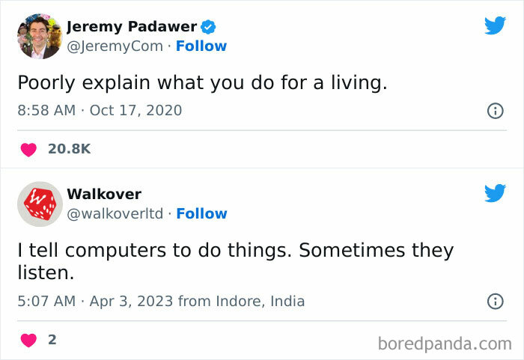

Slide 2
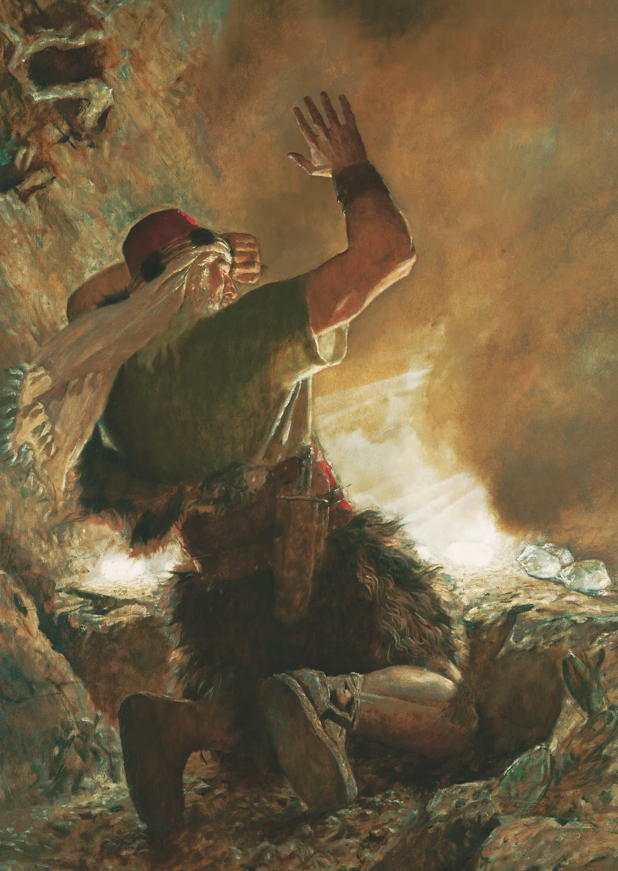
The Lord doesn't always give us the answers – Ether 2-3
There were two problems with the barges:
No light
Limited air
The Lord give the solution to the air problem, instructing them how to add "holes" in the boat to allow air in when needed.
But for light, he asks the brother of Jared what he wants the Lord to do.
The Lord gives some constraints on why and obvious solution (windows) won't work
But the asks the brother of Jared to use his creativity to come up with a solution

Slide 3
Images

Slide 4
Images

Slide 5
Project 1 – Image Processor
For your first project in this class, you'll be writing a small program that reads in images, manipulates them, and then writes out the resulting image.
Several of the next labs, along with Homework 2, focus on developing some of the functionality you will need to complete the project.
You will need the byuimage library for these assignments and will install it (if you haven't already) during your next lab session
Since you will be working with images, let's talk a bit about them, how they are represented, and how we work with them

Slide 6
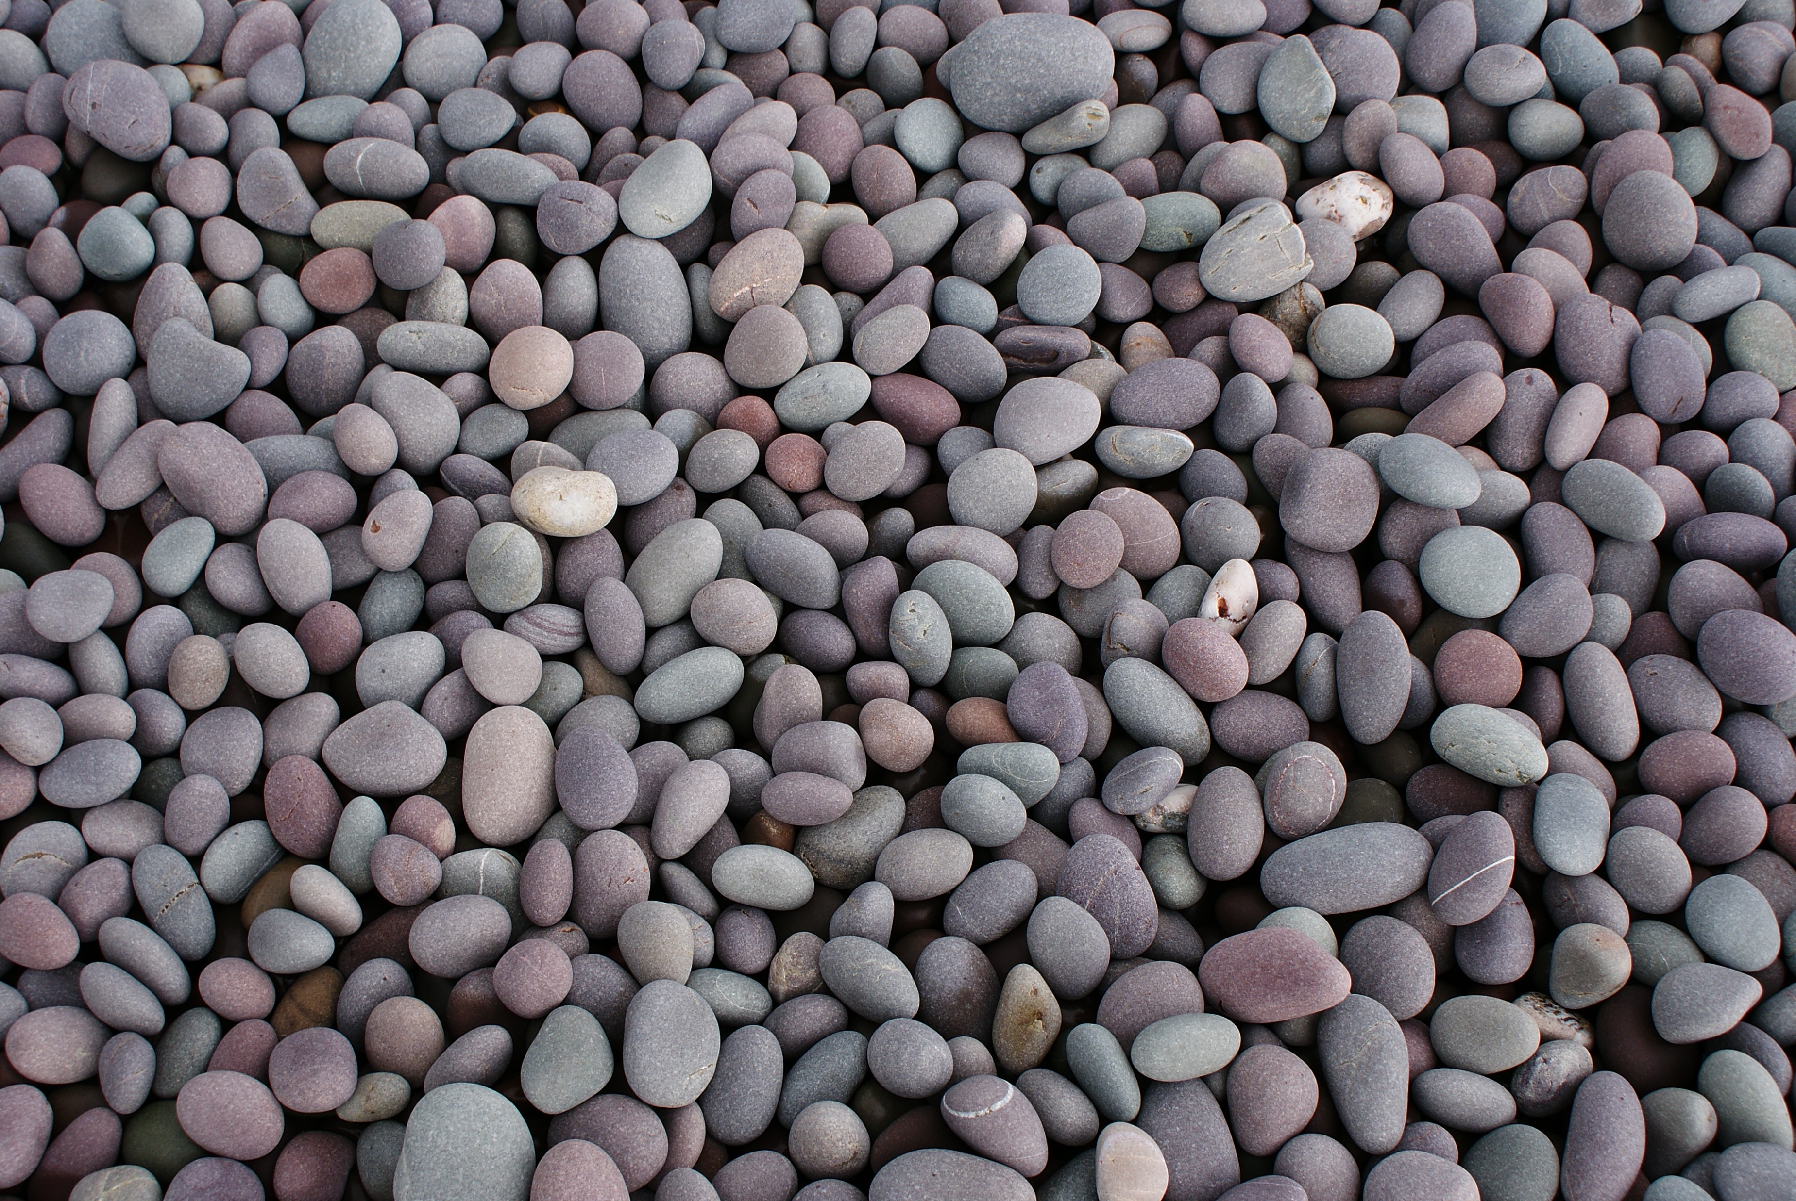
Understanding Images
Images consist of pixels
A pixel is just a tiny square showing a single color
They are arranged in a rectangular grid
Colors are represented by a number of different systems – RGB, HSV, LCH, CMYK, etc.
Each of these use different values to represent the colors
We'll be using the RGB system - RGB stands for Red-Green-Blue
The pixel color is controlled by varying the values in each of those three color channels
Values can range from 0-255
The colors mix to form the final color of the pixel
With 256 values in each color channel there are 16.7 million colors possible.

Slide 7
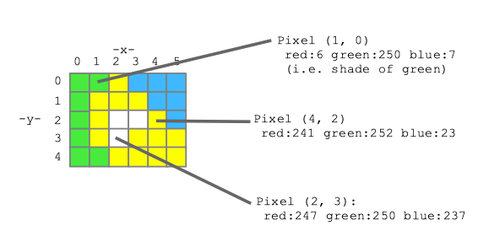
Reading in an image
Using the byuimage library, reading in an image is simple
The pixels in the image are a collection, sort of like a list
The collection is ordered
they go from left to right and top to bottom
(0,0) → (1,0) → (2,0) …
(0,1) → (1,1) → (2,1) …
The collection is iterable
from byuimage import Image
myImage = Image("pebbles.jpg")
myImage.show()

Slide 8
Looping over an image
Since the Image object is iterable, we can loop over all the pixels and manipulate them if we wanted to
To see only the red values in the image, we might do something like this
This processes each pixel in the image, one by one, setting the blue and green values to zero.
image = Image("pebbles.jpg")
for pixel in image:
pixel.green = 0
pixel.blue = 0
image.show()

Slide 9
Returning an Image from a function
The Images created by the byuimage library are just object like anything else (list, strings, numbers, etc.) and so can be passed to and returned from functions.
What does this function do?
def darken(image):
for pixel in image:
pixel.red = pixel.red * 0.5
pixel.green = pixel.green * 0.5
pixel.blue = pixel.blue * 0.5
return image

Slide 10
Accessing specific pixels
So far, we've been accessing every pixel in the image using the for loop.
What if we want to just access a specific pixel (or range of pixels) in the image?
Remember that our image is just a grid
The Image object has some additional functions and attributes that will be useful
.height = the height of the image in pixels
.width = the width of the image in pixels
.get_pixel(x,y) – A function that returns the pixel at the specified coordinates

Slide 11
Accessing specific pixels (cont.)
This gives us a different way to loop over all the pixels
Here's a slightly different version of the darken() function
What if we wanted to only darken the top half of the image?
Or the right half?
def darken(image):
""" Pass in an image, modify it """
for y in range(image.height):
for x in range(image.width):
pixel = image.get_pixel(x, y)
pixel.red = pixel.red * 0.5
pixel.green = pixel.green * 0.5
pixel.blue = pixel.blue * 0.5

Slide 12
Copying pixels
If we have two different pixels, how do we copy one into the other?
We just copy the color values
a = image.get_pixel(1,7)
b = image.get_pixel(3,10)
a.red = b.red
a.green = b.green
a.blue = b.blue

Slide 13
Copying images
What if we wanted to copy an entire image into a new one?
The Image object has a function called blank() that takes a width and height as parameters and returns an empty (white) image of that size.
Then we can just copy the pixel from the old image to the new one
def copy(image):
new_image = Image.blank(image.width, image.height)
for y in range(image.height):
for x in range(image.width):
pixel = image.get_pixel(x, y)
pixel_new = new_image.get_pixel(x, y)
pixel_new.red = pixel.red
pixel_new.green = pixel.green
pixel_new.blue = pixel.blue
return new_image

Slide 15
Manipulating Images

Slide 16
Manipulating the images
We can write functions to manipulate the image in any way we want.
This one makes a copy of the image and then darkens only the pixels in the top half that have an average color value greater than 220
def mute_top(image):
new_image = Image.blank(image.width, image.height)
for y in range(image.height):
for x in range(image.width):
pixel = image.get_pixel(x, y)
pixel_new = new_image.get_pixel(x, y)
factor = 1.0
if (pixel.red + pixel.blue + pixel.green)/3 > 220 and y < image.height//2:
factor = 0.5
pixel_new.red = pixel.red * factor
pixel_new.green = pixel.green * factor
pixel_new.blue = pixel.blue * factor
return new_image

Slide 17
Let's add a border
Let's write a function that takes an image and adds a 50-pixel wide, black border at the bottom.
def bottom_black_border(image):
"""
This function take an Image object and returns a new
Image that is 50 pixels larger with a black stripe at
the bottom
"""

Slide 18
Add a border (solution)
def bottom_black_border(image):
new_image = Image.blank(image.width, image.height+50) # Create the larger image.
for y in range(image.height): # Copy the original image
for x in range(image.width): # into the top of the new
pixel = image.get_pixel(x, y) # one.
pixel_new = new_image.get_pixel(x, y)
pixel_new.red = pixel.red
pixel_new.green = pixel.green
pixel_new.blue = pixel.blue
for y in range(image.height,image.height+50): # Make the pixels in the
for x in range(image.width): # bottom black. RGB for
pixel_new = new_image.get_pixel(x, y) # black is (0,0,0).
pixel_new.red = 0
pixel_new.green = 0
pixel_new.blue = 0
return new_image

Slide 20
Green Screen

Slide 21
Chroma key compositing (AKA green screening)
Let's try something a little more challenging – a simple green screen effect
For this we need two images
The background
The foreground image with the green screen
What do we need to do?
Create a copy of the background
Copy the pixels from the foreground image that aren't green into the new image
How do we determine that?

Slide 22
Determining Green
How do we tell if a pixel is green or not?
We could check the green pixels to see if it is above some threshold
Let's see what that does if we change everything detected as green to red:
def detect_green(pixel):
threshold = 100
if pixel.green > threshold:
return True
else:
return False
def change_to_red(image):
for y in range(image.height):
for x in range(image.width):
pixel = image.get_pixel(x, y)
if detect_green(pixel):
pixel.red = 255
pixel.green = 0
pixel.blue = 0

Slide 23
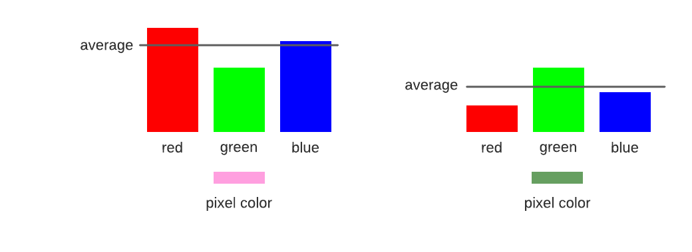
Determining green II
That didn't work
What about looking at the average color of the pixel
And then checking to see if the green value is higher than that by some factor?
We can play with the value of factor to get it to be a better fit
def detect_green(pixel):
factor = 1.7
average = (pixel.red + pixel.green + pixel.blue) / 3
if pixel.green >= factor * average:
return True
else:
return False

Slide 24
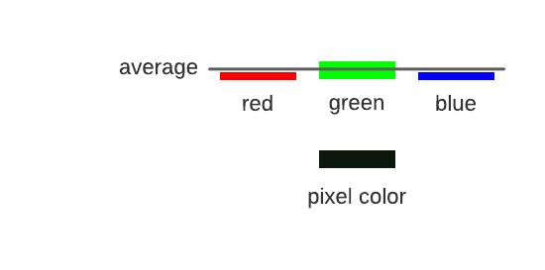
Determining green III
But there is still an issue
Look at his hair and his belt
These pixels are dark, almost black, but are still getting changed.
They have values something like this image
Let's combine the two techniques
def detect_green(pixel):
factor = 1.3
threshold = 100
average = (pixel.red + pixel.green + pixel.blue) / 3
if pixel.green >= factor * average and pixel.green > threshold:
return True
else:
return False

Slide 25
Putting it all together
def green_screen(foreground,background):
final = Image.blank(background.width,background.height)
for y in range(background.height):
for x in range(background.width):
fp = final.get_pixel(x,y)
bp = background.get_pixel(x,y)
fp.red = bp.red
fp.green = bp.green
fp.blue = bp.blue
for y in range(foreground.height):
for x in range(foreground.width):
fp = foreground.get_pixel(x, y)
if not detect_green(fp):
np = final.get_pixel(x,y)
np.red = fp.red
np.green = fp.green
np.blue =fp.blue
return final
What problems might we have with this code?

Slide 27
Abstraction

Slide 28
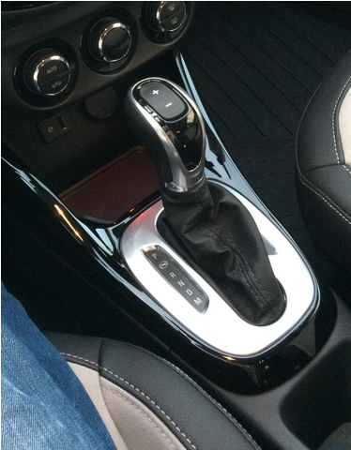
Abstraction
In CS, we often "abstract away the details."
We intentionally ignore some details in order to provide a consistent interface.
This allows us to focus on the concepts instead of the implementation and think about problems at a higher level

Slide 29
Abstraction by Parameterization

Slide 30
Abstraction by parameterization (Generalization)
In a world before functions...
Parameterized!
A parameterized function performs a computation that works for all acceptable values of the parameters.
✂️ Removed detail: the values themselves!
interest = 1 + 0.6 * 2
interest2 = 1 + 0.9 * 4
interest3 = 1 + 2.1 * 3
def interest(rate, years):
return 1 + rate * years

Slide 31
Revisiting the detect_green() function
Let's look at our final detect_green() function from last lecture
We have two values, factor and threshold, that we had modified as we were testing it out. If we wanted to change them, others using our function (including ourselves in the future) might want to as well.
These should be parameterized
def detect_green(pixel):
factor = 1.3
threshold = 100
average = (pixel.red + pixel.green + pixel.blue) / 3
if pixel.green >= factor * average and pixel.green > threshold:
return True
else:
return False

Slide 32
Revisiting the detect_green() function
Let's make them parameters
Now the user can specify the value for each of these variables at runtime instead of having the change the code of the function.
def detect_green(pixel, factor, threshold):
average = (pixel.red + pixel.green + pixel.blue) / 3
if pixel.green >= factor * average and pixel.green > threshold:
return True
else:
return False

Slide 33
Examples – darken()
Can we generalize (abstraction by parameterization) our darken function from last time?
def darken(image):
for pixel in image:
pixel.red = pixel.red * 0.5
pixel.green = pixel.green * 0.5
pixel.blue = pixel.blue * 0.5
def darken(image, factor):
""" Reduce the intensity of an image to factor of its
original value. 0 = fully black, 1 = no effect.
"""
for pixel in image:
pixel.red = pixel.red * factor
pixel.green = pixel.green * factor
pixel.blue = pixel.blue * factor

Slide 34
Examples – adding a border
Remember this function?
def bottom_black_border(image):
new_image = Image.blank(image.width, image.height+50) # Create the larger image.
for y in range(image.height): # Copy the original image
for x in range(image.width): # into the top of the new
pixel = image.get_pixel(x, y) # one.
pixel_new = new_image.get_pixel(x, y)
pixel_new.red = pixel.red
pixel_new.green = pixel.green
pixel_new.blue = pixel.blue
for y in range(image.height,image.height+50): # Make the pixels in the
for x in range(image.width): # bottom black. RGB for
pixel_new = new_image.get_pixel(x, y) # black is (0,0,0).
pixel_new.red = 0
pixel_new.green = 0
pixel_new.blue = 0
return new_image
How might we abstract this?
Notes:
Abstracting it is part of Homework 2

