Slide 1


Slide 2

Are we listening for our personal revelation?
“What he said was …
What I heard was …”
Salina Pita
BYU Devotional – 05/13/25

Slide 3
Putting it all together
def green_screen(foreground,background):
final = Image.blank(background.width,background.height)
for y in range(background.height):
for x in range(background.width):
fp = final.get_pixel(x,y)
bp = background.get_pixel(x,y)
fp.red = bp.red
fp.green = bp.green
fp.blue = bp.blue
for y in range(foreground.height):
for x in range(foreground.width):
fp = foreground.get_pixel(x, y)
if not detect_green(fp):
np = final.get_pixel(x,y)
np.red = fp.red
np.green = fp.green
np.blue =fp.blue
return final
What problems might we have with this code?

Slide 5
Abstraction

Slide 6

Abstraction
In CS, we often "abstract away the details."
We intentionally ignore some details in order to provide a consistent interface.
This allows us to focus on the concepts instead of the implementation and think about problems at a higher level

Slide 7
Abstraction by Parameterization

Slide 8
Abstraction by parameterization (Generalization)
In a world before functions...
Parameterized!
A parameterized function performs a computation that works for all acceptable values of the parameters.
✂️ Removed detail: the values themselves!
interest = 1 + 0.6 * 2
interest2 = 1 + 0.9 * 4
interest3 = 1 + 2.1 * 3
def interest(rate, years):
return 1 + rate * years

Slide 9
Revisiting the detect_green() function
Let's look at our final detect_green() function from last lecture
We have two values, factor and threshold, that we had modified as we were testing it out. If we wanted to change them, others using our function (including ourselves in the future) might want to as well.
These should be parameterized
def detect_green(pixel):
factor = 1.3
threshold = 100
average = (pixel.red + pixel.green + pixel.blue) / 3
if pixel.green >= factor * average and pixel.green > threshold:
return True
else:
return False

Slide 10
Revisiting the detect_green() function
Let's make them parameters
Now the user can specify the value for each of these variables at runtime instead of having the change the code of the function.
def detect_green(pixel, factor, threshold):
average = (pixel.red + pixel.green + pixel.blue) / 3
if pixel.green >= factor * average and pixel.green > threshold:
return True
else:
return False

Slide 11
Examples – darken()
Can we generalize (abstraction by parameterization) our darken function from last time?
def darken(image):
for pixel in image:
pixel.red = pixel.red * 0.5
pixel.green = pixel.green * 0.5
pixel.blue = pixel.blue * 0.5
def darken(image, factor):
""" Reduce the intensity of an image to factor of its
original value. 0 = fully black, 1 = no effect.
"""
for pixel in image:
pixel.red = pixel.red * factor
pixel.green = pixel.green * factor
pixel.blue = pixel.blue * factor

Slide 12
Examples – adding a border
Remember this function?
def bottom_black_border(image):
new_image = Image.blank(image.width, image.height+50) # Create the larger image.
for y in range(image.height): # Copy the original image
for x in range(image.width): # into the top of the new
pixel = image.get_pixel(x, y) # one.
pixel_new = new_image.get_pixel(x, y)
pixel_new.red = pixel.red
pixel_new.green = pixel.green
pixel_new.blue = pixel.blue
for y in range(image.height,image.height+50): # Make the pixels in the
for x in range(image.width): # bottom black. RGB for
pixel_new = new_image.get_pixel(x, y) # black is (0,0,0).
pixel_new.red = 0
pixel_new.green = 0
pixel_new.blue = 0
return new_image
How might we abstract this?
Notes:
Abstracting it is part of Homework 2

Slide 14
Command Line Arguments, Object Oriented Programming, & Classes

Slide 15
Abstraction by Specification

Slide 16
Abstraction by specification
A specification for the built-in round function:
A well-designed function specification (function signature + docstring) serves as a contract between the implementer and the user.
✂️ Removed detail: the implementation!
round(number[, ndigits]): Return number rounded to n digits precision after the decimal point. If n digits is omitted or is None, it returns the nearest integer to its input.
See full documentation.

Slide 17
Using an abstraction
Based on this specification..
This should work!
square(n): Returns the square of the number n.
def sum_squares(x, y):
"""
>>> sum_squares(3, 9)
90
"""
return square(x) + square(y)

Slide 18
Implementing the abstraction
Many possible implementations can be used:
It could even be built-in to Python, in theory!
def square(x):
return pow(x, 2)
def square(x):
return x ** 2
from operator import mul
def square(x):
return mul(x, x)

Slide 19
Not all implementations are equal
An implementation may have practical consequences:
  Affecting the size of the program
  Affecting the speed of the program's execution
Not the ideal implementation:
But you can cross that bridge when you come to it.
from operator import mul
def square(x):
return mul(x, 2)

Slide 21
Command-line Arguments

Slide 22
Abstraction by parameterization at the program level
Just like we will often add parameters to a function so that we can call it with different values and not have to edit code, we can do the same with our entire scripts
This allows the user of our program to give it parameters for execution without having to edit the code.
  Values to use for certain program parameters
  Command for which part of the program to run
  Input and output file names
  …
When we give parameters to a program at run time these are call command-line arguments

Slide 23
Command-line arguments
To pass command-line arguments when we run a Python script, we simply add the arguments after the name of the script
This runs myScript.py and passes the values "add", "2", and "3.2" to the script.
They are delimited by whitespace
  If you want to pass in a string that contains whitespace, you need to enclose it in quotations marks (")
python myScript.py add 2 3.2
python myScript.py "This is a single argument"

Slide 24
Accessing command-line arguments
Access to the command-line arguments passed to a script is provided by the sys (system) library.
sys.argv (argument values) is a Python list containing all of the command-line arguments passed to the program.
If we called our script like this:
sys.argv would contain:
sys.argv[0] is always the name of the script that was run
import sys
args = sys.argv
python myScript.py add 2 3.2
['myScript.py', 'add', '2', '3.2']

Slide 25
Using command-line arguments
The individual elements of sys.argv are just values and we can use them in any way we normally would
However, all elements of sys.argv are read in as strings
If we know they should be numbers, we need to convert them using the int() and float() functions
Note: if you try to call int() on a string representing a floating-point number, you will get an error
sys.argv = ['myScript.py', 'add', '2', '3.2']
command = sys.argv[1] # 'add'
have_good_args = validate_arguments(sys.argv[1:])
integer_value = int(sys.argv[2]) # convert '2' to 2
float_value = float(sys.argv[3]) # convert '3.2' to 3.2

Slide 27
Object-Oriented Programming

Slide 28
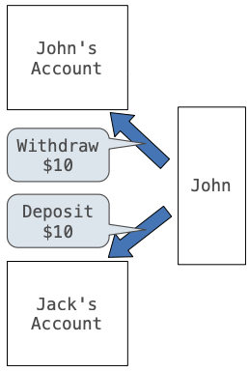
Object-oriented programming
OOP is a method for organizing programs which includes:
  Data abstraction
  Bundling together information and related behavior
A metaphor for computation using distributed state:
  Each object has its own local state
  Each object also knows how to manage its own local state, based on method calls
  Method calls are messages passed between objects
  Several objects may all be instances of a common type
  Different types may relate to each other

Slide 29
Abstraction/Information Hiding
One of the great benefits of using objects is the ability to abstract away details and hide unnecessary information from the user of the object.
  Think about the steering wheel in a car – all you as the user needs to know is that turning it makes the car turn. You don’t need to know the details of how it interacts with the axle and wheels of the car
Information hiding also allows us to make improvements in code without impacting how the object is used.

Slide 30
Encapsulation
Another benefit of classes is the idea of encapsulation.
The class encapsulates the data that it contains
  This "hides" the data from the user – doesn't allow direct access
  The class defines the ways the user can access and interact with the data so that the data's integrity is always maintained.

Slide 32
An OOP Shop

Slide 33
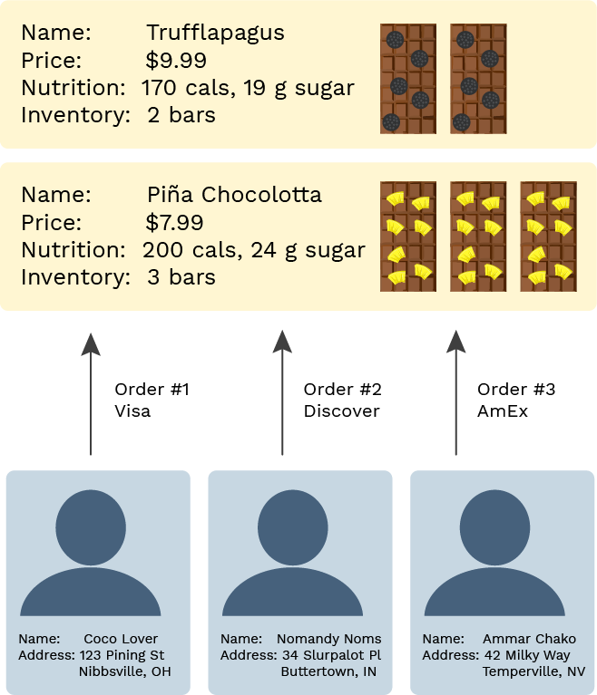
Building a chocolate shop
The shop has products that have names, prices, nutrition information, and an inventory count
There are customers who have names and addresses
And there are payments that reference the customers and products and have payment information

Slide 34
The OOP approach
We can use objects to organize our code for the shop:
An object bundles together information and related behavior.
# Inventory tracking
Product(name, price, nutrition)
Product.get_label()
Product.get_nutrition_info()
Product.increase_inventory(amount)
Product.reduce_inventory(amount)
Product.get_inventory_report()
# Customer tracking
Customer(name, address)
Customer.get_greeting()
Customer.get_formatted_address()
Customer.buy(product, quantity, cc_info)
# Purchase tracking
Order(customer, product, quantity, cc_info)
Order.ship()
Order.refund(reason)
# Shop management
ChocolateShop(name)
ChocolateShop.signup_customer(name, address)
ChocolateShop.add_product(name, price, nutrition)

Slide 35
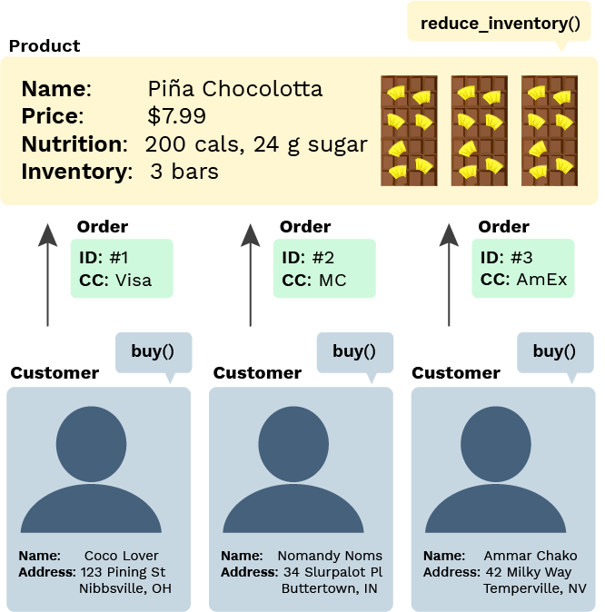
Python OOP terminology
A class is a template for defining new data types.
An instance of a class is called an object.
Each object has data attributes called instance variables that describe its state.
Each object also has function attributes called methods.
Python includes special syntax to create classes and objects.

Slide 37
Classes

Slide 38
A fully coded class and usage
# Define a new type of data
class Product:
# Set the initial values
def __init__(self, name, price, nutrition_info):
self.name = name
self.price = price
self.nutrition_info = nutrition_info
self.inventory = 0
# Define methods
def increase_inventory(self, amount):
self.inventory += amount
def reduce_inventory(self, amount):
self.inventory -= amount
def get_label(self):
return "Foxolate Shop: " + self.name
def get_inventory_report(self):
if self.inventory == 0:
return "There are no bars!"
return f"There are {self.inventory} bars."
pina_bar = Product("Piña Chocolotta", 7.99,
["200 calories", "24 g sugar"])
pina_bar.increase_inventory(2)

Slide 39
Let's break it down …

Slide 40
Class instantiation (Object construction)
pina_bar = Product("Piña Chocolotta", 7.99,
["200 calories", "24 g sugar"])
Product(args) is often called the constructor.
When the constructor is called:
  A new instance of that class is created
  The __init__() method of the class is called with the new object as its first argument (named self), along with any additional arguments provided in the call expression
class Product:
def __init__(self, name, price, nutrition_info):
self.name = name
self.price = price
self.nutrition_info = nutrition_info
self.inventory = 0

Slide 41
Instance variables
Instance variables are data attributes that describe the state of an object.
This __init__() initializes 4 instance variables:
The object's methods can then change the values of those variables or assign new variables.
class Product:
def __init__(self, name, price, nutrition_info):
self.name = name
self.price = price
self.nutrition_info = nutrition_info
self.inventory = 0

Slide 42
Method invocation
This expression…
… calls this function in the class definition:
pina_bar.increase_inventory() is a bound method: a function which has its first parameter pre-bound to a particular value.
In this case, self is pre-bound to pina_bar and amount is set to 2.
It's equivalent to:
pina_bar.increase_inventory(2)
class Product:
def increase_inventory(self, amount):
self.inventory += amount
Product.increase_inventory(pina_bar, 2)

Slide 43
Dot notation
All object attributes (which includes variables and methods) can be accessed with dot notation:
That evaluates to the value of the attribute looked up by increase_inventory() in the object referenced by pina_bar.
The left-hand side of the dot notation can also be any expression that evaluates to an object reference:
pina_bar.increase_inventory(2)
bars = [pina_bar, truffle_bar]
bars[0].increase_inventory(2)

Slide 44
All together now
The class definition:
Object instantiation and method invocation:
# Define a new type of data
class Product:
# Set the initial values
def __init__(self, name, price, nutrition_info):
self.name = name
self.price = price
self.nutrition_info = nutrition_info
self.inventory = 0
# Define methods
def increase_inventory(self, amount):
self.inventory += amount
…
pina_bar = Product("Piña Chocolotta", 7.99,
["200 calories", "24 g sugar"])
pina_bar.increase_inventory(2)

Slide 45
Exercise: Player class
"""
This class represents a player in a video game.
It tracks their name and health.
"""
class Player:
"""
>>> player = Player("Mario")
>>> player.name
'Mario'
>>> player.health
100
>>> player.damage(10)
>>> player.health
90
>>> player.boost(5)
>>> player.health
95
"""

Slide 46
Exercise: Player class (solution)
"""
This class represents a player in a video game.
It tracks their name and health.
"""
class Player:
def __init__(self, name):
self.name = name
self.health = 100
def damage(self, amount):
self.health -= amount
def boost(self, amount):
self.health += amount

Slide 47
Exercise: Clothing class
"""
Clothing is a class that represents pieces of clothing in a closet. It tracks
the color, category, and clean/dirty state.
"""
class Clothing:
"""
>>> blue_shirt = Clothing("shirt", "blue")
>>> blue_shirt.category
'shirt'
>>> blue_shirt.color
'blue'
>>> blue_shirt.is_clean
True
>>> blue_shirt.wear()
>>> blue_shirt.is_clean
False
>>> blue_shirt.clean()
>>> blue_shirt.is_clean
True
"""

Slide 48
Exercise: Clothing class (solution)
"""
Clothing is a class that represents pieces of clothing in a closet.
It tracks the color, category, and clean/dirty state.
"""
class Clothing:
def __init__(self, category, color):
self.category = category
self.color = color
self.is_clean = True
def wear(self):
self.is_clean = False
def clean(self):
self.is_clean = True

Slide 50
Dynamic Attributes

Slide 51

Classes in environment diagrams
class Product:
def __init__(self, name, price, nutrition_info):
def increase_inventory(self, amount):
def reduce_inventory(self, amount):
def get_label(self):
def get_inventory_report(self):
A class statement creates a new class and binds that class to the class name in the first frame of the current environment.
Inner def statements create attributes of the class (not names in frames).
View in PythonTutor

Slide 52
Dynamic instance variables
An object can create a new instance variable whenever it'd like.
Now pina_bar has an updated binding for inventory and a new binding for needs_restocking (which was not in __init__()).
class Product:
def reduce_inventory(self, amount):
if (self.inventory - amount) <= 0:
self.needs_restocking = True
self.inventory -= amount
pina_bar = Product("Piña Chocolotta", 7.99,
["200 calories", "24 g sugar"])
pina_bar.reduce_inventory(1)
View in PythonTutor

