Slide 1
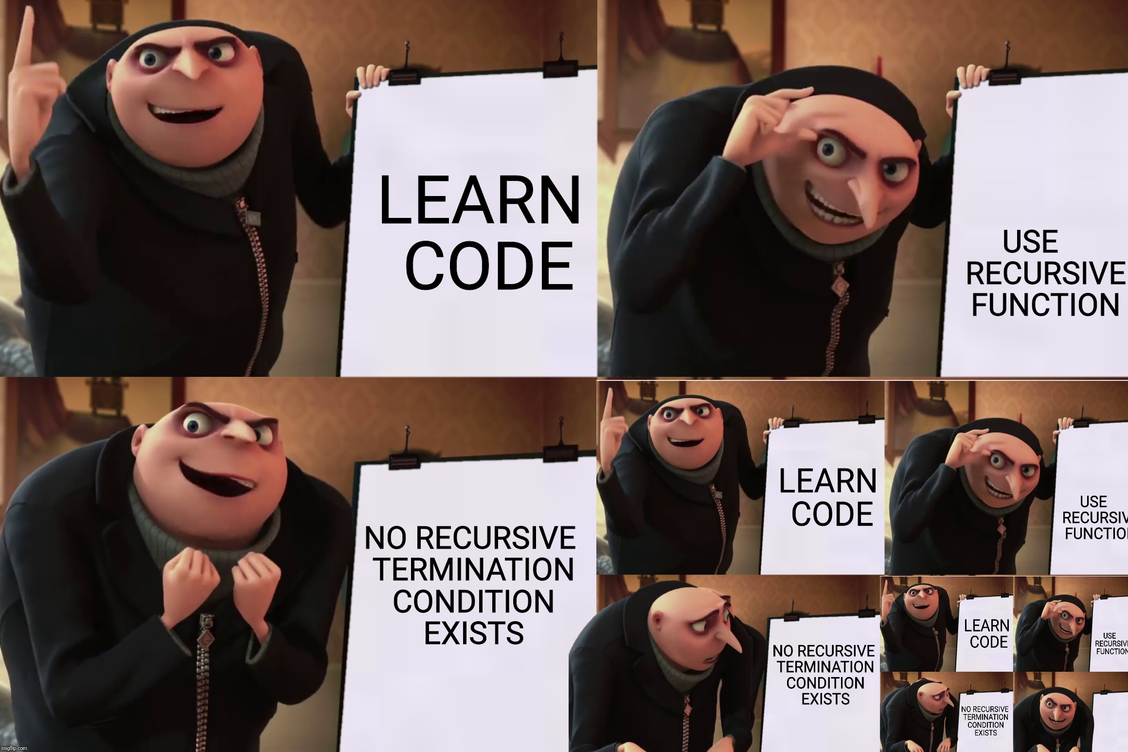

Slide 2
A reminder on AI use in this class
How to use ChatGPT (or any other AI including the duck) in your assignments so that you can still learn
First and foremost: write every line of code yourself. Do not include lines written by ChatGPT
You can always use it as a reference manual, i.e., ask for an example of the syntax of a function or for the functions contained in a library
Always try to debug your code yourself using the IDE debugger, print statements, etc.
If you still can’t find the problem, please talk to a real person – a fellow student, a TA, or me.
If you ask ChatGPT to check your code, you must say something like: “Please tell me where to look for the problem in this code, but do not give me an explanation or corrected code.”

Slide 3
Tree Recursion

Slide 4
Order of recursive calls

Slide 5
The cascade function
def cascade(n):
if n < 10:
print(n)
else:
print(n)
cascade(n//10)
print(n)
What would this display?
cascade(123)

Slide 6
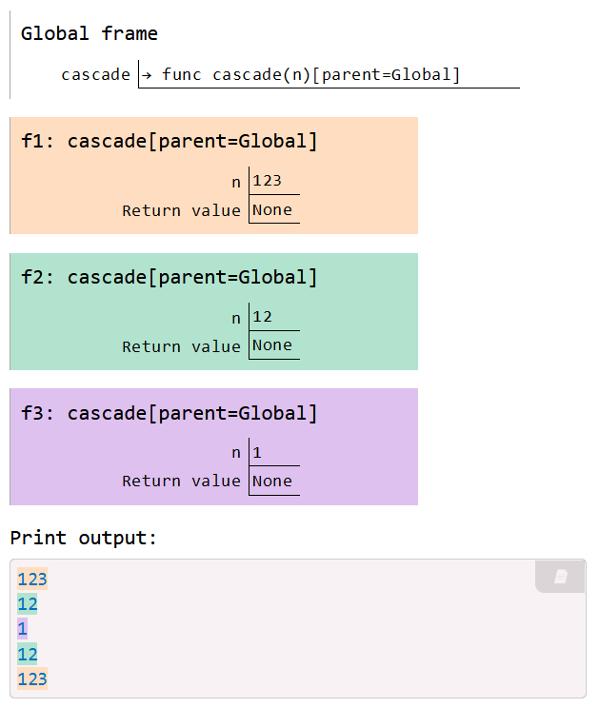

Cascade environment diagram
def cascade(n):
if n < 10:
print(n)
else:
print(n)
cascade(n//10)
print(n)
cascade(123)
Each cascade frame is from a different call to cascade.
Until the Return value appears, that call has not completed.
Any statement can appear before or after the recursive call.
View in PythonTutor

Slide 7
Two definitions of cascade
def cascade(n):
if n < 10:
print(n)
else:
print(n)
cascade(n//10)
print(n)
def cascade(n):
print(n)
if n >= 10:
cascade(n//10)
print(n)
If two implementations are equally clear, then the shorter one is usually better
When learning to write recursive functions, put the base cases first
Both are recursive functions, even though only the first has typical structure

Slide 8
Inverse cascade
How can we output this cascade instead?
1
12
123
12
1

Slide 9
Inverse cascade solution
def inverse_cascade(n):
grow(n)
print(n)
shrink(n)
def f_then_g(f, g, n):
if n:
f(n)
g(n)
View in PythonTutor
grow, print, n//10
grow = lambda n: f_then_g( )
shrink = lambda n: f_then_g( )
print, shrink, n//10

Slide 11
Tree recursion

Slide 12
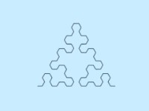
Tree Recursion
Tree-shaped processes arise whenever a recursive function makes more than one recursive call.
Sierpinski curve

Slide 13
Recursive Virahanka-Fibonacci
The nth number of the Virahanka-Fibonacci series is defined as:
$$virfib\left(n\right)=\left\{\begin{aligned}0 \\ 1 \\ virfib\left(n−2\right)+virfib(n−1)\end{aligned} \right. \begin{matrix}if n=0 \\ if n=1 \\ otherwise\end{matrix}$$
def virfib(n):
"""Compute the nth Virahanka-Fibonacci number, for N >= 1.
>>> virfib(2)
1
>>> virfib(6)
8
"""
if n == 0:
return 0
elif n == 1:
return 1
else:
return virfib(n-2) + virfib(n-1)

Slide 14
A tree-recursive process
virfib(5)
ret: 5
virfib(3)
ret: 2
virfib(4)
ret: 3
virfib(1)
ret: 1
virfib(2)
ret: 1
virfib(2)
ret: 1
virfib(3)
ret: 2
virfib(0)
ret: 0
virfib(1)
ret: 1
virfib(0)
ret: 0
virfib(1)
ret: 1
virfib(1)
ret: 1
virfib(2)
ret: 1
virfib(0)
ret: 0
virfib(1)
ret: 1

Slide 15
Redundant computations
The function is called on the same number multiple times. 🙀
virfib(5)
ret: 5
virfib(3)
ret: 2
virfib(4)
ret: 3
virfib(1)
ret: 1
virfib(2)
ret: 1
virfib(2)
ret: 1
virfib(3)
ret: 2
virfib(0)
ret: 0
virfib(1)
ret: 1
virfib(0)
ret: 0
virfib(1)
ret: 1
virfib(1)
ret: 1
virfib(2)
ret: 1
virfib(0)
ret: 0
virfib(1)
ret: 1

Slide 17
Counting partitions

Slide 18
Counting partitions problem
The number of partitions of a positive integer n, using parts up to size m, is the number of ways in which n can be expressed as the sum of positive integer parts up to m in increasing order.
2 + 4 = 6
1 + 1 + 4 = 6
3 + 3 = 6
1 + 2 + 3 = 6
1 + 1 + 1 + 3 = 6
2 + 2 + 2 = 6
1 + 1 + 2 + 2 = 6
1 + 1 + 1 + 1 + 2 = 6
1 + 1 + 1 + 1 + 1 + 1 = 6
count_partitions(6, 4)
Notes:
Used in number theory and material distribution. How many ways can we divide up the number n with a maximum of m items in a group?

Slide 19
Counting partitions approach
The number of partitions of a positive integer n, using parts up to size m, is the number of ways in which n can be expressed as the sum of positive integer parts up to m in increasing order.
count_partitions(6, 4)
Recursive decomposition: finding simpler instances of the problem.
Explore two possibilities:
Use at least one 4
Don't use any 4
Tree recursion often involves exploring different choices.

Slide 20
Counting partitions approach
The number of partitions of a positive integer n, using parts up to size m, is the number of ways in which n can be expressed as the sum of positive integer parts up to m in increasing order.
count_partitions(6, 4)
Solve two simpler problems:
count_partitions(2, 4)
count_partitions(n-m, m)
count_partitions(6, 3)
count_partitions(n, m-1)

Slide 21
Counting partitions process
count(4,2)
ret: 3
count(2,2)
ret: 2
count(4,1)
ret: 1
count(0,2)
ret: 1
count(2,1)
ret: 1
count(3,1)
ret: 1
count(4,0)
ret: 0
count(1,1)
ret: 1
count(2,0)
ret: 0
count(2,1)
ret: 1
count(3,0)
ret: 0
count(0,1)
ret: 1
count(1,0)
ret: 0
count(1,1)
ret: 1
count(2,0)
ret: 0
count(0,1)
ret: 1
count(1,0)
ret: 0
Notes:
put the code for this back in
add more examples

Slide 22
Merge Sort

Slide 23
Merge sort
As a practical example of tree recursion, we're going to look at the merge sort algorithm
You'll look at mergesort in detail and analyze its performance in relation to other sorting algorithms in CS 235. Here we are just going to look how it works, and you'll implement it in Homework 5

Slide 24
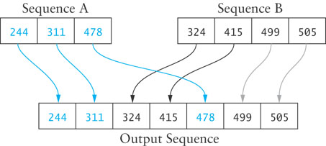
Merging
A merge is a common data processing operation performed on two sequences of data with the following characteristics:
Both sequences are ordered by the same comparison operator (that is, both sequences are sorted).
The result of the merge operation is a third sequence containing all the data from the first two sequences.

Slide 25
Merge Algorithm
Access the first item from both sequences.
While not finished with either sequence
Compare the current items from the two sequences, copy the smaller current item to the output sequence, and access the next item from the input sequence whose item was copied.
Copy any remaining items from the first sequence to the output sequence.
Copy any remaining items from the second sequence to the output sequence.

Slide 26
Recursive Merge Sort
We can modify merging to sort a single, unsorted list
Split the list into two halves
Sort the left half
Sort the right half
Merge the two

Slide 27
Recursive Merge Sort
This algorithm can be written recursively
If the list has only a single element, return
Store the first half of the list in left
Store the second half of the table in right
Recursively apply the merge sort algorithm to left
Recursively apply the merge sort algorithm to right
Call the merge function with left and right as the input sequences
Return the merged list.

Slide 28
Merge Sort
50
60
45
30
90
20
80
15
50
60
45
30
90
20
80
15
50
60
45
30
90
20
80
15

Slide 29
Merge Sort
50
60
45
30
90
20
80
15
50
60
45
30
90
20
80
15
50
60
45
30
50
60
45
30

Slide 30
Merge Sort
50
60
45
30
90
20
80
15
50
60
45
30
90
20
80
15
50
60
45
30
50
60
50
60

Slide 31
Merge Sort
50
60
45
30
90
20
80
15
50
60
45
30
90
20
80
15
50
60
45
30
50
60
60

Slide 32
Merge Sort
50
60
45
30
90
20
80
15
50
60
45
30
90
20
80
15
50
60
45
30
45
30
45
30

Slide 33
Merge Sort
50
60
45
30
90
20
80
15
50
60
45
30
90
20
80
15
50
60
45
30
30
45
45
30
45

Slide 34
Merge Sort
50
60
45
30
90
20
80
15
30
50
45
60
50
45
60
30
90
20
80
15
50
60
30
45
30
45
45
30

Slide 35
Merge Sort
50
60
45
30
90
20
80
15
30
50
45
60
50
45
60
30
90
20
80
15
90
20
80
15

Slide 36
Merge Sort
50
60
45
30
90
20
80
15
30
50
45
60
50
45
60
30
90
20
80
15
90
20
80
15
90
20

Slide 37
Merge Sort
50
60
45
30
90
20
80
15
30
50
45
60
50
45
60
30
90
20
80
15
90
20
20
90
80
15
90
20

Slide 38
Merge Sort
50
60
45
30
90
20
80
15
30
50
45
60
50
45
60
30
90
20
80
15
20
90
80
15
80
15

Slide 39
Merge Sort
50
60
45
30
90
20
80
15
30
50
45
60
50
45
60
30
90
20
80
15
20
90
80
15
80
15
80
15

Slide 40
Merge Sort
50
60
45
30
90
20
80
15
30
50
45
60
50
45
60
30
90
15
20
20
80
80
15
90
20
90
15
80

Slide 41
Merge Sort
50
15
60
20
45
30
30
45
90
50
20
60
80
80
15
90
30
50
45
60
50
45
60
30
90
15
20
20
85
80
15
90

Slide 42
Activity
Work with a partner. Show each step of merge sort on the following list:
8 5 4 6 2 3 4 7 1
8 5 4 6 | 2 3 4 7 1
8 5 | 4 6 | 2 3 | 4 7 1
8 | 5 | 4 | 6 | 2 | 3 | 4 | 7 1
8 | 5 | 4 | 6 | 2 | 3 | 4 | 7 | 1
8 | 5 | 4 | 6 | 2 | 3 | 4 | 1 7
5 8 | 4 6 | 2 3 | 1 4 7
4 5 6 8 | 1 2 3 4 7
1 2 3 4 4 5 6 7 8

Slide 43
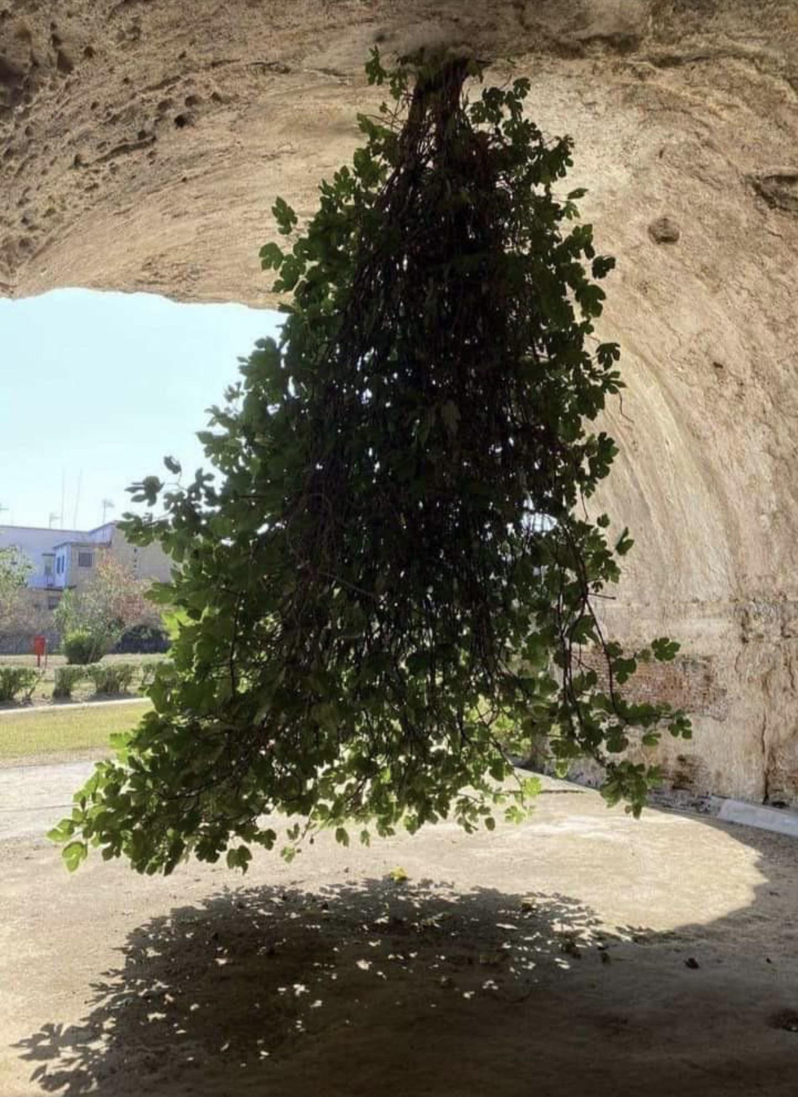
Trees

Slide 44
Trees
We've looked at tree recursion, where we broke a problem down into two or more smaller sub-problems.
We're now going to look at trees as a data structure.
They are a lot like linked lists, but instead of "rest" being a single object, it can have many objects (typically stored in a list).

Slide 45
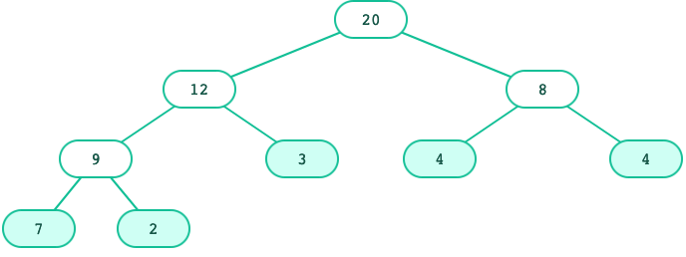
Tree Concepts
Recursive description
A tree has a root label and a list of branches
Each branch is itself a tree
A tree with zero branches is called a leaf
A tree starts at the root
Relative Description
Each location in a tree is called a node
Each node has a label that can be any value
One node can be the parent/child of another
The top node is the root node

Slide 46
Trees: Data abstraction
As a data abstraction, we can have this constructor and these selectors:
tree(label, branches) | Returns a tree with root label and list of branches
label(tree) | Returns the root label of tree
branches(tree) | Returns the branches of tree (each a tree).
is_leaf(tree) | Returns true if tree is a leaf node.
t = tree(3, [
tree(1),
tree(2, [
tree(1),
tree(1)
])])
label(t) # 3
is_leaf(branches(t)[0]) # True
3
1
2
1
1

Slide 47
Tree: One implementation
t = tree(3, [
tree(1),
tree(2, [
tree(1),
tree(1)
])])
3
1
2
1
1
Each tree is stored as a list where first element is label and subsequent elements are branches.
[3, [1], [2, [1], [1]]]
def tree(label, branches=[]):
return [label] + list(branches)
def label(tree):
return tree[0]
def branches(tree):
return tree[1:]
def is_leaf(tree):
return len(branches(tree)) == 0

Slide 49
Working with Trees

Slide 50
Tree processing
A tree is a recursive structure.
Each tree has:
A label
0 or more branches, each a tree
Recursive structure implies recursive algorithm!

Slide 51
Tree processing: Counting leaves
def count_leaves(t):
"""Returns the number of leaf nodes in t."""
if is_leaf(t):
return 1
else:
leaves_under = 0
for b in branches(t):
leaves_under += count_leaves(b)
return leaves_under
What's the base case?
What's the recursive call?

Slide 52
Tree processing: Counting leaves
The sum() function sums up the items of an iterable.
That leads to this shorter function:
sum([1, 1, 1, 1]) # 4
def count_leaves(t):
"""Returns the number of leaf nodes in t."""
if is_leaf(t):
return 1
else:
branch_counts = [count_leaves(b) for b in branches(t)]
return sum(branch_counts)

Slide 53
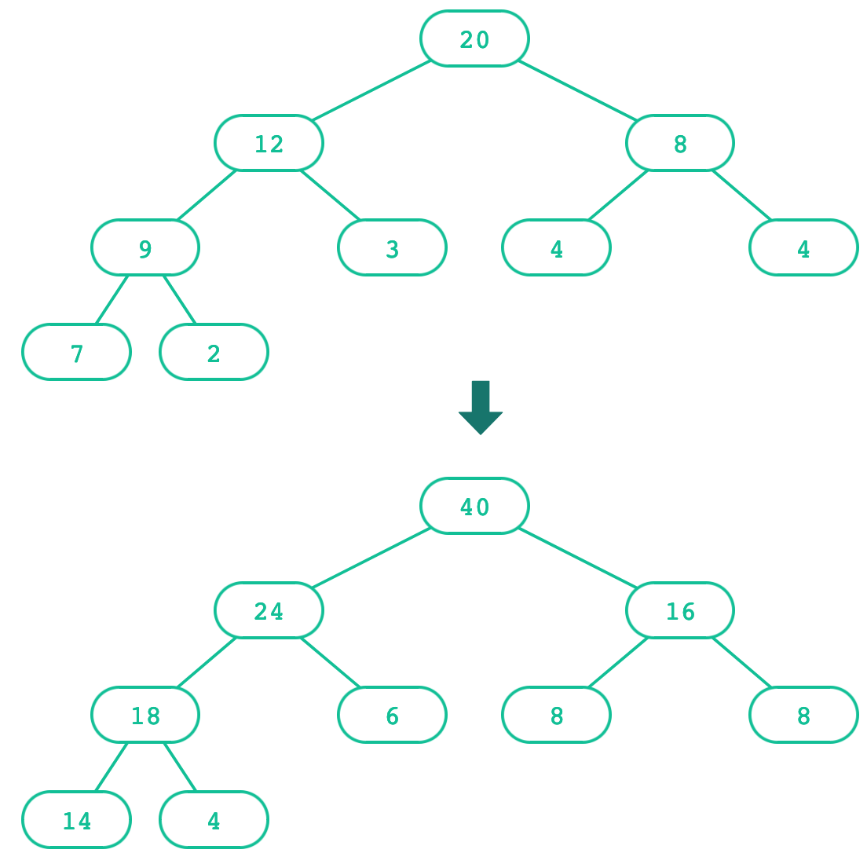
Creating trees
A function that creates a tree from another tree is also often recursive.

Slide 54
Creating trees: Doubling labels
def double(t):
"""Returns a tree identical to t, but with all labels doubled."""
if is_leaf(t):
return tree(label(t) * 2)
else:
return tree(label(t) * 2,
[double(b) for b in branches(t)])
What's the base case? What's the recursive call?

Slide 55
Creating trees: Doubling labels
A shorter solution:
Explicit base cases aren't always necessary in the final code, but it's useful to think in terms of base case vs. recursive case when learning.
def double(t):
"""Returns the number of leaf nodes in t."""
return tree(label(t) * 2,
[double(b) for b in branches(t)])

Slide 56
Exercise: Printing trees
def print_tree(t, indent=0):
"""Prints the labels of t with a depth-based
indent of 2 spaces.
>>> t = tree(3, [tree(1), tree(2, [tree(1), tree(1)])])
>>> print_tree(t)
3
1
2
1
1
"""

Slide 57
Exercise: Printing trees (solution)
def print_tree(t, indent=0):
"""Prints the labels of t with a depth-based
indent of 2 spaces.
>>> t = tree(3, [tree(1), tree(2, [tree(1), tree(1)])])
>>> print(t)
3
1
2
1
1
"""
print(indent * " " + label(t))
for b in branches(t):
print_tree(b, indent + 2)

Slide 58
Exercise: List of leaves
def leaves(t):
"""Return a list containing the leaf labels of t.
>>> t = tree(20, [tree(12, [tree(9, [tree(7), tree(2)])
,tree(3)]), tree(8, [tree(4), tree(4)])])
>>> leaves(t)
[7, 2, 3, 4, 4]
"""
Hint: If you sum a list of lists, you get a list containing the elements of those lists. The sum function takes a second argument, the starting value of the sum.
sum([ [1], [2, 3], [4] ], []) # [1, 2, 3, 4]
sum([ [1] ], []) # [1]
sum([ [[1]], [2] ], []) # [[1], 2]

Slide 59
Exercise: List of leaves (solution)
def leaves(t):
"""Return a list containing the leaf labels of t.
>>> t = tree(20, [tree(12, [tree(9, [tree(7), tree(2)])
,tree(3)]), tree(8, [tree(4), tree(4)])])
>>> leaves(t)
[7, 2, 3, 4, 4]
"""
if is_leaf(t):
return [label(t)]
else:
leaf_labels = [leaves(b) for b in branches(t)]
return sum(leaf_labels, [])

Slide 60
Exercise: Counting paths
def count_paths(t, total):
"""Return the number of paths from the root to any node in t
for which the labels along the path sum to total.
>>> t = tree(3, [tree(-1), tree(1, [tree(2, [tree(1)]), tree(3)]), tree(1, [tree(-1)])])
>>> count_paths(t, 3)
2
>>> count_paths(t, 4)
2
>>> count_paths(t, 5)
0
>>> count_paths(t, 6)
1
>>> count_paths(t, 7)
2
"""

Slide 61
Exercise: Counting paths (solution)
def count_paths(t, total):
"""Return the number of paths from the root to any node in t
for which the labels along the path sum to total.
>>> t = tree(3, [tree(-1), tree(1, [tree(2, [tree(1)]), tree(3)]), tree(1, [tree(-1)])])
>>> count_paths(t, 3)
2
>>> count_paths(t, 4)
2
>>> count_paths(t, 5)
0
>>> count_paths(t, 6)
1
>>> count_paths(t, 7)
2
"""
if label(t) == total:
found = 1
else:
found = 0
return found + sum([count_paths(b, total - label(t)) for b in branches(t)])

