Slide 1


Slide 2
Trees & Backtracking

Slide 3
Abstraction and Trees

Slide 4
Tree: Layers of abstraction
Primitive Representation | 1 2 3 "a" "b" "c" [.. , ..]
Data abstraction | tree() branches() label() is_leaf()
User program | double(t) count_leaves(t)
Each layer only uses the layer above it.

Slide 6
Trees, Trees, everywhere!

Slide 7
Directory structures
CS 111
Tree for a directory Structure
Homework
Labs
HW01
HW02
HW03
HW04
admissions.py
test_files
Admission_algorithms_dataset.csv
key_outliers.txt
…
key_chosen_students.txt

Slide 8
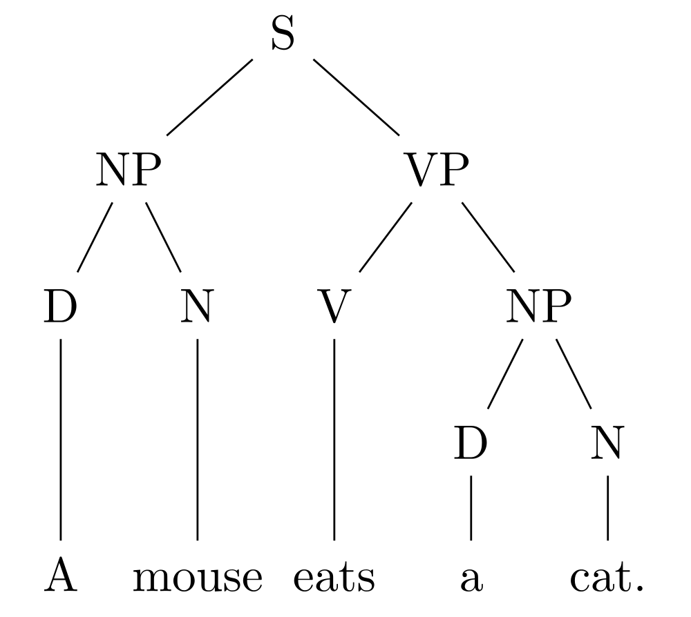
Parse trees
For natural languages …
Key:
S = Sentence
NP = Noun phrase
D = Determiner
N = Noun
V = Verb
VP = Verb Phrase

Slide 9
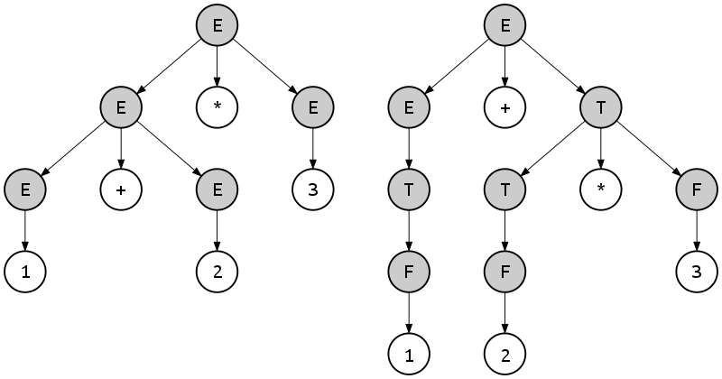
Parse trees
For programming languages, too …
Key:
E = expression
T = term
F = factor

Slide 11
A Tree Class

Slide 12
Trees: Data abstraction (review)
So far, here's what we've been using:
With an implementation like this:
tree(label, branches) | Returns a tree with root label and list of branches
label(tree) | Returns the root label of tree
branches(tree) | Returns the branches of tree (each a tree).
is_leaf(tree) | Returns true if tree is a leaf node.
def tree(label, branches=[]):
return [label] + list(branches)
def label(tree):
return tree[0]
def branches(tree):
return tree[1:]
def is_leaf(tree):
return not branches(tree)
🤔 How could we represent trees as a Python class?

Slide 13
A Tree class
class Tree:
def __init__(self, label, branches=[]):
self.label = label
self.branches = list(branches)
def is_leaf(self):
return not self.branches
🤔 What's different? What's the same?

Slide 14
tree versus Tree
tree | Tree
t = tree(label, branches=[]) branches(t) | t = Tree(label, branches=[]) t.branches
label(t) | t.label
is_leaf(t) | t.is_leaf()
def fib_tree(n):
if n == 0 or n == 1:
return tree(n)
else:
left = fib_tree(n - 2)
right = fib_tree(n - 1)
fib_n = label(left) + label(right)
return tree(fib_n, [left, right])
def fib_tree(n):
if n == 0 or n == 1:
return Tree(n)
else:
left = fib_tree(n - 2)
right = fib_tree(n - 1)
fib_n = left.label + right.label
return Tree(fib_n, [left, right])

Slide 15
A fancier Tree
class Tree:
def __init__(self, label, branches=[]):
self.label = label
for branch in branches:
assert isinstance(branch, Tree)
self.branches = list(branches)
def is_leaf(self):
return not self.branches
def __repr__(self):
if self.branches:
branch_str = ', ' + repr(self.branches)
else:
branch_str = ''
return 'Tree({0}{1})'.format(self.label, branch_str)
def __str__(self):
return '\n'.join(self.indented())
def indented(self):
lines = []
for b in self.branches:
for line in b.indented():
lines.append(' ' + line)
return [str(self.label)] + lines

Slide 17
Tree mutation

Slide 18
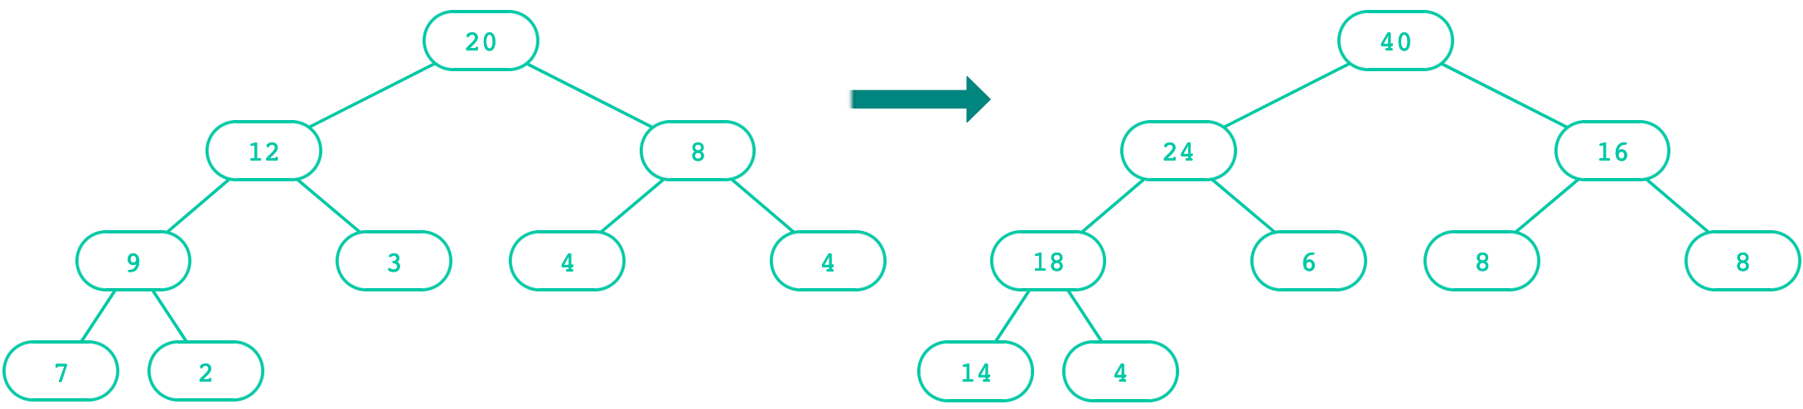
Doubling a Tree
def double(t):
"""Doubles every label in t, mutating t.
>>> t = Tree(1, [Tree(3, [Tree(5)]), Tree(7)])
>>> double(t)
>>> t
Tree(2, [Tree(6, [Tree(10)]), Tree(14)])
"""
t.label = t.label * 2
for b in t.branches:
double(b)

Slide 19
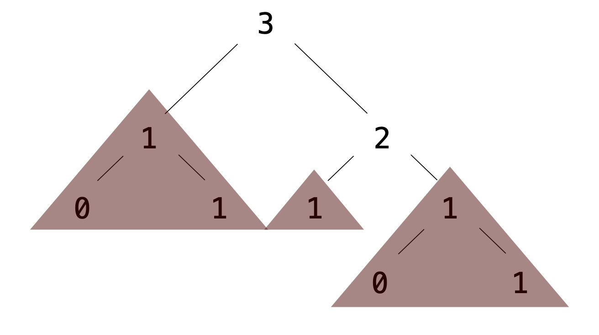
Exercise: Pruning trees
Removing subtrees from a tree is called pruning.
Always prune branches before recursive processing.
def prune(t, n):
"""Prune all sub-trees whose label is n.
>>> t = Tree(3, [Tree(1, [Tree(0), Tree(1)]), Tree(2,
[Tree(1), Tree(1, [Tree(0), Tree(1)])])])
>>> prune(t, 1)
>>> t
Tree(3, [Tree(2)])
"""
t.branches = [___ for b in t.branches if ___]
for b in t.branches:
prune(___, ___)

Slide 20
Exercise: Pruning trees (solution)
Removing subtrees from a tree is called pruning.
Always prune branches before recursive processing.
def prune(t, n):
"""Prune all sub-trees whose label is n.
>>> t = Tree(3, [Tree(1, [Tree(0), Tree(1)]), Tree(2,
[Tree(1), Tree(1, [Tree(0), Tree(1)])])])
>>> prune(t, 1)
>>> t
Tree(3, [Tree(2)])
"""
t.branches = [b for b in t.branches if b.label !=n]
for b in t.branches:
prune(b, n)

Slide 22
Recursive Objects

Slide 23
Recursive objects
Why are Tree and Link considered recursive objects?
Each type of object contains references to the same type of object.
An instance of Tree can contain additional instances of Tree, in the branches variable.
An instance of Link can contain an additional instance of Link, in the rest variable.
Both classes lend themselves to recursive algorithms. Generally:
For Tree: The base case is when is_leaf() is True; the recursive call is on the branches.
For Link: The base case is when the rest is empty; the recursive call is on the rest.

Slide 25
Backtracking

Slide 26
What is Backtracking?
A general problem-solving technique that works by exploring different solution paths and “backtracking” when a followed path fails and then going down a different one.
It is a systematic “trial and error” process – try a path to see if it works, if not try something else
We use recursion to keep track of where we are in that process.
Sometimes we want to find all solutions, other times we just want any solution.
Our counting paths example from last lecture was a simple example of backtracking. In that case, we didn’t care what the path was, just that it existed, and were counting how many unique paths there were.

Slide 27
Key Concepts
State space – all possible complete and partial solutions – we need to keep track of what we’ve learned
Recursive exploration – As we move through the algorithm, we make choices. We use recursion to process each of the different values of the choices we make
Base case – It’s recursion, we need to know when to stop. There are typically base cases for finding a solution and situations when we know the path we are on fails
Backtrack step – If we get to a failure, we “backtrack” to the last choice and go down a new path. Sometimes we need to undo what we did going forward or mark the path as taken.

Slide 28
General Algorithm Pattern
The general flow of a backtracking algorithm looks like this:
state is all the information we have on the solution at the moment – it could be a class containing the data or a number of variables
These steps are not always embodied as functions; we might just have code that tries all the possible choices.
def backtrack(state):
if solution_found(state): # our success base case
record_solution(state)
return
for choice in valid_choices(state): # our recursion
make(choice)
backtrack(state)
undo(choice)

Slide 29
Example: 4-Queens
How can you place 4 queens on a 4x4 chess board with none of the queens attacking each other
Algorithm:
Each queen must occupy a different row (why?)
Place one queen somewhere on each row and then move to the next row
To place a queen, on each row we try the following on each column
If the position is safe, place a queen
recurse to the next row
If the recursion fails (no solution), remove the queen and try the next column
Let’s walk through this on the board

Slide 30
Backtracking Strengths & Weaknesses
Strengths
Simple and often elegant solutions
Works well for constraint-based problems (e.g. not infinite choices)
Weaknesses:
Potentially exponential time complexity
If decision space is large, there are a lot of choice combinations to consider
Can be slow due to large number of choices or large problem space

Slide 31
Tips for Implementation
When implementing a backtracking solution:
Identify the decision to made
Find your base cases
Understand how to undo a choice when you need to backtrack
Start with small visual problems to test your algorithm
Work through the recursion by hand for a few steps to verify it all works. (Then you can take the leap of faith for the big problem).

Slide 32
Write a backtracker to solve a Sudoku board
Can you develop the algorithm to solve a sudoku board?
Things to think about
What decision do you have to make?
How do you use recursion to represent the choices?
How do you maintain state across calls?
How do you determine a good or bad choice?
How do you determine success?
How do you undo a bad choice?
Work with a neighbor to get started.

