Slide 1
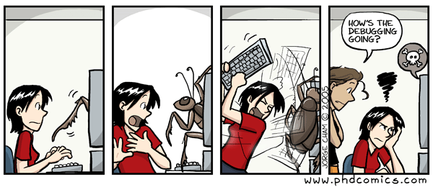

Slide 2
Testing, Dictionaries, Tuples, & Exceptions

Slide 3
pytest

Slide 4
The pytest library
To use pytest, you first need to install the pytest library as it is not part of the standard Python installation
However, you've already installed it as it was installed when you installed the byu_pytest_utils library.
Full documentation on the pytest library can be found at https://docs.pytest.org
pytest provides a more versatile and powerful set of tools than are available from doctests
python –m pip install pytest

Slide 5
Running pytests
If you've run the tests we've provided for the assignments, you've seen the basic way to invoke pytest that runs all tests in the directory:
You can additionally just have pytest run a single test file by giving the name of the file you want it to run
You can also have it run just a single test within the file by giving it the name of the test function after the filename separated by "::"
For other ways to invoke pytest, see the documentation at https://docs.pytest.org/en/7.4.x/how-to/usage.html
pytest
or
python –m pytest
pytest <filename>
pytest <filename>::<testname>

Slide 6
What does pytest actually run?
When you invoke pytest without a filename, it looks in the current directory for any files that match either of the following patterns
  test_<name>.py
  <name>_test.py
If you invoke it with a filename, it just runs the file specified.
Within that file, it looks for functions of the form test_<name>() and runs each of those functions in turn.
  These functions should take no arguments

Slide 7
Pytest output - success
If all the tests pass, you'll see something like this
========================== test session starts ==========================
platform win32 -- Python 3.9.13, pytest-7.4.0, pluggy-1.2.0
rootdir: C:\Users\dagor\PycharmProjects\demo
plugins: byu-pytest-utils-0.7.2
collected 2 item
test_demo.py .. [100%]
=========================== 2 passed in 0.25s ===========================
All the tests ran
green means no failures
How long it took

Slide 8
Pytest output - failure
When test fails, there is a bit more output:
========================= test session starts ==========================
platform win32 -- Python 3.9.13, pytest-7.4.0, pluggy-1.2.0
rootdir: C:\Users\dagor\PycharmProjects\demo
plugins: byu-pytest-utils-0.7.2
collected 2 items
test_demo.py .F [100%]
=============================== FAILURES ===============================
______________________________ test_error ______________________________
def test_error():
> assert func(3) == 5
E assert 4 == 5
E + where 4 = func(3)
test_demo.py:9: AssertionError
======================= short test summary info ========================
FAILED test_demo.py::test_error - assert 4 == 5
===================== 1 failed, 1 passed in 0.18s ======================
One entry per test:
. = succuss
F = failure
All the tests ran
red means failures
Test that failed
Actual line that failed
Values that failed

Slide 9
Writing tests - naming
Typically, our tests will go in a separate file and import the functions or classes we want to test
Inside that file, we write our test functions
  Function names are of the form test_<name>() and take no parameters
  <name> should be something descriptive that makes clear what is being tested
    test_square_returns_valid_value()
    test_sqrt_throws_exception_for_negative()

Slide 10
Writing tests - content
What goes inside our test functions?
  Anything we want
The most common statement is an assertion
  We call the function we are testing with known input values
  We then assert that all we received all the expected outputs
assert <Boolean expression>
def test_square_valid():
assert square(3) == 9

Slide 11
A more complicated example
def test_grid_constructions():
grid = Grid(2,2)
assert grid.height == 2
assert grid.width == 2
for x in range(grid.width):
for y in range(grid.height):
assert grid.get(x,y) == None
With multiple asserts, all must pass for the test to pass
The test will stop on the first failure.

Slide 12
Checking floating point numbers
What happens if we run the following in the Python interpreter?
Surprisingly, we get False
This is due to the imprecision of floating-point number representation in computers
  You may have already seen this a few times this semester, noticeably on Homework 1
To make comparisons like this safely, we must do something like this:
where val1 (0.1+0.2 from above) and val2 (0.3 from above) are the values we ant to compare and tolerance is some small value like 1e-6
0.1 + 0.2 == 0.3
abs(val1 – val2) < tolerance

Slide 13
Checking floating point numbers
But that's a pain to write
pytest gives us an approx() method that allows us to write this more cleanly:
This would return True.
If you want to change the tolerance, for example when working with large or small numbers, there are additional parameters to approx() that you can set.
The full documentation is here: https://docs.pytest.org/en/7.4.x/reference/reference.html#pytest-approx
val1 == approx(val2)
i.e.
0.1 + 0.2 == approx(0.3)

Slide 15
Tuples

Slide 16
Tuples
A tuple is an immutable sequence. It's like a list, but no mutation allowed!
An empty tuple:
A tuple with multiple elements:
A tuple with a single element: 🙀
empty = ()
# or
empty = tuple()
conditions = ('rain', 'shine')
# or
conditions = 'rain', 'shine'
oogly = (61,)
# or
oogly = 61,

Slide 17
Creating a tuple from another sequence
Just like the list() function creates a list from an iterable sequence (like a list or string), the tuple() functions creates a tuple from an iterable sequence
digit_list = [0,1,2,3,4,5,6,7,8,9]
digit_tuple = tuple(digit_list)
# (0,1,2,3,4,5,6,7,8,9)

Slide 18
Tuple operations
Many of a list's read-only operations work on tuples.
Combining tuples into a new tuple:
Checking containment:
Accessing elements:
Slicing:
# ('come', '☂', 'or', '☼')
('come', '☂') + ('or', '☼')
'wally' in ('wall-e', 'wallace', 'waldo')
# False
conditions = ('rain', 'shine')
conditions[1]
# 'shine'
digits = (0,1,2,3,4,5,6,7,8,9)
numbers = digits[3:8]
# (3,4,5,6,7)

Slide 20
Dictionaries

Slide 21
Dictionaries
A dict is a mapping of key-value pairs
states = {
"CA": "California",
"DE": "Delaware",
"NY": "New York",
"TX": "Texas",
"WY": "Wyoming"
}
>>> len(states)
5
>>> "CA" in states
True
>>> “Texas" in states
False
Notes:
The dictionary slides need to move to an earlier lecture

Slide 22
Dictionary selection
words = {
"más": "more",
"otro": "other",
"agua": "water"
}
Select a value:
>>> words["otro"]
'other'
>>> first_word = "agua"
>>> words[first_word]
'water'
>>> words["pavo"]
KeyError: pavo
>>> words.get("pavo", "🤔")
'🤔'

Slide 23
Dictionary rules
A key cannot be a list or dictionary (or any mutable type)
All keys in a dictionary are distinct (there can only be one value per key)
The values can be any type, however!
spiders = {
"smeringopus": {
"name": "Pale Daddy Long-leg",
"length": 7
},
"holocnemus pluchei": {
"name": "Marbled cellar spider",
"length": (5, 7)
}
}

Slide 24
Dictionary iteration
insects = {"spiders": 8, "centipedes": 100, "bees": 6}
for name in insects:
print(insects[name])
What will be the order of items?
Keys are iterated over in the order they are first added.
8 100 6

Slide 25
Dictionary comprehensions
General syntax
  Notice the curly braces {} instead of brackets []
  There are two items before the for keyword: the key and the value separated by a colon
Example
{key: value for <name> in <iter exp>}
{x: x*x for x in range(3,6)}
# {3: 9, 4: 16, 5: 25}

Slide 27
Exceptions
Notes:
Maybe this should go up with errors?

Slide 28
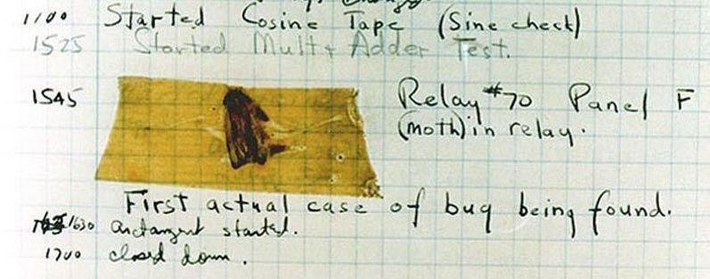
Handling errors
Sometimes, computer programs behave in non-standard ways.
  A function receives an argument value of an improper type
  Some resource (such as a file) is not available
  A network connection is lost in the middle of data transmission
  Moth found in a Mark II Computer (Grace Hopper's Notebook, 1947)

Slide 29
To Err is Human
What to do with an error:
  Return a special value.
  Use a Boolean return value to indicate success or failure.
  Set a global variable.
  Put an input or output stream in a fail state.
  Print an error message.
  Print an error message and exit the program.
The first four options allow the user of a function to respond to the error

Slide 30
Exceptions
An exception is a built-in mechanism in a programming language to declare and respond to "exceptional" conditions.
A program raises an exception when an error occurs.
If the exception is not handled, the program will stop running entirely.
But if a programmer can anticipate when exceptions might happen, they can include code for handling the exception, so that the program continues running.
Many languages include exception handling: C++, Java, Python, JavaScript, C#, etc.

Slide 31
Handling Exceptions
If exceptions are not caught and handled, they will cause the program to crash.
If we catch an exception, we can decide what to do about it
  Record it - log it to a file, print it out, send an e-mail, page someone, etc.
  Rethrow it so another part of the program can address it as well
  Retry the operation that caused the failure
  Ignore it and not pass it on (not a good idea) – called swallowing the exception

Slide 32
Exceptions
Python raises an exception whenever a runtime error occurs.
How an unhandled exception is reported:
If an exception is not handled, the program stops executing immediately.
>>> 10/0
Traceback (most recent call last):
File "<stdin>", line 1, in
ZeroDivisionError: division by zero

Slide 33
Types of exceptions
A few exception types and examples of buggy code:
See full list in the exceptions docs.
Exception | Example
OverflowError | pow(2.12, 1000)
TypeError | 'hello'[1] = 'j'
IndexError | 'hello'[7]
NameError | x += 5
FileNotFoundError | open('dsfdfd.txt')

Slide 35
The try Statement

Slide 36
The try statement
To handle an exception (keep the program running), use a try statement.
The <try suite> is executed first. If, during the course of executing the <try suite>, an exception is raised that is not handled otherwise, and If the class of the exception inherits from <exception class>, then the <except suite> is executed, with <name> bound to the exception.
Note that when an exception is raised, the try suite ends immediately and none of the later code is executed.
try:
<try suite>
except <exception class> as <name>:
<except suite>
...

Slide 37
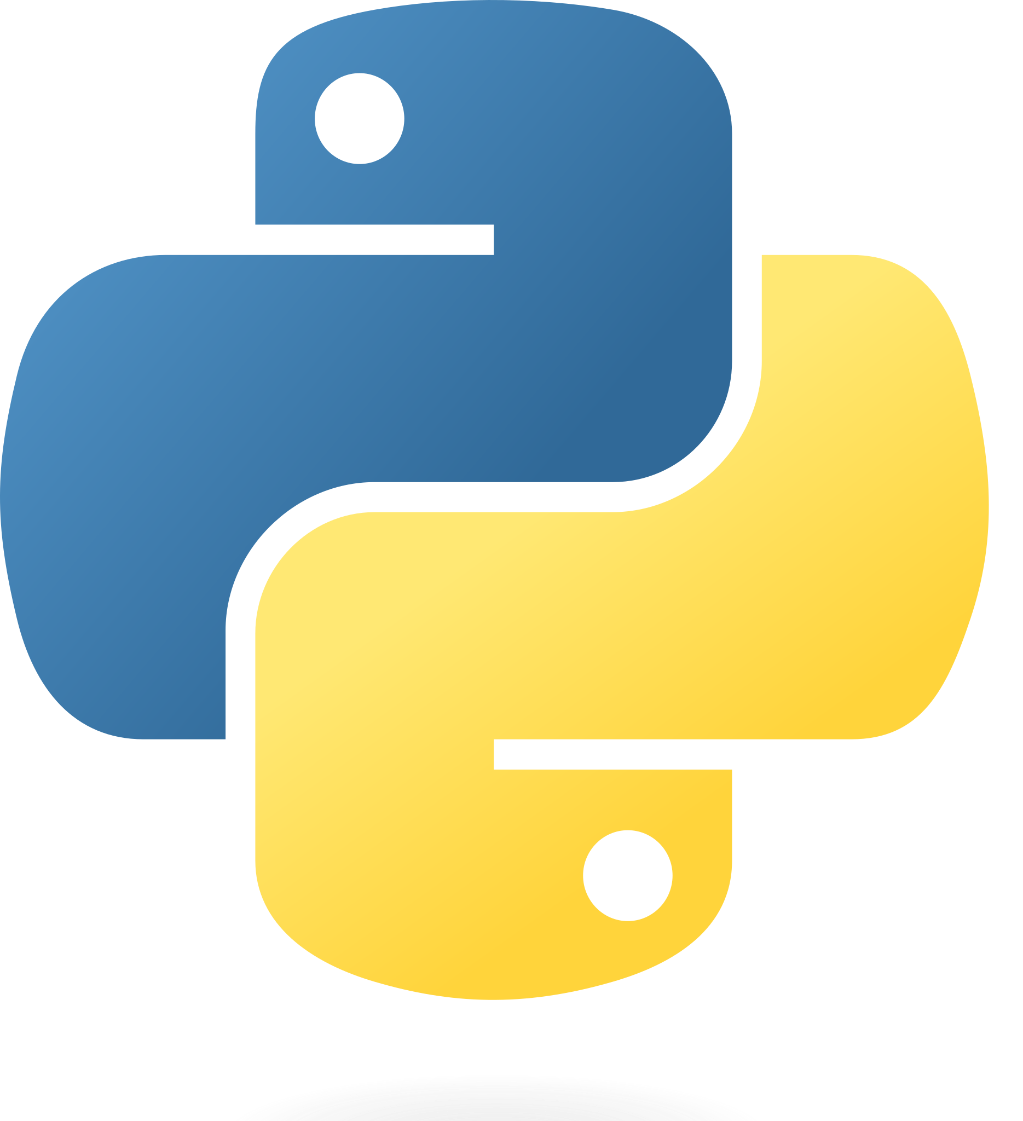
Try statement example
try:
quot = 10/0
except ZeroDivisionError as e:
print('handling a', type(e))
quot = 0
View in PythonTutor

Slide 38
Try inside a function
def div_numbers(dividend, divisor):
try:
quotient = dividend/divisor
except ZeroDivisionError:
print("Function was called with 0 as divisor")
quotient = 0
return quotient
div_numbers(10, 2)
div_numbers(10, 0)
div_numbers(10, -1)
View in PythonTutor

Slide 39
What would Python do?
def invert(x):
inverse = 1/x # Raises a ZeroDivisionError if x is 0
print('Never printed if x is 0')
return inverse
def invert_safe(x):
try:
return invert(x)
except ZeroDivisionError as e:
print('Handled', e)
return 0
invert_safe(1/0)
try:
invert_safe(0)
except ZeroDivisionError as e:
print('Handled!')
inverrrrt_safe(1/0)

Slide 41
Raising exceptions

Slide 42
Assert statements
Assert statements raise an exception of type AssertionError:
  where <expression> should evaluate to True and if it doesn't, <string> is the message passed with the AssertionError
Assertions are designed to be used liberally. They can be ignored to increase efficiency by running Python with the "-O" flag; "O" stands for optimized.
Put assertions in your code wherever your code is checking input or conditions that you as the programmer have control over. If an assertion is raised, it means you have a bug that you can fix.
If you don't have control over the input, raise an exception.
assert <expression>, <string>
python3 -O

Slide 43
Raise Statements
Any type of exception can be raised with a raise statement
<expression> must evaluate to a subclass of BaseException or an instance of one
Exceptions are constructed like any other object. e.g.,
raise <expression>
TypeError('Bad argument!')

Slide 44
Pytest Note: Testing for exceptions
While assertion is the most common thing we do in the tests, pytest provides a number of other checks we can make
A common one is to see if an exception is raised where it is expected
This uses the raises() function from pytest
def square_root(x):
if x < 0:
raise ValueError("Negative numbers not allowed")
return sqrt(x)
def test_square_root_raises_exception():
with pytest.raises(ValueError):
square_root(-4)

Slide 45
When we should not use exceptions
When an error event happens routinely and could be considered part of normal execution, handle without throwing exceptions.
  Generate error codes or return values
  Use if() statements to check and handle errors

Slide 46
When we should use exceptions
When we don't have control of the input or processing state, we should use exceptions to report errors
Use try-except blocks
  Around code that can potentially (and unexpectedly) generate an exception.
  Prevent and recover from application crashes.
  Raise an exception when your program can identify an external problem that prevents execution.

Slide 47
Advantages of using exceptions
Compared to error reporting via return-codes and if statements, using try / except / raise is likely to result in code
  that is easier to read,
  that has fewer bugs,
  is less expensive to develop,
  and has faster time-to-market (time-to-submission for students ☺).
Notes:
Add in an example of easier to read i.e. code with lots of if statements vs try/except

Slide 48
Code with and without excpetions
def sqrt(x):
if x < 0:
return None
# code to compute square root
def sqrt(x):
if x < 0:
raise ValueArgument ("Negative numbers not allowed.")
# code to compute square root
with open(filename,”w”) as inFile:
for n in inFile:
root = sqrt(float(n))
if root:
print(f”The square root of {n} is {root}”)
else:
print(f”Cannot take the square root of {n}”)
with open(filename,”w”) as inFile:
for n in inFile:
try:
print(f”The square root of {n} is {sqrt(float(n))}”)
except ValueArgument as e:
print(f”Cannot take the square root of {n}”, e)

Slide 49
Input validation
Input validation is a form of defensive programming.
Whenever a function or method receives input from a user, it is a good practice to validate that the input provided is in the function's domain.
If the arguments are provided by the user, we should raise exceptions or return error codes.
If the arguments are provided by the developer, we should use assertions.
def sqrt(x):
if x < 0:
raise ValueArgument ("Negative numbers not allowed.")
# code to compute square root

