Slide 1


Slide 2
Command Line Arguments, Object Oriented Programming, & Classes

Slide 3
Abstraction by Specification

Slide 4
Abstraction by specification
A specification for the built-in round function:
A well-designed function specification (function signature + docstring) serves as a contract between the implementer and the user.
✂️ Removed detail: the implementation!
round(number[, ndigits]): Return number rounded to n digits precision after the decimal point. If n digits is omitted or is None, it returns the nearest integer to its input.
See full documentation.

Slide 5
Using an abstraction
Based on this specification..
This should work!
square(n): Returns the square of the number n.
def sum_squares(x, y):
"""
>>> sum_squares(3, 9)
90
"""
return square(x) + square(y)

Slide 6
Implementing the abstraction
Many possible implementations can be used:
It could even be built-in to Python, in theory!
def square(x):
return pow(x, 2)
def square(x):
return x ** 2
from operator import mul
def square(x):
return mul(x, x)

Slide 7
Not all implementations are equal
An implementation may have practical consequences:
Affecting the size of the program
Affecting the speed of the program's execution
Not the ideal implementation:
But you can cross that bridge when you come to it.
from operator import mul
def square(x):
return mul(x, 2)

Slide 9
Command-line Arguments

Slide 10
Abstraction by parameterization at the program level
Just like we will often add parameters to a function so that we can call it with different values and not have to edit code, we can do the same with our entire scripts
This allows the user of our program to give it parameters for execution without having to edit the code.
Values to use for certain program parameters
Command for which part of the program to run
Input and output file names
…
When we give parameters to a program at run time these are call command-line arguments

Slide 11
Command-line arguments
To pass command-line arguments when we run a Python script, we simply add the arguments after the name of the script
This runs myScript.py and passes the values "add", "2", and "3.2" to the script.
They are delimited by whitespace
If you want to pass in a string that contains whitespace, you need to enclose it in quotations marks (")
python myScript.py add 2 3.2
python myScript.py "This is a single argument"

Slide 12
Accessing command-line arguments
Access to the command-line arguments passed to a script is provided by the sys (system) library.
sys.argv (argument values) is a Python list containing all of the command-line arguments passed to the program.
If we called our script like this:
sys.argv would contain:
sys.argv[0] is always the name of the script that was run
import sys
args = sys.argv
python myScript.py add 2 3.2
['myScript.py', 'add', '2', '3.2']

Slide 13
Using command-line arguments
The individual elements of sys.argv are just values and we can use them in any way we normally would
However, all elements of sys.argv are read in as strings
If we know they should be numbers, we need to convert them using the int() and float() functions
Note: if you try to call int() on a string representing a floating-point number, you will get an error
sys.argv = ['myScript.py', 'add', '2', '3.2']
command = sys.argv[1] # 'add'
have_good_args = validate_arguments(sys.argv[1:])
integer_value = int(sys.argv[2]) # convert '2' to 2
float_value = float(sys.argv[3]) # convert '3.2' to 3.2

Slide 15
Object-Oriented Programming

Slide 16
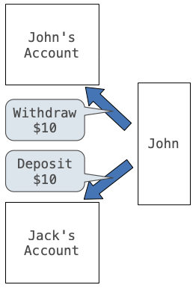
Object-oriented programming
OOP is a method for organizing programs which includes:
Data abstraction
Bundling together information and related behavior
A metaphor for computation using distributed state:
Each object has its own local state
Each object also knows how to manage its own local state, based on method calls
Method calls are messages passed between objects
Several objects may all be instances of a common type
Different types may relate to each other

Slide 17
Abstraction/Information Hiding
One of the great benefits of using objects is the ability to abstract away details and hide unnecessary information from the user of the object.
Think about the steering wheel in a car – all you as the user needs to know is that turning it makes the car turn. You don’t need to know the details of how it interacts with the axle and wheels of the car
Information hiding also allows us to make improvements in code without impacting how the object is used.

Slide 18
Encapsulation
Another benefit of classes is the idea of encapsulation.
The class encapsulates the data that it contains
This "hides" the data from the user – doesn't allow direct access
The class defines the ways the user can access and interact with the data so that the data's integrity is always maintained.

Slide 20
An OOP Shop

Slide 21
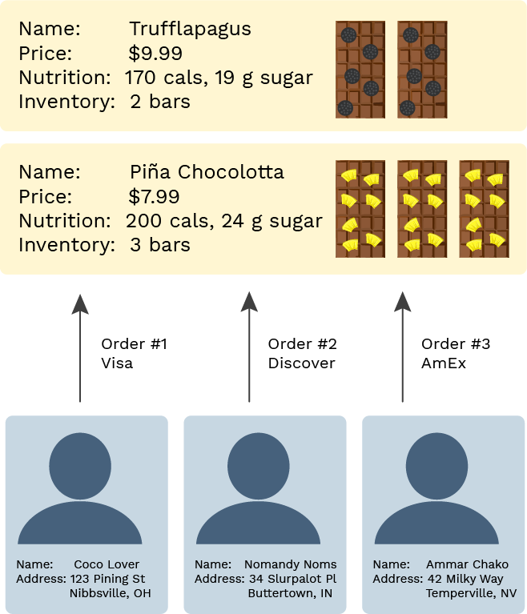
Building a chocolate shop
The shop has products that have names, prices, nutrition information, and an inventory count
There are customers who have names and addresses
And there are payments that reference the customers and products and have payment information

Slide 22
The OOP approach
We can use objects to organize our code for the shop:
An object bundles together information and related behavior.
# Inventory tracking
Product(name, price, nutrition)
Product.get_label()
Product.get_nutrition_info()
Product.increase_inventory(amount)
Product.reduce_inventory(amount)
Product.get_inventory_report()
# Customer tracking
Customer(name, address)
Customer.get_greeting()
Customer.get_formatted_address()
Customer.buy(product, quantity, cc_info)
# Purchase tracking
Order(customer, product, quantity, cc_info)
Order.ship()
Order.refund(reason)
# Shop management
ChocolateShop(name)
ChocolateShop.signup_customer(name, address)
ChocolateShop.add_product(name, price, nutrition)

Slide 23
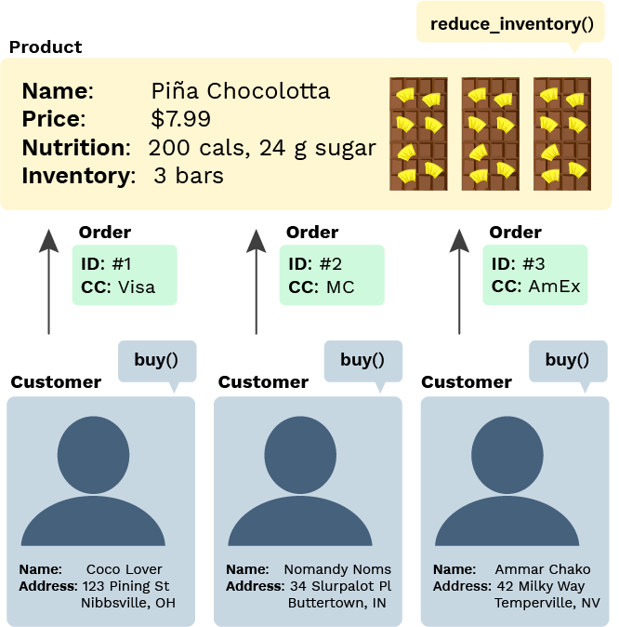
Python OOP terminology
A class is a template for defining new data types.
An instance of a class is called an object.
Each object has data attributes called instance variables that describe its state.
Each object also has function attributes called methods.
Python includes special syntax to create classes and objects.

Slide 25
Classes

Slide 26
A fully coded class and usage
# Define a new type of data
class Product:
# Set the initial values
def __init__(self, name, price, nutrition_info):
self.name = name
self.price = price
self.nutrition_info = nutrition_info
self.inventory = 0
# Define methods
def increase_inventory(self, amount):
self.inventory += amount
def reduce_inventory(self, amount):
self.inventory -= amount
def get_label(self):
return "Foxolate Shop: " + self.name
def get_inventory_report(self):
if self.inventory == 0:
return "There are no bars!"
return f"There are {self.inventory} bars."
pina_bar = Product("Piña Chocolotta", 7.99,
["200 calories", "24 g sugar"])
pina_bar.increase_inventory(2)

Slide 27
Let's break it down …

Slide 28
Class instantiation (Object construction)
pina_bar = Product("Piña Chocolotta", 7.99,
["200 calories", "24 g sugar"])
Product(args) is often called the constructor.
When the constructor is called:
A new instance of that class is created
The __init__() method of the class is called with the new object as its first argument (named self), along with any additional arguments provided in the call expression
class Product:
def __init__(self, name, price, nutrition_info):
self.name = name
self.price = price
self.nutrition_info = nutrition_info
self.inventory = 0

Slide 29
Instance variables
Instance variables are data attributes that describe the state of an object.
This __init__() initializes 4 instance variables:
The object's methods can then change the values of those variables or assign new variables.
class Product:
def __init__(self, name, price, nutrition_info):
self.name = name
self.price = price
self.nutrition_info = nutrition_info
self.inventory = 0

Slide 30
Method invocation
This expression…
… calls this function in the class definition:
pina_bar.increase_inventory() is a bound method: a function which has its first parameter pre-bound to a particular value.
In this case, self is pre-bound to pina_bar and amount is set to 2.
It's equivalent to:
pina_bar.increase_inventory(2)
class Product:
def increase_inventory(self, amount):
self.inventory += amount
Product.increase_inventory(pina_bar, 2)

Slide 31
Dot notation
All object attributes (which includes variables and methods) can be accessed with dot notation:
That evaluates to the value of the attribute looked up by increase_inventory() in the object referenced by pina_bar.
The left-hand side of the dot notation can also be any expression that evaluates to an object reference:
pina_bar.increase_inventory(2)
bars = [pina_bar, truffle_bar]
bars[0].increase_inventory(2)

Slide 32
All together now
The class definition:
Object instantiation and method invocation:
# Define a new type of data
class Product:
# Set the initial values
def __init__(self, name, price, nutrition_info):
self.name = name
self.price = price
self.nutrition_info = nutrition_info
self.inventory = 0
# Define methods
def increase_inventory(self, amount):
self.inventory += amount
…
pina_bar = Product("Piña Chocolotta", 7.99,
["200 calories", "24 g sugar"])
pina_bar.increase_inventory(2)

Slide 33
Exercise: Player class
"""
This class represents a player in a video game.
It tracks their name and health.
"""
class Player:
"""
>>> player = Player("Mario")
>>> player.name
'Mario'
>>> player.health
100
>>> player.damage(10)
>>> player.health
90
>>> player.boost(5)
>>> player.health
95
"""

Slide 34
Exercise: Player class (solution)
"""
This class represents a player in a video game.
It tracks their name and health.
"""
class Player:
def __init__(self, name):
self.name = name
self.health = 100
def damage(self, amount):
self.health -= amount
def boost(self, amount):
self.health += amount

Slide 35
Exercise: Clothing class
"""
Clothing is a class that represents pieces of clothing in a closet. It tracks
the color, category, and clean/dirty state.
"""
class Clothing:
"""
>>> blue_shirt = Clothing("shirt", "blue")
>>> blue_shirt.category
'shirt'
>>> blue_shirt.color
'blue'
>>> blue_shirt.is_clean
True
>>> blue_shirt.wear()
>>> blue_shirt.is_clean
False
>>> blue_shirt.clean()
>>> blue_shirt.is_clean
True
"""

Slide 36
Exercise: Clothing class (solution)
"""
Clothing is a class that represents pieces of clothing in a closet.
It tracks the color, category, and clean/dirty state.
"""
class Clothing:
def __init__(self, category, color):
self.category = category
self.color = color
self.is_clean = True
def wear(self):
self.is_clean = False
def clean(self):
self.is_clean = True

Slide 38
Dynamic Attributes

Slide 39

Classes in environment diagrams
class Product:
def __init__(self, name, price, nutrition_info):
def increase_inventory(self, amount):
def reduce_inventory(self, amount):
def get_label(self):
def get_inventory_report(self):
A class statement creates a new class and binds that class to the class name in the first frame of the current environment.
Inner def statements create attributes of the class (not names in frames).
View in PythonTutor

Slide 40
Dynamic instance variables
An object can create a new instance variable whenever it'd like.
Now pina_bar has an updated binding for inventory and a new binding for needs_restocking (which was not in __init__()).
class Product:
def reduce_inventory(self, amount):
if (self.inventory - amount) <= 0:
self.needs_restocking = True
self.inventory -= amount
pina_bar = Product("Piña Chocolotta", 7.99,
["200 calories", "24 g sugar"])
pina_bar.reduce_inventory(1)
View in PythonTutor

