Slide 1
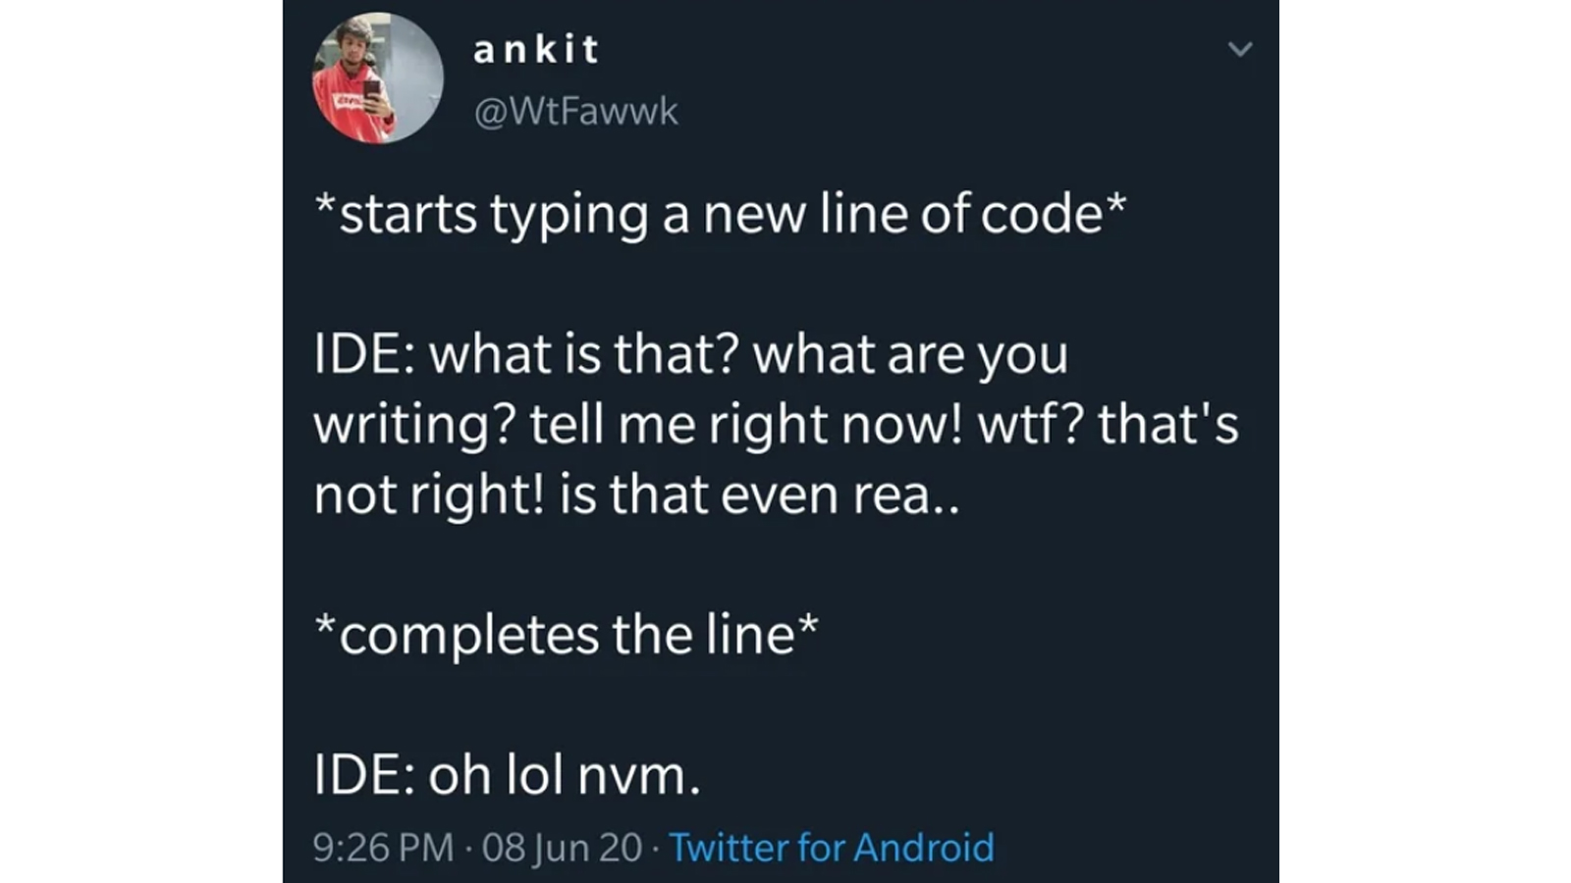

Slide 2
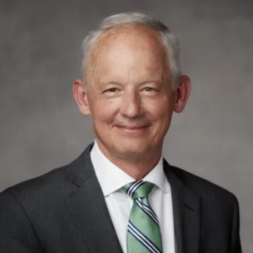
These Foolish Things
Elder Michael A. Dunn
BYU Devotional – 03/04/25
Do we dismiss the intent because of the way it is presented?
Can we seek the possibilities in all things?
It is the Atonement of Christ that makes the implausible possible.

Slide 3
Recursion

Slide 4
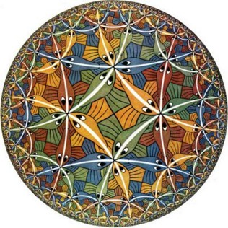
Recursive functions
A function is recursive if the body of that function calls itself, either directly or indirectly.
Recursive functions often operate on increasingly smaller instances of a problem.
Circle Limit, by M.C. Escher

Slide 5
Summing Digits
What if we wanted to find out the sum of the digits in a number?
i.e. the sum of the digits in the number 2023?
2 + 0 + 2 + 3 = 7
How would we go about doing that using recursion?

Slide 6
The problems within the problem
The sum of the digits of 6 is simply 6.
Generally: the sum of any one-digit, non-negative number is that number.
The sum of the digits of 2023 is:
Generally: the sum of a number is the sum of the first digits (number // 10), plus the last digit (number % 10).
2 0 2 3
Sum of these digits + This digit

Slide 7
Summing digits without a loop
def sum_digits(n):
"""Return the sum of the digits of positive integer n.
>>> sum_digits(6)
6
>>> sum_digits(2023)
7
"""
if n < 10:
return n
else:
all_but_last = n // 10
last = n % 10
return sum_digits(all_but_last) + last

Slide 8
Anatomy of a recursive function
Base case: Evaluated without a recursive call (the smallest subproblem).
Recursive case: Evaluated with a recursive call (breaking down the problem further)
Conditional statement to decide if it's a base case
def sum_digits(n):
if n < 10:
return n
else:
all_but_last = n // 10
last = n % 10
return sum_digits(all_but_last) + last
Recursive Case
Base Case

Slide 10
Visualizing recursion

Slide 11
Recursive factorial
The factorial of a number is defined as:
$$n!= \left\{\begin{aligned}1 \\ n∙\left(n−1\right)!\end{aligned}\right. {if n=0 \atop otherwise}$$
def fact(n):
"""
>>> fact(0)
1
>>> fact(4)
24
"""
if n == 0:
return 1
else:
return n * fact(n-1)

Slide 12
Recursive call visualization
6
def fact(n):
if n == 0:
return 1
else:
return n * fact(n-1)
fact(3)
fact(3)
2
fact(2)
1
fact(1)
1
fact(0)

Slide 13
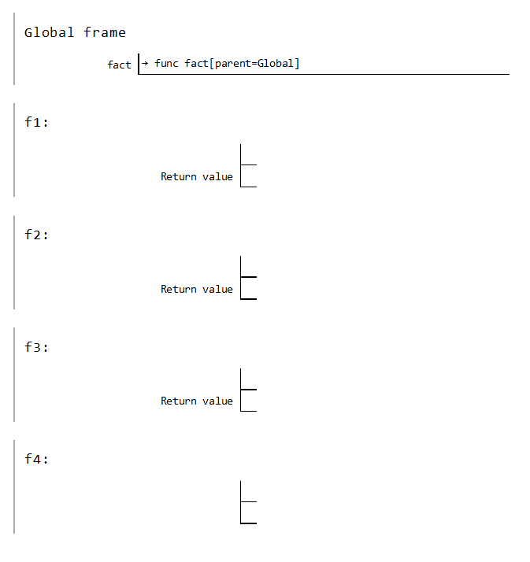
Recursion in environment diagrams
def fact(n):
if n == 0:
return 1
else:
return n * fact(n-1)
fact(3)
fact[parent=Global]
3
6
fact[parent=Global]
2
2
The same function fact is called multiple times
Different frames keep track of the different arguments in each call
n depends on the current environment
Each call to fact solves a simpler problem than the last: smaller n
fact[parent=Global]
1
1
fact[parent=Global]
0
1

Slide 15
Verifying recursive functions

Slide 16

Falling Dominos
If a million dominoes are equally spaced out and we tip the first one, will they all fall?
  Verify that one domino will fall, if tipped
  Assume that any given domino falling over will tip the next one over
  Verify that tipping the first domino tips over the next one

Slide 17
The recursive leap of faith
def fact(n):
"""Returns the factorial of N."""
if n == 0:
return 1
else:
return n * fact(n-1)
Is fact implemented correctly?
  Verify the base case
  Treat fact as a functional abstraction!
  Assume that fact(n-1) is correct (← the leap!)
  Verify that fact(n) is correct

Slide 18
The recursive elf's promise
Imagine we're trying to compute 5!
🤔 We ask ourselves, "If I somehow knew how to compute 4!, could I compute 5!?"
💡 Yep, 5! = 5 * 4!
🧝🏽‍♀️ The fact() function promises, "hey friend, tell you what, while you're working hard on 5!, I'll compute 4! for you, and you can finish it off!"
Credit: FuschiaKnight, r/compsci

Slide 20
Mutual Recursion

Slide 21
The Luhn algorithm
Used to verify that a credit card number is valid.
From the rightmost digit, which is the check digit, moving left, double the value of every second digit; if the product of this doubling operation is greater than 9 (e.g., 7 * 2 = 14), then sum the digits of that product (e.g., 14: 1 + 4 = 5)
Take the sum of all the digits
The Luhn sum of a valid credit card number is a multiple of 10
Original | 1 | 3 | 8 | 7 | 4 | 3
Processed
2
3
1+6=7
7
8
3
=30

Slide 22
Calculating the Luhn sum
Let's start with…
def sum_digits(n):
if n < 10:
return n
else:
last = n % 10
all_but_last = n // 10
return last + sum_digits(all_but_last)
def luhn_sum(n):
"""Returns the Luhn sum for the positive number N.
>>> luhn_sum(2)
2
>>> luhn_sum(32)
8
>>> luhn_sum(5105105105105100)
20
"""

Slide 23
Luhn sum with mutual recursion
def luhn_sum(n):
if n < 10:
return n
else:
last = n % 10
all_but_last = n // 10
return last + luhn_sum_double(all_but_last)
def luhn_sum_double(n):
last = n % 10
all_but_last = n // 10
luhn_digit = sum_digits(last * 2)
if n < 10:
return luhn_digit
else:
return luhn_digit + luhn_sum(all_but_last)

Slide 25
Recursion and Iteration

Slide 26
Recursion vs. iteration
 | Using recursion: | Using iteration:
Math: | $$n!= \left\{\begin{aligned}1 \\ n∙\left(n−1\right)!\end{aligned}\right. {if n=0 \atop otherwise}$$ | $$n!=\prod_{k=1}^{n}{k}$$
Names: | fact, n | fact, n, total, k
def fact(n):
if n == 0:
return 1
else:
return n * fact(n-1)
def fact(n):
total = 1
while n > 0:
total *= n
n -= 1
return total

Slide 27
Converting recursion to iteration
Can be tricky: Iteration is a special case of recursion.
Figure out what state must be maintained by the iterative function.
def sum_digits(n):
if n < 10:
return n
else:
all_but_last = n // 10
last = n % 10
return sum_digits(all_but_last) + last
def sum_digits(n):
digit_sum = 0
while n > 0:
last = n % 10
n = n // 10
digit_sum += last
return digit_sum

Slide 28
Converting iteration to recursion
More formulaic: Iteration is a special case of recursion.
The state of an iteration can be passed as arguments.
def sum_digits(n):
digit_sum = 0
while n > 0:
last = n % 10
n = n // 10
digit_sum += last
return digit_sum
def sum_digits(n, digit_sum):
if n == 0:
return digit_sum
else:
last = n % 10
all_but_last = n // 10
return sum_digits(all_but_last, digit_sum + last)

Slide 29
Recursion Exercises

Slide 30
Recursively sum a list
Let's code this up recursively:
Docstrings typically would not specify whether an approach was recursive or iterative, since that is an implementation detail.
However, we'll make it clear in assignments and exam questions.
def sum_nums(nums):
"""Returns the sum of the numbers in nums.
>>> sum_nums([6, 24, 1984])
2014
>>> sum_nums([-32, 0, 32])
0
"""

Slide 31
Recursively sum a list (solution)
def sum_nums(nums):
"""Returns the sum of the numbers in nums.
>>> sum_nums([6, 24, 1984])
2014
>>> sum_nums([-32, 0, 32])
0
"""
if nums == []:
return 0
else:
return nums[0] + sum_nums( nums[1:] )
When recursively processing lists, the base case is often the empty list and the recursive case is often all-but-the-first items.

Slide 32
Iteratively sum a range
Let's code this up iteratively:
def sum_up_to(n):
"""Returns the sum of positive numbers from 1
up to n (inclusive).
>>> sum_up_to(5)
15
"""

Slide 33
Iteratively sum a range (solution)
Using the range type:
Remember that range(start, end) always ends right before end.
def sum_up_to(n):
"""Returns the sum of positive numbers from 1
up to n (inclusive).
>>> sum_up_to(5)
15
"""
sum = 0
for i in range(1, n+1):
sum += i
return sum

Slide 34
Recursively sum a range
Now try it recursively:
def sum_up_to(n):
"""Returns the sum of positive numbers from 1
up to n (inclusive).
>>> sum_up_to(5)
15
"""

Slide 35
Recursively sum a range (solution)
Now try it recursively:
def sum_up_to(n):
"""Returns the sum of positive numbers from 1
up to n (inclusive).
>>> sum_up_to(5)
15
"""
if n == 1:
return 1
else:
return n + sum_up_to(n-1)

