Slide 1
CS 111: Introduction to Computer Science
Dr. Tom Stephens

Slide 2
Who is Dr. Stephens Anyway?
Education
  BS Physics 1996 – BYU
  MS Astronomy 1999 – NMSU
  Ph.D. Astronomy 2003 – NMSU
  MS Library and Information Science – 2016 – UNT
Work
  Assistant Professor – BYU – Dec 2020 – present
  Software Developer & Manager – NASA – 2003-15, 2017-20, now part-time
  Physical and Mathematical Sciences Librarian – 2014-17

Slide 3
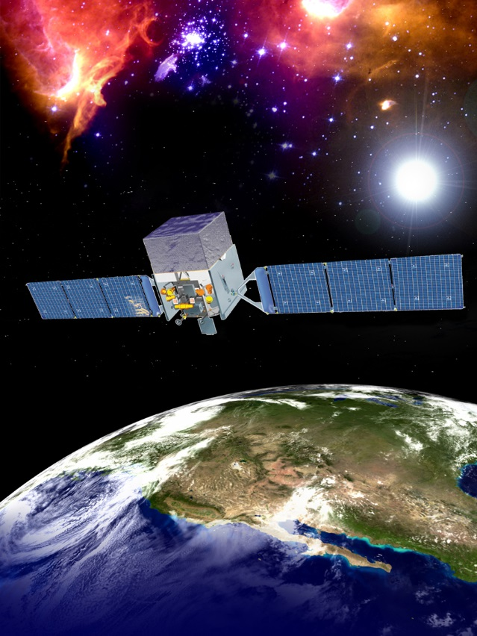
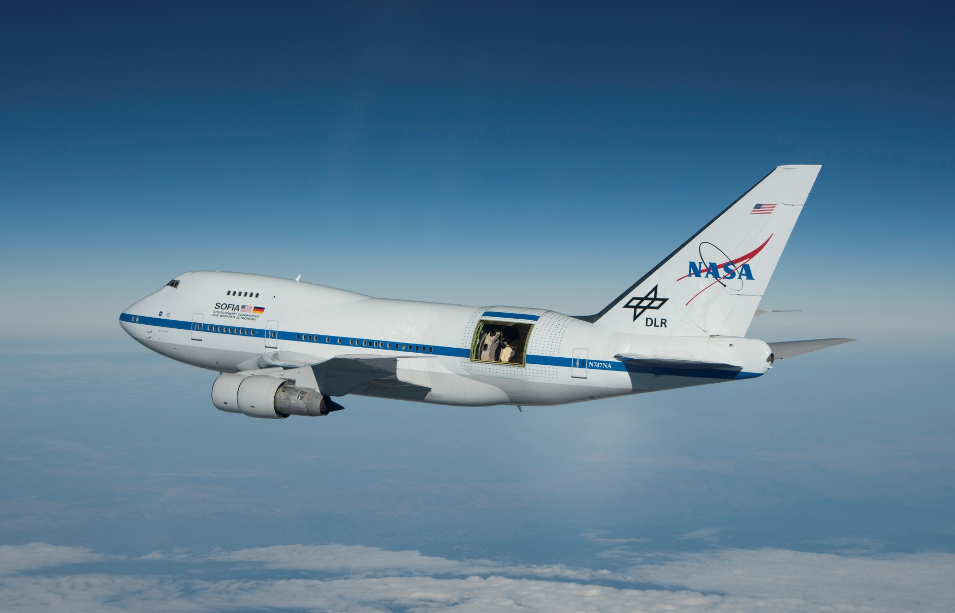
Who is Dr. Stephens Anyway?

Slide 4
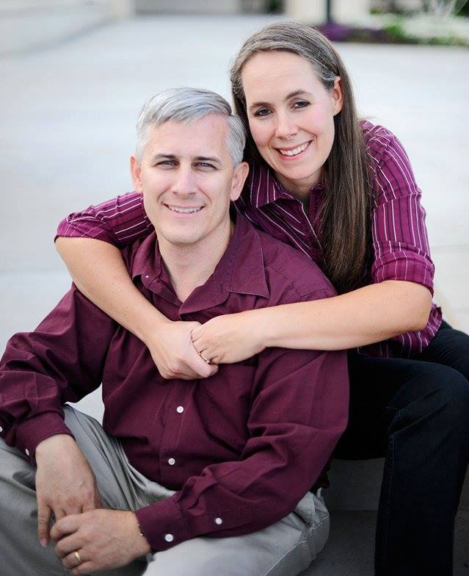
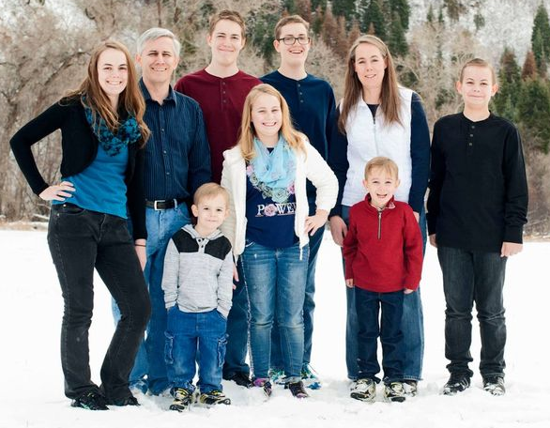
Who is Dr. Stephens Anyway?
Father of 7
Current Calling: Deacons Quorum Specialist
Hobbies
  Hiking/Camping
  Reading & Writing (1 self-published sci-fi novel)
  Role-Playing Games – published a quarterly game magazine & more general blog
  3D Modeling and Printing
  Playing Minecraft (and Roblox with my younger boys)

Slide 5
Contacting Dr. Stephens
Office – 2256 TMCB – feel free to drop in anytime I’m there.
E-mail – tstephen@cs.byu.edu – This is the best way to reach me.
Office Hours – https://calendly.com/byu-cs-tstephen/office-hours
Stalk me on-line
  I'm on the class Discord
  @dagorym on most online sites
  Tom Stephens on Facebook

Slide 6
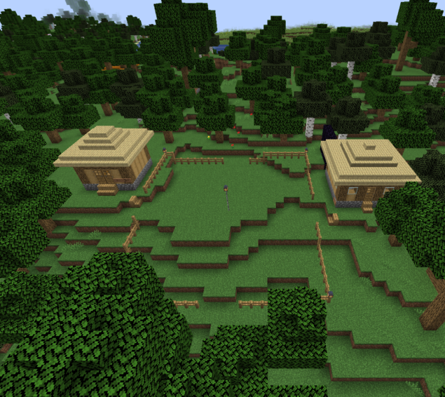
My Minecraft Server
For those Minecraft players in the class, I have a server set up you’re welcome to join.
Details can be found at:
https://expandingfrontier.com/cs-minecraft-server/

Slide 7

BYU Minecraft Club
I'm also the Faculty Advisor for the BYU Minecraft Club
Club Discord: https://discord.gg/cx2PuAmR23
The club runs multiple servers including
  The main survival world
  An anarchy server
  The Campus Creation world where they are recreating BYU Campus
There is also a coding group that works on mods and resource packs for the server.

Slide 8
Questions?

