Slide 1
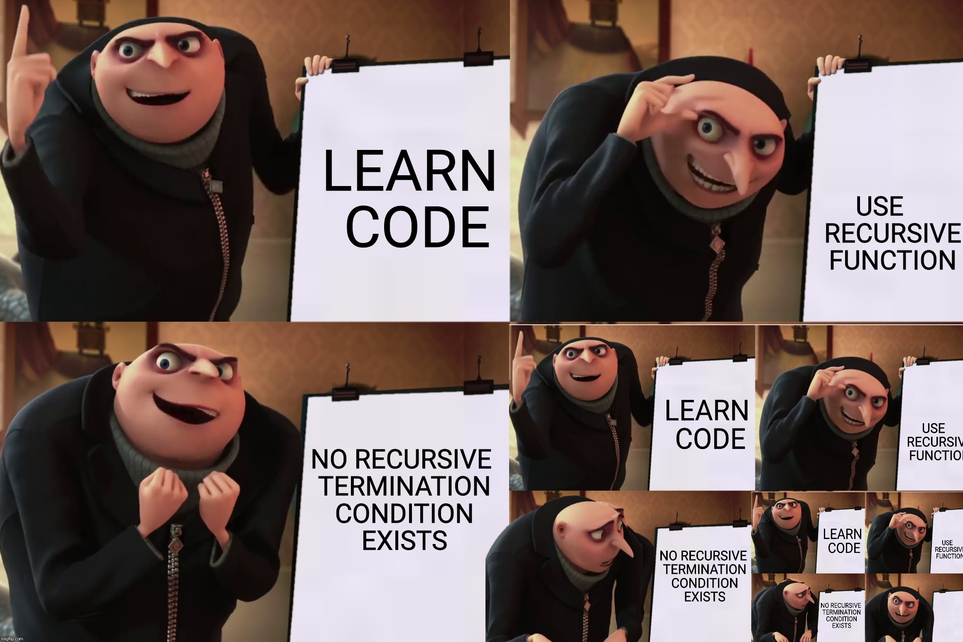

Slide 2
Tree Recursion

Slide 3
Order of recursive calls

Slide 4
The cascade function
def cascade(n):
if n < 10:
print(n)
else:
print(n)
cascade(n//10)
print(n)
What would this display?
cascade(123)

Slide 5
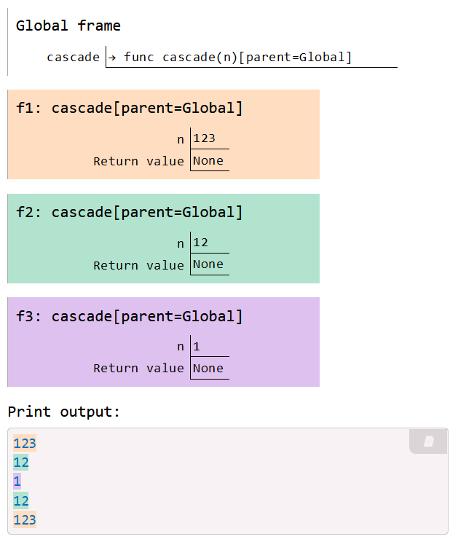

Cascade environment diagram
def cascade(n):
if n < 10:
print(n)
else:
print(n)
cascade(n//10)
print(n)
cascade(123)
Each cascade frame is from a different call to cascade.
Until the Return value appears, that call has not completed.
Any statement can appear before or after the recursive call.
View in PythonTutor

Slide 6
Two definitions of cascade
def cascade(n):
if n < 10:
print(n)
else:
print(n)
cascade(n//10)
print(n)
def cascade(n):
print(n)
if n >= 10:
cascade(n//10)
print(n)
If two implementations are equally clear, then the shorter one is usually better
When learning to write recursive functions, put the base cases first
Both are recursive functions, even though only the first has typical structure

Slide 7
Inverse cascade
How can we output this cascade instead?
1
12
123
12
1

Slide 8
Inverse cascade solution
def inverse_cascade(n):
grow(n)
print(n)
shrink(n)
def f_then_g(f, g, n):
if n:
f(n)
g(n)
View in PythonTutor
grow, print, n//10
grow = lambda n: f_then_g( )
shrink = lambda n: f_then_g( )
print, shrink, n//10

Slide 10
Tree recursion

Slide 11

Tree Recursion
Tree-shaped processes arise whenever a recursive function makes more than one recursive call.
Sierpinski curve

Slide 12

Recursive Virahanka-Fibonacci
The nth number of the Virahanka-Fibonacci series is defined as:
$$virfib\left(n\right)=\left\{\begin{aligned}0 \\ 1 \\ virfib\left(n−2\right)+virfib(n−1)\end{aligned} \right. \begin{matrix}if n=0 \\ if n=1 \\ otherwise\end{matrix}$$
def virfib(n):
"""Compute the nth Virahanka-Fibonacci number, for N >= 1.
>>> virfib(2)
1
>>> virfib(6)
8
"""
if n == 0:
return 0
elif n == 1:
return 1
else:
return virfib(n-2) + virfib(n-1)

Slide 13
A tree-recursive process
virfib(5)
ret: 5
virfib(3)
ret: 2
virfib(4)
ret: 3
virfib(1)
ret: 1
virfib(2)
ret: 1
virfib(2)
ret: 1
virfib(3)
ret: 2
virfib(0)
ret: 0
virfib(1)
ret: 1
virfib(0)
ret: 0
virfib(1)
ret: 1
virfib(1)
ret: 1
virfib(2)
ret: 1
virfib(0)
ret: 0
virfib(1)
ret: 1

Slide 14
Redundant computations
The function is called on the same number multiple times. 🙀
virfib(5)
ret: 5
virfib(3)
ret: 2
virfib(4)
ret: 3
virfib(1)
ret: 1
virfib(2)
ret: 1
virfib(2)
ret: 1
virfib(3)
ret: 2
virfib(0)
ret: 0
virfib(1)
ret: 1
virfib(0)
ret: 0
virfib(1)
ret: 1
virfib(1)
ret: 1
virfib(2)
ret: 1
virfib(0)
ret: 0
virfib(1)
ret: 1

Slide 16
Counting partitions

Slide 17
Counting partitions problem
The number of partitions of a positive integer n, using parts up to size m, is the number of ways in which n can be expressed as the sum of positive integer parts up to m in increasing order.
  2 + 4 = 6
  1 + 1 + 4 = 6
  3 + 3 = 6
  1 + 2 + 3 = 6
  1 + 1 + 1 + 3 = 6
  2 + 2 + 2 = 6
  1 + 1 + 2 + 2 = 6
  1 + 1 + 1 + 1 + 2 = 6
  1 + 1 + 1 + 1 + 1 + 1 = 6
count_partitions(6, 4)
Notes:
Used in number theory and material distribution. How many ways can we divide up the number n with a maximum of m items in a group?

Slide 18
Counting partitions approach
The number of partitions of a positive integer n, using parts up to size m, is the number of ways in which n can be expressed as the sum of positive integer parts up to m in increasing order.
count_partitions(6, 4)
Recursive decomposition: finding simpler instances of the problem.
Explore two possibilities:
  Use at least one 4
  Don't use any 4
Tree recursion often involves exploring different choices.

Slide 19
Counting partitions approach
The number of partitions of a positive integer n, using parts up to size m, is the number of ways in which n can be expressed as the sum of positive integer parts up to m in increasing order.
count_partitions(6, 4)
Solve two simpler problems:
count_partitions(2, 4)
count_partitions(n-m, m)
count_partitions(6, 3)
count_partitions(n, m-1)

Slide 20
Counting partitions process
count(4,2)
ret: 3
count(2,2)
ret: 2
count(4,1)
ret: 1
count(0,2)
ret: 1
count(2,1)
ret: 1
count(3,1)
ret: 1
count(4,0)
ret: 0
count(1,1)
ret: 1
count(2,0)
ret: 0
count(2,1)
ret: 1
count(3,0)
ret: 0
count(0,1)
ret: 1
count(1,0)
ret: 0
count(1,1)
ret: 1
count(2,0)
ret: 0
count(0,1)
ret: 1
count(1,0)
ret: 0
Notes:
put the code for this back in
add more examples

