Slide 1
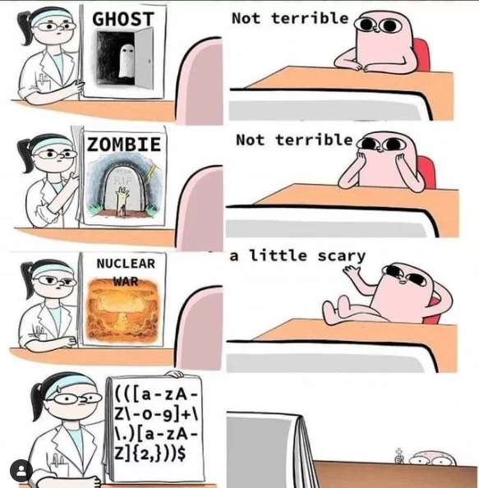

Slide 2
Efficiency

Slide 3
Exponentiation

Slide 4
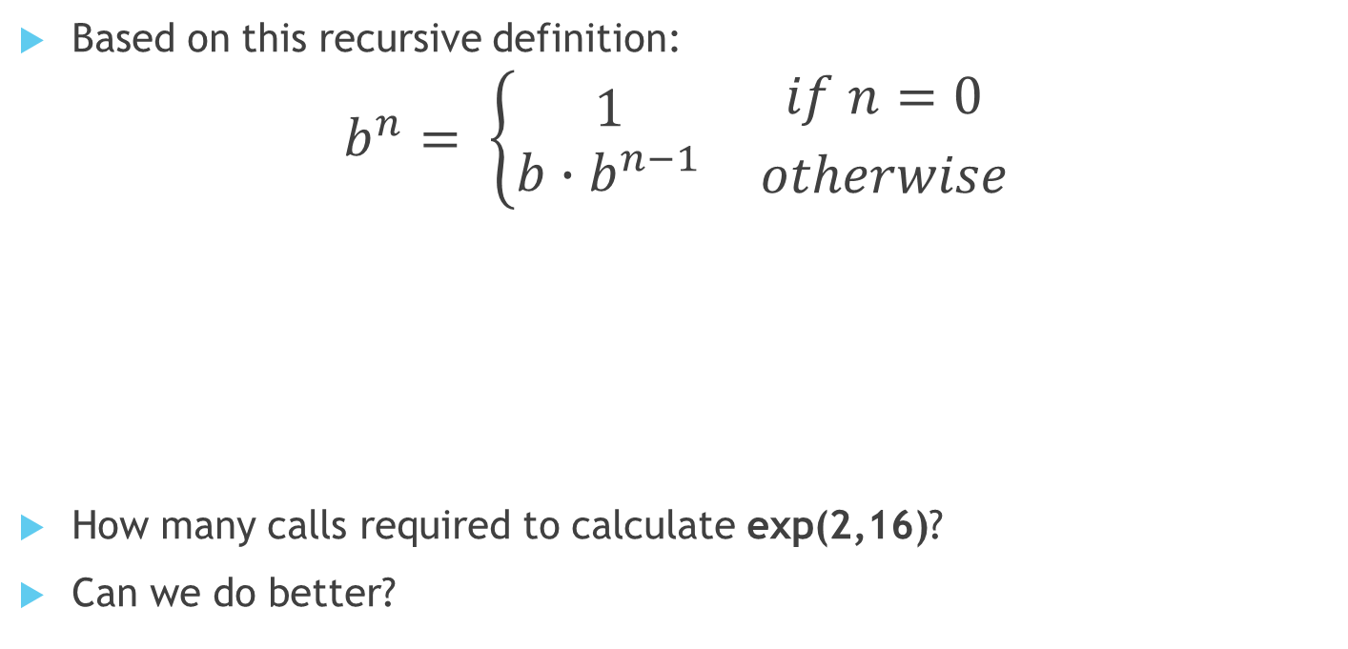
Exponentiation approach #1
Based on this recursive definition:
$$b^{n}= \left\{\begin{aligned}1 \\ b∙b^{n−1}\end{aligned}\right. {if n=0 \atop otherwise}$$
How many calls required to calculate exp(2,16)?
Can we do better?
def exp(b, n):
if n == 0:
return 1
else:
return b * exp(b, n-1)

Slide 5

Exponentiation approach #2
Based on this recursive definition:
$$b^{n}=\left\{\begin{aligned}1 \\ {(b^{\frac{1}{2}n})}^{2} \\ b∙b^{(n−1)}\end{aligned} \begin{matrix}if n=0 \\ if n is even \\ if n is odd\end{matrix}\right.$$
How many calls required to calculate exp(2,16)?
Some algorithms are more efficient than others!
square = lambda x: x * x
def exp_fast(b, n):
if n == 0:
return 1
elif n % 2 == 0:
return square(exp_fast(b, n//2))
else:
return b * exp_fast(b, n-1)

Slide 7
Orders of Growth

Slide 8
Common orders of growth
One way to describe the efficiency of an algorithm according to its order of growth, the effect of increasing the size of input on the number of steps required.
Order of growth | Description
Exponential growth | Number of steps increases faster than a polynomial function of the input size.
Quadratic growth | Number of steps increases in proportion to the square of the input size.
Linear growth | Number of steps increases in direct proportion to the input size.
Logarithmic growth | Number of steps increases proportionally to the logarithm of the input size.
Constant growth | Always takes same number of steps, regardless of input size.

Slide 9
Adding to the front of linked list
def insert_front(linked_list, new_val):
"""Inserts NEW_VAL in front of LINKED_LIST,returning new linked list.
>>> ll = Link(1, Link(3, Link(5)))
>>> insert_front(ll, 0)
Link(0, Link(1, Link(3, Link(5))))
"""
return Link(new_val, linked_list)
How many operations will this require for increasing lengths of the list?
List Size | Operations
1
10
100
1000
1
1
1
1

Slide 10
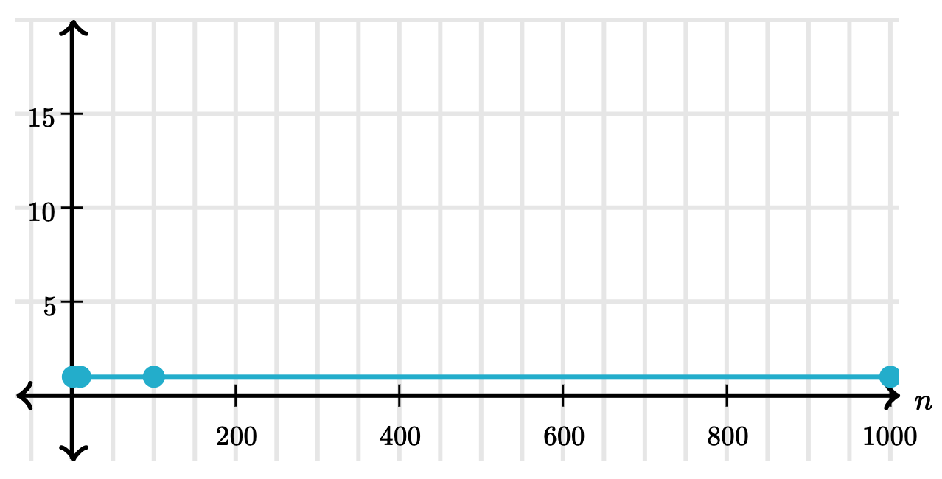
Constant Time
An algorithm that takes constant time, always makes a fixed number of operations regardless of the input size.
List Size | Operations
1 | 1
10 | 1
100 | 1
1000 | 1

Slide 11
Fast Exponentiation
square = lambda x: x * x
def exp_fast(b, n):
if n == 0:
return 1
elif n % 2 == 0:
return square(exp_fast(b, n//2))
else:
return b * exp_fast(b, n-1)
How many operations will this require for increasing values of n?
N | Operations
0
8
16
1024
1
5
6
12

Slide 12
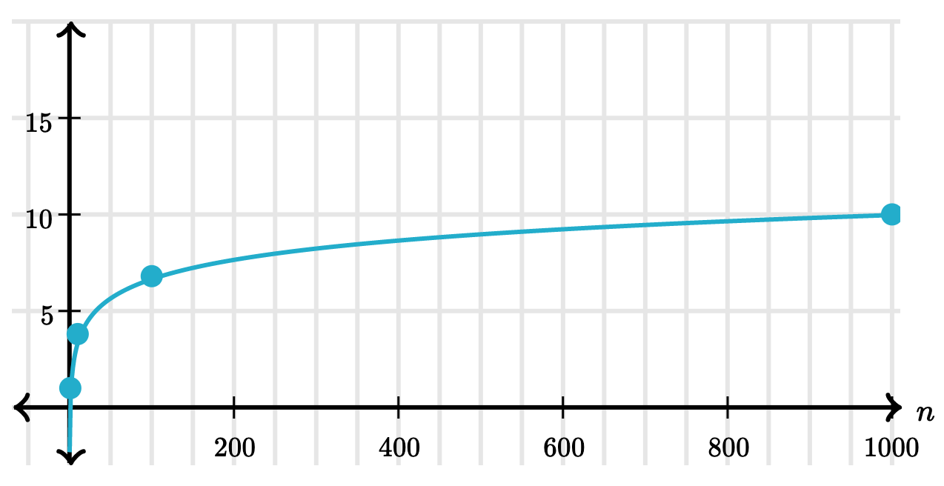
Logarithmic Time
When an algorithm takes logarithmic time, the time that it takes increases proportionally to the logarithm of the input size.
N | Operations
0 | 1
8 | 5
16 | 6
1024 | 12

Slide 13
Finding values in a linked list
def find_in_link(ll, value):
"""Return true if linked list LL contains VALUE.
>>> find_in_link(Link(3, Link(4, Link(5))), 4)
True
>>> find_in_link(Link(3, Link(4, Link(5))), 7)
False
"""
if ll is Link.empty:
return False
elif ll.first == value:
return True
return find_in_link(ll.rest, value)
How many operations will this require for finding a value in the list? Consider both the best case and worst case.
List Size | Best case: Operations | Worst Case: Operations
0
10
100
1000
1
1
1
10
1
100
1
1000

Slide 14
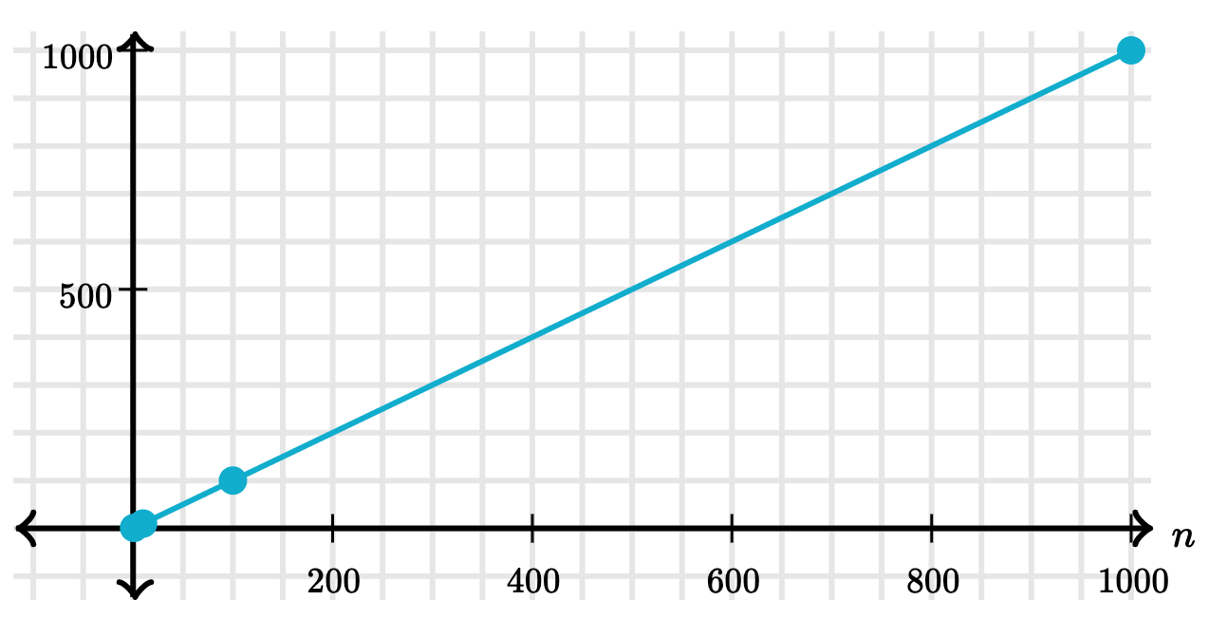
Linear Time
When an algorithm takes linear time, its number of operations increases in direct proportion to the input size.
List Size | Worst Case: Operations
1 | 1
10 | 10
100 | 100
1000 | 1000

Slide 15
Counting overlapping items in lists
def overlap(a, b):
"""
>>> overlap([3, 5, 7, 6], [4, 5, 6, 5])
3
"""
count = 0
for item in a:
for other in b:
if item == other:
count += 1
return count
 | 3 | 5 | 6 | 7
4
5 |  | +
6 |  |  | +
5 |  | +
How many operations will this require for finding the overlapping elements?
List Size | Operations
1
10
100
1000
1
100
10000
1000000

Slide 16
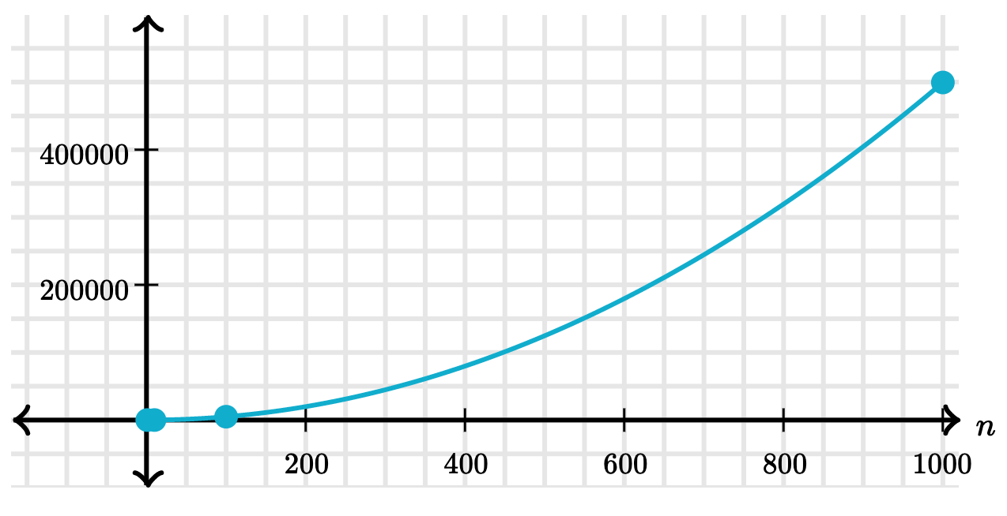
Quadratic Time
When an algorithm grows in quadratic time, its steps increase in proportion to square of the input size.
List Size | Operations
1 | 1
10 | 100
100 | 10000
1000 | 1000000

Slide 17
Recursive Virahanka-Fibonacci
def virfib(n):
if n == 0:
return 0
elif n == 1:
return 1
else:
return virfib(n-2) + virfib(n-1)
How many operations are required for increasing values of n?
N | Operations
1
2
3
4
7
8
20
1
3
5
9
41
67
21891

Slide 18
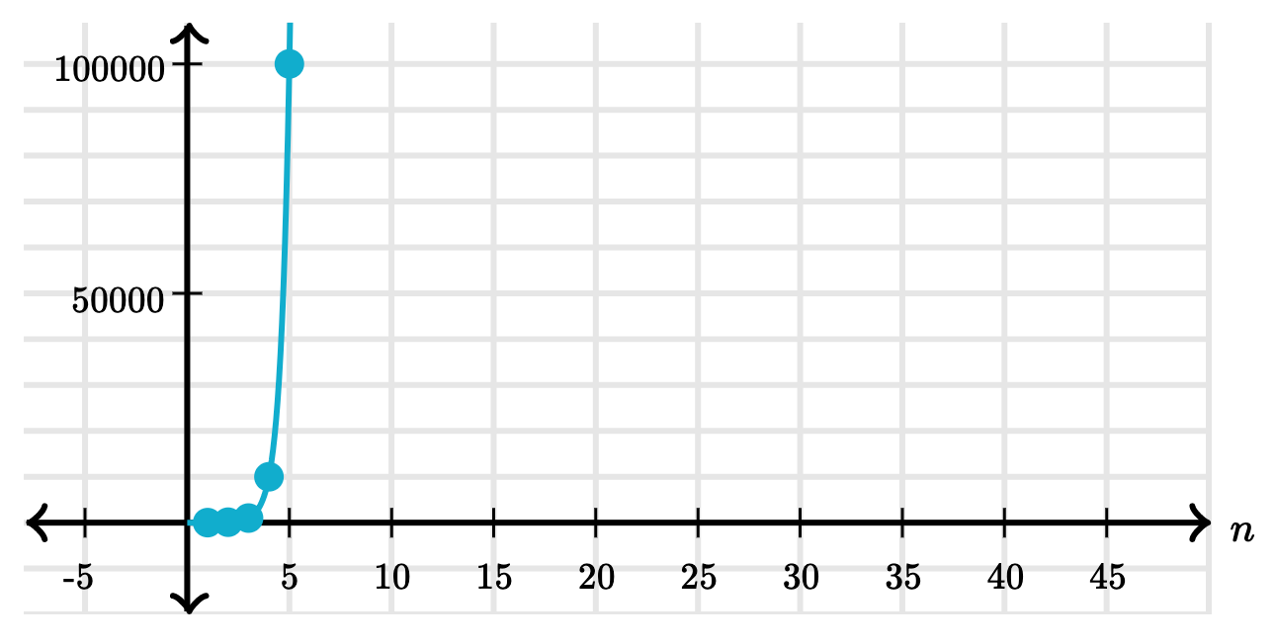
Exponential Time
When an algorithm grows in exponential time, its number of steps increases faster than a polynomial function of the input size.
N | Operations
1 | 1
2 | 3
3 | 5
4 | 9
7 | 41
8 | 67
20 | 21891

Slide 19
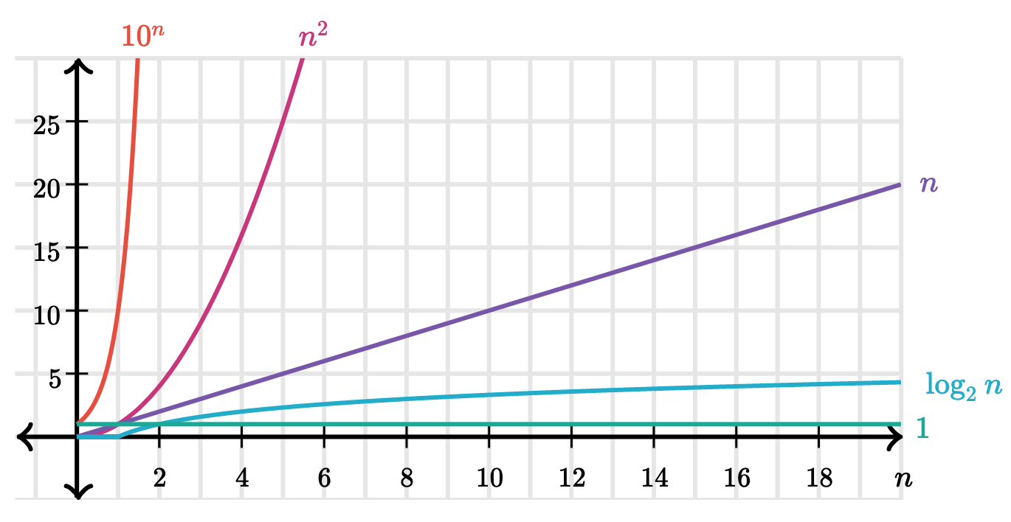
Comparing orders of growth

Slide 20
Big O Notation
A formal notation for describing the efficiency of an algorithm, using asymptotic analysis.
Order of growth | Example | Big O
Exponential growth | recursive virfib | O(b^{n})
Quadratic growth | overlap | O(n²)
Linear growth | find_in_link | O(n)
Logarithmic growth | exp_fast | O(log⁡ n)
Constant growth | add_to_front | O(1)

Slide 22
Space

Slide 23
Space and environments
The space needed for a program depends on the environments in use.
At any moment there is a set of active environments.
Values and frames in active environments consume memory.
Memory that is used for other values and frames can be recycled.
Active environments:
  Environments for any function calls currently being evaluated.
  Parent environments of functions named in active environments.

Slide 24

Active environments in PythonTutor
def virfib(n):
if n == 0:
return 0
elif n == 1:
return 1
else:
return virfib(n-2) + virfib(n-1)
View in PythonTutor
Make sure to select "don't display exited functions"

Slide 25
Visualization of space consumption
virfib(5)
ret: 5
virfib(3)
ret: 2
virfib(4)
ret: 3
virfib(1)
ret: 1
virfib(2)
ret: 1
virfib(2)
ret: 1
virfib(3)
ret: 2
virfib(0)
ret: 0
virfib(1)
ret: 1
virfib(0)
ret: 0
virfib(1)
ret: 1
virfib(1)
ret: 1
virfib(2)
ret: 1
virfib(0)
ret: 0
virfib(1)
ret: 1

Slide 27
Memoization

Slide 28
Memoization
Memoization, or caching, is a strategy to reduce redundant computation by remembering the results of previous function calls in a "memo" or cache.

Slide 29
A memoization HOF
def memo(f):
cache = {}
def memoized(n):
if n not in cache:
cache[n] = f(n)
return cache[n]
return memoized

Slide 30
Memoizing Virahanka-Fibonacci
n | Original | Memoized
5 | 15 | 9
6 | 25 | 11
7 | 41 | 13
8 | 67 | 15
10 | 177 | 19
20 | 21891 | 39
Video visualization

