Slide 1
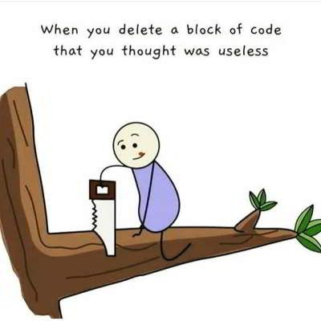

Slide 2
Machine Learning

Slide 3
What is Machine Learning?

Slide 4
What is Machine Learning?
Machine Learning (ML) is a subfield of AI in which algorithms learn patterns from data to solve problems, rather than following explicit instructions.
ML algorithms are the driving force behind google search, Facebook ads, voice recognition on your phone, ChatGPT, and many other applications.
Some ML algorithms attempt to infer from past data what future data may look like. This process is often called inference or prediction.
Other ML algorithms attempt to group data together based on similarities between instances. This process if often called clustering.

Slide 5
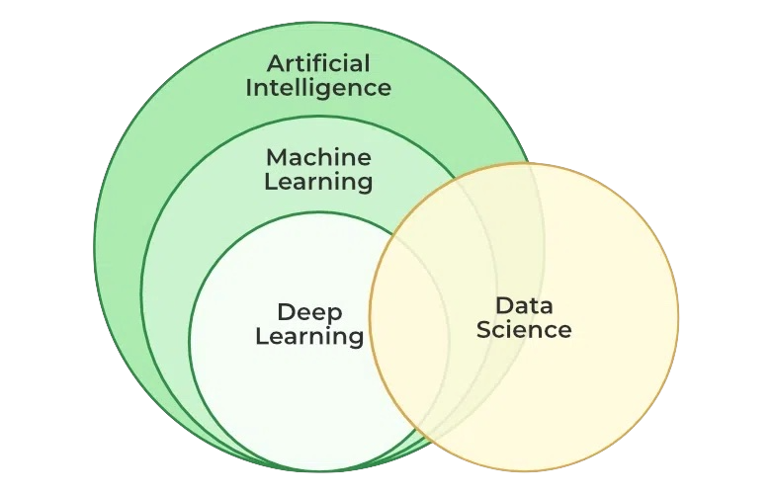
Artificial Intelligence seeks to mimic
human capacities and decision-making
Machine Learning seeks to construct
these capacities directly from data
Deep Learning is a subset of
machine learning algorithms
based on neural networks
Data Science seeks to construct
meaning from data via machine
learning, visualizations, and
statistical analysis
image from GeeksForGeeks

Slide 6
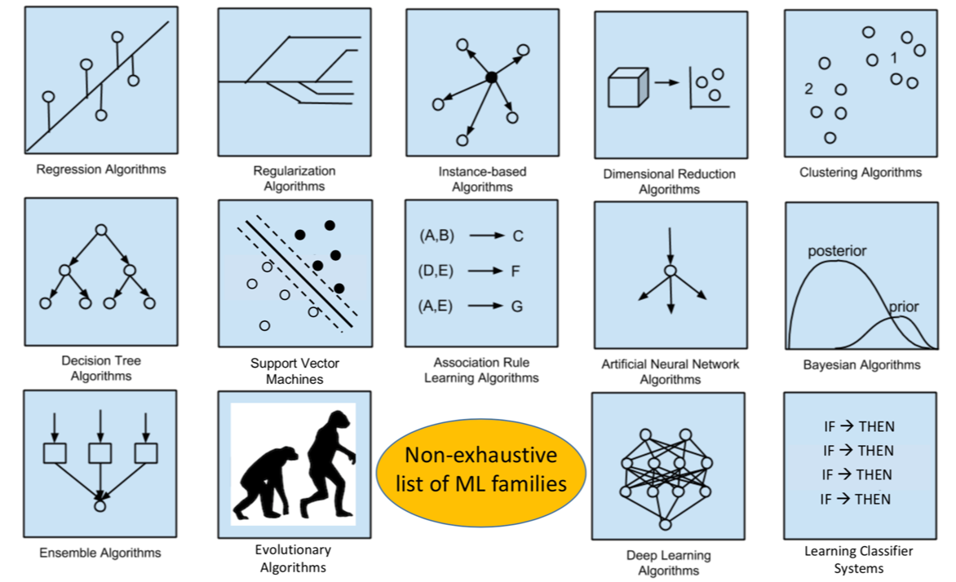
There are a great many types of machine learning algorithms, each best at certain types of jobs. Today, we’ll look at just a couple of examples.
image from Children's Hospital of Philidelphia

Slide 7
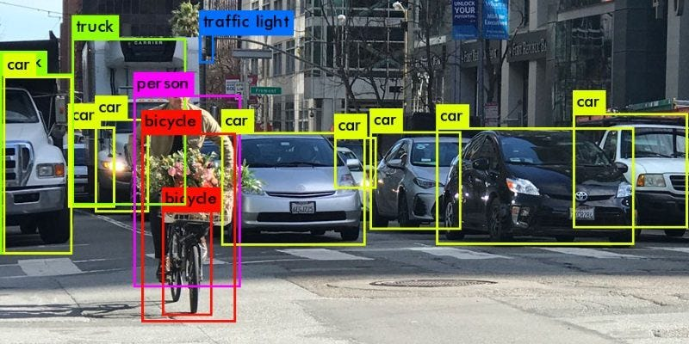


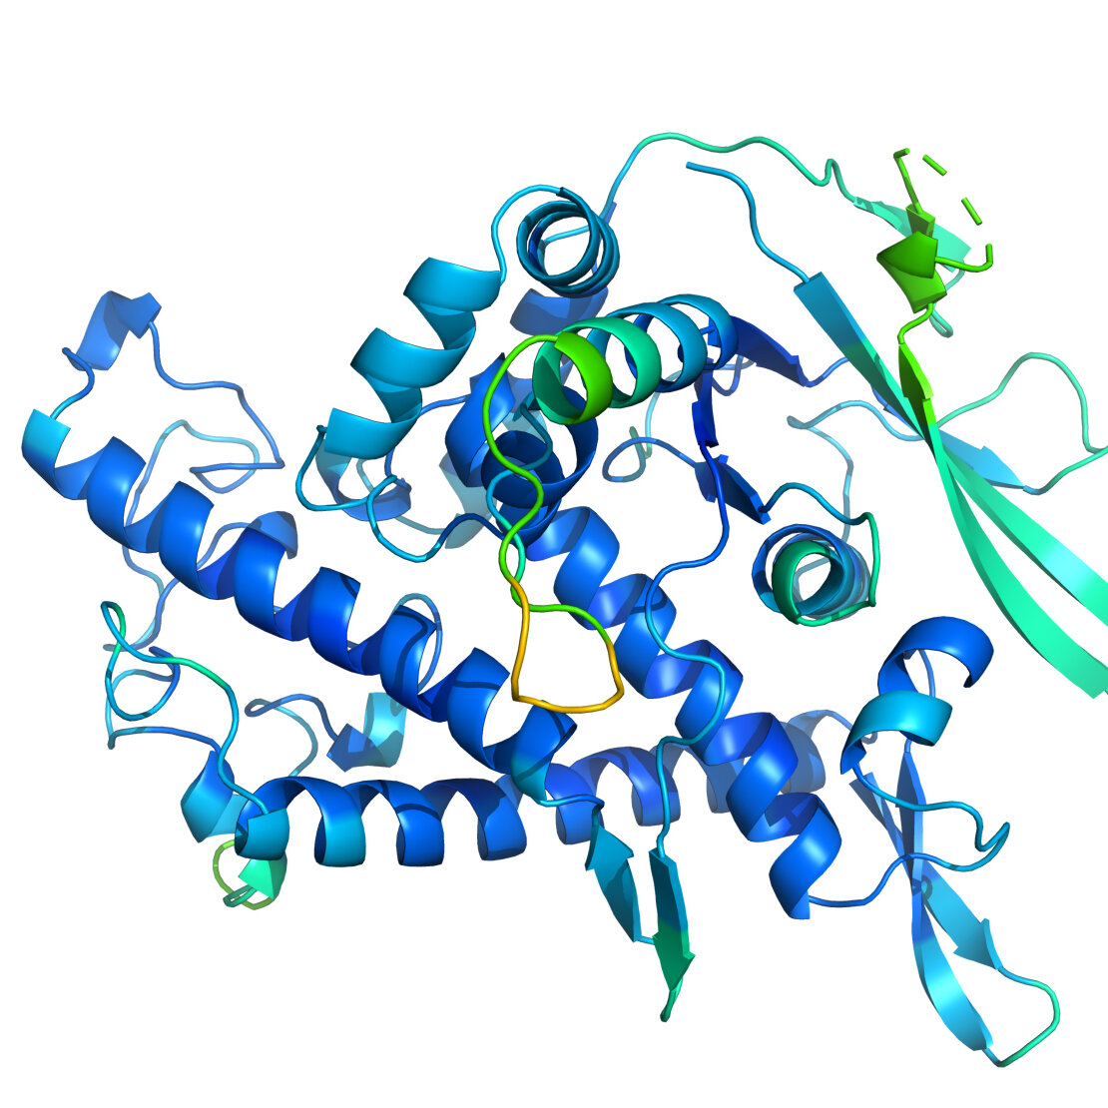

A few popular applications of machine learning:
Image processing
Natural Language Processing
Advertising/product
recommendations
Drug discovery
Health care

Slide 9
How does Machine Learning Work?

Slide 10
A Simple Example – Text Prediction
Given a corpus of text, can the computer learn how to make other text that sounds the same/looks like it was written by the same author?
Let's see what we can figure out
We'll start with the text of 1st Nephi
I, Nephi, having been born of goodly parents, therefore I was taught somewhat in all the learning of my father; and having seen many afflictions in the course of my days, nevertheless, having been highly favored of the Lord in all my days; yea, having had a great knowledge of the goodness and the mysteries of God, therefore I make a record of my proceedings in my days. Yea, I make a record in the language of my father, …

Slide 11
Text Prediction
We start by reading in all the words, in order, and storing them in a list.
  For this simple example, we'll remove all punctuation and make everything lower case
We then create a dictionary using each unique word in our list as the key and the word following it as its value:
  i.e. I -> Nephi, Nephi -> having, having -> been, …
We can then use this to dictionary to generate new text from some initial word (it just has to be in our list)
  Given a word in our list, our dictionary predicts what word should come next

Slide 12
Predicted Text
If we use the word "Nephi" to start, we get the following:
nephi make an end ye shall be saved at the last day and thus it is amen and thus it is amen and thus it is amen and thus it is amen and thus it is amen and thus it is amen and thus it is amen and thus it is amen and thus it is amen and thus it is amen and thus it is amen and thus it is amen and thus it is amen and thus it is amen and thus it is amen and thus it is amen and thus it is amen and thus it is
That didn't work!
Why? What could we do better?

Slide 13
Text Prediction II
Storing just a single word after each word was actually losing information.
Once our dictionary was built, only the last word that followed any given word was stored in the dictionary.
Instead of using a single word as the value, let's store a list of all words that followed the word being used as the key instead.
Then we can randomly pick a word from that list when we need the next word
For example, the entry for 'nephi' would then contain the following list:
  ['having', 'do', 'will', 'being', 'because', 'returned', 'said', 'and', 'crept', 'had', 'did', 'wherefore', 'after', 'nevertheless', 'proceed', 'was', 'what', 'saw', 'also', 'beheld', 'saying', 'heard', 'am', 'spake', 'took', 'went', 'who', 'began', 'received', 'have', 'declare', 'say', 'make']

Slide 14
Predicted Text II
If we again use the word "Nephi" to start, we get the following:
nephi who should have read in one pointed the instruction of fruit was obedient unto his righteous wherefore he knew them off the river and marvelous work timbers of angels in these times of water that thou beholdest that she also laid the desires to build the hands and eve who should no such thing shall minister unto the guilty taketh the servant o lord are engraven the sun smite him ye from my sons of darkness which shall judge the taking away in dominion and be nursed by way forward through on dry ground a small voice but because of
Better, we didn't get into a loop, but still not very good!
What could we do better?

Slide 15
Text Prediction III
In the last iteration, we just made a list of all the words that followed a given word and randomly picked from them.
We ignored how often a word followed the specific word.
We could keep track of the number of times a word followed each word.
Then we could randomly pick a new following word based on the frequency that the two words appear together. Thus, words that more commonly appear together in the original will more commonly appear together in the final output.

Slide 16
Predicted Text III
One more time, using the word "Nephi" to start we get the following:
nephi and it came to pass that the plates of israel do ye will not the space of promise yea and our father thou say it came to the nations of his word he hath declared unto him and lemuel did look and he might see and it was upon all nations of his sheep and shall be as a record from among them and the wrath of israel unto blindness to pass that great church of my brethren that the lord had done for thus saith the things concerning his rod of god and the wicked from the jews as
Is that better? Maybe?
What could we do to improve it?

Slide 17
Another Corpus
Let's try reading in the Sorcerer's Stone and starting with the word "Harry"
harry he said professor mcgonagall told him me out then the floor he hurried out his mommy said ron though his seat hungry after a good holiday said hagrid asked as they went again hermione had lord said harry felt particularly hungry he was skimming through the size of stairs as well yeah an excellent adventure was measuring between door and hermione opened the snitch wins his hands clasped in trouble they had a canary yellow circus tent him he remembers what you ll really done ron reminded them how often happened harry heard the friar haven t have to what
It's still not good
But we didn't write anything new. Given a new corpus, the code can construct text using the same algorithm and learn how to imitate a new author.
We just need a better algorithm.

Slide 19
Another example: Neural networks

Slide 20
Neural networks
Neural networks were inspired by the structure of neurons and synapses in biological brains
The algorithm simulates a series of neurons connected to each other by “weights” indicating their connection strength
The chance that any given neuron will pass information forward is proportional to the amount of incoming signal it receives from other neurons
If the network produces an incorrect output, it adjusts all of its weight values in a way that would have produced a better output

Slide 21
Neural networks
The NN learning algorithm is simple in concept (but the math is complex):
  Begin with random values for all network weights
  Give the network a piece of data as input, and observe its output value(s)
  If the output is wrong, determine whether it was too high or too low, and adjust all network weights in the direction that would have had less error. Each weight update is very tiny, because you don’t want to overshoot the correct values.
  Repeat on 10,000 - 100,000,000 unique training examples. Eventually the network will begin to display better behavior.

Slide 22
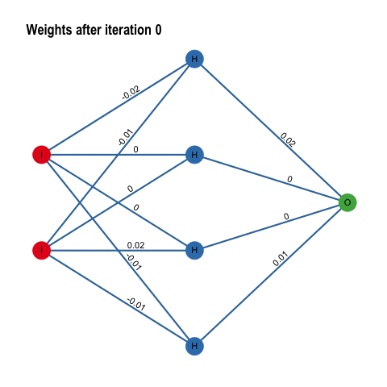
Inputs
Output
Image from https://histalk2.com/2018/11/14/a-machine-learning-primer-for-clinicians-part-5/

Slide 23
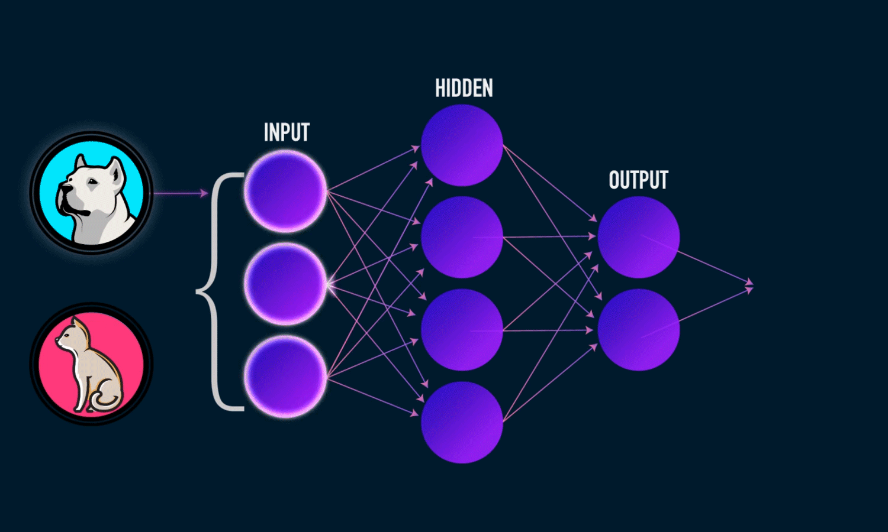
Image from https://towardsdatascience.com/everything-you-need-to-know-about-neural-networks-and-backpropagation-machine-learning-made-easy-e5285bc2be3a

Slide 24
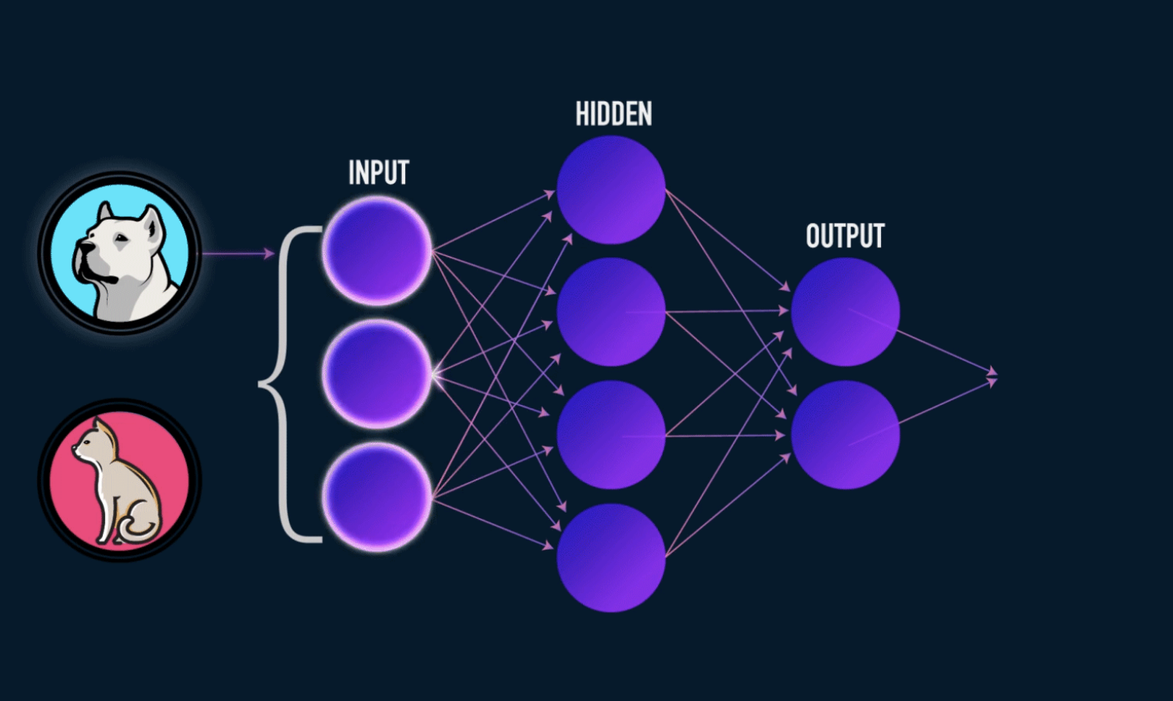

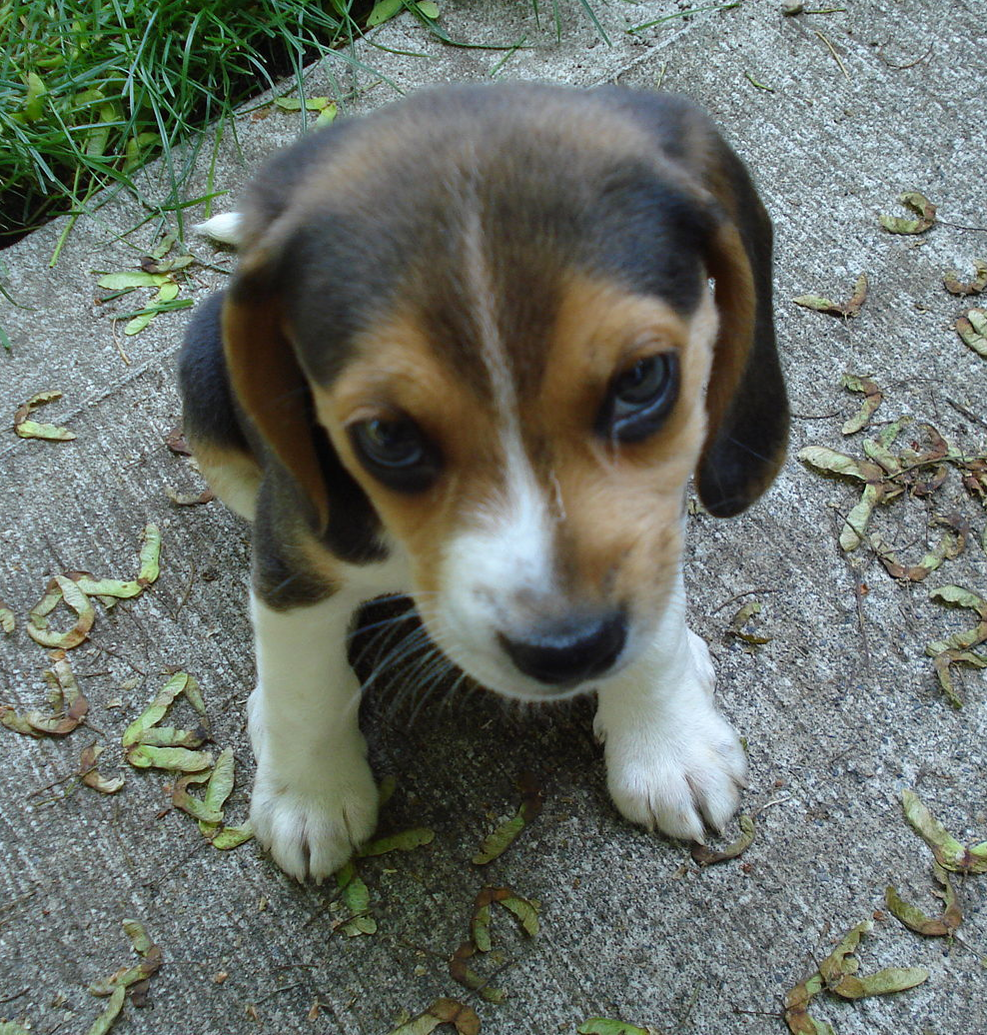
cat
cat
dog
dog
dog
dog
cat
dog
cat
cat
cat
cat
Once the network has seen enough training examples, it will begin to produce correct outputs
cat
cat
dog
dog
dog
dog
dog
cat
cat
cat
dog
cat
dog
dog
cat
dog
dog
cat
dog
cat

Slide 25
cat
cat
dog
dog
dog
cat
cat
cat
cat
cat
cat
cat
Some of the data might be incorrectly labeled. Neural network algorithms are robust to this as long as most of the information is correct
dog
cat
dog
dog
dog
dog
dog
cat
cat
cat
cat
cat
dog
dog
dog
dog
dog
cat
dog
cat

Slide 26
cat
cat
dog
dog
dog
cat
cat
cat
cat
cat
cat
cat
HOWEVER: Neural networks are notoriously finicky. They don’t always learn, or don’t always learn correctly, and as the complexity of the task increases, they get harder and harder to design and train.
dog
cat
dog
dog
dog
dog
dog
cat
cat
cat
cat
cat
dog
dog
dog
dog
dog
cat
dog
cat

Slide 28
ChatGPT

Slide 29
ChatGPT
ChatGPT was trained on the text prediction task. Given some example text from the internet, the network’s job was to predict the words or tokens that would have come next.
Afterward, ChatGPT was further refined by giving it special training data to help it answer questions in the way a human would.
It is one of the most sophisticated machine learning algorithms available today and required hundreds of people and over $3.2 million dollars to build.
OpenAI has not released full details on ChatGPT, but its predecessor model was trained using 285,000 processor cores and 10,000 graphics cards, running night and day for 32 days.
Achieving the same result using only one GPU would take about 355 years.

Slide 30
ChatGPT
Neural network size is often measured in terms of the number of trainable parameters in the network, meaning the number of weights that connect neurons.
Our simple example a few slides ago had 12 weights
The popular word embedding network BERT has 345 million parameters
ChatGPT probably has around 70 billion parameters.
If the size of BERT represented the distance from the Earth to the Sun, then ChatGPT would be about 7 times farther out than Pluto.

Slide 32
Machine Translation

Slide 33
Neural Machine Translation (MT)
Years before ChatGPT was released in 2016, Google released a new version of its Google Translate system that used neural models to translate between languages
Microsoft and many other MT providers followed, and after a few years, neural models became the standard way of doing MT, translating several 100’s of billions of words every day on the internet!
Neural MT models were initially quite a bit smaller than ChatGPT and other LLMs, but now some contain up to 55 billion parameters
Because they were trained specifically on bilingual data for over 100 languages, they can do as well as ChatGPT translating common languages and they do much better on a large number of less common languages
Another significant advancement was the creation of “massively multilingual” neural MT models, with a single large model being trained on bilingual data from 100-200 languages.

Slide 34
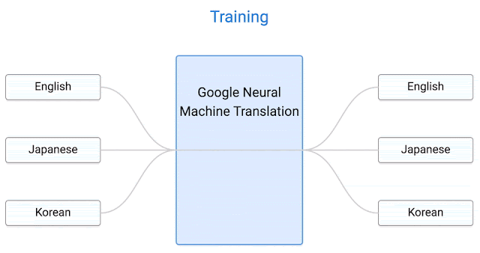
Neural Machine Translation (MT)
Massively multilingual models can translate between any two languages, even though their training data did not contain explicitly parallel data between those two languages! This is Zero-Shot translation, and here’s how it works:

