Slide 1


Slide 2
The Internet, World Wide Web, & HTML

Slide 3
The Internet

Slide 4
The Internet
When I say "The Internet" what do you think of?
Today, most people think of the World Wide Web (WWW)
But the internet is actually much larger (and simpler?) than that.
At its basic level, it is network that allows computers to talk to one another. The WWW is just one method of communication.

Slide 5
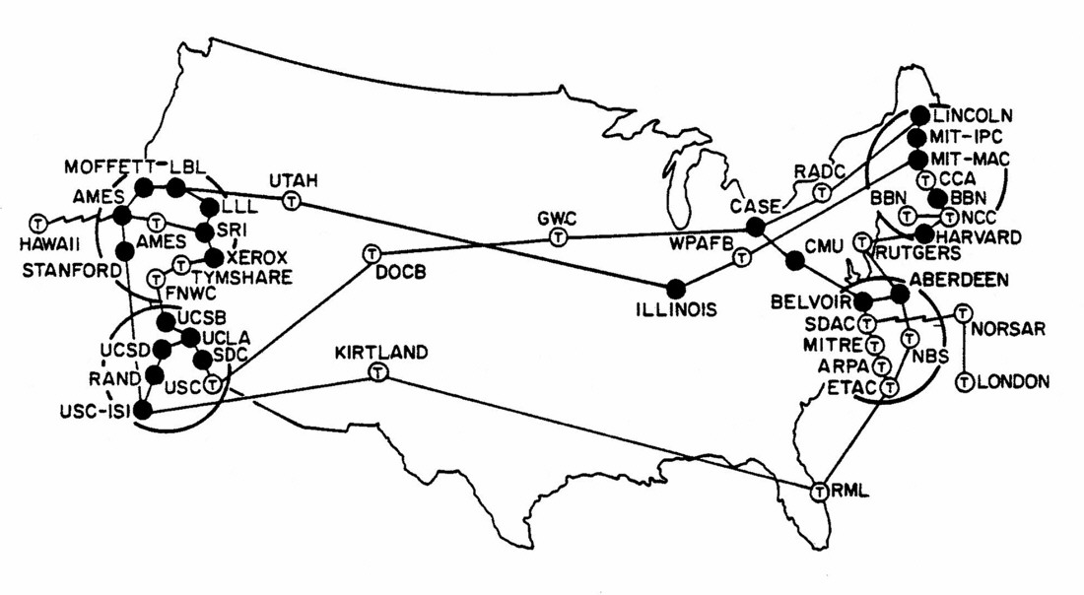
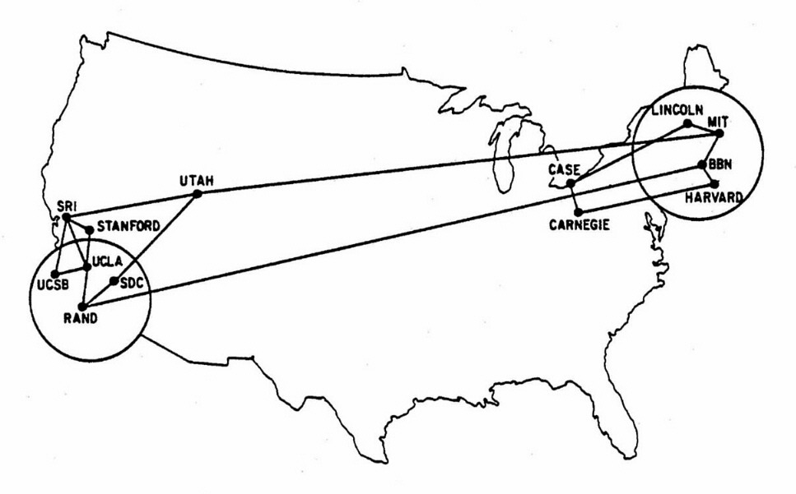
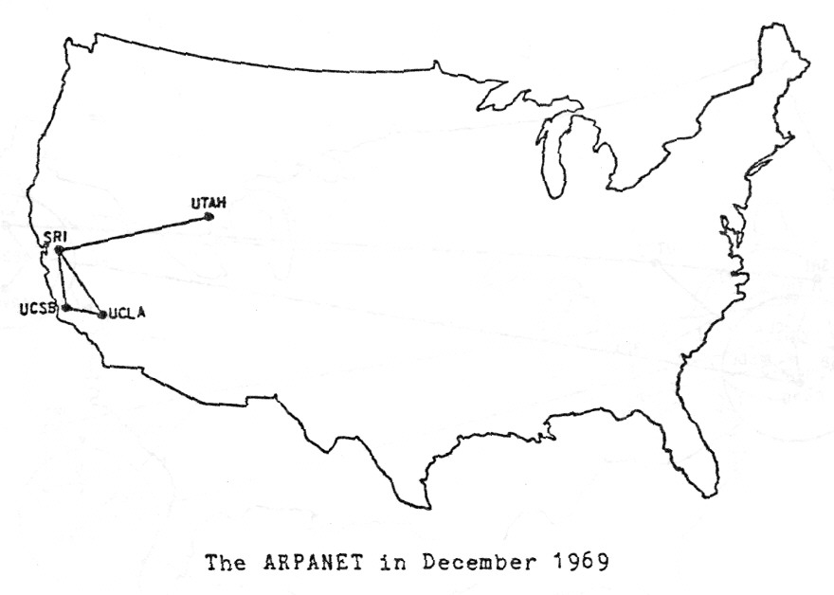
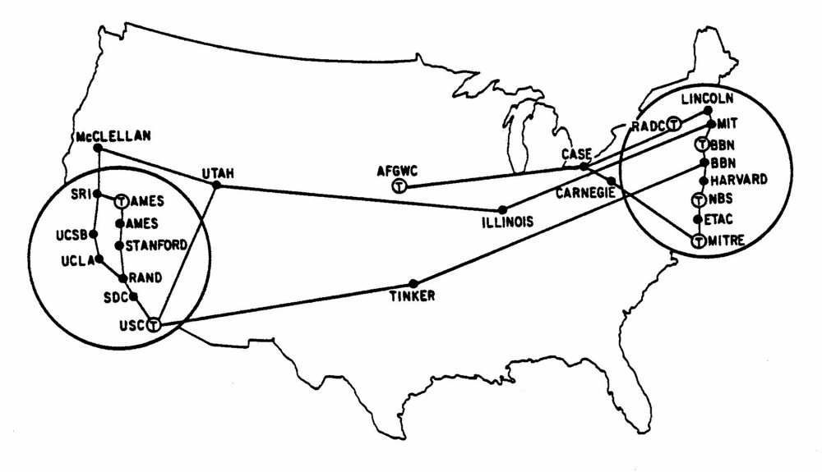
Some History
In the early days of computing, if you wanted two computers to talk to one another
  They had to be directly connected
  They had to speak the same "language" or communication protocol
  Everyone spoke a different language
In 1969, the Advanced Research Projects Agency Network (ARPANET) came online with 4 nodes:
It was developed initially to allow greater access to limited number of large research computers in the country.
Superseded by the National Science Foundation Network (NSFNet) beginning in the 1980s, ARPANET was shut down in Feb 1990.
NSFNet would grow to become the Internet we know today.

Slide 6
Internet Communication
Part of the goal of ARPANET was to provide a single communication protocol that all the computers could "speak", to allow them to talk with one another.
Initially it used the Network Control Protocol but in the 1980s switched to the TCP/IP protocols that we still use today

Slide 7
The Internet Protocol
The Internet Protocol (IP) defines how messages are transmitted and routed through the network.
Every device that wants to communicate on the network must have an IP address
  128.187.16.184
  104.243.63.194
  172.217.15.238
The IP handles getting data from one address to another
It is an abstraction on the underlying networking hardware

Slide 8
Transfer Control Protocol
The Transfer Control Protocol (TCP) is responsible for making sure that data arrives where it was sent.
  The IP just guarantees a "best-effort" delivery
  Things could get lost on the way.
TCP is an abstraction built on IP that provides a reliable byte stream:
  the data arrives in order
  the data is correct
  duplicate data is discarded
  lost data is resent
There are other protocols build on IP such as User Datagram Protocol (UDP), Stream Control Transmission Protocol (SCTP), and Real-time Transport Protocol (RTP) among others.

Slide 10
The World Wide Web

Slide 11
The World Wide Web (early history)
Invented by Tim Berners-Lee at CERN as a way to share research documents and data between collaborators
  Proposed in May 1989
  Operational at Cern by the end of 1990 (original web page: http://info.cern.ch/hypertext/WWW/TheProject.html)
  Released to other research institutions in Jan 1991 and the whole internet on 23 Aug 1991
Initially, it was a purely text-based system.
The first graphical web-browser Mosaic, was released by the National Center for Supercomputing Applications (NSCA) in 1993.
The Netscape Navigator browser (the ancestor of Firefox) was released in Dec 1994 and the company went public in 1995.
Windows Internet Explorer was released in Aug 1995.

Slide 12
The Hyper-Text Transfer Protocol
The world wide web (WWW) uses the Hyper-Text Transfer Protocol (HTTP), an abstraction built on TCP/IP to send data between computers
The WWW uses a client-server model of computing
  The server hosts the data and listens for connections
  The client initiates a connection to the server requesting information
  The server provides the data to the client
  Connections are temporary and the governed by the HTTP.

Slide 13
Universal Resource Locator
To access things on the internet, we use Universal Resource Locators (URLs) to specify what we want to access.
A URL consists of three parts:
  The protocol to use
  The server address (usually represented as a domain)
  The path to the object on the server
http://cs.byu.edu/labs/lab18
Protocol
Domain
Path to resource

Slide 14
Requesting a resource
HTTP defines a number of ways to access resources on the web.
The most common are GET and POST
GET is used when we just need to read data from the server.
  Most links to load webpages are GET requests
POST is used when we need to send data to the server.
  When we submit a form, it uses a POST to send the contents of the form to the server.
For details of what is happening under the hood, take CS 260, CS 324, and/or CS 240.

Slide 15
Status Codes
Whenever we request a resource, in addition to returning the resource, the server sends a status code.
These let the client know if the request succeeded or not, if there is more data coming, or if there was some other problem.
The most common status codes are:
  200 – Success
  404 – File not found
  500 – Server error
We'll see a bit more about these when we start making requests ourselves.

Slide 17
The Hyper-Text Markup Language

Slide 18
The Hyper-Text Markup Language
While the HTTP described how computers should request and receive information, that was only half the problem Tim Berners-Lee needed to solve.
The Hyper-Text Markup Language (HTML) was the other half and describes a way of packaging the information so it could be understood on the other end.
HTML is a declarative language that describes the semantics of a document.
It is up to the web browser reading the document to decide how it gets rendered on the screen.

Slide 19
A simple HTML document
<html>
<head>
<title>Hello world!</title>
</head>
<body>
<h1>Hello world!</h1>
<p>This is a simple Hello World web page.</p>
</body>
</html>

Slide 20
Whitespace in HTML
Unlike Python, whitespace mostly doesn't matter in HTML.
The previous page could be written like this and render just fine:
HTML doesn't care about indentation or spacing around its contents.
Any single whitespace character (space, tab, & newline) are displayed as a space on the rendered web page.
Multiple whitespace characters are collapsed and rendered as a single space.
<html><head><title>Hello world!</title></head><body> <h1>Hello world!</h1><p>This is a simple Hello World web page.</p></body></html>

Slide 22
Tags

Slide 23
Tags
In HTML, everything in the document is enclosed in tags.
The tags describe what the material they contain is supposed to be.
  Parts of the document – i.e. head, body, footer, anchor point
  Types of text – i.e. header, paragraph
  Other components – i.e. images, horizontal lines
  Some style guides – i.e. emphasis, strong, line breaks
There is typically an opening tag and a closing tag for each element
  You can think of these like opening and closing parentheses surrounding the object

Slide 24
Tags
The tags themselves are enclosed in "angle brackets" → "<" and ">"
  <head>, <body>, etc.
Closing tags include a forward slash (/) before the tag name:
  </head>, </body>, etc.
A few tags stand alone and have the forward slash after the tag name inside the angle brackets, e.g.
  <br /> - line break
  <hr /> - horizontal rule (a line)
Tag names are case insensitive
  <HEAD> and <head> are the same thing

Slide 25
Tags
HTML is very forgiving/permissive.
  So much so that Tim Berners-Lee and the World Wide Web Consortium (W3C) he created tried to supplant it with a stricter XHTML based on XML (Extensible Markup Language) but failed
Many of the tags that are recommended are not strictly required and pages will render and work properly if they are missing.
However, using them better defines the semantics of the page and you should try to use them properly.
A useful reference for all the HTML tags is the W3Schools website: https://www.w3schools.com/html.

Slide 26
The <html> tag
The <html> tag (and it's closing </html> tag) are the first and last tags in the document.
They surround everything and indicate that the text inside them should be interpreted as HTML.

Slide 27
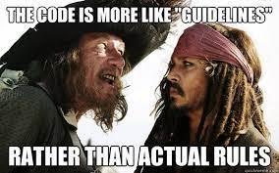
The <head> tag
The <head> (and </head) tag denotes the header information for the page.
The contents of this section are typically not meant to be directly rendered on the page and contain information about the page and its contents
  Like the Pirate's Code, that is merely a suggestion, if you put renderable content here, it will be displayed on the page
One of the most common contents of this section is the <title> tag
Most HTML documents should have a <head> tag

Slide 28
The <footer> tags
The <footer> (and </footer>) tag denotes a section of content that is typically rendered at the bottom of the page.
  HTML doesn't force it to the bottom however, you have to physically place it last in the document.
It typically contains things like
  authorship, copyright, and contact information
  links to related documents
  etc.

Slide 29
The <title> tag
The <title> tag is placed inside the <head> tagged section of the document and is designed to specify the title for the entire document.
The contents of this tag are not rendered on the web page itself
In older browsers, the title would be rendered in the bar at the top of the window.
In modern browsers, it is rendered in the tab the page is being displayed in.
This is also the default text that will be grabbed for the name of a web page if you try to bookmark it.
<title>CS 111 Homepage</title>

Slide 30
The <body> tag
The <body> tag is used to denote the main content of the page.
Everything that should appear on the page (outside the footer) belongs inside this tag.
Every page should have a <body> tag

Slide 31
Headers
HTML defines a set of header tags (<h1>, <h2>, …, <h6>) that can be used to create headers of various sizes within the document.
  These are used to separate sections of a document as you would use headers in a word processor
  <h1> is the largest, top-level header
  <h6> is the smallest
<h1>This is a large header</h1>
<h2>This is a sub-header</h2>
<h6>I've never used this one</h6>

Slide 32
The <p> tag
The <p> tag denotes a paragraph or block of text
Most content in a document will be contained inside a paragraph tag <p>
The closing paragraph tag </p> signifies to the browser that a newline should be inserted at that point
<p>Most of the text contents in your HTML document will
appear inside paragraph tags.</p>
<p>The browser automatically renders a new line at the end of the paragraph when it encounters the closing tag.</p>

Slide 33
Lists
We can create numbered or bulleted lists in HTML using the ordered list <ol> or unordered list <ul> tags.
List elements are surrounded by list item <li> tags
Lists can also be nested.
<ol>
<li>This is item 1</li>
<li>This is item 2</li>
<li>Item 3 has a bulleted sub-list
<ul>
<li>First bullet</li>
<li>Second bullet</li>
</ul></li>
</ol>

Slide 34
Miscellaneous simple tags
The <strong></strong> tag is used to mark text that should be bold.
The <em></em> tag is used to mark text that should be emphasized and is typically rendered in italics.
The <br /> tag doesn't have a closing tag and forces a line break at the position of the tag.
The <hr /> tag also doesn't have a closing tag a causes a line to be drawn across the width of the page.
The word <strong>happy</strong> should be bold.
<em>CS 111</em> will render in <em>italics</em>.
There is a<br />line break in the middle of this sentence.
<hr />
<p>This paragraph has a line above it.</p>

Slide 36
Attributes

Slide 37
Attributes
Before we look at the next few tags, we need to talk about attributes.
In addition to just the tag name, tags can have attributes.
This looks like
A common attribute for paragraphs and headers is the align attribute. It can take on the values of left, right and center and controls the justification of the contents
For ordered lists, you can set what the number "type" will be – i.e. A, a, 1, i, etc.
<tag_name attribute1=value attribute2=value ... >
<h1 align="center">A centered header</h1>
<ol type="A">

Slide 38
Images
To include an image, you use the <img> tag
It has at least one necessary attribute src that give the URL to the location of the image to be displayed.
The image tag does not have a closing tag.
<img src="https://cs111.byu.edu/lab/lab05/assets/image_example.png">

Slide 39
Images
You can also specify height and width attributes to specify the size the image should display at
  Numbers = size in pixels
  Percentages = fraction of the page size
If you specify both, it will force the image to be that size, possibly compressing or stretching it in one direction.
If you only specify one of the two attributes, it sets the one specified and then scales the other based on the aspect ratio of the image.
<img height= "100" width="200"
src="https://cs111.byu.edu/assets/images/BYU%20monogram_white.svg">

Slide 40
Links
We've made it this far and still haven't talked about how to create links, the foundation of the WWW.
To create a link, you use the <a> tag.
It has one necessary attribute, href, that give the URL it should open when clicked.
The text between the opening <a> tag and closing </a> tag is what is displayed on the web page.
This is typically underlined to represent a link and changes color depending on if you've visited the link before or not.
<a href="https://cs111.byu.edu">CS111 Homepage</a>

Slide 41
Tables
It is possible to render tables in HTML as well.
A table starts and ends with the <table> and </table> tags
Each row is enclosed in a table row tag (<tr> & </tr>)
Each element is enclosed in table data tag (<td> and </td>)
By default, no borders are shown around a table. If you want to have them displayed, add the border attribute to the table tag. The value is the thickness of the outside border in pixels.
<p>A simple two by two table</p>
<table>
<tr><td>1</td><td>2</td></tr>
<tr><td>3</td><td>4</td></tr>
</table>
<table border="1">

Slide 43
Cascading Style Sheets

Slide 44
Cascading Style Sheets
Cascading Style Sheets (CSS) are beyond the scope of this class, but we want to mention them as they are an integral part of the WWW today.
While HTML is mostly concerned about what the parts of the page are, CSS is another declarative language that focuses on how page elements should be rendered.
You can give CSS descriptors to an individual tag on a web page using the style attribute.
You can also set CSS descriptors for all occurrences of a specific tag in a separate CSS file that you would then tell the page to load in the <head> section.
As you look for information about HTML tags and attributes online, you will see many references to CSS as the two languages are closely intertwined. Many of the things that you used to do with HTML attributes are done with CSS today.

