Slide 1
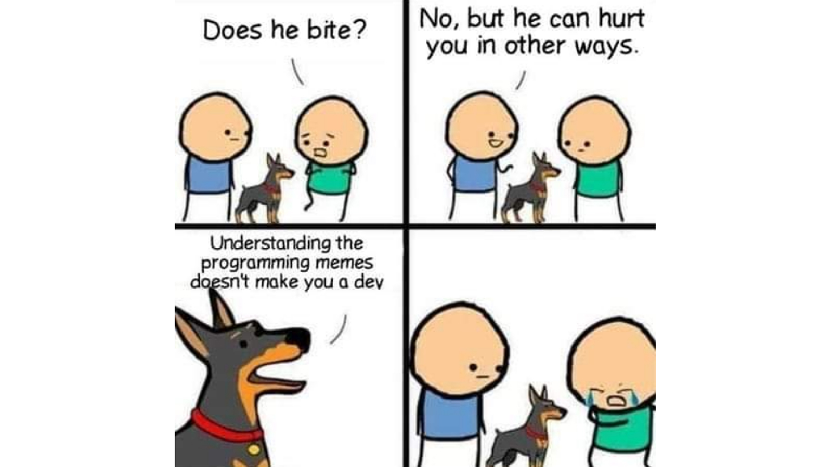

Slide 2
Conclusion

Slide 3
What did we learn?

Slide 4
Programming paradigms
Imperative programming: using statements to change a program's state.
Functional programming: expressions, not statements; no side-effects; use of higher-order functions.
nums = [1, 2, 4]
for i in range(0, len(nums)):
nums[i] = nums[i] ** 2
list(map(lambda x: x ** 2, [1, 2, 4]))
(+ 3 (* 2 6) (- 10 7))

Slide 5
Programming paradigms #2
Data-centric and object-oriented programming.
Declarative programming: State goals or properties of the solution rather than procedures.
t = tree(3, [tree(1), tree(2, [tree(1), tree(1)])])
[b.label for b in branches(t)
innocent_bee = Bee(5)
horrible_ant = Ant(10)
innocent_bee.fend_off(horrible_ant)
(.+)@(.+)\.(.{3})
<body>
<p>This is a paragraph with <em>something emphasized</em>
and <a href="cs111.byu.edu">a link</a></p>
</body>

Slide 6
Programming Concepts
Data storage:
Primitive/simple types: booleans, numbers, strings
Compound types: lists, linked lists, trees
Environments: rules for how programs access and modify named objects
Higher-order functions: Functions as data values, functions on functions
Recursion: approaching a problem recursively, general recursive patterns
Mutability: mutable objects, mutation operations, dangers of mutation
Exceptions: Dealing with errors
Efficiency: Different programs have different time/space needs

Slide 7
Software Engineering
Abstractions, separation of concerns
Specification of a program vs. its implementation
Syntactic spec (header) vs. semantic spec (docstring).
Example of multiple implementations for the same abstract behavior
Testing: for every program, there is a test.
Coding style (Composition)

Slide 8
Some useful tools
Images and how to manipulate them
Introduction to HTML
How to surf the web programmatically
How to generate plots

Slide 9
What's next?

Slide 10
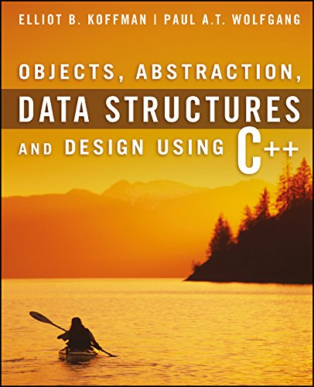
What's next?
After passing CS 111, you can now take the following CS courses:
CS 235: Data Structures
Next course needed for CS major or minor
Language: C++
Test Book: Objects, Abstraction, Data Structures and Design: Using C++
Amazon.com: Can rent paperback
CS 260: Web Programming
Required for CS major, elective for CS minor
Language: JavaScript (similar to Python)

Slide 11
Specialized CS Courses
Here are some other CS courses you could take:
CS 202: Software Engineering Lab 1
1 credit course for Software Engineering Emphasis
Language: Java
CS 180: Intro to Data Science
Language: Python

Slide 12
CS Courses Prerequisites
CS 235
CS 224
CS 236
CS 240
(All these courses are required for the CS Major. CS Minor requires 236 and 240. See BYU catalog for more course details: https://catalog.byu.edu/physical-and-mathematical-sciences/computer-science/

Slide 13
Teaching Assistants
Opportunity to be a TA for CS 111
Run a Section 💻
Build your peer network 👥
Share your knowledge and enthusiasm 🎉
Help other students succeed and feel they belong ⚓
Details 👇
Work from 4-15 hours per week
Flexible office hours
Contact your TA Section leaders or Dr. Stephens
Don't forget to thank this semester's TAs 👏

Slide 14
Course Evaluation Survey
Please fill out the Course Completion Survey on Canvas.
Also don't forget to do your Student Evaluations for the course.

Slide 15
Thank you!

