Slide 1
Trees & Languages

Slide 2
Working with Trees

Slide 3
Tree processing
A tree is a recursive structure.
Each tree has:
  A label
  0 or more branches, each a tree
Recursive structure implies recursive algorithm!

Slide 4
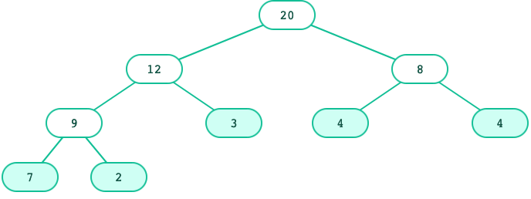
Tree processing: Counting leaves
def count_leaves(t):
"""Returns the number of leaf nodes in t."""
if is_leaf(t):
return 1
else:
leaves_under = 0
for b in branches(t):
leaves_under += count_leaves(b)
return leaves_under
What's the base case?
What's the recursive call?

Slide 5
Tree processing: Counting leaves
The sum() function sums up the items of an iterable.
That leads to this shorter function:
sum([1, 1, 1, 1]) # 4
def count_leaves(t):
"""Returns the number of leaf nodes in t."""
if is_leaf(t):
return 1
else:
branch_counts = [count_leaves(b) for b in branches(t)]
return sum(branch_counts)

Slide 6
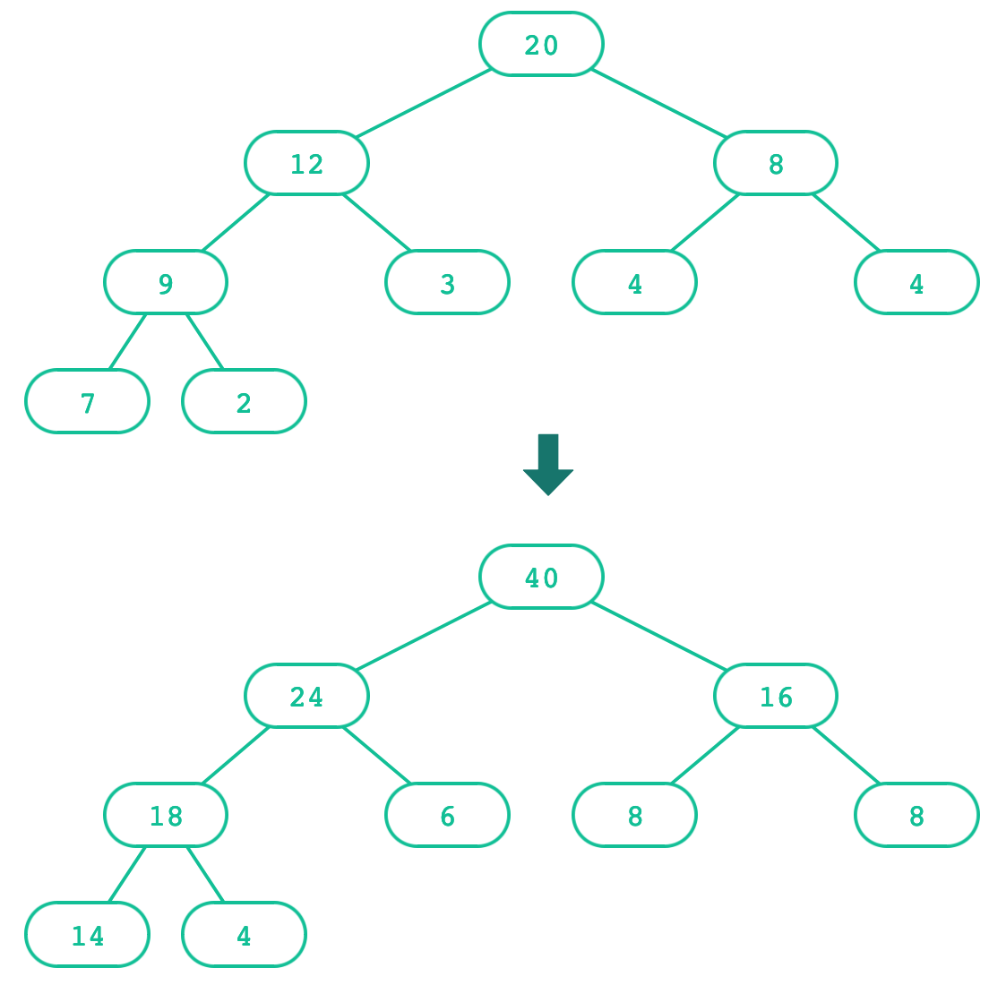
Creating trees
A function that creates a tree from another tree is also often recursive.

Slide 7
Creating trees: Doubling labels
def double(t):
"""Returns a tree identical to t, but with all labels doubled."""
if is_leaf(t):
return tree(label(t) * 2)
else:
return tree(label(t) * 2,
[double(b) for b in branches(t)])
What's the base case? What's the recursive call?

Slide 8
Creating trees: Doubling labels
A shorter solution:
Explicit base cases aren't always necessary in the final code, but it's useful to think in terms of base case vs. recursive case when learning.
def double(t):
"""Returns the number of leaf nodes in t."""
return tree(label(t) * 2,
[double(b) for b in branches(t)])

Slide 9
Exercise: Printing trees
def print_tree(t, indent=0):
"""Prints the labels of t with a depth-based
indent of 2 spaces.
>>> t = tree(3, [tree(1), tree(2, [tree(1), tree(1)])])
>>> print_tree(t)
3
1
2
1
1
"""

Slide 10
Exercise: Printing trees (solution)
def print_tree(t, indent=0):
"""Prints the labels of t with a depth-based
indent of 2 spaces.
>>> t = tree(3, [tree(1), tree(2, [tree(1), tree(1)])])
>>> print(t)
3
1
2
1
1
"""
print(indent * " " + label(t))
for b in branches(t):
print_tree(b, indent + 2)

Slide 11
Exercise: List of leaves
def leaves(t):
"""Return a list containing the leaf labels of t.
>>> t = tree(20, [tree(12, [tree(9, [tree(7), tree(2)])
,tree(3)]), tree(8, [tree(4), tree(4)])])
>>> leaves(t)
[7, 2, 3, 4, 4]
"""
Hint: If you sum a list of lists, you get a list containing the elements of those lists. The sum function takes a second argument, the starting value of the sum.
sum([ [1], [2, 3], [4] ], []) # [1, 2, 3, 4]
sum([ [1] ], []) # [1]
sum([ [[1]], [2] ], []) # [[1], 2]

Slide 12
Exercise: List of leaves (solution)
def leaves(t):
"""Return a list containing the leaf labels of t.
>>> t = tree(20, [tree(12, [tree(9, [tree(7), tree(2)])
,tree(3)]), tree(8, [tree(4), tree(4)])])
>>> leaves(t)
[7, 2, 3, 4, 4]
"""
if is_leaf(t):
return [label(t)]
else:
leaf_labels = [leaves(b) for b in branches(t)]
return sum(leaf_labels, [])

Slide 13
Exercise: Counting paths
def count_paths(t, total):
"""Return the number of paths from the root to any node in t
for which the labels along the path sum to total.
>>> t = tree(3, [tree(-1), tree(1, [tree(2, [tree(1)]), tree(3)]), tree(1, [tree(-1)])])
>>> count_paths(t, 3)
2
>>> count_paths(t, 4)
2
>>> count_paths(t, 5)
0
>>> count_paths(t, 6)
1
>>> count_paths(t, 7)
2
"""

Slide 14
Exercise: Counting paths (solution)
def count_paths(t, total):
"""Return the number of paths from the root to any node in t
for which the labels along the path sum to total.
>>> t = tree(3, [tree(-1), tree(1, [tree(2, [tree(1)]), tree(3)]), tree(1, [tree(-1)])])
>>> count_paths(t, 3)
2
>>> count_paths(t, 4)
2
>>> count_paths(t, 5)
0
>>> count_paths(t, 6)
1
>>> count_paths(t, 7)
2
"""
if label(t) == total:
found = 1
else:
found = 0
return found + sum([count_paths(b, total - label(t)) for b in branches(t)])

Slide 16
Abstraction and Trees

Slide 17
Tree: Layers of abstraction
Primitive Representation | 1 2 3 "a" "b" "c" [.. , ..]
Data abstraction | tree() branches() label() is_leaf()
User program | double(t) count_leaves(t)
Each layer only uses the layer above it.

Slide 19
Trees, Trees, everywhere!

Slide 20
Directory structures
CS 111
Tree for a directory Structure
Homework
Labs
HW01
HW02
HW03
HW04
admissions.py
test_files
Admission_algorithms_dataset.csv
key_outliers.txt
…
key_chosen_students.txt

Slide 21
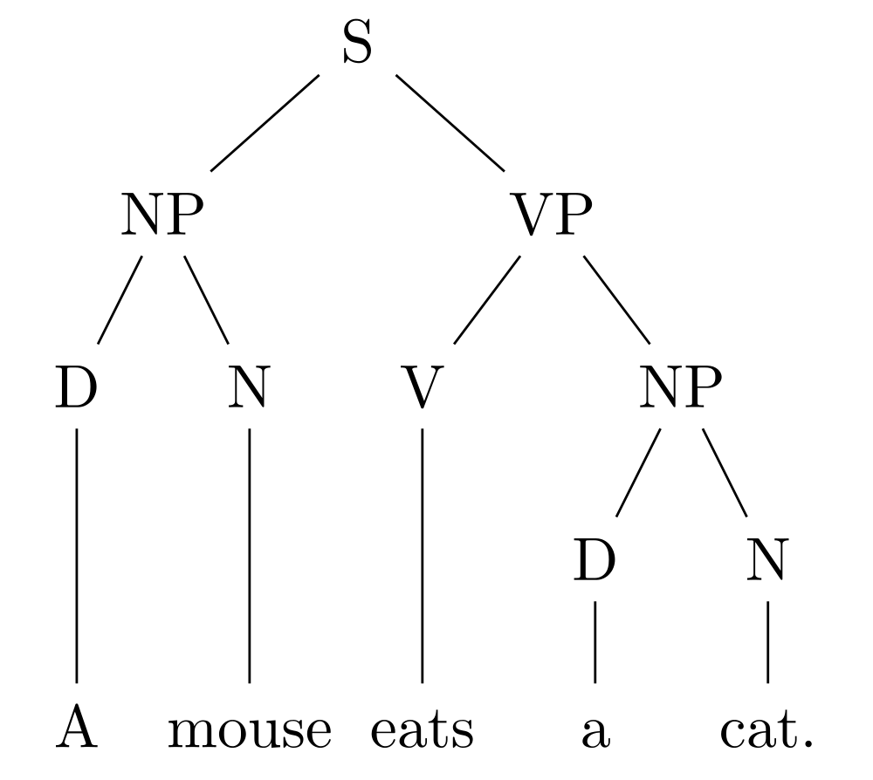
Parse trees
For natural languages …
Key:
  S = Sentence
  NP = Noun phrase
  D = Determiner
  N = Noun
  V = Verb
  VP = Verb Phrase

Slide 22
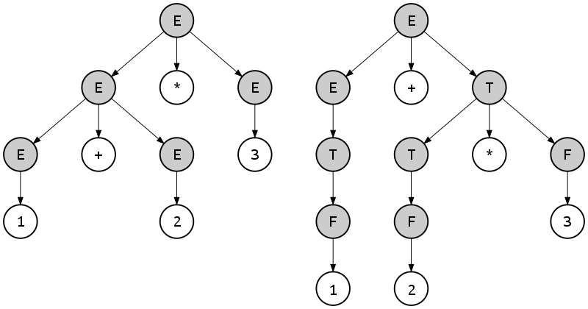
Parse trees
For programming languages, too …
Key:
  E = expression
  T = term
  F = factor

Slide 24
A Tree Class

Slide 25
Trees: Data abstraction (review)
So far, here's what we've been using:
With an implementation like this:
tree(label, branches) | Returns a tree with root label and list of branches
label(tree) | Returns the root label of tree
branches(tree) | Returns the branches of tree (each a tree).
is_leaf(tree) | Returns true if tree is a leaf node.
def tree(label, branches=[]):
return [label] + list(branches)
def label(tree):
return tree[0]
def branches(tree):
return tree[1:]
def is_leaf(tree):
return not branches(tree)
🤔 How could we represent trees as a Python class?

Slide 26
A Tree class
class Tree:
def __init__(self, label, branches=[]):
self.label = label
self.branches = list(branches)
def is_leaf(self):
return not self.branches
🤔 What's different? What's the same?

Slide 27
tree versus Tree
tree | Tree
t = tree(label, branches=[]) branches(t) | t = Tree(label, branches=[]) t.branches
label(t) | t.label
is_leaf(t) | t.is_leaf()
def fib_tree(n):
if n == 0 or n == 1:
return tree(n)
else:
left = fib_tree(n - 2)
right = fib_tree(n - 1)
fib_n = label(left) + label(right)
return tree(fib_n, [left, right])
def fib_tree(n):
if n == 0 or n == 1:
return Tree(n)
else:
left = fib_tree(n - 2)
right = fib_tree(n - 1)
fib_n = left.label + right.label
return Tree(fib_n, [left, right])

Slide 28
A fancier Tree
class Tree:
def __init__(self, label, branches=[]):
self.label = label
for branch in branches:
assert isinstance(branch, Tree)
self.branches = list(branches)
def is_leaf(self):
return not self.branches
def __repr__(self):
if self.branches:
branch_str = ', ' + repr(self.branches)
else:
branch_str = ''
return 'Tree({0}{1})'.format(self.label, branch_str)
def __str__(self):
return '\n'.join(self.indented())
def indented(self):
lines = []
for b in self.branches:
for line in b.indented():
lines.append(' ' + line)
return [str(self.label)] + lines

Slide 30
Tree mutation

Slide 31
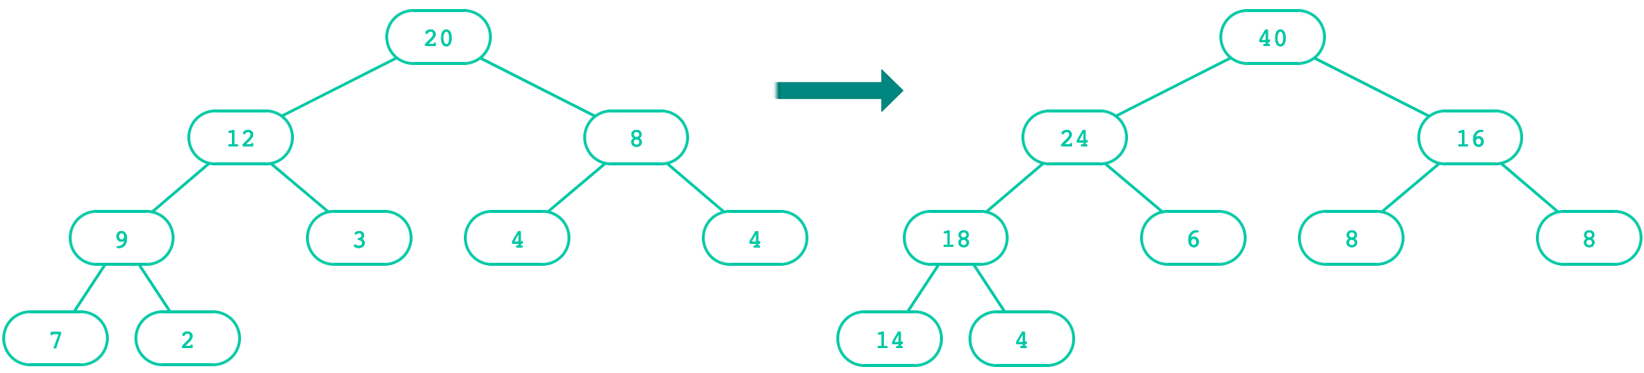
Doubling a Tree
def double(t):
"""Doubles every label in t, mutating t.
>>> t = Tree(1, [Tree(3, [Tree(5)]), Tree(7)])
>>> double(t)
>>> t
Tree(2, [Tree(6, [Tree(10)]), Tree(14)])
"""
t.label = t.label * 2
for b in t.branches:
double(b)

Slide 32
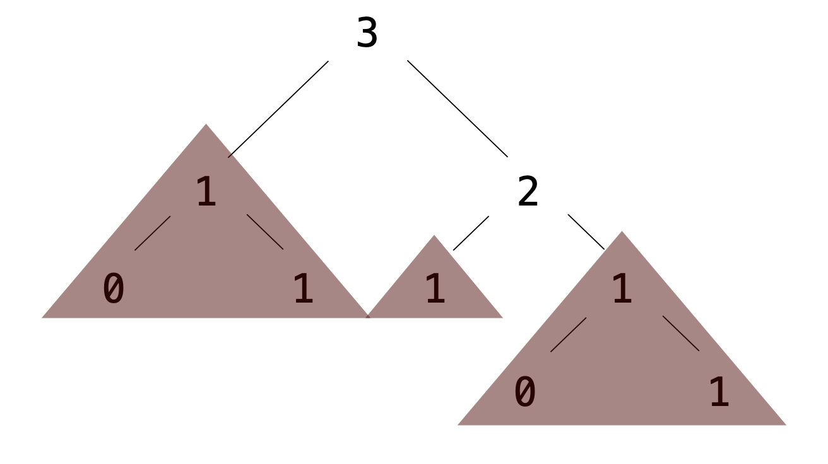
Exercise: Pruning trees
Removing subtrees from a tree is called pruning.
Always prune branches before recursive processing.
def prune(t, n):
"""Prune all sub-trees whose label is n.
>>> t = Tree(3, [Tree(1, [Tree(0), Tree(1)]), Tree(2,
[Tree(1), Tree(1, [Tree(0), Tree(1)])])])
>>> prune(t, 1)
>>> t
Tree(3, [Tree(2)])
"""
t.branches = [___ for b in t.branches if ___]
for b in t.branches:
prune(___, ___)

Slide 33
Exercise: Pruning trees (solution)
Removing subtrees from a tree is called pruning.
Always prune branches before recursive processing.
def prune(t, n):
"""Prune all sub-trees whose label is n.
>>> t = Tree(3, [Tree(1, [Tree(0), Tree(1)]), Tree(2,
[Tree(1), Tree(1, [Tree(0), Tree(1)])])])
>>> prune(t, 1)
>>> t
Tree(3, [Tree(2)])
"""
t.branches = [b for b in t.branches if b.label !=n]
for b in t.branches:
prune(b, n)

Slide 35
Recursive Objects

Slide 36
Recursive objects
Why are Tree and Link considered recursive objects?
Each type of object contains references to the same type of object.
  An instance of Tree can contain additional instances of Tree, in the branches variable.
  An instance of Link can contain an additional instance of Link, in the rest variable.
Both classes lend themselves to recursive algorithms. Generally:
  For Tree: The base case is when is_leaf() is True; the recursive call is on the branches.
  For Link: The base case is when the rest is empty; the recursive call is on the rest.

Slide 38
Language & Syntax

Slide 39
Syntax Trees

Slide 40
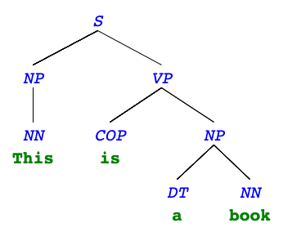
Syntax trees
Both programming languages and spoken languages can be parsed into syntax trees.
For a spoken language, a syntax tree reveals the syntactic structure of a single sentence.
"This is a book"

Slide 41
Syntax tree terminals
The leaves are also called terminals: they contain both a syntactic identifer (tag) and the actual world.
  NN: singular noun (e.g. "This", "book")
  COP: copula (e.g. "is")
  DT: determiner (e.g. "the")
Other terminals: NNS (plural noun), NNP (proper noun), PRP (personal pronoun), JJ (adjective), IN (preposition), CC (coordinating conjunction), AUX (auxillary verb), RB (adverb), VBN (verb, past participle), ...

Slide 42
Syntax tree non-terminals
The other nodes are called non-terminals and contain only tags (typically a phrase type). The tag describes the phrase in the leaves under them.
  S: sentence (e.g. "This is a book")
  NP: noun phrase (e.g. "This", "a book")
  VP: verb phrase (e.g. "is a book")
Other non-terminals: SQ (question), PP (prepositional phrase), ADVP (adverb phrase)...

Slide 43
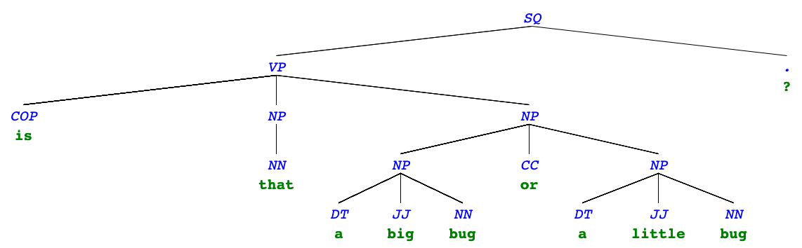
More syntax trees
"Is that a big bug or a little bug?"

Slide 44
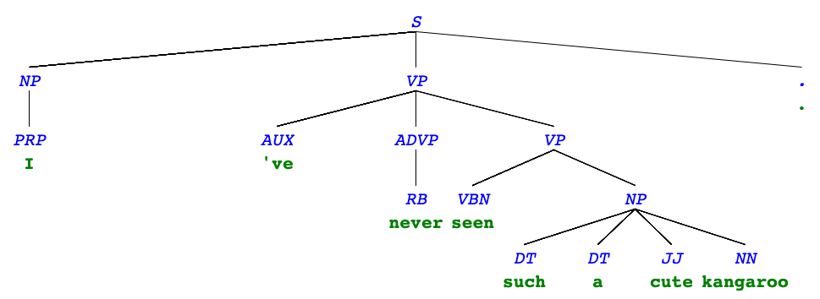
More syntax trees
"I've never seen such a cute kangaroo."

Slide 46
Syntax tree representation

Slide 47
Using the tree abstraction
The label of non-terminals will be just the tag: "S", "NP", "VP".
The label of terminals will be a list of the tag and the word itself:
  ["NN", "This"]
  ["COP", "is"]
  ["DT", "a"]
  ["NN", "book"]

Slide 48
A tree() version
t = tree("S", [
tree("NP", [tree(["NN", "this"])]),
tree("VP", [
tree(["COP", "is"]),
tree("NP", [
tree(["DT", "a"]),
tree(["NN", "book"])
])
])
])

Slide 49
Additional abstractions
def phrase(tag, branches):
return tree(tag, branches)
def word(tag, text):
return tree([tag, text])
def text(word):
return label(word)[1]
def tag(t):
"""Return the tag of a phrase or word."""
if is_leaf(t):
return label(t)[0]
else:
return label(t)

Slide 51
Programming Languages

Slide 52
Levels of languages
High-level programming language
(Python, C++, JavaScript)
⬇
Assembly language
(Hardware-specific)
⬇
Machine language
(Hardware-specific)

Slide 53
Machine language
The language of the machine is all 1s and 0s, often specifying the action and the memory address to act on:
Code is executed directly by the hardware.
00000100 10000010 # Load data in 10000010
00000001 10000001 # Subtract data at 10000001
00000101 10000100 # Store result in 10000100
00001011 10000100 # Etc..
00001101 00010000
00010100 00000010
00000101 10000011
00001111 00000000
00010100 00000011
00000101 10000011
00001111 00000000

Slide 54
Assembly language
Assembly language was introduced for (slightly) easier programming.
Machine code |  | Assembly code
00000100 10000010 00000001 10000001 00000101 10000100 00001011 10000100 00001101 00010000 00010100 00000010 00000101 10000011 00001111 00000000 00010100 00000011 00000101 10000011 00001111 00000000 |  | LOD Y SUB X STO T1 CPL T1 JMZ 16 LOD #2 STO Z HLT LOD #3 STO Z HLT

Slide 55
Higher-level languages
Higher level languages:
  provide means of abstraction such as naming, function definition, and objects
  abstract away system details to be independent of hardware and operating system
Statements & expressions are either interpreted by another program or compiled (translated) into a lower-level language.
a = y – x
if a > y:
z = 2
else:
z = 3

Slide 56
Compiled vs. interpreted
When a program is compiled, the source code is translated into machine code, and that code can be distributed and run repeatedly.
  Source code → Compiler → Machine code → Output
When a program is interpreted, an interpreter runs the source code directly (without compiling it first).
  Source code → Interpreter → Output
In its most popular implementation (CPython), Python programs are interpreted but have a compile step:
  Source code → Compiler → Bytecode → Virtual Machine → Output

Slide 57
Phases of an interpreter/compiler
In order to either interpret or compile source code, a program must be written that understands that source code.
Typical phases of understanding:
  Source code → Lexing → Parsing → Abstract Syntax Tree
We'll come back to this after we talk about the Calculator Language

