Slide 1
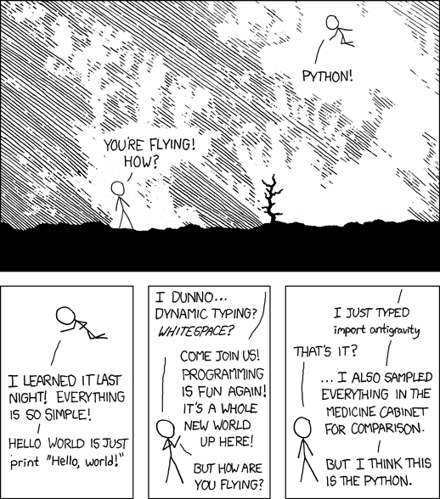

Slide 2
Abstraction & Names

Slide 3
Abstraction

Slide 4
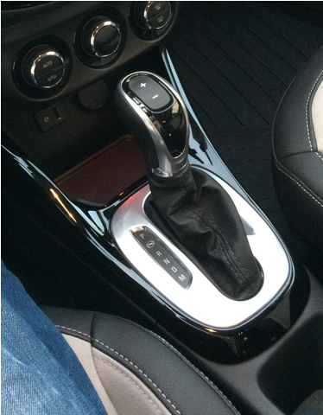
Abstraction
In CS, we often "abstract away the details."
We intentionally ignore some details in order to provide a consistent interface.
This allows us to focus on the concepts instead of the implementation and think about problems at a higher level

Slide 6
Abstraction by Parameterization

Slide 7
Abstraction by parameterization (Generalization)
In a world before functions...
Parameterized!
A parameterized function performs a computation that works for all acceptable values of the parameters.
✂️ Removed detail: the values themselves!
interest = 1 + 0.6 * 2
interest2 = 1 + 0.9 * 4
interest3 = 1 + 2.1 * 3
def interest(rate, years):
return 1 + rate * years

Slide 8
Revisiting the detect_green() function
Let's look at our final detect_green() function from last lecture
We have two values, factor and threshold, that we had modified as we were testing it out. If we wanted to change them, others using our function (including ourselves in the future) might want to as well.
These should be parameterized
def detect_green(pixel):
factor = 1.3
threshold = 100
average = (pixel.red + pixel.green + pixel.blue) / 3
if pixel.green >= factor * average and pixel.green > threshold:
return True
else:
return False

Slide 9
Revisiting the detect_green() function
Let's make them parameters
Now the user can specify the value for each of these variables at runtime instead of having the change the code of the function.
def detect_green(pixel, factor, threshold):
average = (pixel.red + pixel.green + pixel.blue) / 3
if pixel.green >= factor * average and pixel.green > threshold:
return True
else:
return False

Slide 10
Examples – darken()
Can we generalize (abstraction by parameterization) our darken function from last time?
def darken(image):
for pixel in image:
pixel.red = pixel.red * 0.5
pixel.green = pixel.green * 0.5
pixel.blue = pixel.blue * 0.5
def darken(image, factor):
""" Reduce the intensity of an image to factor of its
original value. 0 = fully black, 1 = no effect.
"""
for pixel in image:
pixel.red = pixel.red * factor
pixel.green = pixel.green * factor
pixel.blue = pixel.blue * factor

Slide 11
Examples – adding a border
Remember this function?
def bottom_black_border(image):
new_image = Image.blank(image.width, image.height+50) # Create the larger image.
for y in range(image.height): # Copy the original image
for x in range(image.width): # into the top of the new
pixel = image.get_pixel(x, y) # one.
pixel_new = new_image.get_pixel(x, y)
pixel_new.red = pixel.red
pixel_new.green = pixel.green
pixel_new.blue = pixel.blue
for y in range(image.height,image.height+50): # Make the pixels in the
for x in range(image.width): # bottom black. RGB for
pixel_new = new_image.get_pixel(x, y) # black is (0,0,0).
pixel_new.red = 0
pixel_new.green = 0
pixel_new.blue = 0
return new_image
How might we abstract this?
Notes:
Abstracting it is part of Homework 2

Slide 13
Abstraction by Specification

Slide 14
Abstraction by specification
A specification for the built-in round function:
A well-designed function specification (function signature + docstring) serves as a contract between the implementer and the user.
✂️ Removed detail: the implementation!
round(number[, ndigits]): Return number rounded to n digits precision after the decimal point. If n digits is omitted or is None, it returns the nearest integer to its input.
See full documentation.

Slide 15
Using an abstraction
Based on this specification..
This should work!
square(n): Returns the square of the number n.
def sum_squares(x, y):
"""
>>> sum_squares(3, 9)
90
"""
return square(x) + square(y)

Slide 16
Implementing the abstraction
Many possible implementations can be used:
It could even be built-in to Python, in theory!
def square(x):
return pow(x, 2)
def square(x):
return x ** 2
from operator import mul
def square(x):
return mul(x, x)

Slide 17
Not all implementations are equal
An implementation may have practical consequences:
  Affecting the size of the program
  Affecting the speed of the program's execution
Not the ideal implementation:
But you can cross that bridge when you come to it.
from operator import mul
def square(x):
return mul(x, 2)

Slide 19
Names
There are only two hard things in Computer Science: cache invalidation and naming things. --Phil Karlton

Slide 20
Choosing names
Names typically don’t matter for correctness, but they matter a lot for readability.
From 😟 | To 🤩
true_false | is_green
r | red
helper | add_border
my_int | border_thickness
Names should convey the meaning or purpose of the values to which they are bound.
Function names typically convey their effect (print), their behavior (triple), or the value returned (abs).

Slide 21
Parameter names
The type of value bound to a parameter name is best documented in a function's docstring.
def summation(n, f):
"""Sums the result of applying the function F
to each term in the sequence from 1 to N.
N can be any integer > 1, F must take a single
integer argument and return a number.
"""
total = 0
k = 1
while k <= n:
total = total + f(k)
k = k + 1
return total
Notes:
Sneak peak at higher order functions in the next lecture.

Slide 22
Which values deserve a name?
Repeated compound expressions:
Meaningful parts of complex expressions:
if sqrt(square(a) + square(b)) > 1:
x = x + sqrt(square(a) + square(b))
hypotenuse = sqrt(square(a) + square(b))
if hypotenuse > 1:
x = x + hypotenuse
x1 = (-b + sqrt(square(b) - 4 * a * c)) / (2 * a)
discriminant = square(b) - 4 * a * c
x1 = (-b + sqrt(discriminant)) / (2 * a)

Slide 23
More naming tips
Names can be short if they represent generic quantities: counts, arbitrary functions, arguments to mathematical operations, etc.
  n, k, i - Usually integers
  x, y, z - Usually real numbers or coordinates
  f, g, h - Usually functions
Names can be long if they help document your code:
is preferable to...
average_age = average(age, students)
# Compute average age of students
aa = avg(a, st)

