Slide 1


Slide 2
Introduction to Classes

Slide 3
Object-Oriented Programming

Slide 4
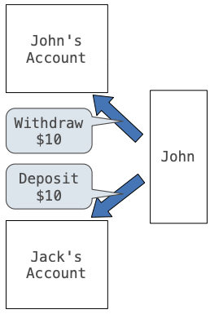
Object-oriented programming
OOP is a method for organizing programs which includes:
  Data abstraction
  Bundling together information and related behavior
A metaphor for computation using distributed state:
  Each object has its own local state
  Each object also knows how to manage its own local state, based on method calls
  Method calls are messages passed between objects
  Several objects may all be instances of a common type
  Different types may relate to each other

Slide 5
Abstraction/Information Hiding
One of the great benefits of using objects is the ability to abstract away details and hide unnecessary information from the user of the object.
  Think about the steering wheel in a car – all you as the user needs to know is that turning it makes the car turn. You don’t need to know the details of how it interacts with the axle and wheels of the car
Information hiding also allows us to make improvements in code without impacting how the object is used.

Slide 6
Encapsulation
Another benefit of classes is the idea of encapsulation.
The class encapsulates the data that it contains
  This "hides" the data from the user – doesn't allow direct access
  The class defines the ways the user can access and interact with the data so that the data's integrity is always maintained.

Slide 8
An OOP Shop

Slide 9
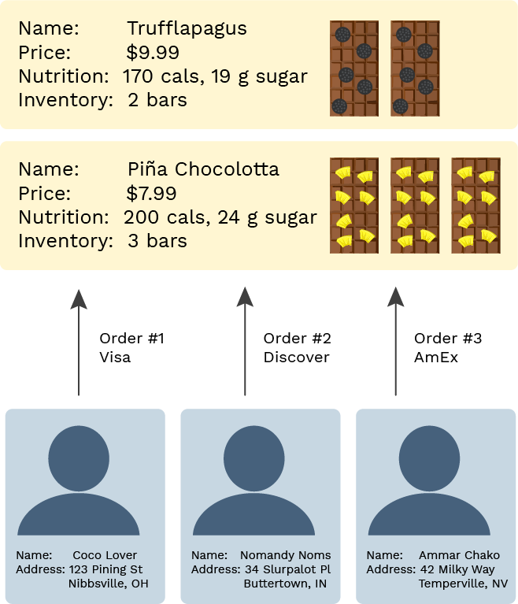
Building a chocolate shop
The shop has products that have names, prices, nutrition information, and an inventory count
There are customers who have names and addresses
And there are payments that reference the customers and products and have payment information

Slide 10
The OOP approach
We can use objects to organize our code for the shop:
An object bundles together information and related behavior.
# Inventory tracking
Product(name, price, nutrition)
Product.get_label()
Product.get_nutrition_info()
Product.increase_inventory(amount)
Product.reduce_inventory(amount)
Product.get_inventory_report()
# Customer tracking
Customer(name, address)
Customer.get_greeting()
Customer.get_formatted_address()
Customer.buy(product, quantity, cc_info)
# Purchase tracking
Order(customer, product, quantity, cc_info)
Order.ship()
Order.refund(reason)
# Shop management
ChocolateShop(name)
ChocolateShop.signup_customer(name, address)
ChocolateShop.add_product(name, price, nutrition)

Slide 11
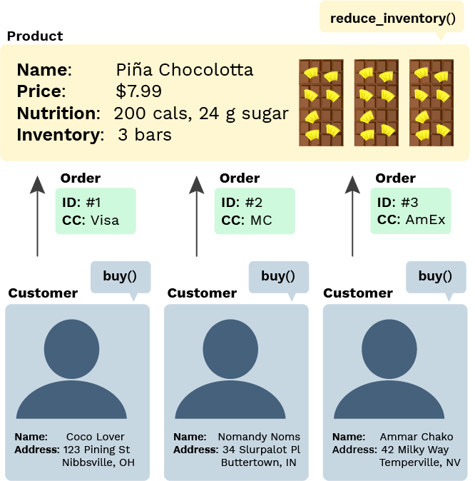
Python OOP terminology
A class is a template for defining new data types.
An instance of a class is called an object.
Each object has data attributes called instance variables that describe its state.
Each object also has function attributes called methods.
Python includes special syntax to create classes and objects.

Slide 13
Classes

Slide 14
A fully coded class and usage
# Define a new type of data
class Product:
# Set the initial values
def __init__(self, name, price, nutrition_info):
self.name = name
self.price = price
self.nutrition_info = nutrition_info
self.inventory = 0
# Define methods
def increase_inventory(self, amount):
self.inventory += amount
def reduce_inventory(self, amount):
self.inventory -= amount
def get_label(self):
return "Foxolate Shop: " + self.name
def get_inventory_report(self):
if self.inventory == 0:
return "There are no bars!"
return f"There are {self.inventory} bars."
pina_bar = Product("Piña Chocolotta", 7.99,
["200 calories", "24 g sugar"])
pina_bar.increase_inventory(2)

Slide 15
Let's break it down …

Slide 16
Class instantiation (Object construction)
pina_bar = Product("Piña Chocolotta", 7.99,
["200 calories", "24 g sugar"])
Product(args) is often called the constructor.
When the constructor is called:
  A new instance of that class is created
  The __init__() method of the class is called with the new object as its first argument (named self), along with any additional arguments provided in the call expression
class Product:
def __init__(self, name, price, nutrition_info):
self.name = name
self.price = price
self.nutrition_info = nutrition_info
self.inventory = 0

Slide 17
Instance variables
Instance variables are data attributes that describe the state of an object.
This __init__() initializes 4 instance variables:
The object's methods can then change the values of those variables or assign new variables.
class Product:
def __init__(self, name, price, nutrition_info):
self.name = name
self.price = price
self.nutrition_info = nutrition_info
self.inventory = 0

Slide 18
Method invocation
This expression…
… calls this function in the class definition:
pina_bar.increase_inventory() is a bound method: a function which has its first parameter pre-bound to a particular value.
In this case, self is pre-bound to pina_bar and amount is set to 2.
It's equivalent to:
pina_bar.increase_inventory(2)
class Product:
def increase_inventory(self, amount):
self.inventory += amount
Product.increase_inventory(pina_bar, 2)

Slide 19
Dot notation
All object attributes (which includes variables and methods) can be accessed with dot notation:
That evaluates to the value of the attribute looked up by increase_inventory() in the object referenced by pina_bar.
The left-hand side of the dot notation can also be any expression that evaluates to an object reference:
pina_bar.increase_inventory(2)
bars = [pina_bar, truffle_bar]
bars[0].increase_inventory(2)

Slide 20
All together now
The class definition:
Object instantiation and method invocation:
# Define a new type of data
class Product:
# Set the initial values
def __init__(self, name, price, nutrition_info):
self.name = name
self.price = price
self.nutrition_info = nutrition_info
self.inventory = 0
# Define methods
def increase_inventory(self, amount):
self.inventory += amount
…
pina_bar = Product("Piña Chocolotta", 7.99,
["200 calories", "24 g sugar"])
pina_bar.increase_inventory(2)

Slide 21
Exercise: Player class
"""
This class represents a player in a video game.
It tracks their name and health.
"""
class Player:
"""
>>> player = Player("Mario")
>>> player.name
'Mario'
>>> player.health
100
>>> player.damage(10)
>>> player.health
90
>>> player.boost(5)
>>> player.health
95
"""

Slide 22
Exercise: Player class (solution)
"""
This class represents a player in a video game.
It tracks their name and health.
"""
class Player:
def __init__(self, name):
self.name = name
self.health = 100
def damage(self, amount):
self.health -= amount
def boost(self, amount):
self.health += amount

Slide 23
Exercise: Clothing class
"""
Clothing is a class that represents pieces of clothing in a closet. It tracks
the color, category, and clean/dirty state.
"""
class Clothing:
"""
>>> blue_shirt = Clothing("shirt", "blue")
>>> blue_shirt.category
'shirt'
>>> blue_shirt.color
'blue'
>>> blue_shirt.is_clean
True
>>> blue_shirt.wear()
>>> blue_shirt.is_clean
False
>>> blue_shirt.clean()
>>> blue_shirt.is_clean
True
"""

Slide 24
Exercise: Clothing class (solution)
"""
Clothing is a class that represents pieces of clothing in a closet.
It tracks the color, category, and clean/dirty state.
"""
class Clothing:
def __init__(self, category, color):
self.category = category
self.color = color
self.is_clean = True
def wear(self):
self.is_clean = False
def clean(self):
self.is_clean = True

Slide 26
Dynamic Attributes

Slide 27

Classes in environment diagrams
class Product:
def __init__(self, name, price, nutrition_info):
def increase_inventory(self, amount):
def reduce_inventory(self, amount):
def get_label(self):
def get_inventory_report(self):
A class statement creates a new class and binds that class to the class name in the first frame of the current environment.
Inner def statements create attributes of the class (not names in frames).
View in PythonTutor

Slide 28
Dynamic instance variables
An object can create a new instance variable whenever it'd like.
Now pina_bar has an updated binding for inventory and a new binding for needs_restocking (which was not in __init__()).
class Product:
def reduce_inventory(self, amount):
if (self.inventory - amount) <= 0:
self.needs_restocking = True
self.inventory -= amount
pina_bar = Product("Piña Chocolotta", 7.99,
["200 calories", "24 g sugar"])
pina_bar.reduce_inventory(1)
View in PythonTutor

Slide 30
Class variables

Slide 31
Class variables
A class variable is an assignment inside the class that isn't inside a method body.
Class variables are "shared" across all instances of a class because they are attributes of the class, not the instance.
class Product:
sales_tax = 0.07
class Product:
sales_tax = 0.07
def get_total_price(self, quantity):
return (self.price * (1 + self.sales_tax)) * quantity
pina_bar = Product("Piña Chocolotta", 7.99,
["200 calories", "24 g sugar"])
truffle_bar = Product("Truffalapagus", 9.99,
["170 calories", "19 g sugar"])
pina_bar.sales_tax
truffle_bar.sales_tax
pina_bar.get_total_price(4)
truffle_bar.get_total_price(4)

Slide 32
Exercise: StudentGrade class
"""
This class represents grades for students in a class.
"""
class StudentGrade:
"""
>>> grade1 = StudentGrade("Arfur Artery", 300)
>>> grade1.is_failing()
False
>>> grade2 = StudentGrade("MoMo OhNo", 158)
>>> grade2.is_failing()
True
>>> grade1.failing_grade
159
>>> grade2.failing_grade
159
>>> StudentGrade.failing_grade
159
>>>
"""
def __init__(self, student_name, num_points):
self.student_name = student_name
self.num_points = num_points
def is_failing(self):
return self.num_points < ___

Slide 33
Exercise: StudentGrade class (solution)
"""
This class represents grades for students in a class.
"""
class StudentGrade:
"""
>>> grade1 = StudentGrade("Arfur Artery", 300)
>>> grade1.is_failing()
False
>>> grade2 = StudentGrade("MoMo OhNo", 158)
>>> grade2.is_failing()
True
>>> grade1.failing_grade
159
>>> grade2.failing_grade
159
>>> StudentGrade.failing_grade
159
>>>
"""
failing_grade = 159
def __init__(self, student_name, num_points):
self.student_name = student_name
self.num_points = num_points
def is_failing(self):
return self.num_points < self.failing_grade

Slide 35
Accessing Attributes

Slide 36
getattr/hasattr built-ins
Using getattr(), we can look up an attribute using a string
getattr() and dot expressions look up a name in the same way
Looking up an attribute name in an object may return:
  One of its instance attributes, or
  One of the attributes of its class
getattr(pina_bar, 'inventory') # 1
hasattr(pina_bar, 'reduce_inventory') # True

Slide 37
Attributes are all public
As long as you have a reference to an object, you can access or change any attributes.
You can even assign new instance variables:
pina_bar = Product("Piña Chocolotta", 7.99,
["200 calories", "24 g sugar"])
current = pina_bar.inventory
pina_bar.inventory = 5000000
pina_bar.inventory = -5000
pina_bar.brand_new_attribute_haha = "instanception"

Slide 38
"Private" attributes
To communicate the desired access level of attributes, Python programmers generally use this convention:
  __ (double underscore) before very private attribute names
  _ (single underscore) before semi-private attribute names
  no underscore before public attribute names
That allows classes to hide implementation details and add additional error checking.

Slide 40
Quiz: Objects + Classes

Slide 41
Multiple instances
There can be multiple instances of each class.
What are the classes here?
How many instances of each?
pina_bar = Product("Piña Chocolotta", 7.99,
["200 calories", "24 g sugar"])
cust1 = Customer("Coco Lover",
["123 Pining St", "Nibbsville", "OH"])
cust2 = Customer("Nomandy Noms",
["34 Shlurpalot St", "Buttertown", "IN"])
Product, Customer
1 Product, 2 Customers

Slide 42
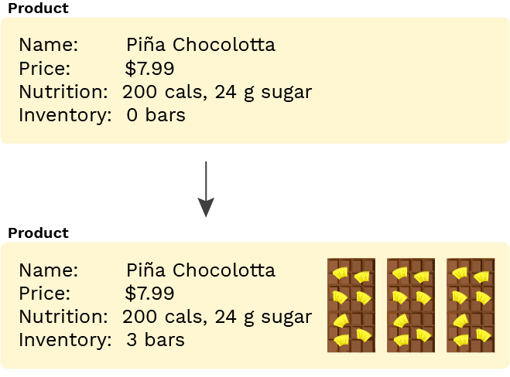
State management
An object can use instance variables to describe its state. A best practice is to hide the representation of the state and manage it entirely via method calls.
What's the initial state?
What changes the state?
>>> pina_bar = Product("Piña Chocolotta", 7.99,
["200 calories", "24 g sugar"])
>>> pina_bar.get_inventory_report()
"There are NO bars!"
>>> pina_bar.increase_inventory(3)
>>> pina_bar.get_inventory_report()
"There are 3 bars total (worth $23.97 total)."
0 bars in inventory
increase_inventory() by changing the instance variable _inventory

Slide 43
Class vs. instance variables
class Customer:
salutation = "Dear"
def __init__(self, name, address):
self.name = name
self.address = address
def get_greeting(self):
return f"{self.salutation} {self.name},"
def get_formatted_address(self):
return "\n".join(self.address)
cust1 = Customer("Coco Lover",
["123 Pining St", "Nibbsville", "OH"])
What are the class variables?
What are the instance variables?
salutation
name, address

