Slide 1
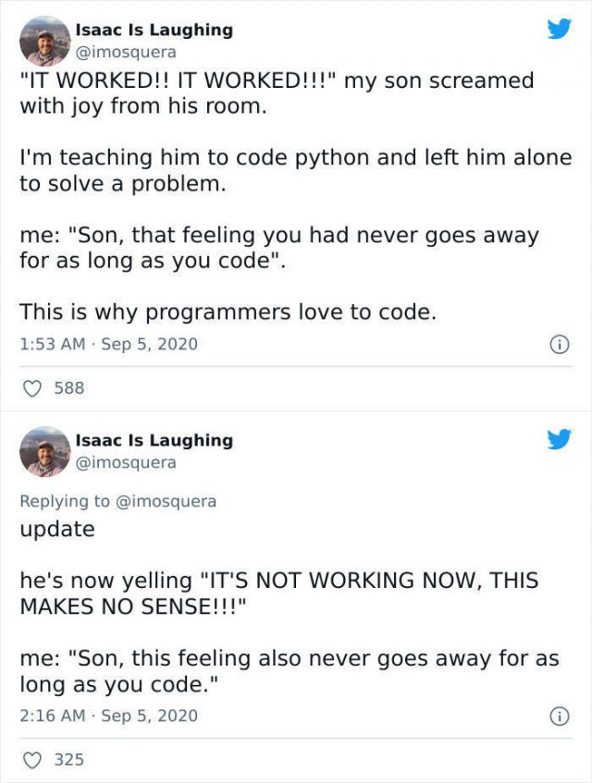

Slide 2
Classes – Inheritance & Interfaces

Slide 3
Inheritance

Slide 4
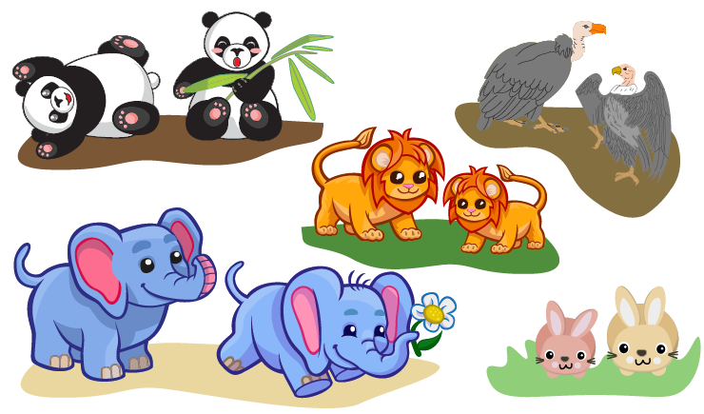
Building "Animal Conserving"
Imagine we're building a game where we take care of cute furry/ferocious animals:
What would be the classes in this program?

Slide 5
A Food Class
Let's start simple:
How would we use that class?
class Food:
def __init__(self, name, type, calories):
self.name = name
self.type = type
self.calories = calories
broccoli = Food("Broccoli Rabe", "veggies", 20)
bone_marrow = Food("Bone Marrow", "meat", 100)

Slide 6
An Elephant class
class Elephant:
species_name = "African Savanna Elephant"
scientific_name = "Loxodonta africana"
calories_needed = 8000
def __init__(self, name, age=0):
self.name = name
self.age = age
self.calories_eaten = 0
self.happiness = 0
def play(self, num_hours):
self.happiness += (num_hours * 4)
print("WHEEE PLAY TIME!")
def eat(self, food):
self.calories_eaten += food.calories
print(f"Om nom nom yummy {food.name}")
if self.calories_eaten > self.calories_needed:
self.happiness -= 1
print("Ugh so full")
def interact_with(self, animal2):
self.happiness += 1
print(f"Yay happy fun time with {animal2.name}")
How would we use this class?
el1 = Elephant("Willaby", 5)
el2 = Elephant("Wallaby", 3)
el1.play(2)
el1.interact_with(el2)

Slide 7
A Rabbit class
class Rabbit:
species_name = "European rabbit"
scientific_name = "Oryctolagus cuniculus"
calories_needed = 200
def __init__(self, name, age=0):
self.name = name
self.age = age
self.calories_eaten = 0
self.happiness = 0
def play(self, num_hours):
self.happiness += (num_hours * 10)
print("WHEEE PLAY TIME!")
def eat(self, food):
self.calories_eaten += food.calories
print(f"Om nom nom yummy {food.name}")
if self.calories_eaten > self.calories_needed:
self.happiness -= 1
print("Ugh so full")
def interact_with(self, animal2):
self.happiness += 4
print(f"Yay happy fun time with {animal2.name}")
How would we use this class?
rabbit1 = Rabbit("Mister Wabbit", 3)
rabbit2 = Rabbit("Bugs Bunny", 2)
rabbit1.eat(broccoli)
rabbit2.interact_with(rabbit1)

Slide 8
Notice similarities?
Elephant Rabbit
# Class variables
species_name
scientific_name
calories_needed
# Instance variables
name
age
happiness
# Methods
eat(food)
play()
interact_with(other)
# Class variables
species_name
scientific_name
calories_needed
# Instance variables
name
age
happiness
# Methods
eat(food)
play()
interact_with(other)
Elephant and Rabbit are both animals, so they have similar attributes. Instead of repeating code, we can inherit the code.

Slide 9
Inheritance
In object-oriented programming, inheritance is where one class is derived from another class.
The derived (child, or sub-) class has all the attributes and methods of the base (parent or super-) class.
It can then add new attributes and methods and also override methods from the parent.

Slide 11
Base and Sub classes

Slide 12
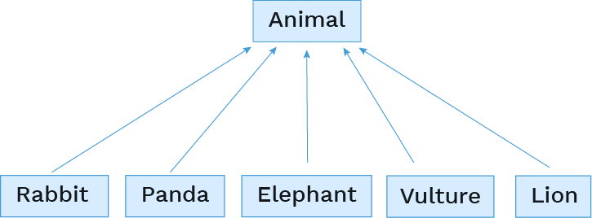
Base classes and subclasses
When multiple classes share similar attributes, you can reduce redundant code by defining a base class and then subclasses can inherit from the base class.

Slide 13
The base class
class Animal:
species_name = "Animal"
scientific_name = "Animalia"
play_multiplier = 2
interact_increment = 1
calories_needed = 0
def __init__(self, name, age=0):
self.name = name
self.age = age
self.calories_eaten = 0
self.happiness = 0
def play(self, num_hours):
self.happiness += (num_hours * self.play_multiplier)
print("WHEEE PLAY TIME!")
def eat(self, food):
self.calories_eaten += food.calories
print(f"Om nom nom yummy {food.name}")
if self.calories_eaten > self.calories_needed:
self.happiness -= 1
print("Ugh so full")
def interact_with(self, animal2):
self.happiness += self.interact_increment
print(f"Yay happy fun time with {animal2.name}")
What has changed?

Slide 14
The subclasses
To declare a subclass, put parentheses after the class name and specify the base class in the parentheses:
Then the subclasses only need the code that's unique to them. They can redefine any aspect: class variables, method definitions, or constructor. A redefinition is called overriding.
The simplest subclass overrides nothing:
But this is rarely the case or you wouldn't need a subclass!
class Panda(Animal):
class AmorphousBlob(Animal):
pass

Slide 15
Overriding class variables
Subclasses can override existing class variables and assign new class variables:
class Rabbit(Animal):
species_name = "European rabbit"
scientific_name = "Oryctolagus cuniculus"
calories_needed = 200
play_multiplier = 8
interact_increment = 4
num_in_litter = 12
class Elephant(Animal):
species_name = "African Savanna Elephant"
scientific_name = "Loxodonta africana"
calories_needed = 8000
play_multiplier = 4
interact_increment = 2
num_tusks = 2

Slide 16
Overriding methods
If a subclass overrides a method, Python will use that definition instead of the superclass definition.
How would we call that method?
class Panda(Animal):
species_name = "Giant Panda"
scientific_name = "Ailuropoda melanoleuca"
calories_needed = 6000
def interact_with(self, other):
print(f"I'm a Panda, I'm solitary, go away {other.name}!")
panda1 = Panda("Pandeybear", 6)
panda2 = Panda("Spot", 3)
panda1.interact_with(panda2)

Slide 17
Using methods from the base class
To refer to a superclass method, we can use super():
How would we call that method?
class Lion(Animal):
species_name = "Lion"
scientific_name = "Panthera"
calories_needed = 3000
def eat(self, food):
if food.type == "meat":
super().eat(food)
bones = Food("Bones", "meat", 50)
mufasa = Lion("Mufasa", 10)
mufasa.eat(bones)

Slide 18
More on super()
super().attribute refers to the definition of attribute in the superclass of the first parameter to the method.
is the same as:
super() is better style than BaseClassName, though slightly slower.
def eat(self, food):
if food.type == "meat":
super().eat(food)
def eat(self, food):
if food.type == "meat":
Animal.eat(self, food)

Slide 19
Overriding __init__()
Similarly, if we override __init__() in our subclasss, we need to explicitly call super().__init__() if we want to call the __init__ functionality of the base class.
What would this display?
class Elephant(Animal):
species_name = "Elephant"
scientific_name = "Loxodonta"
calories_needed = 8000
def __init__(self, name, age=0):
super().__init__(name, age)
if age < 1:
self.calories_needed = 1000
elif age < 5:
self.calories_needed = 3000
elly = Elephant("Ellie", 3)
elly.calories_needed
# 3000

Slide 21
Multi-level Inheritance

Slide 22
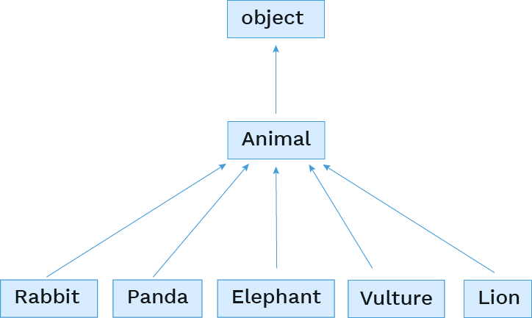
Object base class
Every Python 3 class implicitly extends the object class.

Slide 23
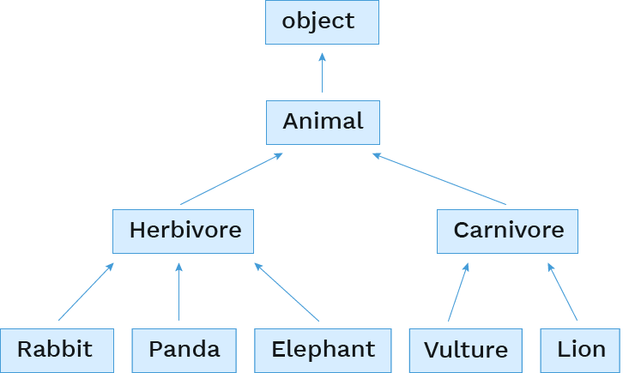
Adding layers of inheritance
But we can also add in more levels ourselves.

Slide 25
Multiple Inheritance

Slide 26
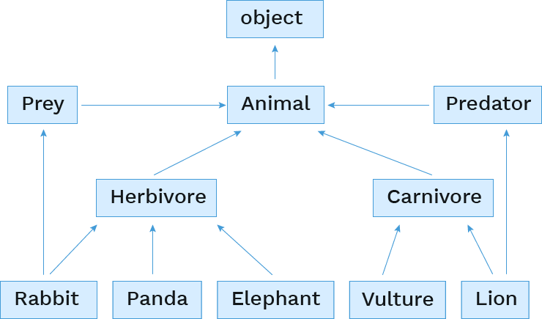
Multiple inheritance
A class may inherit from multiple base classes in Python.

Slide 27
Inheriting from multiple base classes
Then we inherit from them by putting both names in the parentheses:
class Rabbit(Prey, Herbivore):
class Lion(Predator, Carnivore):

Slide 29
Interfaces

Slide 30
Interfaces
A common use of inheritance (single or multiple) is to provide a common interface to a group of classes.
the Animal class provides the eat(), play(), and interact_with() methods
the Predator class might provide a hunt() method
the Prey class might provide an evade() and/or hide() method
The base class may not (and often doesn't) provide an implementation of the provided methods
Rather it just defines the methods' signatures, and then any function using an object of a class derived from the base class knows that it can expect that function to be there.
Python is a little loose on this, but many other languages strictly enforce it. If a method doesn't have a definition, you can't create objects of that class.

Slide 31
Relying on a common interface
If all a group of objects implement a method with the same function signature, a program can rely on that method across instances of different subclasses.
How would we call that function?
def partytime(animals):
"""Assuming ANIMALS is a list of Animals, cause each
to interact with all the others exactly once."""
for i in range(len(animals)):
for j in range(i + 1, len(animals)):
animals[i].interact_with(animals[j])
elly = Elephant("Elly", 5)
pandy = Panda("PandeyBear", 4)
scar = Lion("Scar", 12)
jane_doe = Rabbit("Jane Doe", 2)
partytime([elly, pandy, scar, jane_doe])

Slide 32
Checking identity
exp0 is exp1
evaluates to True if both exp0 and exp1 evaluate to the same object
mufasa = Lion("Mufasa", 15)
nala = Lion("Nala", 8)
mufasa is mufasa
mufasa is nala
mufasa is not nala
nala is not None
# True
# False
# True
# True

Slide 34
Composition

Slide 35
Composition
An object can contain references to objects of other classes.
What examples of composition are in an animal conservatory?
An animal has a mate.
An animal has a mother.
An animal has children.
A conservatory has animals.

Slide 36
Referencing other instances
An instance variable can refer to another instance:
How would we call that method?
class Animal:
def mate_with(self, other):
if other is not self and other.species_name == self.species_name:
self.mate = other
other.mate = self
mr_wabbit = Rabbit("Mister Wabbit", 3)
jane_doe = Rabbit("Jane Doe", 2)
mr_wabbit.mate_with(jane_doe)

Slide 37
Referencing a list of instances
An instance variable can also refer to a list of instances:
How would we call that function?
class Rabbit(Animal):
def reproduce_like_rabbits(self):
if self.mate is None:
print("oh no! better go on ZoOkCupid")
return
self.babies = []
for _ in range(0, self.num_in_litter):
self.babies.append(Rabbit("bunny", 0))
mr_wabbit = Rabbit("Mister Wabbit", 3)
jane_doe = Rabbit("Jane Doe", 2)
mr_wabbit.mate_with(jane_doe)
jane_doe.reproduce_like_rabbits()

Slide 38
Composition vs. Inheritance
Inheritance is best for representing "is-a" relationships
Rabbit is a specific type of Animal
So, Rabbit inherits from Animal
Composition is best for representing "has-a" relationships
A conservatory has a collection of animals it cares for
So, a conservatory has a list of animals as an instance variable

