Slide 1
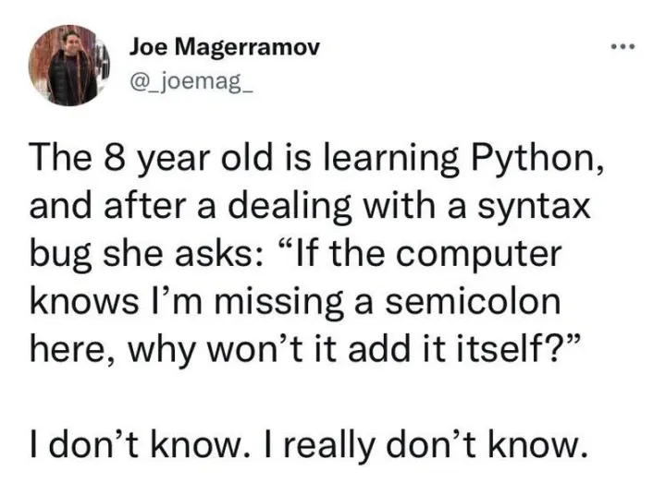

Slide 2
Exceptions

Slide 3
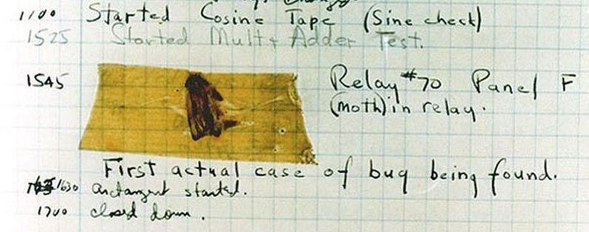
Handling errors
Sometimes, computer programs behave in non-standard ways.
  A function receives an argument value of an improper type
  Some resource (such as a file) is not available
  A network connection is lost in the middle of data transmission
  Moth found in a Mark II Computer (Grace Hopper's Notebook, 1947)

Slide 4
To Err is Human
What to do with an error:
  Return a special value.
  Use a Boolean return value to indicate success or failure.
  Set a global variable.
  Print an error message.
  Print an error message and exit the program.
  Put an input or output stream in a fail state.
The first three options allow the user of a function to respond to the error

Slide 5
Exceptions
An exception is a built-in mechanism in a programming language to declare and respond to "exceptional" conditions.
A program raises an exception when an error occurs.
If the exception is not handled, the program will stop running entirely.
But if a programmer can anticipate when exceptions might happen, they can include code for handling the exception, so that the program continues running.
Many languages include exception handling: C++, Java, Python, JavaScript, C#, etc.

Slide 6
Handling Exceptions
If exceptions are not caught and handled, they will cause the program to crash.
If we catch an exception, we can decide what to do about it
  Record it - log it to a file, print it out, send an e-mail, page someone, etc.
  Rethrow it so another part of the program can address it as well
  Retry the operation that caused the failure
  Ignore it and not pass it on (not a good idea) – called swallowing the exception

Slide 7
Exceptions
Python raises an exception whenever a runtime error occurs.
How an unhandled exception is reported:
If an exception is not handled, the program stops executing immediately.
>>> 10/0
Traceback (most recent call last):
File "<stdin>", line 1, in
ZeroDivisionError: division by zero

Slide 8
Types of exceptions
A few exception types and examples of buggy code:
See full list in the exceptions docs.
Exception | Example
OverflowError | pow(2.12, 1000)
TypeError | 'hello'[1] = 'j'
IndexError | 'hello'[7]
NameError | x += 5
FileNotFoundError | open('dsfdfd.txt')

Slide 10
The try Statement

Slide 11
The try statement
To handle an exception (keep the program running), use a try statement.
The <try suite> is executed first. If, during the course of executing the <try suite>, an exception is raised that is not handled otherwise, and If the class of the exception inherits from <exception class>, then the <except suite> is executed, with <name> bound to the exception.
try:
<try suite>
except <exception class> as <name>:
<except suite>
...

Slide 12

Try statement example
try:
quot = 10/0
except ZeroDivisionError as e:
print('handling a', type(e))
quot = 0
View in PythonTutor

Slide 13
Try inside a function
def div_numbers(dividend, divisor):
try:
quotient = dividend/divisor
except ZeroDivisionError:
print("Function was called with 0 as divisor")
quotient = 0
return quotient
div_numbers(10, 2)
div_numbers(10, 0)
div_numbers(10, -1)
View in PythonTutor

Slide 14
What would Python do?
def invert(x):
inverse = 1/x # Raises a ZeroDivisionError if x is 0
print('Never printed if x is 0')
return inverse
def invert_safe(x):
try:
return invert(x)
except ZeroDivisionError as e:
print('Handled', e)
return 0
invert_safe(1/0)
try:
invert_safe(0)
except ZeroDivisionError as e:
print('Handled!')
inverrrrt_safe(1/0)

Slide 16
Raising exceptions

Slide 17
Assert statements
Assert statements raise an exception of type AssertionError:
  where <expression> should evaluate to True and if it doesn't, <string> is the message passed with the AssertionError
Assertions are designed to be used liberally. They can be ignored to increase efficiency by running Python with the "-O" flag; "O" stands for optimized.
Put assertions in your code wherever your code is checking input or conditions that you as the programmer have control over. If an assertion is raised, it means you have a bug that you can fix.
If you don't have control over the input, raise an exception.
assert <expression>, <string>
python3 -O

Slide 18
Raise Statements
Any type of exception can be raised with a raise statement
<expression> must evaluate to a subclass of BaseException or an instance of one
Exceptions are constructed like any other object. e.g.,
raise <expression>
TypeError('Bad argument!')

Slide 19
When we should not use exceptions
When an error event happens routinely and could be considered part of normal execution, handle without throwing exceptions.
  Generate error codes or return values
  Use if() statements to check and handle errors

Slide 20
When we should use exceptions
When we don't have control of the input or processing state, we should use exceptions to report errors
Use try-except blocks
  Around code that can potentially (and unexpectedly) generate an exception.
  Prevent and recover from application crashes.
  Raise an exception when your program can identify an external problem that prevents execution.

Slide 21
Advantages of using exceptions
Compared to error reporting via return-codes and if statements, using try / except / raise is likely to result in code
  that is easier to read,
  that has fewer bugs,
  is less expensive to develop,
  and has faster time-to-market (time-to-submission for students ☺).

Slide 22
Input validation
Input validation is a form of defensive programming.
Whenever a function or method receives input from a user, it is a good practice to validate that the input provided is in the function's domain.
If the arguments are provided by the user, we should raise exceptions or return error codes.
If the arguments are provided by the developer, we should use assertions.
def sqrt(x):
if x < 0:
raise ValueArgument ("Negative numbers not allowed.")
# code to compute square root

Slide 24
Decomposition

Slide 25
Modules & Packages

Slide 26
Python modules
A Python module is a file typically containing function or class definitions.
link.py:
class Link:
empty = ()
def __init__(self, first, rest=empty):
assert rest is Link.empty or isinstance(rest, Link)
self.first = first
self.rest = rest
def __repr__(self):
if self.rest:
rest_repr = ', ' + repr(self.rest)
else:
rest_repr = ''
return 'Link(' + repr(self.first) + rest_repr + ')'
def __str__(self):
string = '<'
while self.rest is not Link.empty:
string += str(self.first) + ' '
self = self.rest
return string + str(self.first) + '>'

Slide 27
Importing
Importing a whole modules
Importing specific names:
Importing all names:
import link
ll = link.Link(3, link.Link(4, link.Link(5)))
from link import Link
ll = Link(3, Link(4, Link(5)))
from link import *
ll = Link(3, Link(4, Link(5)))

Slide 28
Importing with alias
I don't recommend aliasing a class or function name:
But aliasing a whole module is sometimes okay (and is common in data science):
from link import Link as LL
ll = LL(3, LL(4, LL(5)))
import numpy as np
b = np.array([(1.5, 2, 3), (4, 5, 6)])

Slide 29
Running a module
This command runs a module:
When run like that, Python sets a global variable __name__ to "__main__". That means you often see code at the bottom of modules like this:
The code inside that condition will be executed as well, but only when the module is run directly.
python module.py
if __name__ == "__main__":
# use the code in the module somehow

Slide 30
Python packages
A Python package is a way of bundling multiple related modules together. Popular packages are NumPy and Pillow.
Example package structure
sound/ Top-level package
__init__.py Initialize the sound package
formats/ Subpackage for file format conversions
__init__.py
wavread.py
wavwrite.py
aiffread.py
aiffwrite.py
auread.py
auwrite.py
...
effects/ Subpackage for sound effects
__init__.py
echo.py
surround.py
reverse.py
...
filters/ Subpackage for filters
__init__.py
equalizer.py
vocoder.py
karaoke.py
...

Slide 31
Installing packages
The Python Package Index is a repository of packages for the Python language.
Once you find a package you like, pip is the standard way to install:
You may need to use pip3 if your system defaults to Python 2.
You may also need to use the longhand form if your system is grabbing pip from a different installation than the actual python interpreter:
pip install byuimage
python –m pip install byuimage

Slide 32
Importing from a package
Importing a whole path:
Importing a module from the path:
import sound.effects.echo
sound.effects.echo.echofilter(input, output, delay=0.7, atten=4)
from sound.effects import echo
echo.echofilter(input, output, delay=0.7, atten=4)

Slide 34
Modularity

Slide 35
Modular design
A design principle: Isolate different parts of a program that address different concerns.
A modular component can be developed and tested independently.
Ways to isolate in Python:
  Functions
  Classes
  Modules
  Packages

Slide 36
Image Processing Project Design
byuImage Package
Image, Pixel classes
image_processing.py
Code that uses the Image package

Slide 37
Sand Project Design
Grid.py
Grid representation
Sand.py
Sand representation
datetime Package
date & time tools
sand_oo.py
GUI functionality
tkinter Package
GUI Tools

Slide 39
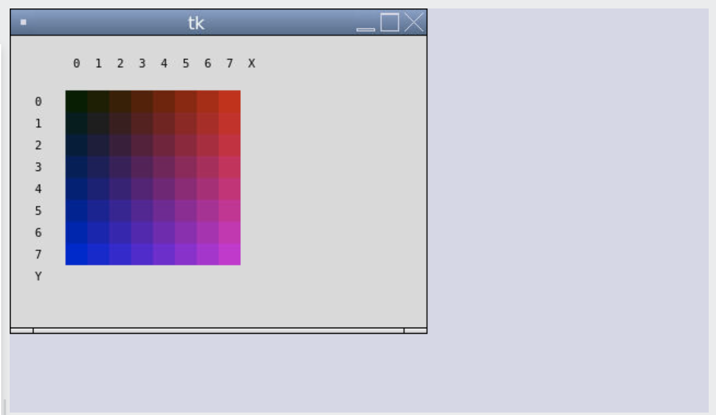
Icon Project

Slide 40
Icon Design
icon.py
display_frame.py
Icon Pixel Color
Defines classes for icon + parts
DisplayFrame
Defines class for displaying icon on canvas
main.py
Creates an Icon and displays in DisplayFrame.

Slide 41
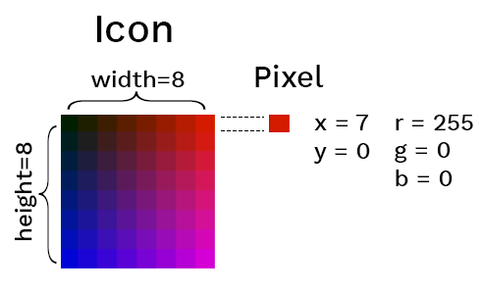
An OOP Icon
Goal: Use OOP to represent an Icon with pixels at a particular location with a particular color.

Slide 42
The Color Class
class Color:
def __init__(self, r, g, b):
self.r = r
self.g = g
self.b = b
def __repr__(self):
return f"Color({self.r},{self.g},{self.b})"
def __str__(self):
return f "{self.r},{self.g},{self.b}"
def to_hex(self):
return f"#{self.r:02x}{self.g:02x}{self.b:02x}"
red = Color(255, 0, 0)
print(red.to_hex())

Slide 43
The Pixel Class
class Pixel:
def __init__(self, x, y, r, g, b):
self.x = x
self.y = y
self.color = Color(r, g, b)
def __repr__(self):
return f"Pixel({self.x},{self.y},{self.color})"
pixel = Pixel(0, 7, 255, 0, 0)
print(pixel.color.to_hex())

Slide 44
The Icon Class
class Icon:
def __init__(self, width, height, pixels=None):
self.width = width
self.height = height
self.pixels = pixels
if not self.pixels:
self.pixels = [ Pixel(x, y, 0, 0, 0)
for x in range(width) for y in range(height)]
def __repr__(self):
pixels = ",".join([repr(pixel) for pixel in self.pixels])
return f"Icon({self.width}, {self.height}, [{pixels}])"
icon = Icon(2, 2, [Pixel(0, 0, 255, 0, 0),
Pixel(0, 1, 255, 50, 0),
Pixel(1, 0, 255, 100, 0),
Pixel(1, 1, 255, 150, 0)])
for pixel in icon.pixels:
pixel.color.g += 50

Slide 45
The DisplayFrame Class
from tkinter import Canvas, Frame, BOTH, font
class DisplayFrame(Frame):
def __init__(self):
super().__init__()
self.pack(fill=BOTH, expand=1)
self.canvas = Canvas(self)
self.canvas.pack(fill=BOTH, expand=1)
def draw_icon(self, icon):
x_offset = 50
y_offset = 50
pixel_size = 20
for pixel in icon.pixels:
top_left_x = x_offset + pixel.x * pixel_size
top_left_y = y_offset + pixel.y * pixel_size
self.canvas.create_rectangle(
top_left_x,
top_left_y,
top_left_x + pixel_size,
top_left_y + pixel_size,
outline="",
fill=pixel.color.to_hex())

Slide 46
The main module
from tkinter import Tk
from icon import Icon, Pixel, Color
from display_frame import DisplayFrame
# Initialize the Tkinter frame and canvas
root = Tk()
# Create an icon
icon = Icon(2, 2, [Pixel(0, 0, 255, 0, 0),
Pixel(0, 1, 255, 50, 0),
Pixel(1, 0, 255, 100, 0),
Pixel(1, 1, 255, 150, 0)])
# Draw the icon
display = DisplayFrame()
display.draw_icon(icon)
# Run Tkinter loop
root.mainloop()
Visit the Repl.it demo to see all the classes used with the Python tkinter package for graphics rendering.

Slide 48
Iterator-producing functions
What happens if we...
map the pixels?
filter the pixels?
changer = lambda p: Pixel(p.x, p.y,
p.x * 30,
p.color.g + 30,
p.y * 30)
icon.pixels = list(map(changer, icon.pixels))
is_odd = lambda p: p.x % 2 == 0
icon.pixels = list(filter(is_odd, icon.pixels))

Slide 49
Iterable-processing functions
What happens if we ask for the min and max of the pixels?
Python doesn't know how to compare Pixel instances! Two options:
  Implement dunder methods ( __eq__ , __lt__ , etc.)
  Pass in a key function that returns a numerical value:
max_pix = max(icon.pixels)
min_pix = min(icon.pixels)
rgb_adder = lambda p: p.color.r + p.color.g + p.color.b
max_pix = max(icon.pixels, key=rgb_adder)
min_pix = min(icon.pixels, key=rgb_adder))

