Slide 1
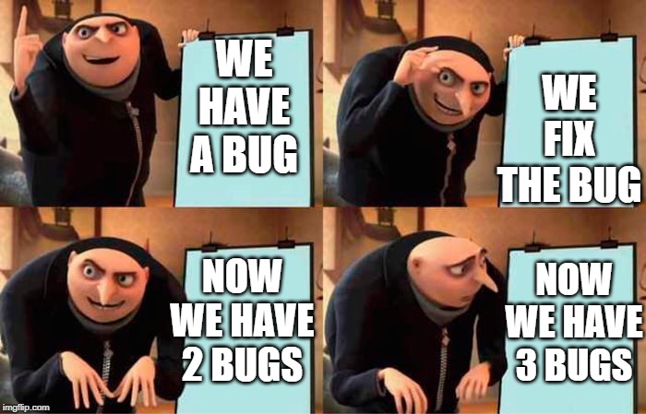

Slide 2
Functional Programming & Higher-order Functions

Slide 3
Side effects

Slide 4
Side effects
A side effect is when something happens as a result of calling a function besides just returning a value.
The most common side effect is logging to the console, via the built-in print() function.
print(-2)
A similar side effect is writing to a file:
f = open('songs.txt', 'w')
f.write("Dancing On My Own, Robyn")
f.close()

Slide 5
Side effects vs. Return values
def square_num1(number):
return pow(number, 2)
def square_num2(number):
print(number ** 2)
Which one has a side effect?
The second function has a side effect, because it prints to the console.
What data type do they each return?
The first function returns a number, the second one returns None.

Slide 7
Pure functions

Slide 8
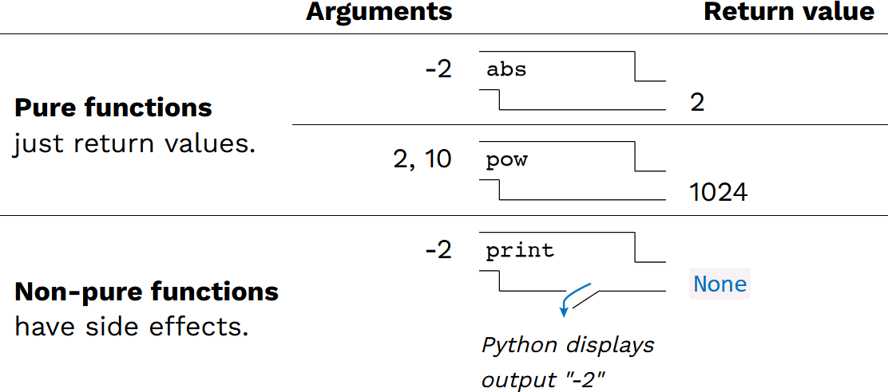
Pure vs. non-pure functions
In programming, we can talk about pure vs. non-pure functions
Pure function – no side effects
Non-pure function – has side effects

Slide 9
Benefits of pure functions
Pure functions provide several benefits
The output of a function is only dependent on its input and is repeatable
same input always means the same output
can't influence or be influenced by external "state"
This is great for math and mathematical proofs
Functions can be tested and verified independent of one another which makes testing easier
Code is easier to parallelize – since it doesn't depend on anything else or affect anything else, it can be run in isolation

Slide 11
Functional Programming

Slide 12
Functional Programming
"Functional programming" is a paradigm that strives to achieve all the benefits of using pure functions in the execution of code.
The chief characteristics of functional programming are:
Programs are more declarative instead of imperative
Functions as first-class objects & higher-order functions
Limited or no side-effects
Immutability of objects
Recursion for control flow
While many (or even most) modern languages support the functional programming paradigm, there are many languages where this it the core programming style
e.g. Haskell, Erlang, Clojure, Common Lisp, and Scala

Slide 13
Why functional programming?
Can be much easier to test and validate
Code is often simpler and more modular
Code written in a functional programming (FP) style is easier to parallelize
FP style is heavily used in the machine learning and big data fields
Many modern development frameworks are written in a functional style

Slide 14
Functional programming downsides
More mathematically based and the vocabulary can be intimidating
Programs can sometimes be harder to read and understand
Can potentially require more time and/or memory space to execute
Can't be used everywhere (database connections, servers, etc.)
You really need to understand recursion

Slide 15
Characteristics of Functional programming
Let's look at some of the characteristics of functional programming.
We've already seen some of them in this class
Functions as first-order objects
Side effects and pure vs. impure functions (today)
The new topics include:
Declarative vs imperative programming (today)
Higher-order functions (today and next time)
Function composition (next time)
Immutability of objects (soon)
Recursion (after the midterm)

Slide 17
Declarative vs. Imperative programming

Slide 18
Declarative programming
In imperative languages:
A "program" is a description of computational processes
The interpreter carries out execution/evaluation rules
In declarative languages:
A "program" is a description of the desired result
The interpreter figures out how to generate the result

Slide 19
Domain-specific languages
Many declarative languages are domain-specific: they are designed to tackle problems in a particular domain, instead of being general purpose multi-domain programming languages.
Language | Domain
Regular expressions | Pattern-matching strings
Backus-Naur Form | Parsing strings into parse trees
SQL | Querying and modifying database tables
HTML | Describing the semantic structure of webpage content
CSS | Styling webpages based on selectors
Prolog | Describes and queries logical relations

Slide 20
Display an image – Declarative vs. Imperative
Python
HTML
from byuimage import Image
print("Hello")
img = Image("profile.jpg")
img.show()
<html>
<p>Hello</p>
<img src="profile.jpg">
<html>
The imperative language (Python) tells the computer what to do at each step to print a message and display an image.
Import the image library, print the message, load the image, display it
The declarative language (HTML) just tells that compute that it wants the message displayed and then an image. The language worries about how that is done.

Slide 22
Designing Functions

Slide 23
Describing Functions
def square(x):
"""Returns the square of X."""
return x * x
Aspect | Example
A function's domain is the set of all inputs it might possibly take as arguments. | x is a number
A function's range is the set of output values it might possibly return. | square returns a non-negative real number
A function's behavior is the relationship it creates between input and output. | square returns the square of x

Slide 24
Designing a function
Give each function exactly one job, but make it apply to many related situations.
Don't Repeat Yourself (DRY): Implement a process just once, execute it many times.
round(1.23) # 1
round(1.23, 0) # 1
round(1.23, 1) # 1.2
round(1.23, 5) # 1.23

Slide 25
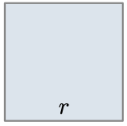
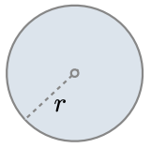
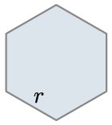
Generalizing patterns with arguments
Geometric shapes have similar area formulas.
Shape
$$\frac{3\sqrt{3}}{2}∗r^{2}$$
Area
$$1∗r^{2}$$
$$π∗r^{2}$$

Slide 26
A non-generalized approach
from math import pi, sqrt
def area_square(r):
return r * r
def area_circle(r):
return r * r * pi
def area_hexagon(r):
return r * r * (3 * sqrt(3) / 2)
How can we generalize the common structure?

Slide 27
Generalized area function
from math import pi, sqrt
def area(r, shape_constant):
"""Return the area of a shape from length measurement R."""
if r < 0:
return 0
return r * r * shape_constant
def area_square(r):
return area(r, 1)
def area_circle(r):
return area(r, pi)
def area_hexagon(r):
return area(r, 3 * sqrt(3) / 2)

Slide 29
Higher-order Functions

Slide 30
What are higher-order functions?
A function that either:
Takes another function as an argument
Returns a function as its result
All other functions are considered first-order functions.

Slide 31
Generalizing over computational processes
$$\sum_{k=1}^{5}{k}=1+2+3+4+5=15$$
$$\sum_{k=1}^{5}{k^{3}}=1^{3}+2^{3}+3^{3}+4^{3}+5^{3}=225$$
$$\sum_{k=1}^{5}{\frac{8}{\left(4k−3\right)∗(4k−1)}}=\frac{8}{3}+ \frac{8}{35}+ \frac{8}{99}+ \frac{8}{195}+ \frac{8}{323}=3.04$$
The common structure among functions may be a computational process, not just a number

Slide 32
Functions as arguments
def cube(k):
return k ** 3
def summation(n, term):
"""Sum the first N terms of a sequence. TERM is a function
that takes a single argument and returns a result.
>>> summation(5, cube)
225
"""
total = 0
k = 1
while k <= n:
total = total + term(k)
k = k + 1
return total

Slide 34
Functions as return values

Slide 35
Locally defined functions
Functions defined within other function bodies are bound to names in a local frame.
def make_adder(n):
"""Return a function that takes one argument k
and returns k + n.
>>> add_three = make_adder(3)
>>> add_three(4)
7
"""
def adder(k):
return k + n
return adder
View in PythonTutor

Slide 36
Call expressions as operator expressions
3
make_adder(1)( 2 )
Operator
Operand
func adder(k)
make_adder(1)
2
func make_adder…
1
make_adder(n)
def adder(k):
return k + n
return adder
func adder(k)

