Slide 1


Slide 2
Function Composition, Lambdas, & Decorators

Slide 3
Function composition

Slide 4
Function composition
Functional composition is the process of combining simpler, pure functions into a more complex function.
  The results of the first function becomes the input to the second and the results of the last function is the result of the whole.
  Mathematically this looks like result = f(g(x))
Functions can be combined as needed to do more complex tasks
It's easy to test the simple base functions and therefore verify that the complex task is performed correctly.

Slide 5

Example: Composer
def happy(text):
return "☻" + text + "☻"
def sad(text):
return "☹" + text + "☹"
def composer(f, g):
def composed(x):
return f(g(x))
return composed
msg1 = composer(sad, happy)("CS 111!")
msg2 = composer(happy, sad)("CS 240!")
What do you think will happen?
View in PythonTutor

Slide 6
Example: Composer (part 2)
One of the composed functions could itself be an HOF...
def happy(text):
return "☻" + text + "☻"
def make_texter(emoji):
def texter(text):
return emoji + text + emoji
return texter
def composer(f, g):
def composed(x):
return f(g(x))
return composed
composer(happy, make_texter("☃︎"))('snow day!')
View in PythonTutor

Slide 8
Lambda expressions

Slide 9
Lambda Syntax
A lambda expression is a simple function definition that evaluates to a function.
The syntax:
A function that takes in parameters and returns the result of expression.
A lambda version of the square function:
A function that takes in parameter x and returns the result of x * x.
lambda <parameters>: <expression>
square = lambda x: x * x

Slide 10
square = lambda x: x * x
A lambda expression does not contain return statements or any statements at all.
Incorrect:
Correct:
square = lambda x: return x * x
square = lambda x: x * x

Slide 11
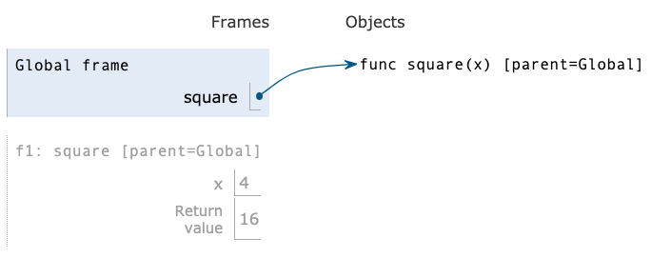
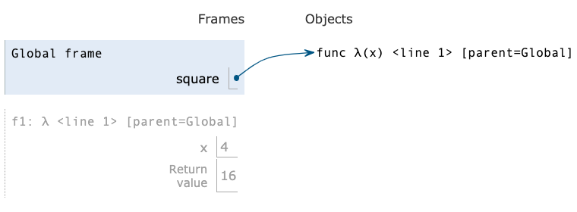
Def statements vs. Lambda expressions
def square(x):
return x * x
vs
square = lambda x: x * x
Both create a function with the same domain, range and behavior
Both bind that function to the name square.
Only the def statement gives the function an intrinsic name, which shows up in environment diagrams but doesn't affect execution (unless the function is printed).

Slide 12
Lambda as argument
It's convenient to use a lambda expression when you are passing in a simple function as an argument to another function.
Instead of...
We can use a lambda
def cube(k):
return k ** 3
summation(5, cube)
summation(5, lambda k: k ** 3)

Slide 14
Conditional Expressions

Slide 15
Conditional expressions
A conditional expression has the form:
Evaluation rule:
  Evaluate the <predicate> expression.
  If it's a true value, the value of the whole expression is the value of the <consequent>.
  Otherwise, the value of the whole expression is the value of the <alternative>.
<consequent> if <predicate> else <alternative>

Slide 16
Lambdas with conditionals
This is invalid syntax:
Conditional expressions to the rescue!
lambda x: if x > 0: x else: 0
lambda x: x if x > 0 else 0

Slide 18
Decorators

Slide 19
A tracing function
Let's make a higher-order tracing function
def trace1(f):
"""Return a function that takes a single argument, x, prints it,
computes and prints F(x), and returns the computed value.
>>> square = lambda x: x * x
>>> trace1(square)(3)
-> 3
<- 9
9
"""
def traced(x):
print("->", x)
r = f(x)
print("<-", r)
return r
return traced

Slide 20
A tracing decorator
What if we always wanted a function to be traced?
That's equivalent to..
@trace1
def square(x):
return x * x
def square(x):
return x * x
square = trace1(square)

Slide 21
General decorator syntax
The notation:
is essentially equivalent to:
ATTR can be any expression, not just a single function name.
@ATTR
def aFunc(...):
...
def aFunc(...):
...
aFunc = ATTR(aFunc)

