Slide 1
CS 111: Introduction to Computer Science

Slide 2
A Very Brief Introduction to Computer Science

Slide 3
What is Computer Science?
What problems can be solved using computing
The study of …
How to solve these problems
What techniques lead to effective solutions
Systems
Graphics
Security
Decision Making
Answering Questions
Artificial Intelligence
Robotics
Translation
Networking
Ethics & Safety
…
Programming Languages
Natural Language Processing
Theory
…
Scientific Computing
Human Computer Interaction
…

Slide 5
About this Course

Slide 6
Learning Outcomes I
Computing: Write programs to accomplish tasks relevant to computer science, such as data visualization, image processing, simulations, data processing, etc.
Design: Design and develop moderate to medium-sized programs for problems with significant complexity, using both object-oriented and functional paradigms.
Abstraction: Effectively use modules, classes, and functions to decompose functionality of a medium-complexity system.
Data Structures: Effectively choose and utilize data structures to organize data in a program.
Algorithms: Effectively use basic algorithms to design and develop a program, including recursion.

Slide 7
Learning Outcomes II
Libraries: Independently read documentation for a library, understand its operation, and incorporate the library into a program to extend its functionality.
Testing and Debugging: Write unit tests to ensure complete and correct functioning of a program. Explain the meaning of error messages encountered when running a program. Use the debugger in an IDE to step through code execution and identify the source of a bug.
Confidence: Demonstrate increased confidence in ability to design, develop, test, and debug programs.

Slide 8

Course topics
Managing complexity in programs (procedural abstractions, data abstractions, programming paradigms)
Deep understanding of programming concepts (using Python)
How computers interpret computer programs
Different types of languages (Python, Regex, Calculator, HTML)
Problem solving techniques (both iterative and recursive approaches)
HTML, HTTP, & the web
Plotting
Software design, testing, & debugging
This course is challenging and often mind-blowing! 🤯

Slide 9
Course Prerequisites
This is NOT an introductory programming class.
You should have prior coding experience with variables, conditionals, branching, loops, functions, and input/output.
If you do not think you have enough programming experience, consider taking CS 110 and joining us next semester.

Slide 11
Course Format

Slide 12
Course Components
Lectures
Labs
Homework assignments
Projects
Exams 😱
Supplemental Textbook (composingprograms.com)
Office hours
Everything is linked from the class website: https://cs111.byu.edu

Slide 13
Weekly Schedule
Monday | Tuesday | Wednesday | Thursday | Friday | Saturday
Lecture |  | Lecture
 | Lab Section |  | Lab Section
 |  | Homework/ Project assignments typically due

Slide 14
Lab Sections
Make sure you are signed up for a Lab section (006-015, 018) as well as the lecture.
Each lab section has a pair of TAs that will lead the activities in those sections. You’ll have the same TAs all semester.
Labs will focus on small coding challenges that provide practice with materials covered in lecture in a safe, supportive environment where you can discuss problems with peers and TAs.
They are a place to “Take chances, make mistakes, and get messy!” – Miss Frizzle.
Attendance is not required, but STRONGLY encouraged. Whether you attend or not, you must submit working code to the auto-grader by the end of the day for credit.

Slide 15
Homeworks & Projects
Homework and Projects are usually due on Wednesday nights. See the course website for exact due dates. Start early, code often!
These often build on and use code from your labs and previous homework assignments.
The course moves fairly fast. Start early! The earlier you find you need help, the better!
You can discuss the assignments at a high-level, but don't copy anyone else's code.

Slide 16
Exams 😱
Midterm 1: Feb 10-14
Midterm 2: Mar 17-20
Final Exam: finals week (Apr 18-23)
All exams are in the Testing Center for in-person classes and online in Canvas for the online section of the class.
Tests are multiple choice, with a page or two of notes and a calculator, but no accessing other resources.

Slide 18
Getting Help

Slide 19
Getting Help
Post questions on the class Discord (invite link: https://discord.gg/zEJgc29exj)
Visit the TA lab (1121 TMCB)
Use the help queue: https://students.cs.byu.edu/~cs111ta/helpqueue/
Come see your professor.
Check out our contact page for how to get in touch (https://cs111.byu.edu/staff/#contact/).

Slide 20
TAs
We have an awesome group of TAs 😎. See the course website for information about them.
The TAs are regularly available five days per week in the help lab at TMCB 1121. Check the schedule at https://cs111.byu.edu/staff/#ta-lab.

Slide 21
TA Responsibilities
TA’s are responsible for:
  Clarifying assignments.
  Working with students one-on-one to help understand concepts.
  Help with grading.
  Motivate students in creative direction.
TA’s are NOT responsible for:
  Debugging student programs.
  Providing solutions during help sessions.

Slide 22
Student Responsibilities
Students should take an active role in their learning and recognize they are accountable for their academic success.
Be in class. Don't jeopardize your own training.
Sweating a little is good. School is your brain gym. You have to work out your muscles, make them a little sore, if you're going to lift a heavier load later on.
Complete the assigned work in a timely manner with attention to quality of work.
Avoid making excuses for your behavior.
Utilize college resources and seek help when needed.
Use help queue sparingly!

Slide 23
Tip #1: Don’t Get Behind
If you find yourself struggling with the material, falling behind on assignments, facing personal problems, lacking motivation, or experiencing any difficulty that effects your schoolwork …
  Resolving problems sooner is always better than later.
  Talk with the TAs and professor at the first sign of problems.
  Attend all lectures and help sessions.
  Work with the TAs – especially in morning hours.
  Maximize deadlines met.
  Run to completion – avoid context switching (distractions).
There is little that can be done to improve your grade if you wait until reading day.

Slide 25
Course Policies

Slide 26
Course Policies
Read the syllabus. You are responsible for knowing the information there (https://cs111.byu.edu/articles/about/).
Late Policy
  Assignment turned in on time or early: full credit
  Assignment turned in up to a week late: 90% credit
  Assignment turned in by the end of the semester: 80% credit

Slide 27
Collaboration
Asking questions is highly encouraged
  Discuss everything with each other; learn from each other!
  Some projects can be completed with a partner
  Choose a partner from your lab section
The limits of collaboration
  Please don’t look at someone else's code!
    Exceptions: lab, your project partner, or after you already solved the problem
  Please don't tell other people the answers! You can point them to what is wrong and describe how to fix it, but don't tell them what to type, and don't type for them
  Copying project solutions causes people to fail the course
  We really do catch people who violate the rules, and we're getting better at it.

Slide 28
Community Guidelines
Your goal should be to learn and help others learn.
Even though everyone here has programming experience, there is still a wide range of experience levels. All are welcome!
🧑🏻‍💻🧑🏼‍💻👩🏻‍💻🧑🏽‍💻🧑🏾‍💻👩🏽‍💻🧑🏿‍💻👩🏾‍💻👨🏻‍💻👩🏿‍💻👨🏼‍💻👨🏽‍💻👩🏼‍💻👨🏾‍💻👨🏿‍💻
There are no "stupid" questions. Ask all your questions and welcome everyone else's questions.
🙋🏻🙋🏼🙋🏿‍♀️🙋🏽🙋🏾‍♀️🙋🏾🙋🏿🙋🏽‍♀️🙋🏻‍♂️🙋🏼‍♀️🙋🏼‍♂️🙋🏽‍♂️🙋🏻‍♀️🙋🏾‍♂️🙋🏿‍♂️🙋🏻‍♀️

Slide 29
Using Large Language Models (ChatGPT and the like)
These can be quite useful for helping you to understand a topic and to answer specific questions.
  On the class Discord server, you can ask questions in the Duck Pond channel. The rubber duck is powered by ChatGPT and is designed to be a "Virtual TA" to help you with concept questions
You should NOT be asking LLMs to give you code for your assignments.
  They will happily do so, but
    We expect you to write the code yourself.
    The code from the LLMs is often wrong or uses advanced material we're not covering in class.
  When you go to get help from the TAs, the first thing they will do is ask you to explain your code and what it is doing.

Slide 30

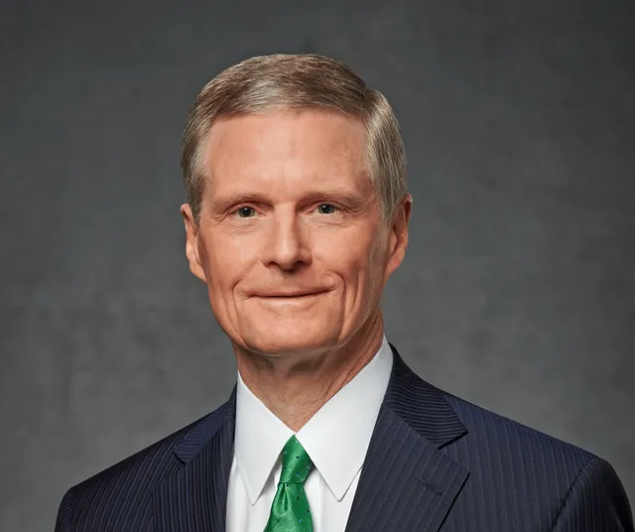
More on the use of AI
Elder Bednar gave a great talk, "Things as They Really Are 2.0," in his Young Adult Devotional in Nov. 2024.
  Link to the full talk – you should watch this if you haven't yet.
This should be your guiding principle in using AI in this class.
Some key excerpts:

Slide 31
Questions?

Slide 32
Basic Python Syntax

Slide 33
Values & Expressions

Slide 34
What do programs do?
Programs work by manipulating values
Expressions in programs evaluate to values
  Expression: 'a' + 'hoy'
  Value: 'ahoy'
  The Python interpreter evaluates expressions and displays their values
Statements give direction to the program
  assigning values
  defining things
  determining program flow

Slide 35
Values
Programs manipulate values.
Each value has a certain data type.
Try these in a Python interpreter. What gets displayed?
Data Type | Example Values
Integers | 2 44 -3
Floats | 3.14 4.5 -2.0
Booleans | True False
Strings | '¡hola!' 'its python time!'

Slide 36
Expressions (with operators)
An expression describes a computation and evaluates to a value.
Some expressions use operators:
  addition: 18 + 69
  subtraction: 2024 - 1972
  multiplication: 2 * 100
  division
    floating point: 23/6
    integer: 23//6
    modulus: 23 % 6
Try these in a Python interpreter. What gets displayed?

Slide 37
Call Expressions
Many expressions use function calls:
  pow(2,100)
  max(50, 300, -1600)
  min(1, -300, -67)
Function calls are a type of expression, called a call expression, and like operator expressions evaluate to some value.

Slide 38
Anatomy of a Call Expression
add ( 18 , 69 )
Operator
Operand
Operand
How Python evaluates a call expression:
Evaluate the operator
Evaluate the operands
Apply the operator (a function) to the evaluated operands (arguments)
Operators and operands are also expressions, so they must be evaluated to discover their values.

Slide 39
Evaluating nested expressions
45
add(add(6, mul(4, 6)), mul(3, 5))
30
15
add
add(6, mul(4, 6))
mul(3, 5)
24
add
6
mul(4, 6)
mul
3
5
This is called an expression tree.
mul
4
6

