Slide 1
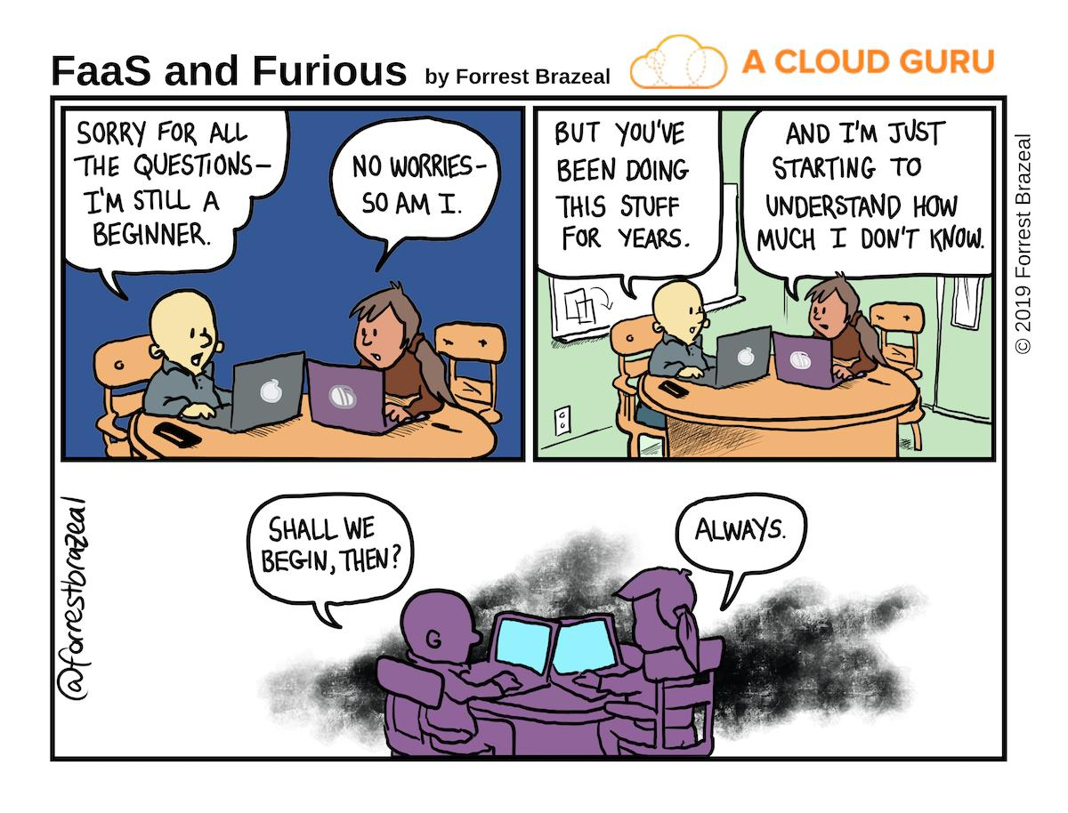

Slide 2
I/O, Conditionals, Booleans, & Libraries

Slide 3
Statements

Slide 4
Statements
A statement is executed by the interpreter to perform an action.
Some examples (details on these in future slides and lectures)
Statement type | Example
Assignment statement | name = 'sosuke' greeting = 'ahoy, ' + name
Def statement | def greet(name): return 'ahoy, ' + name
Return statement | return 'ahoy, ' + name

Slide 5
Compound statements
A compound statement contains groups of other statements.
<header>:
<statement>
<statement>
...
<separating header>:
<statement>
<statement>
...
# CLAUSE
# SUITE
# CLAUSE
# SUITE
The first header determines a statement's type, and the header of each clause controls the suite that follows.

Slide 6
Python and Whitespace
In Python, whitespace matters!
  This is different than most other languages, especially the curly brace languages (C & C++ and their derivatives such as Java, C#, Javascript, etc.)
Python uses newlines to signify the end of statements
Python uses the indentation level to signify the contents of suites or blocks of code.
Everything in a block of code must be at the same indentation level.
It can be tabs or spaces but must be the same for any given suite – no mixing and matching.

Slide 7
Execution of suites
A suite is a sequence of statements.
Execution rule for a sequence of statements:
  Execute the first statement
  Unless directed otherwise, execute the rest
<header>:
<statement>
<statement>
...
<separating header>:
<statement>
<statement>
...
# SUITE
# SUITE

Slide 9
Names

Slide 10
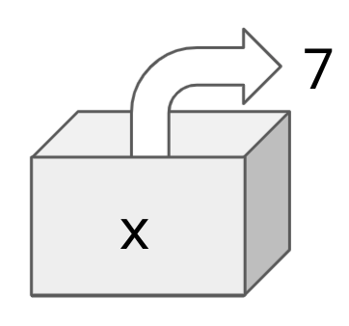
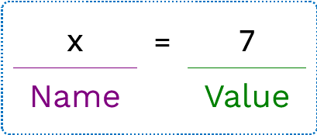
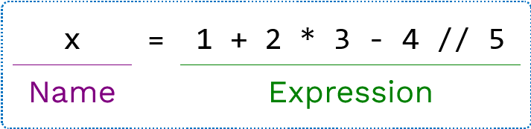
Names
A name can be bound to a value.
One way to bind a name is with an assignment statement.
The value can be any expression:

Slide 11
Using names
A name can be referenced multiple times:
A name that's bound to a data value is also known as a variable.
Be aware that in Python, you can also bind names to existing functions:
x = 10
y = 3
result1 = x * y
result2 = x + y
f = pow
f(10, 2) #=> 100

Slide 12
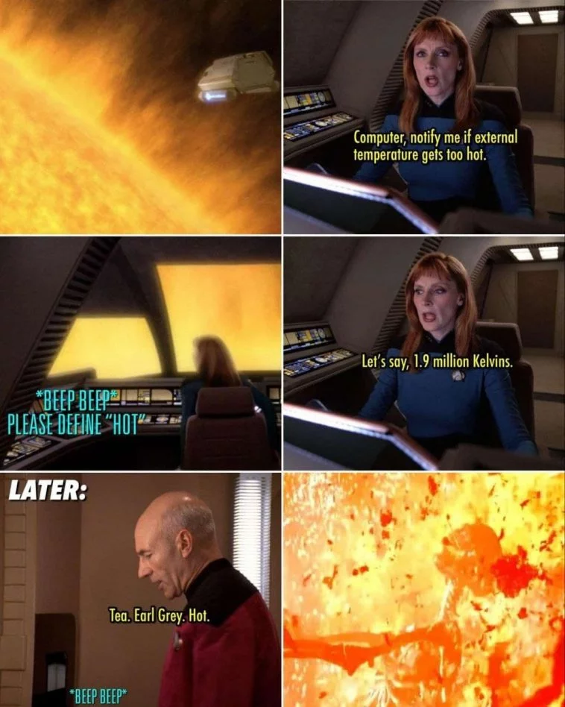
Name rebinding
A name can only be bound to a single value
💬 Will that code cause an error? If not, what will my_name store?
It will not error (similar code in other languages might, however). The name my_name is now bound to the value 'Pamelaella'.
my_name = 'Pamela'
my_name = my_name + 'ella'

Slide 14
Console input & output

Slide 15
Getting User Input
To allow the user to provide input to a program while it is running, we use the input() function
Syntax:
This function returns a string containing whatever the user typed.
If we provide a string as the prompt, that is printed out to the user
We need to capture the output of the function in a variable
input([<prompt>])
nPeople = input("Enter the number of guests")

Slide 16
Converting Strings to Numbers
If you have strings representing numbers, Python doesn't recognize them as numbers unless you convert them.
This is done using the int() and float() functions
Note: if you try to call int() on a string representing a floating-point number, you will get an error
integer_value = int('2') # converts '2' to 2
float_value = float('3.2') # converts '3.2' to 3.2

Slide 17
Writing to the screen
To write something to the computer screen, we use the print() statement
We can print as many different things in a single print statement as we would like.
  Just separate them by commas
  A space is printed in between each one
print("Hello world!")
# Hello world!
n = 10
print("There are", n, "apples.")
# There are 10 apples.

Slide 18
Formatting decimal numbers
When you print floating point numbers, Python will print a number of decimal places that it thinks is appropriate, usually as many as possible.
Often you don't want that.
You can specify the number of decimal places by using an f-string:
We'll talk more about f-strings and their uses in a future lecture
e = 2.718281828459045
print("e = ", e)
# e = 2.718281828459045
e = 2.718281828459045
print(f"2 decimals: {e:.2f}")
print(f"10 decimals: {e:.10f}")
# 2 decimals: 2.72
# 10 decimals: 2.7182818285

Slide 20
Boolean Expressions

Slide 21
Boolean Expressions
A Boolean value is either True or False and is used frequently in computer programs.
An expression can evaluate to a Boolean. Most Boolean expressions use either comparison or logical operators.
An expression with a comparison operator:
An expression with a logical operator:
passed_class = grade > 65
wear_jacket = is_raining or is_windy

Slide 22
Comparison Operators
Operator | Meaning | True expressions
== | Equality (is equal to) | 32 == 32
!= | Inequality (is not equal to) | 30 != 32
> | Greater than | 60 > 32
>= | Greater than or equal | 60 >= 32, 32 >= 32
< | Less than | 20 < 32
<= | Less than or equal | 20 < 32, 32 <= 32
⚠️ Common mistake: Do not confuse = (the assignment operator) with == (the equality operator).

Slide 23
Logical Operators
Operator | True Expressions | Meaning
and | 4 > 0 and -2 < 0 | Evaluates to True if both conditions are true. If one is False evaluates to False.
or | 4 > 2 or -2 < 0 | Evaluates to True if either condition is true. Evaluates to False only if both are false.
not | not (5 == 0) | Evaluates to True if condition is false; evaluates to False if condition is true.

Slide 24
Compound Booleans
When combining multiple operators in a single expression, use parentheses to group:
There is an order of operations to the evaluation of the Boolean operators, but it is always safer to include the parentheses.
may_have_mobility_issues = (age >= 0 and age < 2) or age > 90

Slide 26
Conditional Statements

Slide 27
Conditional Statements
A conditional statement gives your code a way to execute a different suite of code statements based on whether certain conditions are true or false.
A simple conditional:
if <condition>:
<statement>
<statement>
...
clothing = "shirt"
if temperature < 32:
clothing = "jacket"

Slide 28
Compound conditionals
A conditional can include any number of elif statements to check other conditions.
if <condition>:
<statement>
...
elif <condition>:
<statement>
...
elif <condition>:
<statement>
...
clothing = "shirt"
if temperature < 0:
clothing = "snowsuit"
elif temperature < 32:
clothing = "jacket"

Slide 29
The else statement
A conditional can include an else clause to specify code to execute if no previous conditions are true.
if <condition>:
<statement>
...
elif <condition>:
<statement>
...
else:
<statement>
...
if temperature < 0:
clothing = "snowsuit"
elif temperature < 32:
clothing = "jacket"
else:
clothing = "shirt"

Slide 30
Conditional statements summary
if num < 0:
sign = "negative"
elif num > 0:
sign = "positive"
else:
sign = "neutral"
Syntax tips:
  Always start with if clause.
  Zero or more elif clauses.
  Zero or one else clause, always at the end.

Slide 31
Execution of conditional statements
Each clause is considered in order.
  Evaluate the header's expression.
  If it's true, execute the suite of statements underneath and skip the remaining clauses.
  Otherwise, continue to the next clause.
num = 5
if num < 0:
sign = "negative"
elif num > 0:
sign = "positive"
else:
sign = "neutral"

Slide 33
A Note on Program Structure

Slide 34
How Python reads a file
When Python opens a file, it starts reading the file and executing all the statements inside it in order.
But Python files can be opened in different ways:
  As a program
  As a module (more on modules later)
In either case, all the statements are executed
However, when opened as a program a special variable name, __name__ is assigned the value "__main__"
  This allows us to specify code that should only be run when invoked as a program

Slide 35
An example
This is the starter code we give you for Homework 00
We'll talk more about how this can be helpful and useful, as well as the def statement syntax, later. For now, just remember to implement your code where the comment says to.
## CONSTANTS SHOULD GO BELOW THIS COMMENT ##
def main():
## YOUR CODE SHOULD GO IN THIS FUNCTION ##
pass
if __name__ == "__main__":
main()

Slide 37
Working with Files

Slide 38
Opening and closing files
To access files from our programs, we need to be able to open and close them
To open a file:
  <filename> is just the disk path to the file. If it is in the current directory, you can just specify the filename
  <access mode> let's you tell the computer how you're going to access the file, 'r' to read, 'w' to write (overwriting what is already there, and 'a' to append to an existing file.
To close a file we use the close() function
myFile = open(<filename>,<access mode>)
myFile = open('student_data.csv','r')
myFile.close()

Slide 39
The with Statement
If you don't like remembering to write the close() command, you can also use the with statement:
In this form, you put all the code that uses the file in the suite under the with statement as the header for the compound statement.
Once the suite of commands is done executing, the file is automatically closed.
If you need to use the file again later, you will need to reopen it. Or use the other form to keep it open until you are done (and then call close() ).
with open(<filename>,<access mode>) as <name>:
# code that uses the file <name>

Slide 40
Reading text from files
To read textual data from files you have several options
Read in the entire file at once into a single string object:
Read in all the lines in the file into a list of strings:
Read a single line:
If you read all the lines into a list, you can then loop over them with a for statement:
data = myFile.read()
data_lines = myFile.readlines()
one_line = myFile.readline()
for line in data_lines:
# work with the line variable

Slide 41
Writing to files
When writing to a file you have a couple of options:
Write a single string as a single line:
Write a collection of strings (like a list):
  Note: writelines() doesn't put newlines after each item, it just writes the items in the collection, it's up to you to add the newlines if they are not already part of the collection items being written
out_file.write(line)
myList = ['Line 1', 'Line 2', 'Line 3']
out_file.writelines(myList)

Slide 43
Libraries

Slide 44
Libraries
At the simplest level, libraries are just code that is external to your program that you want to use
  Code someone else wrote that does what you need
  Code you wrote at another time that you want to reuse
  Code you're writing now but it's too much to usably fit in a single file
By putting code into libraries, you only need to include the parts that you are going to use instead of having all the code in a single file.
In order to use the code in a library, we need to install and import it.
There are three different ways to import code from a library

Slide 45
Installing libraries
Python comes with a lot of useful libraries, but most libraries are not part of the standard Python distribution.
We'll be using several libraries this semester that you will need to install as you work through the labs, homeworks, and projects
When you want to install new libraries, you use the pip command in a terminal window
Sometimes this doesn't work, and you need to use the longer form:
This installs the library and then you can import it in your Python code
pip install byuimage
python –m pip install byuimage
import byuimage

Slide 46
Import the entire library
Import the entire library
To use functions and object that are imported like this, we reference them using the name of the library, a period, and the name of the thing we want to use:
You can bind the library name to something else if you want
  This is often done if the library name is long to save on typing
  Just be sure your short name makes sense and is easy to understand
import operator
sum = operator.add(3,7)
import operator as op
sum = op.add(3,7)

Slide 47
Import all the names from a library
The previous import method grabbed the entire library but kept the names separate from any names you defined in your program by requiring you to use the library name (or alias) when calling the functions
If you don't want to have to use the library name each time, you can import this way
This is only recommended for small libraries where you know all the names. If you import something this way, and it has the same name as something you created in your code, there will problems and the code might not do what you expect
from operator import *
sum = add(3,7)

Slide 48
Import specific items from a library
When you only need a few items from the library, you can just import the specific items you need
The items are listed in a comma separated list and are added to your code without the library name at the beginning
This is probably the most common way to import functions or objects into your code
from operator import add, mul, sub
sum = add(3, 7)
product = mul(2, 5)
difference = sub(15, 2)

