Slide 1
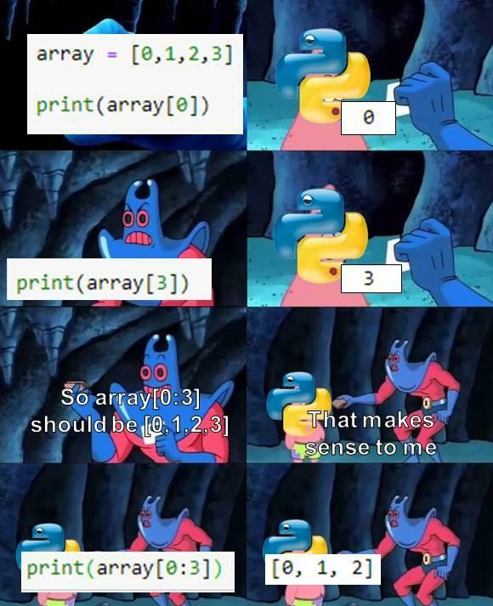

Slide 2
Environments & Debugging

Slide 3
Environments and Frames

Slide 4
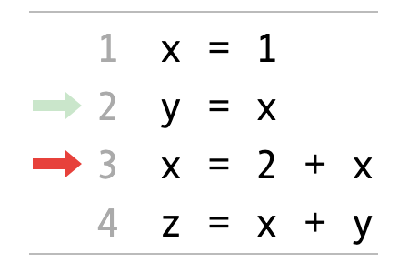
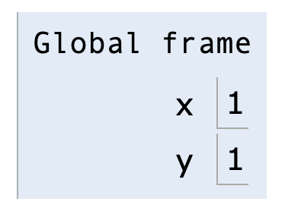
Environment Diagrams
An environment diagram is a visualization of how Python interprets a program. Use the free website PythonTutor to generate diagrams. View example
Code (left) | Frames (right)
Arrows indicate the order of execution. Green = just executed, red = up next. | Each name is bound to a value. Within a frame, each name cannot be repeated.

Slide 5
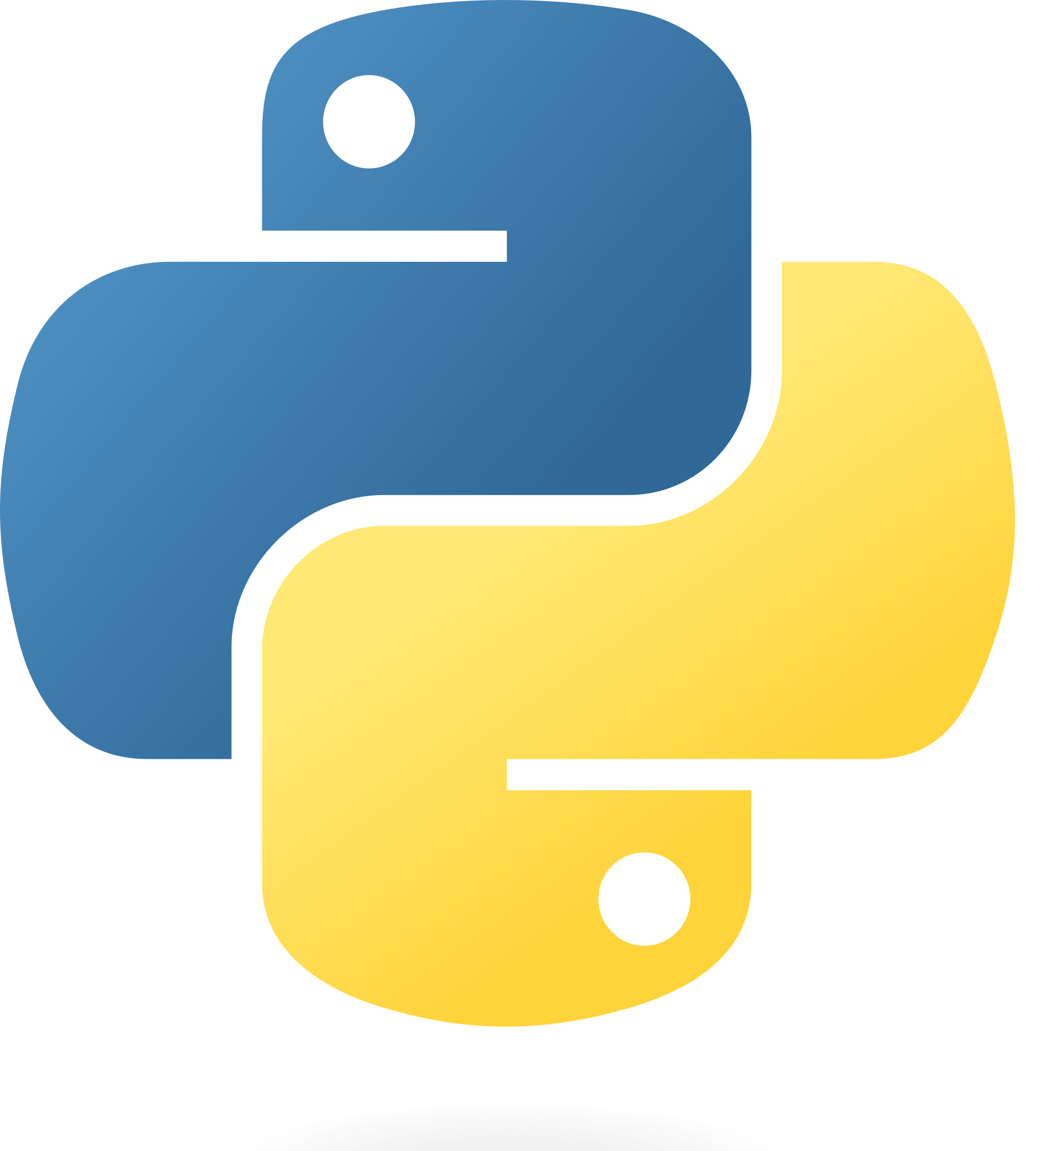
Assignments in Environment diagrams
How Python interprets an assignment statement:
Evaluate the expression to the right of =.
Bind the expression's value to the name that's on the left side of the = sign.
View in PythonTutor

Slide 6
Functions in environment diagrams
How Python interprets a def statement:
It creates a function with the name and parameters
It sets the function body to everything indented after the first line
It binds the function name to that function body (similar to an assignment statement)
View in PythonTutor

Slide 7
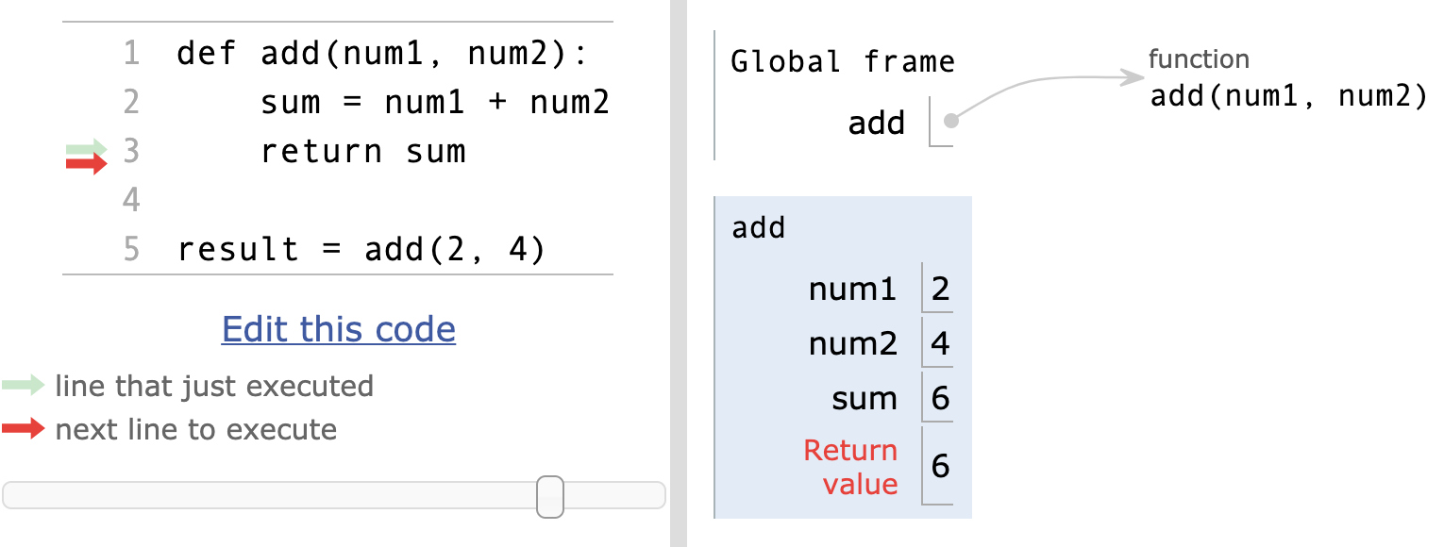
Function calls in environment diagrams
How Python interprets a function call:
It creates a new frame in the environment
It binds the function call's arguments to the parameters in that frame
It executes the body of the function in the new frame
View in PythonTutor

Slide 8
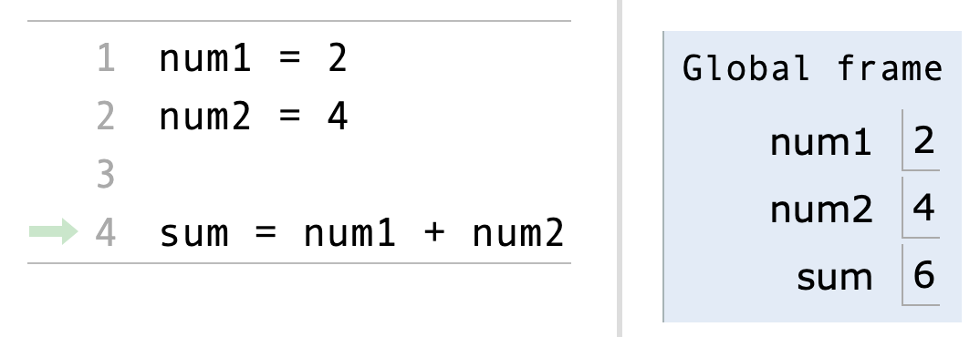
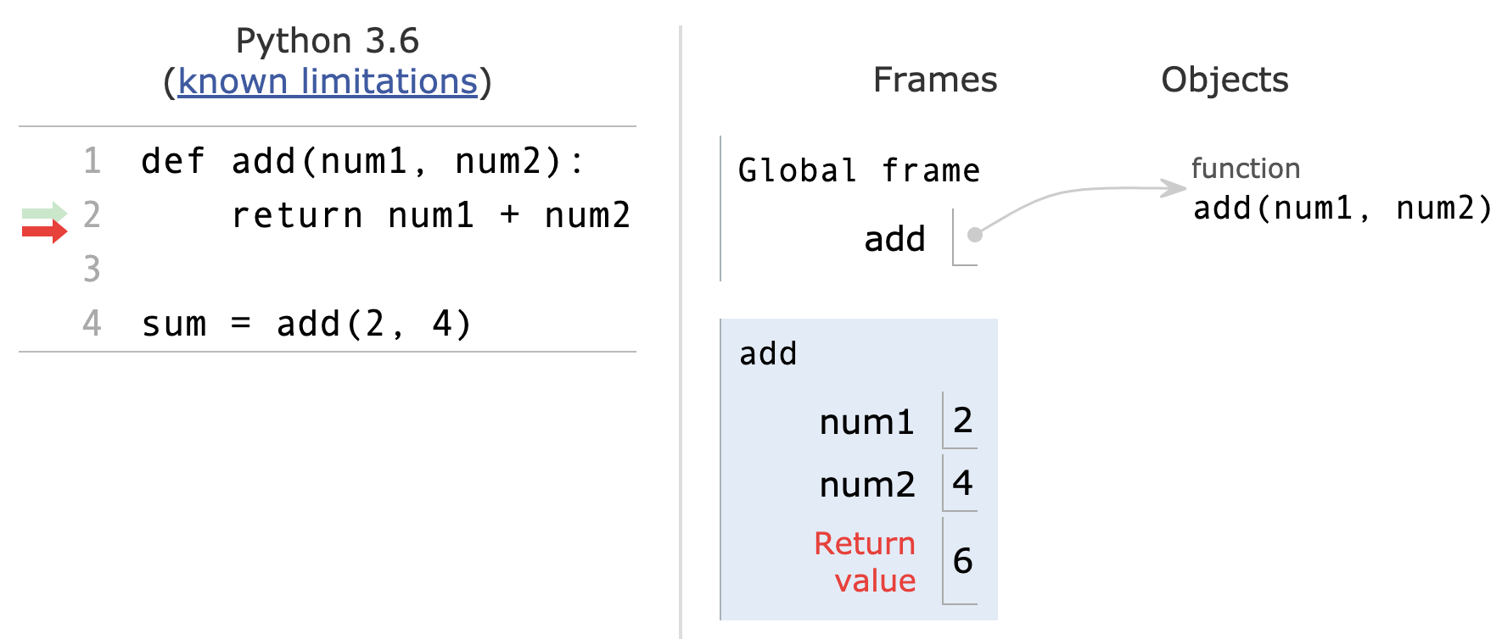
Names and environments
All Python code is evaluated in the context of an environment, which is a sequence of frames.
We've seen two possible environments:
Global Frame
Function's local frame, child of Global frame

Slide 9
Name lookup rules
How Python looks up names in a user-defined function:
Look it up in the local frame
If name isn't in local frame, look it up in the global frame
If name isn't in either frame, throw a NameError
*This is simplified since we haven't learned all the Python features that complicate the rules.

Slide 10
Name lookup example #1
def exclamify(text):
start_exclaim = "¡"
end_exclaim = "!"
return start_exclaim + text + end_exclaim
exclamify("the snails are eating my lupines")
On line 4, which frame is start_exclaim found in?
The local frame for exclamify
On line 4, Which frame is text found in?
The local frame for exclamify
On line 6, which frame is exclamify found in?
The global frame
View in PythonTutor

Slide 11
Name lookup example #2
start_exclaim = "¡"
end_exclaim = "❣️"
def exclamify(text):
return start_exclaim + text + end_exclaim
exclamify("the voles are digging such holes")
On line 5, which frame is start_exclaim found in?
The global frame
On line 5, Which frame is text found in?
The local frame for exclamify
On line 6, which frame is exclamify found in?
The global frame
View in PythonTutor

Slide 12
Name lookup example #3
def exclamify(text):
end_exclaim = "⁉️️️"
return start_exclaim + text + end_exclaim
exclamify("the voles are digging such holes")
Which name will cause a NameError?
The start_exclaim name, since it was never assigned.
When will that error happen?
It will happen when exclamify is called and Python tries to execute the return statement.
View in PythonTutor

Slide 14
Errors
To err is human, to really foul things up requires a computer.

Slide 15
Types of errors
Errors are common to all programming languages
They fall into three main types
Logic errors
Syntax errors
Runtime errors

Slide 16
Logic errors
A program has a logic error if it does not behave as expected. Typically discovered via failing tests or bug reports from users.
Spot the logic error:
To avoid the wrath of angry users, write tests.
# Sum up the numbers from 1 to 10
sum = 0
x = 1
while x < 10:
sum += x
x += 1

Slide 18
Syntax Errors

Slide 19
Syntax errors
Each programming language has syntactic rules. If the rules aren't followed, the program cannot be parsed and will not be executed at all.
Spot the syntax errors:
To fix a syntax error, read the message carefully and go through your code with a critical eye. 👁
# Missing colon
if x > 5
x += 1
sum = 0
x = 0
while x < 10:
sum + = x
x + = 1
# No space needed between + and =

Slide 20
SyntaxError
What it technically means:
The file you ran isn’t valid Python syntax
What it practically means:
You made a typo
What you should look for:
Extra or missing parenthesis
Missing colon at the end of an if, while, def statements, etc.
You started writing a statement but forgot to put any clauses inside
Examples:
print("just testing here"))
title = 'Hello, ' + name ', how are you?'

Slide 21
IndentationError/TabError
What it technically means:
The file you ran isn't valid Python syntax, due to indentation inconsistency.
What it sometimes means:
You used the wrong text editor (or one with different settings)
What you should look for:
A typo or misaligned block of statements
A mix of tabs and spaces
Open your file in an editor that shows them
cat -A filename.py will show them
Example:
def sum(a, b):
total = a + b
return total

Slide 23
Runtime Errors

Slide 24
Runtime errors
A runtime error happens while a program is running, often halting the execution of the program. Each programming language defines its own runtime errors.
Spot the runtime error:
To prevent runtime errors, code defensively and write tests for all edge cases.
def div_numbers(dividend, divisor):
return dividend/divisor
quot1 = div_numbers(10, 2)
quot2 = div_numbers(10, 1)
quot3 = div_numbers(10, 0)
quot4 = div_numbers(10, -1)
# Cannot divide by 0!

Slide 25
TypeError:'X' object is not callable
What it technically means:
Objects of type X cannot be treated as functions
What it practically means:
You accidentally called a non-function as if it were a function
What you should look for:
Parentheses after variables that aren't functions
Example:
sum = 2 + 2
sum(3, 5)

Slide 26
...NoneType...
What it technically means:
You used None in some operation it wasn't meant for
What it practically means:
You forgot a return statement in a function
What you should look for:
Functions missing return statements
Printing instead of returning a value
Example:
def sum(a, b):
print(a + b)
total = sum( sum(30, 45), sum(10, 15) )

Slide 27
NameError
What it technically means:
Python looked up a name but couldn't find it
What it practically means:
You made a typo
You are trying to access variables from the wrong frame
What you should look for:
A typo in the name
The variable being defined in a different frame than expected
Example:
fav_nut = 'pistachio'
best_chip = 'chocolate'
trail_mix = Fav_Nut + best__chip

Slide 28
UnboundLocalError
What it technically means:
A variable that's local to a frame was used before it was assigned
What it practically means:
You are trying to both use a variable from a parent frame, and have the same variable be a local variable in the current frame
What you should look for:
Assignments statements after the variable name
Example:
sum = 0
def sum_nums(x, y):
sum += x + y
return sum
sum_nums(4, 5)

Slide 30
Tracebacks

Slide 31
What's a traceback?
When there's a runtime error in your code, you'll see a traceback in the console.
def div_numbers(dividend, divisor):
return dividend/divisor
quot1 = div_numbers(10, 2)
quot2 = div_numbers(10, 1)
quot3 = div_numbers(10, 0)
quot4 = div_numbers(10, -1)
Traceback (most recent call last):
File "main.py", line 14, in <module>
quot3 = div_numbers(10, 0)
File "main.py", line 10, in div_numbers
return dividend/divisor
ZeroDivisionError: division by zero

Slide 32
Parts of a Traceback
The error message itself
Lines #s on the way to the error
What’s on those lines
The most recent line of code is always last (right before the error message).
Traceback (most recent call last):
File "main.py", line 14, in <module>
quot3 = div_numbers(10, 0)
File "main.py", line 10, in div_numbers
return dividend/divisor
ZeroDivisionError: division by zero

Slide 33
Reading a Traceback
Read the error message (remember what common error messages mean!)
Look at each line, bottom to top, and see if you can find the error.
Traceback (most recent call last):
File "main.py", line 14, in <module>
quot3 = div_numbers(10, 0)
File "main.py", line 10, in div_numbers
return dividend/divisor
ZeroDivisionError: division by zero

Slide 34
Fix this code!
def f(x):
return g(x - 1)
def g(y):
return abs(h(y) - h(1 /& y)
def h(z):
z * z
print(f(12))
Notes:
Not sure where this slide should go exactly. Leaving it here right before debugging for now.

Slide 36
Debugging

Slide 37
Debugging
If you do any amount of coding, you will have errors (bugs) in your code.
If you update code, the changes may introduce errors or expose errors that may have been hidden
Adding new features changes the way the code behaves and interacts which may produce problems
and the list goes on …
Debugging, finding and removing errors, is a critical skill that every programmer needs to develop.
The good?? news is, we usually get lots of practice. How can we do it efficiently.

Slide 39
Debugging Tools & Techniques
There are lots of different ways to examine code and look for errors. We are going to talk about 4 of them:
Read/Explain the Code
Be the CPU
Print Statements
Integrated Debugger in your IDE

Slide 41
Reading the Code

Slide 42
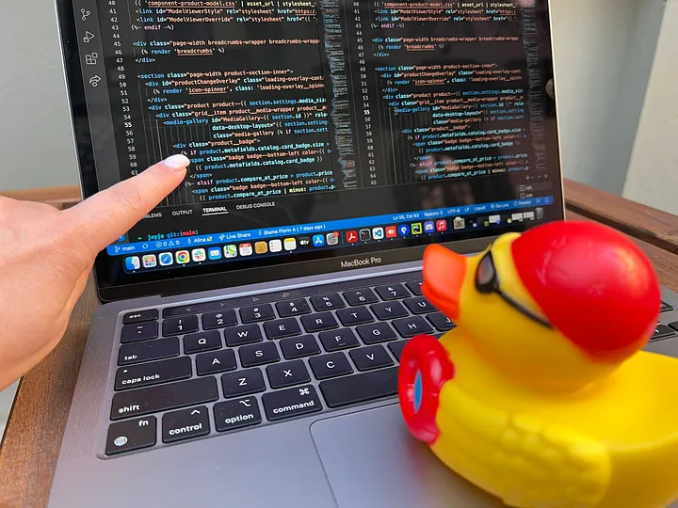
Reading/Explaining the Code
It may seem obvious, but the first step is to really look at the code in question.
The trick is to read what it actually says, and not what you think it should be doing – Don’t make assumptions!
Ask yourself "What does this line of code actually say and do?"
Read the documentation on functions if you're not sure.
Even better than just reading is explaining your code out loud
The act of verbalizing what your code is doing (again, not what you think it should be doing) focuses more of your brain on the problem.
And you don't have to explain it to another person, it can be an inanimate object – it's the vocalization process that is important
Explaining to an inanimate object is known as Rubber Duck Debugging
Photo credit: Alina Dumitru, April 2022

Slide 44
Be the CPU

Slide 45
Be The CPU
Sometimes, just reading and explaining the code isn't enough. You need the actual values the computer is working with.
For smaller programs or parts of programs, you can do this manually
Get a piece of paper and pencil
Working through the code writing down variables and their values
Update them as they change
Evaluate the expressions by hand
This is really just reading your code but at a much more detailed level
Allows you to try different inputs quickly without having to modify any code.

Slide 47
Using Print Statements

Slide 48
Print Statements
As programs get bigger, you are working with larger portions of a program, or the computations become more complex, it's not practical to "Be the CPU"
Instead, we let the CPU do the computations and liberally sprinkle our code with print statements
Display values at certain points in the program
Trace the flow of the program through the code
Despite memes and advice to the contrary, this is a viable and valuable way to find errors in your code
This may require breaking up statements in your code to generate intermediate values you want printed.
Another downside is that you often need to go back and remove all the print statements when you are done. ☹

Slide 49
Print Statement Debugging Demo

