Slide 1
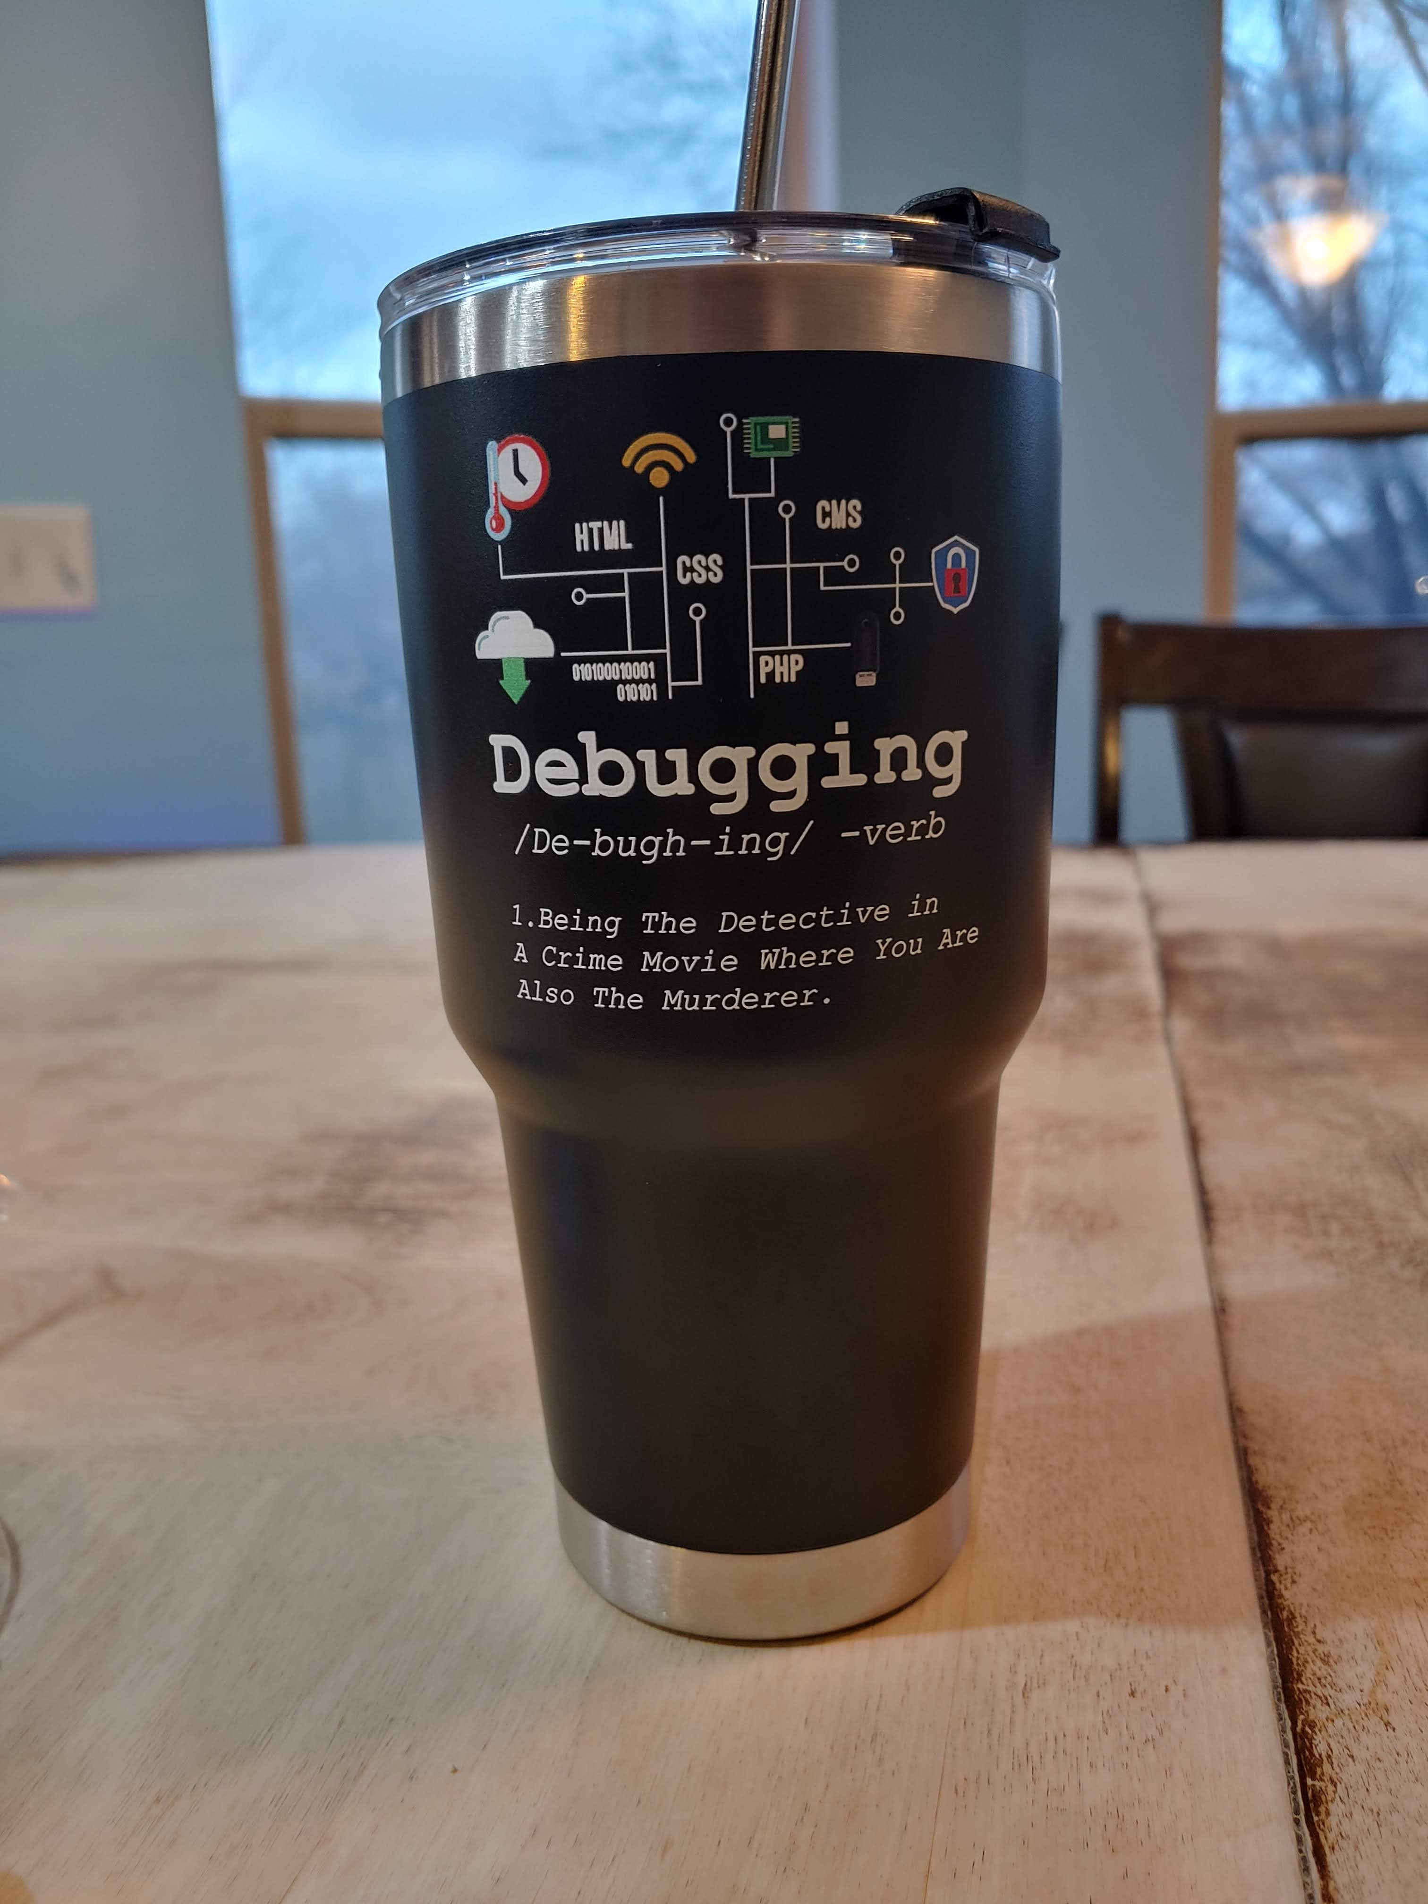

Slide 2
Debugging & Testing

Slide 3
Using the IDE’s Debugger

Slide 4
Your IDE's debugger
Even more powerful than print statements, the debugger interface in your IDE allows you to see everything* in the program as it is running
  All variables in the current frame
  All variables in earlier frames in the program stack
  Allows you to set watches which specify statement/variables not part of your code
The debugger allows you to step through your program one line, expression, or function at a time and see the state of the program as they execute
You can also set breakpoints in your code that tell the debugger to run until it hits that point and then stop.
The * on everything above is because some programming languages optimize certain operations, and they are hard to visualize in the debugger

Slide 5
Using the IDE's Debugger
Every IDE has a slightly different interface, but they all have the same functionality
The most common functions are:
  Setting a breakpoint
  Launching the debugger
  Looking at variable values
  Setting a watch
  Stepping over a line of code
  Stepping into a function
  Stepping out of a function
  Continuing to the next breakpoint
  Looking at values in other frames

Slide 6
Pycharm Debugger Demo

Slide 8
Final Thoughts

Slide 9
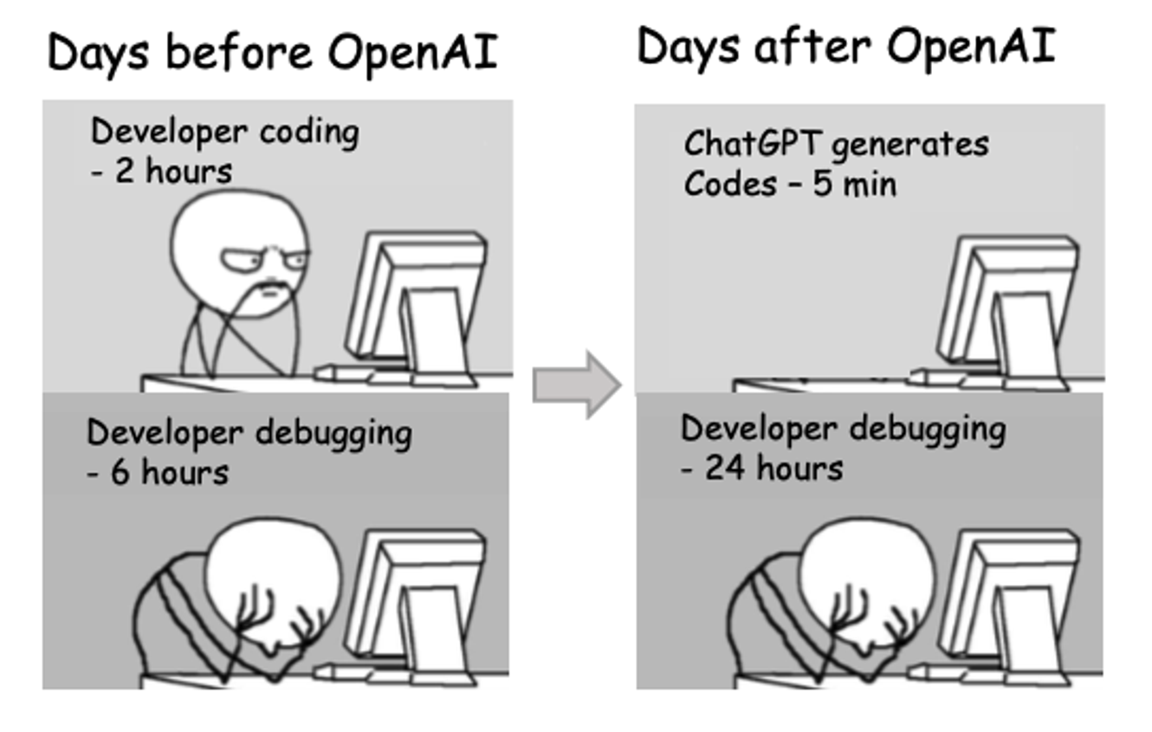
Debugging and LLMs

Slide 10
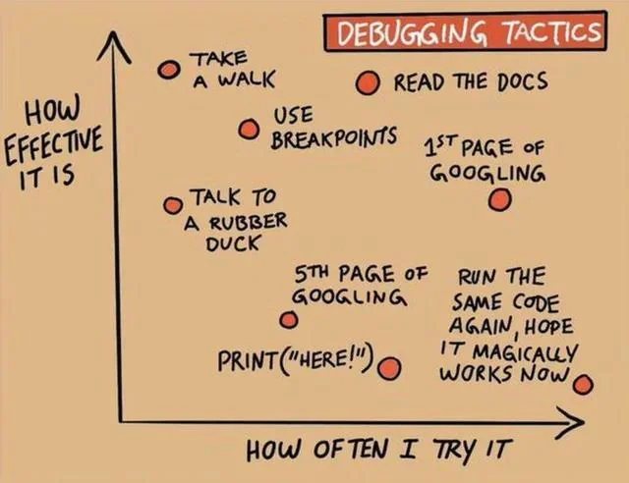

Slide 12
Software Development Basics

Slide 16
Getting Started
Weeks of coding can save you hours of planning
- Unknown
There is often the desire to just start writing code
  We think we know what we need to do
  We like to make things – code appearing feels good
  We just want to get done - writing code looks like progress toward the end
However, jumping in without a plan has many potential drawbacks
  Lots of bugs – more time debugging
  Having to rewrite early code when we see how later code needs to work
  Not fulling understanding requirements results in code to be thrown away
An hour of planning can save you 10 hours of doing.
- Dale Carnegie

Slide 17
Think before you code
Read the entire specification
  For class, this means read the entire assignment before you do anything else.
  In general, this means gather all the information about what the program is supposed to do – this often changes, so gather as much as you can
Spend time thinking about how the different parts of the program should work and interact
Write down notes (physically or digitally)
Think about potential problems and how to solve them.
Is there knowledge you need you don't have? Where will you find that?

Slide 18
Stepwise Refinement
Stepwise refinement is a process for designing your program based on the specifications
  You start by taking a large problem and dividing it into smaller ones
  You then divide the smaller ones into yet smaller chunks,
  Repeat this process until you are the point where you are starting to think in terms of code.
This is often done on paper (physical or digital) separate from the code. Or you might do it as comments in the code files themselves.
You now have a detailed plan of what needs to be built
These smallest chunks are the perfect size for the next step, incremental development

Slide 19
Incremental Program Development
There is often the temptation to write large sections of code all at once before testing any of it
This is usually a bad idea as we need to search through all the code written to find any bug introduced
A better method is to write a little bit of code, test it, then write a bit more
  Bugs are localized
  We know we have working code every step of the way
The smallest bits from our Stepwise Refinement are often the perfect size for one iteration of incremental development.

Slide 20
Modelling SR & ID in your assignments
Your early Homework and Project assignments are designed to model the ideas of Stepwise Refinement and Incremental Development.
As you read through them, think about how the larger problem, given in the beginning specification, is broken down into the Parts and Tasks of the assignments.
Additionally, the instructions call out doing a little coding and then testing to make sure it's doing what you expect.
Later assignments do less and less of this to allow you to practice the skill yourself. We still break the problems down partially, but you should be thinking about if and how to break them down even more before you start coding.

Slide 22
Testing

Slide 23
Why Testing?

Slide 24
Why do we test code?
Programs need to work
… before we send it off to the user
  The user shouldn't be finding errors in our code.
  And they shouldn't be expected to fix the code.
Testing can answer the following questions:
  Does it correctly do the desired task?
  Does it do it efficiently?
Testing can also make it safer for us to modify or extend code
  If it works before we made changes and now it doesn't, we know where the error is.

Slide 25
Testing programs
For simple programs, we can simply inspect the code to verify that it is correct
But there is a limit to what you can do with simple programs
As programs become larger
  inspection isn't always feasible.
  it becomes harder to verify how different parts of the code interact with one another
  there may be more than one developer working on the code

Slide 26

The Space Shuttle

Slide 27
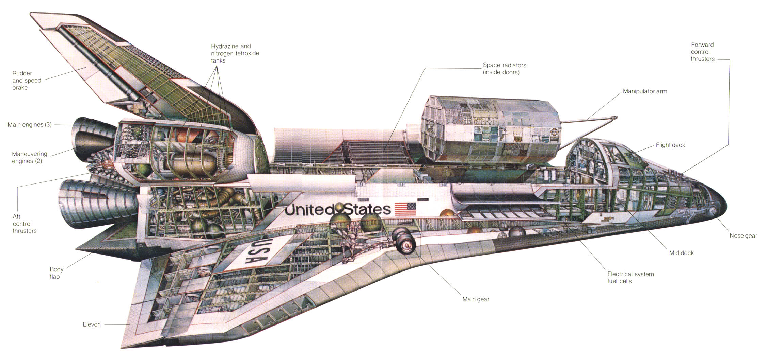
Space Shuttle parts

Slide 28
Putting the space shuttle together
What would happen if you tried to assemble the space shuttle with "untested" parts (i.e., parts that were built but never verified)?
It wouldn't work, and you probably would never be able to make it work
  Cheaper and easier to just start over

Slide 29
Types of tests
There are different types of tests
  Unit tests – tests for small individual parts of a program
  Integration tests – test how different parts of the program work with one another
  System tests – test how the entire program works as a whole
  Performance tests – how quickly does the program perform its tasks
  Usability tests – how easy is the program to use/understand
  and more
We'll be focusing on Unit Tests in this class
  You'll see more in future classes, or you can take CS 329 – Testing, Analysis & Verification

Slide 30
Types of test – Access to data
In addition to testing the various areas of responsibility as described on the previous slide, we can look at testing in relation to how much access it has to a program's internal state.
White-box Testing
  The test has knowledge of, and access to, the internal data of classes and algorithms of methods and functions
  Allows for fine-grained verification of algorithm implementation
  Can be brittle – if the algorithm changes, all the tests have to be rewritten
Black-box Testing
  The test doesn't know anything about the program's internals
  Can only check that correct thing happened given specific inputs
  Allows for changes without rewriting test code as along as behavior is the same

Slide 32
Unit Testing

Slide 33
Unit Tests
A “unit” is any small part of a program – here we are talking about functions and classes
Unit testing, which is done by the developer, involves writing a series of tests to verify that the code does exactly what it is supposed to do
  Works properly with good input
  Properly handles bad input
  Properly handles failure modes
Tests should be small, fast, and easy to run so you can continually test the code as you develop

Slide 34
What makes a good test?
Features of good tests
  Automated and fast
  Only report errors
  Tests are independent of each other
  Try for 100% code coverage
  Tests error and border cases
Tests should be maintained along with the code to allow for regression testing – If running old tests that passed now fail after making a change, the code has “regressed” and there is a bug in the new code

Slide 35
Picking good tests
It’s not possible to test every possible input into a function to verify that it works correctly
Instead, programmers need to pick a representative sample of input
  Input that exercises every branch in the function
  Boundary cases
  Something from each good and bad data range
Each test should verify a single aspect of the code. If you want to test something else, write a separate test.
With a good set of tests, there will often be more test code than code being tested, often 2-4 times as much

Slide 37
Test Driven Development

Slide 38
Test driven development
Test driven development (TDD) is a programming paradigm that focus on incremental development and testing.
Developed or "rediscovered" by Kent Beck in 2003, it encourages simple software design and helps inspire confidence in the code.
In this programming paradigm you write the test first, and then write the code that passes the tests.
And you do this for every piece of functionality in your program.

Slide 39
Test driven development cycle
Add a test - The test should pass if the code properly performed some piece of its functionality – properly computes a value, properly throws an error, etc.
Run all tests – The new test should fail since you haven't written the code yet.
Write the simplest code that passes the test – It doesn't need to be pretty, efficient, or easy to understand. It just needs to work and shouldn't do anything beyond the bare minimum.
Run all tests – Now they should all pass if the code is correct.
Refactor as needed – Go back an make the code more efficient, easier to read, easier to maintain, etc. Run the tests after each change to make sure it is still working.
Repeat – now move on to the next bit of functionality

Slide 41
Writing Tests

Slide 42
Testing frameworks
Tests are usually written using a testing framework that provides us with tools to create meaningful and useful tests.
The testing framework provides a way to run all the tests written
  Makes it easier to run tests
  Allows for automation
Typically, test run through the harness only report errors, if everything works, nothing happens
  "No news is good news" philosophy. Only report the things the developer needs to worry about.
  Also, if successes and failures are reported, it's often hard to find the failures.

Slide 43
doctest and pytest
You've already been exposed to two different testing frameworks in this class
doctests
  This is probably the one you thought of first.
  simple tests you can put in the doc strings of functions
  tests how the functions respond in the interpreter
pytest framework
  This is a much more extensive framework for building tests
  The auto-grader tests that we give you as part of your assignments are written using the pytest framework library.
We're going to talk about how to write tests using both of these frameworks

Slide 45
doctests

Slide 46
Doctests
The functionality for doctests is built into the standard Python library
Doctests are written in the doc string at the beginning of a function
They mimic an interactive Python interpreter session
They describe a series of commands to be executed
  each command is proceeded by ">>>", the Python interpreter prompt
After each command, the expected output of that command is listed
def square(x):
  """ returns the square of x for any value.
  >>> square(10)
  100
  >>> square(3.1415)
  9.86902225
  """
return x * x

Slide 47
Running doctests
Doctests are invoked by running the script with the –m doctest flag
This runs the doctest for every function in the file that has tests defined.
If all goes well and all tests pass, nothing is printed.
If you want to see what is being done and have output even for passed cases, you can use the "-v" flag
The full library documentation can be found at https://docs.python.org/3/library/doctest.html
python –m doctest <filename>
python –m doctest –v <filename>

Slide 48
Doctest error output
If the doctest fails, you'll get output like the following:
**********************************************************************
File "C:\Users\dagor\PycharmProjects\demo\test.py", line 16, in test.square
Failed example:
square(3.1415)
Expected:
9.86902224
Got:
9.86902225
**********************************************************************
1 items had failures:
1 of 2 in test.square
***Test Failed*** 1 failures.
Failed example and line number
Expected and actual results
Items with failures (and how many)
Total failures in entire file

