Slide 1
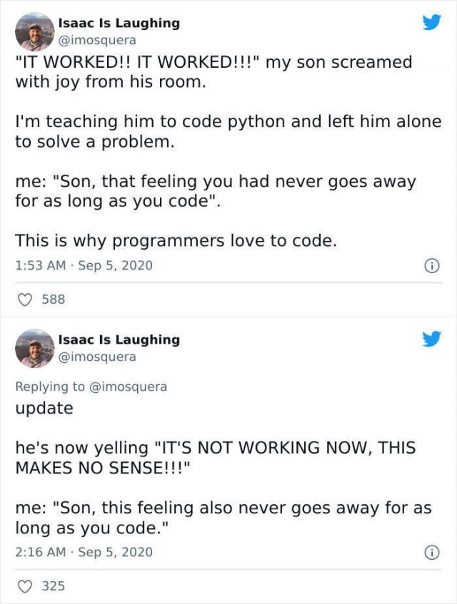

Slide 2
Inheritance & Dunder Functions

Slide 3
Quiz: Objects + Classes

Slide 4
Multiple instances
There can be multiple instances of each class.
What are the classes here?
How many instances of each?
pina_bar = Product("Piña Chocolotta", 7.99,
["200 calories", "24 g sugar"])
cust1 = Customer("Coco Lover",
["123 Pining St", "Nibbsville", "OH"])
cust2 = Customer("Nomandy Noms",
["34 Shlurpalot St", "Buttertown", "IN"])
Product, Customer
1 Product, 2 Customers

Slide 5
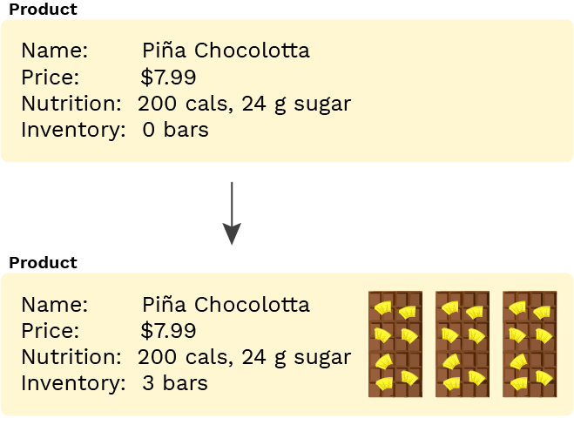
State management
An object can use instance variables to describe its state. A best practice is to hide the representation of the state and manage it entirely via method calls.
What's the initial state?
What changes the state?
>>> pina_bar = Product("Piña Chocolotta", 7.99,
["200 calories", "24 g sugar"])
>>> pina_bar.get_inventory_report()
"There are NO bars!"
>>> pina_bar.increase_inventory(3)
>>> pina_bar.get_inventory_report()
"There are 3 bars total (worth $23.97 total)."
0 bars in inventory
increase_inventory() by changing the instance variable _inventory

Slide 6
Class vs. instance variables
class Customer:
salutation = "Dear"
def __init__(self, name, address):
self.name = name
self.address = address
def get_greeting(self):
return f"{self.salutation} {self.name},"
def get_formatted_address(self):
return "\n".join(self.address)
cust1 = Customer("Coco Lover",
["123 Pining St", "Nibbsville", "OH"])
What are the class variables?
What are the instance variables?
salutation
name, address

Slide 8
Inheritance

Slide 9
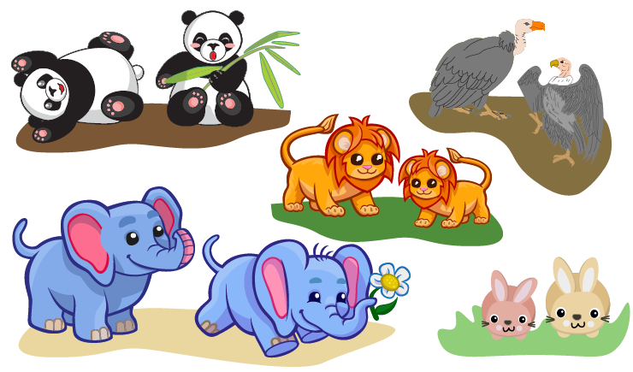
Building "Animal Conserving"
Imagine we're building a game where we take care of cute furry/ferocious animals:
What would be the classes in this program?

Slide 10
A Food Class
Let's start simple:
How would we use that class?
class Food:
def __init__(self, name, type, calories):
self.name = name
self.type = type
self.calories = calories
broccoli = Food("Broccoli Rabe", "veggies", 20)
bone_marrow = Food("Bone Marrow", "meat", 100)

Slide 11
An Elephant class
class Elephant:
species_name = "African Savanna Elephant"
scientific_name = "Loxodonta africana"
calories_needed = 8000
def __init__(self, name, age=0):
self.name = name
self.age = age
self.calories_eaten = 0
self.happiness = 0
def play(self, num_hours):
self.happiness += (num_hours * 4)
print("WHEEE PLAY TIME!")
def eat(self, food):
self.calories_eaten += food.calories
print(f"Om nom nom yummy {food.name}")
if self.calories_eaten > self.calories_needed:
self.happiness -= 1
print("Ugh so full")
def interact_with(self, animal2):
self.happiness += 1
print(f"Yay happy fun time with {animal2.name}")
How would we use this class?
el1 = Elephant("Willaby", 5)
el2 = Elephant("Wallaby", 3)
el1.play(2)
el1.interact_with(el2)

Slide 12
A Rabbit class
class Rabbit:
species_name = "European rabbit"
scientific_name = "Oryctolagus cuniculus"
calories_needed = 200
def __init__(self, name, age=0):
self.name = name
self.age = age
self.calories_eaten = 0
self.happiness = 0
def play(self, num_hours):
self.happiness += (num_hours * 10)
print("WHEEE PLAY TIME!")
def eat(self, food):
self.calories_eaten += food.calories
print(f"Om nom nom yummy {food.name}")
if self.calories_eaten > self.calories_needed:
self.happiness -= 1
print("Ugh so full")
def interact_with(self, animal2):
self.happiness += 4
print(f"Yay happy fun time with {animal2.name}")
How would we use this class?
rabbit1 = Rabbit("Mister Wabbit", 3)
rabbit2 = Rabbit("Bugs Bunny", 2)
rabbit1.eat(broccoli)
rabbit2.interact_with(rabbit1)

Slide 13
Notice similarities?
Elephant Rabbit
# Class variables
species_name
scientific_name
calories_needed
# Instance variables
name
age
happiness
# Methods
eat(food)
play()
interact_with(other)
# Class variables
species_name
scientific_name
calories_needed
# Instance variables
name
age
happiness
# Methods
eat(food)
play()
interact_with(other)
Elephant and Rabbit are both animals, so they have similar attributes. Instead of repeating code, we can inherit the code.

Slide 14
Inheritance
In object-oriented programming, inheritance is where one class is derived from another class.
The derived (child, or sub-) class has all the attributes and methods of the base (parent or super-) class.
It can then add new attributes and methods and also override methods from the parent.

Slide 16
Base and Sub classes

Slide 17
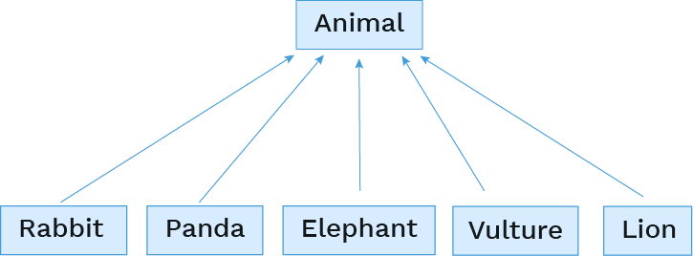
Base classes and subclasses
When multiple classes share similar attributes, you can reduce redundant code by defining a base class and then subclasses can inherit from the base class.

Slide 18
The base class
class Animal:
species_name = "Animal"
scientific_name = "Animalia"
play_multiplier = 2
interact_increment = 1
calories_needed = 0
def __init__(self, name, age=0):
self.name = name
self.age = age
self.calories_eaten = 0
self.happiness = 0
def play(self, num_hours):
self.happiness += (num_hours * self.play_multiplier)
print("WHEEE PLAY TIME!")
def eat(self, food):
self.calories_eaten += food.calories
print(f"Om nom nom yummy {food.name}")
if self.calories_eaten > self.calories_needed:
self.happiness -= 1
print("Ugh so full")
def interact_with(self, animal2):
self.happiness += self.interact_increment
print(f"Yay happy fun time with {animal2.name}")
What has changed?

Slide 19
The subclasses
To declare a subclass, put parentheses after the class name and specify the base class in the parentheses:
Then the subclasses only need the code that's unique to them. They can redefine any aspect: class variables, method definitions, or constructor. A redefinition is called overriding.
The simplest subclass overrides nothing:
But this is rarely the case or you wouldn't need a subclass!
class Panda(Animal):
class AmorphousBlob(Animal):
pass

Slide 20
Overriding class variables
Subclasses can override existing class variables and assign new class variables:
class Rabbit(Animal):
species_name = "European rabbit"
scientific_name = "Oryctolagus cuniculus"
calories_needed = 200
play_multiplier = 8
interact_increment = 4
num_in_litter = 12
class Elephant(Animal):
species_name = "African Savanna Elephant"
scientific_name = "Loxodonta africana"
calories_needed = 8000
play_multiplier = 4
interact_increment = 2
num_tusks = 2

Slide 21
Overriding methods
If a subclass overrides a method, Python will use that definition instead of the superclass definition.
How would we call that method?
class Panda(Animal):
species_name = "Giant Panda"
scientific_name = "Ailuropoda melanoleuca"
calories_needed = 6000
def interact_with(self, other):
print(f"I'm a Panda, I'm solitary, go away {other.name}!")
panda1 = Panda("Pandeybear", 6)
panda2 = Panda("Spot", 3)
panda1.interact_with(panda2)

Slide 22
Using methods from the base class
To refer to a superclass method, we can use super():
How would we call that method?
class Lion(Animal):
species_name = "Lion"
scientific_name = "Panthera"
calories_needed = 3000
def eat(self, food):
if food.type == "meat":
super().eat(food)
bones = Food("Bones", "meat", 50)
mufasa = Lion("Mufasa", 10)
mufasa.eat(bones)

Slide 23
More on super()
super().attribute refers to the definition of attribute in the superclass of the first parameter to the method.
is the same as:
super() is better style than BaseClassName, though slightly slower.
def eat(self, food):
if food.type == "meat":
super().eat(food)
def eat(self, food):
if food.type == "meat":
Animal.eat(self, food)

Slide 24
Overriding __init__()
Similarly, if we override __init__() in our subclasss, we need to explicitly call super().__init__() if we want to call the __init__ functionality of the base class.
What would this display?
class Elephant(Animal):
species_name = "Elephant"
scientific_name = "Loxodonta"
calories_needed = 8000
def __init__(self, name, age=0):
super().__init__(name, age)
if age < 1:
self.calories_needed = 1000
elif age < 5:
self.calories_needed = 3000
elly = Elephant("Ellie", 3)
elly.calories_needed
# 3000

Slide 26
Multi-level Inheritance

Slide 27
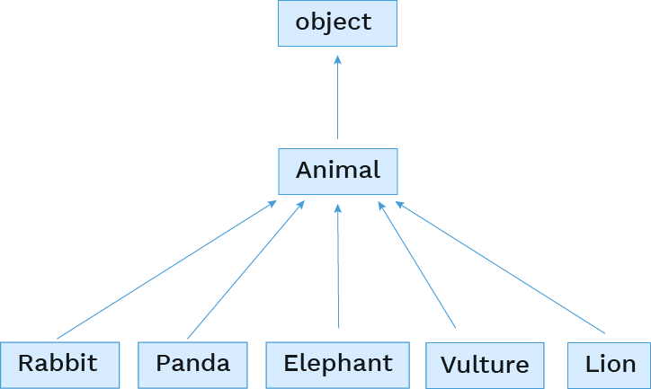
Object base class
Every Python 3 class implicitly extends the object class.

Slide 28
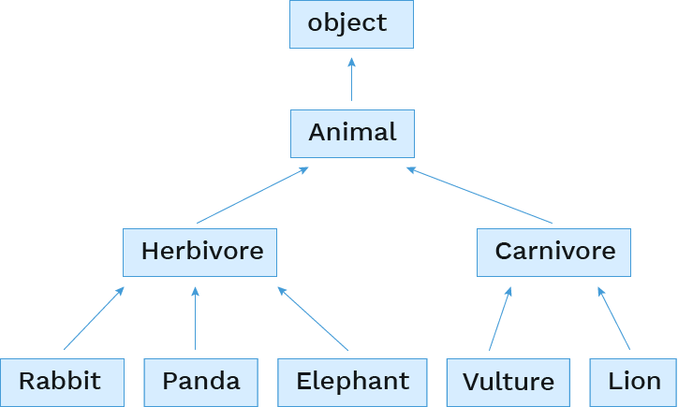
Adding layers of inheritance
But we can also add in more levels ourselves.

Slide 30
Multiple Inheritance

Slide 31
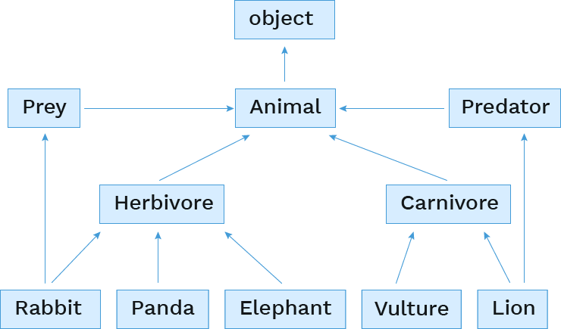
Multiple inheritance
A class may inherit from multiple base classes in Python.

Slide 32
Inheriting from multiple base classes
Then we inherit from them by putting both names in the parentheses:
class Rabbit(Prey, Herbivore):
class Lion(Predator, Carnivore):

Slide 34
Interfaces

Slide 35
Interfaces
A common use of inheritance (single or multiple) is to provide a common interface to a group of classes.
the Animal class provides the eat(), play(), and interact_with() methods
the Predator class might provide a hunt() method
the Prey class might provide an evade() and/or hide() method
The base class may not (and often doesn't) provide an implementation of the provided methods
Rather it just defines the methods' signatures, and then any function using an object of a class derived from the base class knows that it can expect that function to be there.
Python is a little loose on this, but many other languages strictly enforce it. If a method doesn't have a definition, you can't create objects of that class.

Slide 36
Relying on a common interface
If all a group of objects implement a method with the same function signature, a program can rely on that method across instances of different subclasses.
How would we call that function?
def partytime(animals):
"""Assuming ANIMALS is a list of Animals, cause each
to interact with all the others exactly once."""
for i in range(len(animals)):
for j in range(i + 1, len(animals)):
animals[i].interact_with(animals[j])
elly = Elephant("Elly", 5)
pandy = Panda("PandeyBear", 4)
scar = Lion("Scar", 12)
jane_doe = Rabbit("Jane Doe", 2)
partytime([elly, pandy, scar, jane_doe])

Slide 37
Checking identity
exp0 is exp1
evaluates to True if both exp0 and exp1 evaluate to the same object
mufasa = Lion("Mufasa", 15)
nala = Lion("Nala", 8)
mufasa is mufasa
mufasa is nala
mufasa is not nala
nala is not None
# True
# False
# True
# True

Slide 39
Composition

Slide 40
Composition
An object can contain references to objects of other classes.
What examples of composition are in an animal conservatory?
An animal has a mate.
An animal has a mother.
An animal has children.
A conservatory has animals.

Slide 41
Referencing other instances
An instance variable can refer to another instance:
How would we call that method?
class Animal:
def mate_with(self, other):
if other is not self and other.species_name == self.species_name:
self.mate = other
other.mate = self
mr_wabbit = Rabbit("Mister Wabbit", 3)
jane_doe = Rabbit("Jane Doe", 2)
mr_wabbit.mate_with(jane_doe)

Slide 42
Referencing a list of instances
An instance variable can also refer to a list of instances:
How would we call that function?
class Rabbit(Animal):
def reproduce_like_rabbits(self):
if self.mate is None:
print("oh no! better go on ZoOkCupid")
return
self.babies = []
for _ in range(0, self.num_in_litter):
self.babies.append(Rabbit("bunny", 0))
mr_wabbit = Rabbit("Mister Wabbit", 3)
jane_doe = Rabbit("Jane Doe", 2)
mr_wabbit.mate_with(jane_doe)
jane_doe.reproduce_like_rabbits()

Slide 43
Composition vs. Inheritance
Inheritance is best for representing "is-a" relationships
Rabbit is a specific type of Animal
So, Rabbit inherits from Animal
Composition is best for representing "has-a" relationships
A conservatory has a collection of animals it cares for
So, a conservatory has a list of animals as an instance variable

Slide 45
Dunder Functions

Slide 46
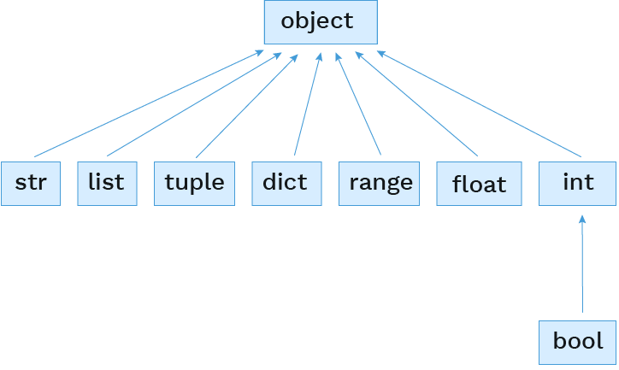
It's all objects
All the built-in types inherit from object:

Slide 47
Built-in object attributes
If all the built-in types and user classes inherit from object, what are they inheriting?
Just ask dir(), a built-in function that returns a list of all the attributes on an object.
For string representation: __repr__, __str__, __format__
For comparisons: __eq__, __ge__, __gt__, __le__, __lt__, __ne__
Related to classes: __bases__, __class__, __new__, __init__, __init_subclass__, __subclasshook__, __setattr__, __delattr__, __getattribute__
Others: __dir__, __hash__, __module__, __reduce__, __reduce_ex__
Python calls these methods behind these scenes, so we are often not aware when the "dunder" methods are being called.
💡 Let us become enlightened! 💡
dir(object)

Slide 49
Representation

Slide 50
__str__
The __str__() method returns a human readable string representation of an object.
from fractions import Fraction
one_third = 1/3
one_half = Fraction(1, 2)
float.__str__(one_third)
Fraction.__str__(one_half)
# '0.3333333333333333'
# '1/2'

Slide 51
__str__ usage
The __str__() method is used in multiple places by Python: print() function, str() constructor, f-strings, and more.
from fractions import Fraction
one_third = 1/3
one_half = Fraction(1, 2)
print(one_third)
print(one_half)
str(one_third)
str(one_half)
f"{one_half} > {one_third}"
# 0.3333333333333333
# 1/2
# '0.3333333333333333'
# '1/2'
# '1/2 > 0.3333333333333333'

Slide 52
Custom __str__ behavior
When making custom classes, we can override __str__() to define our human readable string representation.
class Lamb:
species_name = "Lamb"
scientific_name = "Ovis aries"
def __init__(self, name):
self.name = name
def __str__(self):
return "Lamb named " + self.name
lil = Lamb("Lil lamb")
str(lil)
print(lil)
lil
# 'Lamb named Lil lamb'
# Lamb named Lil lamb
# ⟨__main__.Lamb object at 0x7fc1489b82d0⟩

Slide 53
__repr__
The __repr__() method returns a string that would evaluate to an object with the same values.
If implemented correctly, calling eval() on the result should return back that same-valued object.
from fractions import Fraction
one_half = Fraction(1, 2)
Fraction.__repr__(one_half)
# 'Fraction(1, 2)'
another_half = eval(Fraction.__repr__(one_half))

Slide 54
__repr__ usage
The __repr__() method is used multiple places by Python: when repr(object) is called and when displaying an object in an interactive Python session.
from fractions import Fraction
one_third = 1/3
one_half = Fraction(1, 2)
one_third
one_half
repr(one_third)
repr(one_half)
# 0.3333333333333333
# Fraction(1, 2)
# '0.3333333333333333'
# 'Fraction(1, 2)'

Slide 55
Custom __repr__ behavior
When making custom classes, we can override __repr__() to return a more appropriate Python representation.
class Lamb:
species_name = "Lamb"
scientific_name = "Ovis aries"
def __init__(self, name):
self.name = name
def __str__(self):
return "Lamb named " + self.name
def __repr__(self):
return f"Lamb({repr(self.name)})"
lil = Lamb("Lil lamb")
repr(lil)
lil
# "Lamb('Lil lamb')"
# Lamb('Lil lamb')

