Slide 1
Modular Design, Functional Programming, & Higher Order Functions

Slide 2
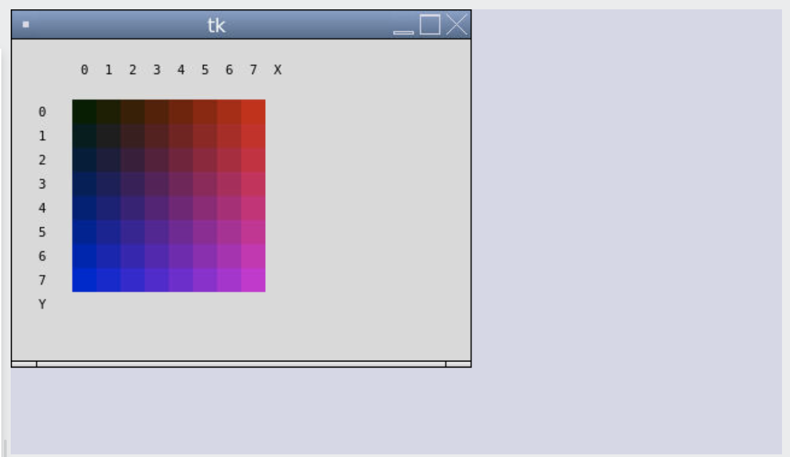
Icon Project

Slide 3
Icon Design
icon.py
display_frame.py
Icon Pixel Color
Defines classes for icon + parts
DisplayFrame
Defines class for displaying icon on canvas
main.py
Creates an Icon and displays in DisplayFrame.

Slide 4
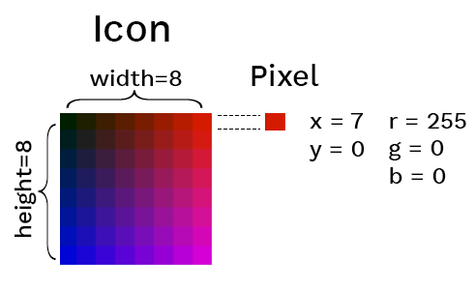
An OOP Icon
Goal: Use OOP to represent an Icon with pixels at a particular location with a particular color.

Slide 5
The Color Class
class Color:
def __init__(self, r, g, b):
self.r = r
self.g = g
self.b = b
def __repr__(self):
return f"Color({self.r},{self.g},{self.b})"
def __str__(self):
return f "{self.r},{self.g},{self.b}"
def to_hex(self):
return f"#{self.r:02x}{self.g:02x}{self.b:02x}"
red = Color(255, 0, 0)
print(red.to_hex())

Slide 6
The Pixel Class
class Pixel:
def __init__(self, x, y, r, g, b):
self.x = x
self.y = y
self.color = Color(r, g, b)
def __repr__(self):
return f"Pixel({self.x},{self.y},{self.color})"
pixel = Pixel(0, 7, 255, 0, 0)
print(pixel.color.to_hex())

Slide 7
The Icon Class
class Icon:
def __init__(self, width, height, pixels=None):
self.width = width
self.height = height
self.pixels = pixels
if not self.pixels:
self.pixels = [ Pixel(x, y, 0, 0, 0)
for x in range(width) for y in range(height)]
def __repr__(self):
pixels = ",".join([repr(pixel) for pixel in self.pixels])
return f"Icon({self.width}, {self.height}, [{pixels}])"
icon = Icon(2, 2, [Pixel(0, 0, 255, 0, 0),
Pixel(0, 1, 255, 50, 0),
Pixel(1, 0, 255, 100, 0),
Pixel(1, 1, 255, 150, 0)])
for pixel in icon.pixels:
pixel.color.g += 50

Slide 8
The DisplayFrame Class
from tkinter import Canvas, Frame, BOTH, font
class DisplayFrame(Frame):
def __init__(self):
super().__init__()
self.pack(fill=BOTH, expand=1)
self.canvas = Canvas(self)
self.canvas.pack(fill=BOTH, expand=1)
def draw_icon(self, icon):
x_offset = 50
y_offset = 50
pixel_size = 20
for pixel in icon.pixels:
top_left_x = x_offset + pixel.x * pixel_size
top_left_y = y_offset + pixel.y * pixel_size
self.canvas.create_rectangle(
top_left_x,
top_left_y,
top_left_x + pixel_size,
top_left_y + pixel_size,
outline="",
fill=pixel.color.to_hex())

Slide 9
The main module
from tkinter import Tk
from icon import Icon, Pixel, Color
from display_frame import DisplayFrame
# Initialize the Tkinter frame and canvas
root = Tk()
# Create an icon
icon = Icon(2, 2, [Pixel(0, 0, 255, 0, 0),
Pixel(0, 1, 255, 50, 0),
Pixel(1, 0, 255, 100, 0),
Pixel(1, 1, 255, 150, 0)])
# Draw the icon
display = DisplayFrame()
display.draw_icon(icon)
# Run Tkinter loop
root.mainloop()
Visit the Repl.it demo to see all the classes used with the Python tkinter package for graphics rendering.

Slide 11
Side effects
Notes:
Should this move up with functions?

Slide 12
Side effects
A side effect is when something happens as a result of calling a function besides just returning a value.
The most common side effect is logging to the console, via the built-in print() function.
print(-2)
A similar side effect is writing to a file:
f = open('songs.txt', 'w')
f.write("Dancing On My Own, Robyn")
f.close()

Slide 13
Side effects vs. Return values
def square_num1(number):
return pow(number, 2)
def square_num2(number):
print(number ** 2)
Which one has a side effect?
  The second function has a side effect, because it prints to the console.
What data type do they each return?
  The first function returns a number, the second one returns None.

Slide 15
Pure functions

Slide 16
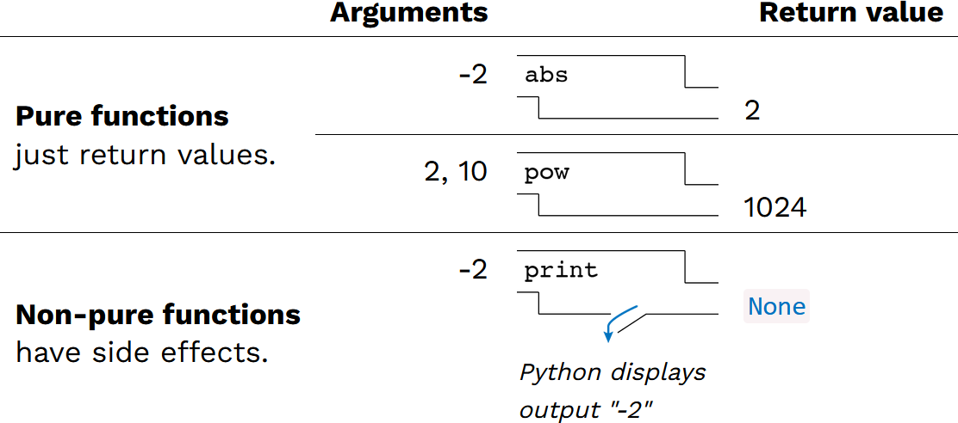
Pure vs. non-pure functions
In programming, we can talk about pure vs. non-pure functions
  Pure function – no side effects
  Non-pure function – has side effects

Slide 17
Benefits of pure functions
Pure functions provide several benefits
  The output of a function is only dependent on its input and is repeatable
    same input always means the same output
    can't influence or be influenced by external "state"
    This is great for math and mathematical proofs
  Functions can be tested and verified independent of one another which makes testing easier
  Code is easier to parallelize – since it doesn't depend on anything else or affect anything else, it can be run in isolation

Slide 19
Functional Programming

Slide 20
Functional Programming
"Functional programming" is a paradigm that strives to achieve all the benefits of using pure functions in the execution of code.
The chief characteristics of functional programming are:
  Programs are more declarative instead of imperative
  Functions as first-class objects & higher-order functions
  Limited or no side-effects
  Immutability of objects
  Recursion for control flow
While many (or even most) modern languages support the functional programming paradigm, there are many languages where this it the core programming style
  e.g. Haskell, Erlang, Clojure, Common Lisp, and Scala

Slide 21
Why functional programming?
Can be much easier to test and validate
Code is often simpler and more modular
Code written in a functional programming (FP) style is easier to parallelize
FP style is heavily used in the machine learning and big data fields
Many modern development frameworks are written in a functional style

Slide 22
Functional programming downsides
More mathematically based and the vocabulary can be intimidating
Programs can sometimes be harder to read and understand
Can potentially require more time and/or memory space to execute
Can't be used everywhere (database connections, servers, etc.)
You really need to understand recursion

Slide 23
Characteristics of Functional programming
Let's look at some of the characteristics of functional programming.
We've already seen some of them in this class
  Functions as first-order objects
  Side effects and pure vs. impure functions (today)
The new topics include:
  Declarative vs imperative programming (today)
  Higher-order functions (today and next time)
  Function composition (next time)
  Immutability of objects (soon)
  Recursion (after the midterm)

Slide 25
Declarative vs. Imperative programming

Slide 26
Declarative programming
In imperative languages:
  A "program" is a description of computational processes
  The interpreter carries out execution/evaluation rules
In declarative languages:
  A "program" is a description of the desired result
  The interpreter figures out how to generate the result

Slide 27
Domain-specific languages
Many declarative languages are domain-specific: they are designed to tackle problems in a particular domain, instead of being general purpose multi-domain programming languages.
Language | Domain
Regular expressions | Pattern-matching strings
Backus-Naur Form | Parsing strings into parse trees
SQL | Querying and modifying database tables
HTML | Describing the semantic structure of webpage content
CSS | Styling webpages based on selectors
Prolog | Describes and queries logical relations

Slide 28
Display an image – Declarative vs. Imperative
Python
HTML
from byuimage import Image
print("Hello")
img = Image("profile.jpg")
img.show()
<html>
<p>Hello</p>
<img src="profile.jpg">
<html>
The imperative language (Python) tells the computer what to do at each step to print a message and display an image.
  Import the image library, print the message, load the image, display it
The declarative language (HTML) just tells that compute that it wants the message displayed and then an image. The language worries about how that is done.

Slide 30
Higher-order Functions

Slide 31
What are higher-order functions?
A function that either:
  Takes another function as an argument
  Returns a function as its result
All other functions are considered first-order functions.

Slide 32
Generalizing over computational processes
$$\sum_{k=1}^{5}{k}=1+2+3+4+5=15$$
$$\sum_{k=1}^{5}{k^{3}}=1^{3}+2^{3}+3^{3}+4^{3}+5^{3}=225$$
$$\sum_{k=1}^{5}{\frac{8}{\left(4k−3\right)∗(4k−1)}}=\frac{8}{3}+ \frac{8}{35}+ \frac{8}{99}+ \frac{8}{195}+ \frac{8}{323}=3.04$$
The common structure among functions may be a computational process, not just a number

Slide 33
Functions as arguments
def cube(k):
return k ** 3
def summation(n, term):
"""Sum the first N terms of a sequence. TERM is a function
that takes a single argument and returns a result.
>>> summation(5, cube)
225
"""
total = 0
k = 1
while k <= n:
total = total + term(k)
k = k + 1
return total

Slide 35
Functions as return values

Slide 36

Locally defined functions
Functions defined within other function bodies are bound to names in a local frame.
def make_adder(n):
"""Return a function that takes one argument k
and returns k + n.
>>> add_three = make_adder(3)
>>> add_three(4)
7
"""
def adder(k):
return k + n
return adder
View in PythonTutor

Slide 37
Call expressions as operator expressions
3
make_adder(1)( 2 )
Operator
Operand
func adder(k)
make_adder(1)
2
func make_adder…
1
make_adder(n)
def adder(k):
return k + n
return adder
func adder(k)

Slide 39
Function composition

Slide 40
Function composition
Functional composition is the process of combining simpler, pure functions into a more complex function.
  The results of the first function becomes the input to the second and the results of the last function is the result of the whole.
  Mathematically this looks like result = f(g(x))
Functions can be combined as needed to do more complex tasks
It's easy to test the simple base functions and therefore verify that the complex task is performed correctly.

Slide 41
Example: Composer
def happy(text):
return "☻" + text + "☻"
def sad(text):
return "☹" + text + "☹"
def composer(f, g):
def composed(x):
return f(g(x))
return composed
msg1 = composer(sad, happy)("CS 111!")
msg2 = composer(happy, sad)("CS 240!")
What do you think will happen?
View in PythonTutor

Slide 42
Example: Composer (part 2)
One of the composed functions could itself be an HOF...
def happy(text):
return "☻" + text + "☻"
def make_texter(emoji):
def texter(text):
return emoji + text + emoji
return texter
def composer(f, g):
def composed(x):
return f(g(x))
return composed
composer(happy, make_texter("☃︎"))('snow day!')
View in PythonTutor

