Slide 1
The Calculator Language

Slide 2
What's in a language?
A programming language has:
Syntax: The legal statements and expressions in the language
Semantics: The execution/evaluation rule for those statements and expressions
To create a new programming language, you either need a:
Specification: A document describe the precise syntax and semantics of the language
Canonical Implementation: An interpreter or compiler for the language

Slide 3
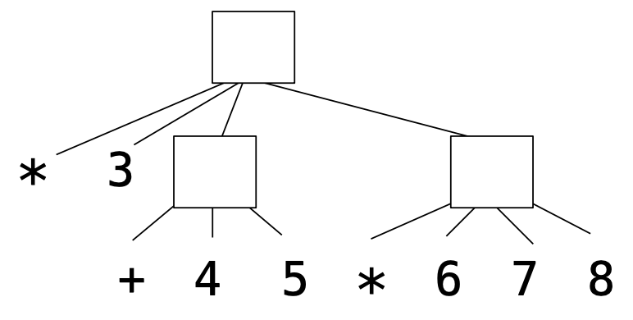
Calculator language syntax
The Calculator language has primitive expressions and call expressions. (That's it!)
A primitive expression is a number: 2 -4 5.6
A call expression is a combination that begins with an operator (+, -, *, /) followed by 1 or more expressions and is surrounded by parentheses:
(+ 1 2 3) (/ 3 (+ 4 5))
Expression | Expression tree | Representation as Links
(* 3 (+ 4 5) (* 6 7 8))

Slide 4
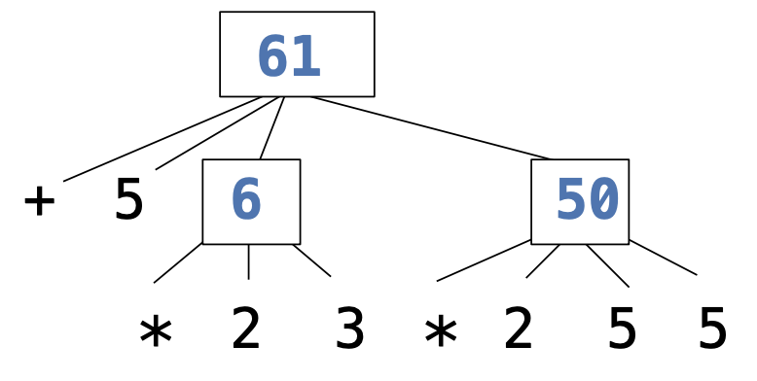
Calculator language semantics
The value of a calculator expression is defined recursively.
Primitive: A number evaluates to itself.
Call: A call expression evaluates to its argument values combined by an operator.
+: Sum of the arguments
*: Product of the arguments
-: If one argument, negate it. If more than one, subtract the rest from the first.
/: If one argument, invert it. If more than one, divide the first by the rest.
Expression | Expression tree
(+ 5 (* 2 3) (* 2 5 5))

Slide 6
Interactive interpreters

Slide 7
REPL: Read-Eval-Print Loop
The user interface for many programming languages is an interactive interpreter
Print a prompt
Read text input from the user
Parse the text input into an expression
Evaluate the expression
If any errors occur, report those errors, otherwise
Print the value of the expression and repeat

Slide 8
Raising exceptions
Exceptions can be raised during lexical analysis, syntactic analysis, eval, and apply.
Example exceptions
Lexical analysis: The token 2.3.4 raises ValueError("invalid numeral")
Syntactic analysis: An extra ) raises SyntaxError("unexpected token")
Eval: An empty combination raises TypeError("() is not a number or call expression")
Apply: No arguments to - raises TypeError("- requires at least 1 argument")

Slide 9
Handling exceptions
An interactive interpreter prints information about each error.
A well-designed interactive interpreter should not halt completely on an error, so that the user has an opportunity to try again in the current environment.

Slide 11
Parsing & Evaluation

Slide 12
Reading Calculator Expressions
A Calculator expression is written as elements in parentheses:
Each <element> can be another expression or a primitive.
The task of parsing a language involves turning a string representation of an expression into a structured object representing the expression.
(<element_0> <element_1> ... <element_n>)
(+ (* 3 (+ (* 2 4) (+ 3 5))) (+ (- 10 7) 6))

Slide 13
Parsing
A parser takes text and returns an expression object.
Text | Lexical Analysis | Tokens | Syntactic Analysis | Expression
'(+ 1' | → | '(', '+', 1 | → | Pair('+', Pair(1, ...)) printed as (+ 1 (- 23) (* 4 5.6))
' (- 23)' | → | '(', '-', 23, ')' | →
' (* 4 5.6))' | → | '(', '*', 4, 5.6, ')', ')'

Slide 15
Lexing

Slide 16
Lexical analysis
' (* 4 5.6))' → '(', '*', 4, 5.6, ')', ')'
Iterative process
Checks for malformed tokens
Determines types of tokens
Processes one line at a time

Slide 17
Useful string methods
str.strip() returns a string without whitespace (spaces, tabs, etc.) on the ends
str.split(sep) returns a list of strings that were separated by sep (if not specified, sep is any whitespace).
str.replace(a, b) returns a string with all instances of string a replaced by string b
' hello '.strip()
# 'hello'
# ['hi', 'there']
'hi there '.split()
'2+2'.replace('+', ' + ')
# '2 + 2'

Slide 18
Tokenizing sentences
Here's an example using sentences
Input data: parsed2.txt
Desired output: tree()s!
File comes from: MacWhinney, B. (2000). The CHILDES Project: Tools for analyzing talk. Third Edition. Mahwah, NJ: Lawrence Erlbaum Associates.
(ROOT (S (NP (NN this)) (VP (COP is) (NP (DT a) (NN book))) (. .)))
(ROOT (S (NP (PRP I))
(VP (AUX 've)
(ADVP (RB never))
(VP (VBN seen) (NP (DT such) (DT a) (JJ cute) (NN kangaroo))))
(. .)))

Slide 19
From lines to tokens
['(ROOT (S (NP (NN this)) (VP (COP is) (NP (DT a) (NN book))) (. ?)))\n',
'\n',..
to
A function, read_sentences() takes care of this:
[['(', 'ROOT', '(', 'S', '(', 'NP', '(', 'NN', 'this', ')', ')',
'(', 'VP', '(', 'COP', 'is', ')', '(', 'NP', '(', 'DT', 'a', ')',
'(', 'NN', 'book', ')', ')', ')', '(', '.', '?', ')', ')', ')'],
...]
lines = open('parsed2.txt').readlines()
tokens = read_sentences(lines)

Slide 21
Parsing

Slide 22
Syntactic analysis
'(', '+', 1, ... → Pair('+', Pair(1, ...))
Tree-recursive process
Balances parentheses
Returns tree structure
Processes multiple lines
In your project, each call to parse() consumes the input tokens for exactly one expression.
Base case:
Recursive case:
operators and numbers
read subexpressions and combine them

Slide 23
Pair class
The Pair class represents Cacluator expressions and lists. A list is a pair whose second element is either pair or an empty list.
Improper lists:
class Pair:
s = Pair(1, Pair(2, Pair(3, nil)))
print(s)
len(s)
# (1 2 3)
# 3
# (1 . 2)
# (1 2 . 3)
Error!
print(Pair(1, 2))
print(Pair(1, Pair(2, 3)))
len(Pair(1, Pair(2, 3)))

Slide 24
From tokens to trees
[..., '(', 'NP', '(', 'DT', 'a', ')', '(', 'JJ', 'big', ')', '(', 'NN', 'bug', ')', ')', ...]
# i
def read_parse_tree(tokens, i):
# Read the tag, which is tokens[i], then advance i.
# While the current item is a '(',
# call read_parse_tree to construct a branch.
# Once the current item is a ')',
# return a phrase from the tag and branches.
# Base case: there is no '(' or ')'
# because there is just text after the tag.
read_parse_tree() will return the tree it read and what to read next.
tree = read_parse_tree(tokens[0], 1)

Slide 26
Evaluation

Slide 27
The eval() function
The eval function computes the value of an expression.
It is a generic function that behaves according to the type of the expression (primitive or call).
You'll use isinstance() to check the type
It recursively calls itself when it encounters sub-expressions
If you have just an operator and operands as values, you call the apply() function to apply the operator to the operands
(/ 3 (+ 4 5))
this generates a recursive call

Slide 28
Applying built-in operators
The apply function applies some operation to a (Calculator) list of argument values
In calculator, all operations are named by built-in operators: +, -, *, /
Implementation | Language semantics
def calc_apply(operator, args): if operator == '+': return reduce(add, args, 0) elif operator == '-': ... elif operator == '*': ... elif operator == '/': ... else: raise TypeError | + Sum of the arguments - ... * ... / ...

Slide 29
The Calculator eval() algorithm
(/ 3 (+ 4 5))
Pair('/', Pair(3, Pair(Pair('+',
Pair(4, Pair(5, nil))), nil)))
(* 3 (+ 4 5) (* 6 7 8))
If the expression is a primitive (int or float), we just return the value
If the expression is a Pair object it is some sort of expression
Get the operator from the first item of the Pair object
Call eval() on the first item of each Pair in the rest of the expression, building a Pair list with the operands as the values.
Call the apply() function passing in the operator and the results of step 2.2.
Return the result of the apply() function from the previous step.
If the expression is not a primitive or a Pair, raise a TypeError exception.
Notes:
walk through this process with the expression (/ 3 (+ 4 5 ))
Pair('/', Pair(3, Pair(Pair('+', Pair(4, Pair(5, nil))), nil)))

