Slide 1
Orders of Growth & Intro to Machine Learning

Slide 2
Orders of Growth

Slide 3
Common orders of growth
One way to describe the efficiency of an algorithm according to its order of growth, the effect of increasing the size of input on the number of steps required.
Order of growth | Description
Exponential growth | Number of steps increases faster than a polynomial function of the input size.
Quadratic growth | Number of steps increases in proportion to the square of the input size.
Linear growth | Number of steps increases in direct proportion to the input size.
Logarithmic growth | Number of steps increases proportionally to the logarithm of the input size.
Constant growth | Always takes same number of steps, regardless of input size.

Slide 4
Adding to the front of linked list
def insert_front(linked_list, new_val):
"""Inserts NEW_VAL in front of LINKED_LIST,returning new linked list.
>>> ll = Link(1, Link(3, Link(5)))
>>> insert_front(ll, 0)
Link(0, Link(1, Link(3, Link(5))))
"""
return Link(new_val, linked_list)
How many operations will this require for increasing lengths of the list?
List Size | Operations
1
10
100
1000
1
1
1
1

Slide 5
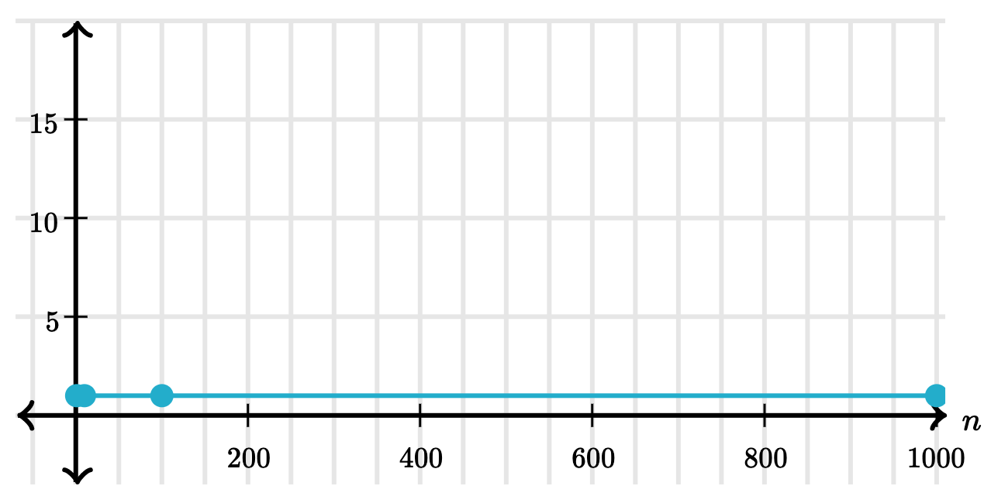
Constant Time
An algorithm that takes constant time, always makes a fixed number of operations regardless of the input size.
List Size | Operations
1 | 1
10 | 1
100 | 1
1000 | 1

Slide 6
Fast Exponentiation
square = lambda x: x * x
def exp_fast(b, n):
if n == 0:
return 1
elif n % 2 == 0:
return square(exp_fast(b, n//2))
else:
return b * exp_fast(b, n-1)
How many operations will this require for increasing values of n?
N | Operations
0
8
16
1024
1
5
6
12

Slide 7
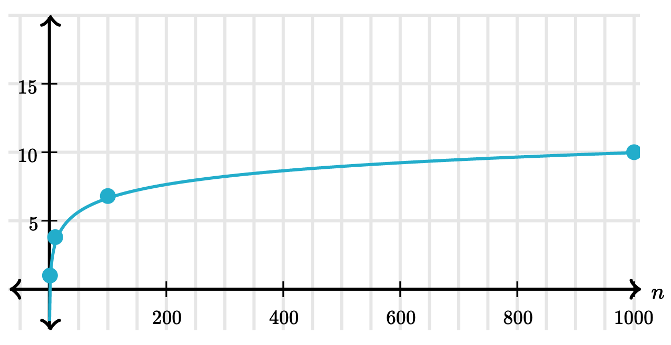
Logarithmic Time
When an algorithm takes logarithmic time, the time that it takes increases proportionally to the logarithm of the input size.
N | Operations
0 | 1
8 | 5
16 | 6
1024 | 12

Slide 8
Finding values in a linked list
def find_in_link(ll, value):
"""Return true if linked list LL contains VALUE.
>>> find_in_link(Link(3, Link(4, Link(5))), 4)
True
>>> find_in_link(Link(3, Link(4, Link(5))), 7)
False
"""
if ll is Link.empty:
return False
elif ll.first == value:
return True
return find_in_link(ll.rest, value)
How many operations will this require for finding a value in the list? Consider both the best case and worst case.
List Size | Best case: Operations | Worst Case: Operations
0
10
100
1000
1
1
1
10
1
100
1
1000

Slide 9
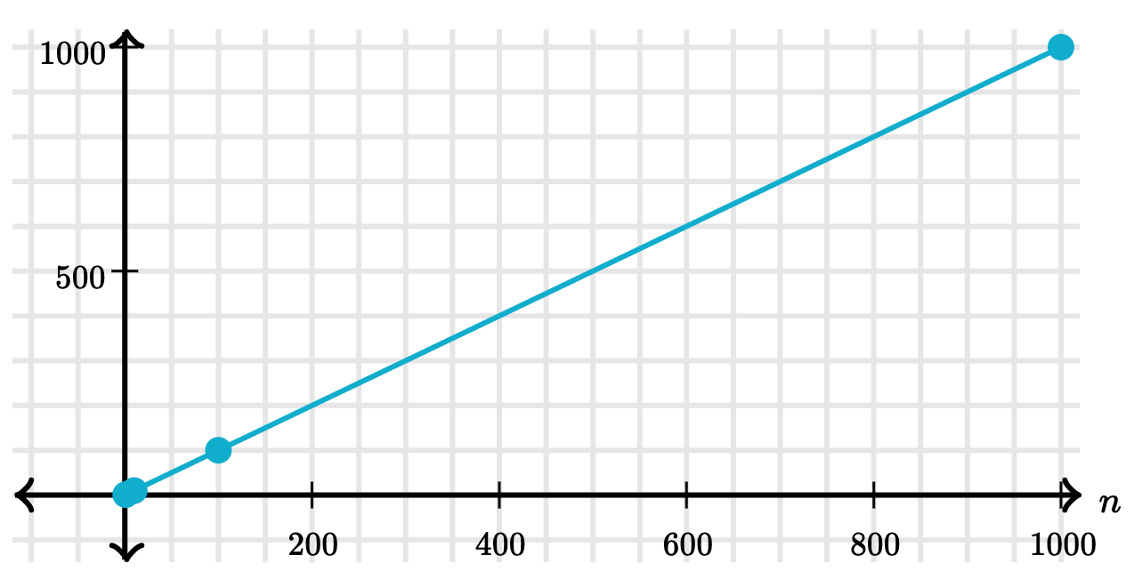
Linear Time
When an algorithm takes linear time, its number of operations increases in direct proportion to the input size.
List Size | Worst Case: Operations
1 | 1
10 | 10
100 | 100
1000 | 1000

Slide 10
Counting overlapping items in lists
def overlap(a, b):
"""
>>> overlap([3, 5, 7, 6], [4, 5, 6, 5])
3
"""
count = 0
for item in a:
for other in b:
if item == other:
count += 1
return count
 | 3 | 5 | 6 | 7
4
5 |  | +
6 |  |  | +
5 |  | +
How many operations will this require for finding the overlapping elements?
List Size | Operations
1
10
100
1000
1
100
10000
1000000

Slide 11
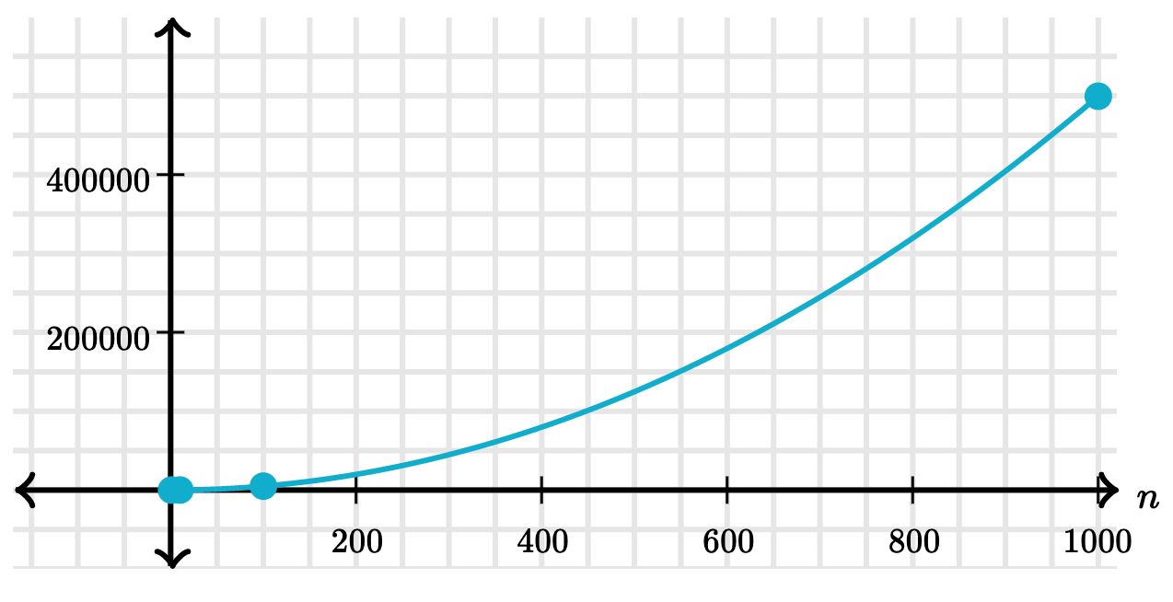
Quadratic Time
When an algorithm grows in quadratic time, its steps increase in proportion to square of the input size.
List Size | Operations
1 | 1
10 | 100
100 | 10000
1000 | 1000000

Slide 12
Recursive Virahanka-Fibonacci
def virfib(n):
if n == 0:
return 0
elif n == 1:
return 1
else:
return virfib(n-2) + virfib(n-1)
How many operations are required for increasing values of n?
N | Operations
1
2
3
4
7
8
20
1
3
5
9
41
67
21891

Slide 13
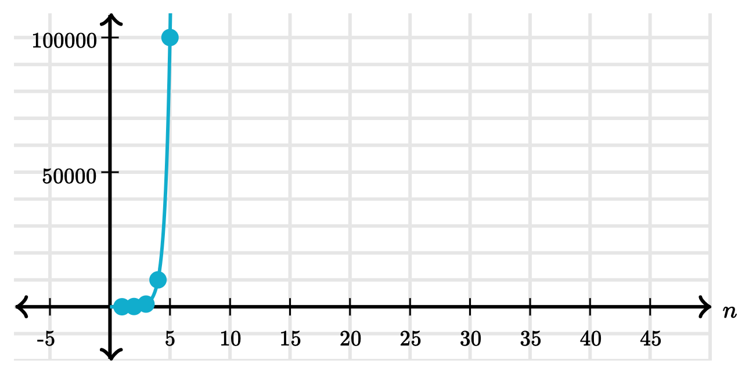
Exponential Time
When an algorithm grows in exponential time, its number of steps increases faster than a polynomial function of the input size.
N | Operations
1 | 1
2 | 3
3 | 5
4 | 9
7 | 41
8 | 67
20 | 21891

Slide 14
Comparing orders of growth

Slide 15
Big O Notation
A formal notation for describing the efficiency of an algorithm, using asymptotic analysis.
Order of growth | Example | Big O
Exponential growth | recursive virfib | O(b^{n})
Quadratic growth | overlap | O(n²)
Linear growth | find_in_link | O(n)
Logarithmic growth | exp_fast | O(log⁡ n)
Constant growth | add_to_front | O(1)

Slide 17
Space

Slide 18
Space and environments
The space needed for a program depends on the environments in use.
At any moment there is a set of active environments.
Values and frames in active environments consume memory.
Memory that is used for other values and frames can be recycled.
Active environments:
Environments for any function calls currently being evaluated.
Parent environments of functions named in active environments.

Slide 19
Active environments in PythonTutor
def virfib(n):
if n == 0:
return 0
elif n == 1:
return 1
else:
return virfib(n-2) + virfib(n-1)
View in PythonTutor
Make sure to select "don't display exited functions"

Slide 20
Visualization of space consumption
virfib(5)
ret: 5
virfib(3)
ret: 2
virfib(4)
ret: 3
virfib(1)
ret: 1
virfib(2)
ret: 1
virfib(2)
ret: 1
virfib(3)
ret: 2
virfib(0)
ret: 0
virfib(1)
ret: 1
virfib(0)
ret: 0
virfib(1)
ret: 1
virfib(1)
ret: 1
virfib(2)
ret: 1
virfib(0)
ret: 0
virfib(1)
ret: 1

Slide 22
Memoization

Slide 23
Memoization
Memoization, or caching, is a strategy to reduce redundant computation by remembering the results of previous function calls in a "memo" or cache.

Slide 24
A memoization HOF
def memo(f):
cache = {}
def memoized(n):
if n not in cache:
cache[n] = f(n)
return cache[n]
return memoized

Slide 25
Memoizing Virahanka-Fibonacci
n | Original | Memoized
5 | 15 | 9
6 | 25 | 11
7 | 41 | 13
8 | 67 | 15
10 | 177 | 19
20 | 21891 | 39
Video visualization

Slide 27
Machine Learning

Slide 28
What is Machine Learning?

Slide 29
What is Machine Learning?
Machine Learning (ML) is a subfield of AI in which algorithms learn patterns from data to solve problems, rather than following explicit instructions.
ML algorithms are the driving force behind google search, Facebook ads, voice recognition on your phone, ChatGPT, and many other applications.
Some ML algorithms attempt to infer from past data what future data may look like. This process is often called inference or prediction.
Other ML algorithms attempt to group data together based on similarities between instances. This process if often called clustering.

Slide 30
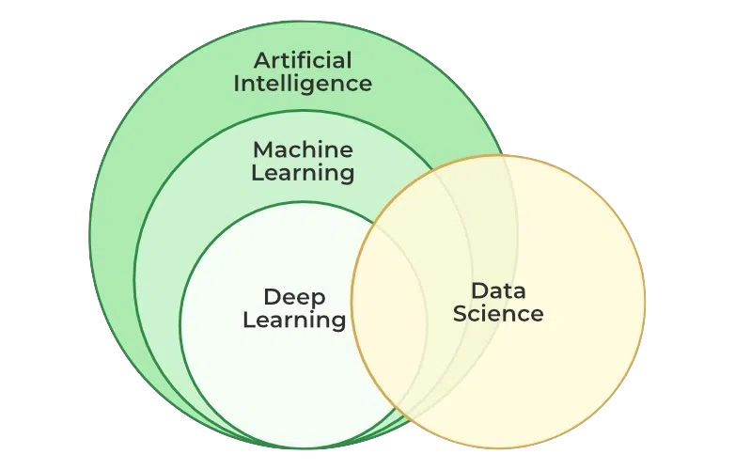
Artificial Intelligence seeks to mimic
human capacities and decision-making
Machine Learning seeks to construct
these capacities directly from data
Deep Learning is a subset of
machine learning algorithms
based on neural networks
Data Science seeks to construct
meaning from data via machine
learning, visualizations, and
statistical analysis
image from GeeksForGeeks

Slide 31
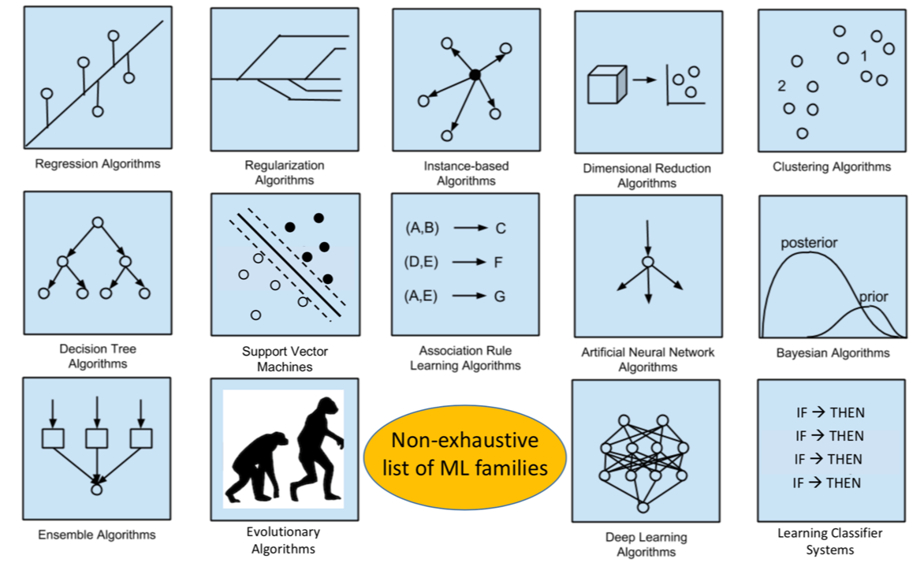
There are a great many types of machine learning algorithms, each best at certain types of jobs. Today, we’ll look at just a couple of examples.
image from Children's Hospital of Philidelphia

Slide 32
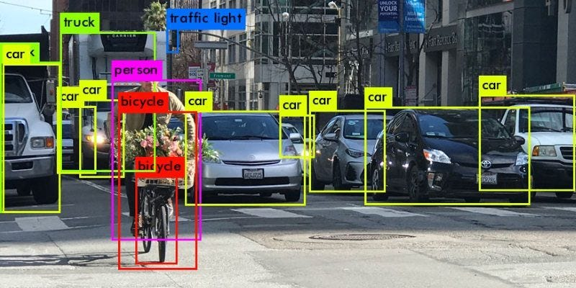
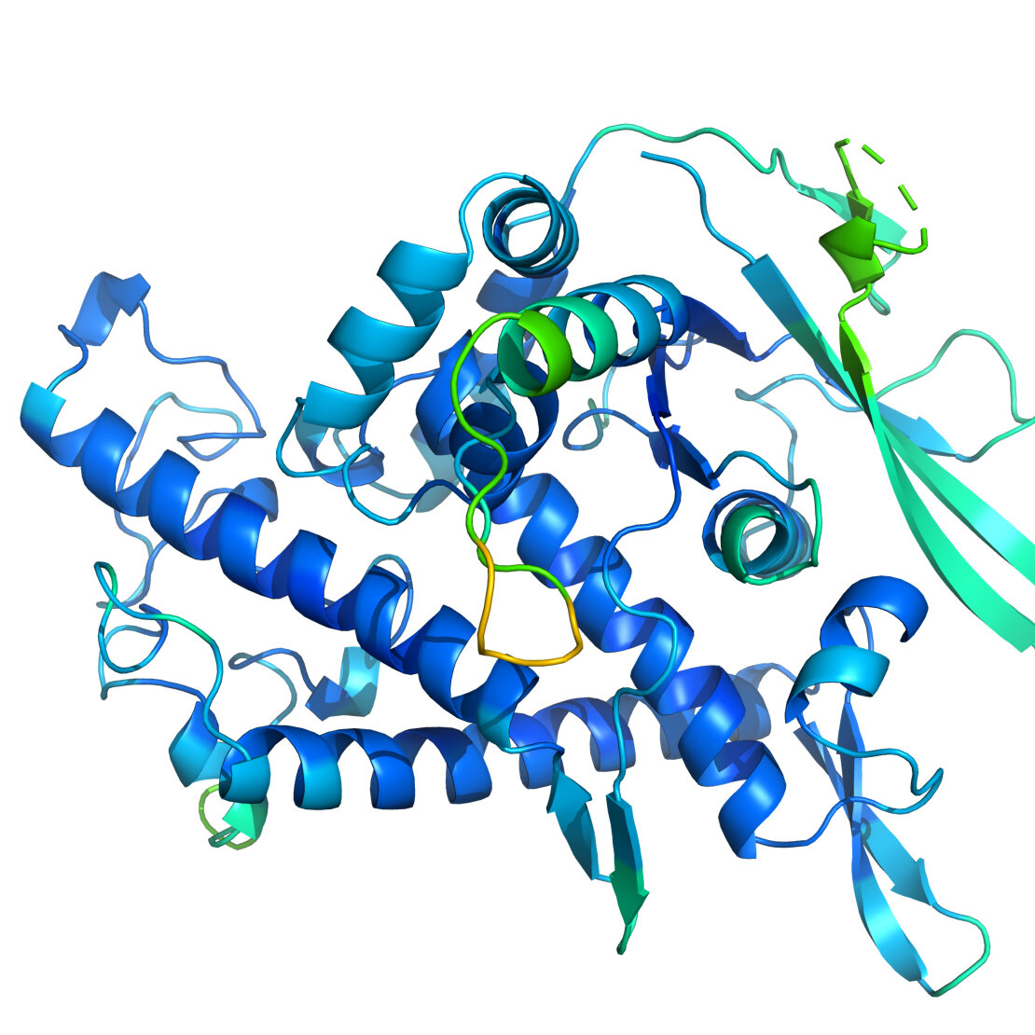
A few popular applications of machine learning:
Image processing
Natural Language Processing
Advertising/product
recommendations
Drug discovery
Health care

Slide 34
How does Machine Learning Work?

Slide 35
A Simple Example – Text Prediction
Given a corpus of text, can the computer learn how to make other text that sounds the same/looks like it was written by the same author?
Let's see what we can figure out
We'll start with the text of 1st Nephi
I, Nephi, having been born of goodly parents, therefore I was taught somewhat in all the learning of my father; and having seen many afflictions in the course of my days, nevertheless, having been highly favored of the Lord in all my days; yea, having had a great knowledge of the goodness and the mysteries of God, therefore I make a record of my proceedings in my days. Yea, I make a record in the language of my father, …

Slide 36
Text Prediction
We start by reading in all the words, in order, and storing them in a list.
For this simple example, we'll remove all punctuation and make everything lower case
We then create a dictionary using each unique word in our list as the key and the word following it as its value:
i.e. I -> Nephi, Nephi -> having, having -> been, …
We can then use this to dictionary to generate new text from some initial word (it just has to be in our list)
Given a word in our list, our dictionary predicts what word should come next

Slide 37
Predicted Text
If we use the word "Nephi" to start, we get the following:
nephi make an end ye shall be saved at the last day and thus it is amen and thus it is amen and thus it is amen and thus it is amen and thus it is amen and thus it is amen and thus it is amen and thus it is amen and thus it is amen and thus it is amen and thus it is amen and thus it is amen and thus it is amen and thus it is amen and thus it is amen and thus it is amen and thus it is amen and thus it is
That didn't work!
Why? What could we do better?

Slide 38
Text Prediction II
Storing just a single word after each word was actually losing information.
Once our dictionary was built, only the last word that followed any given word was stored in the dictionary.
Instead of using a single word as the value, let's store a list of all words that followed the word being used as the key instead.
Then we can randomly pick a word from that list when we need the next word
For example, the entry for 'nephi' would then contain the following list:
['having', 'do', 'will', 'being', 'because', 'returned', 'said', 'and', 'crept', 'had', 'did', 'wherefore', 'after', 'nevertheless', 'proceed', 'was', 'what', 'saw', 'also', 'beheld', 'saying', 'heard', 'am', 'spake', 'took', 'went', 'who', 'began', 'received', 'have', 'declare', 'say', 'make']

Slide 39
Predicted Text II
If we again use the word "Nephi" to start, we get the following:
nephi who should have read in one pointed the instruction of fruit was obedient unto his righteous wherefore he knew them off the river and marvelous work timbers of angels in these times of water that thou beholdest that she also laid the desires to build the hands and eve who should no such thing shall minister unto the guilty taketh the servant o lord are engraven the sun smite him ye from my sons of darkness which shall judge the taking away in dominion and be nursed by way forward through on dry ground a small voice but because of
Better, we didn't get into a loop, but still not very good!
What could we do better?

Slide 40
Text Prediction III
In the last iteration, we just made a list of all the words that followed a given word and randomly picked from them.
We ignored how often a word followed the specific word.
We could keep track of the number of times a word followed each word.
Then we could randomly pick a new following word based on the frequency that the two words appear together. Thus, words that more commonly appear together in the original will more commonly appear together in the final output.

Slide 41
Predicted Text III
One more time, using the word "Nephi" to start we get the following:
nephi and it came to pass that the plates of israel do ye will not the space of promise yea and our father thou say it came to the nations of his word he hath declared unto him and lemuel did look and he might see and it was upon all nations of his sheep and shall be as a record from among them and the wrath of israel unto blindness to pass that great church of my brethren that the lord had done for thus saith the things concerning his rod of god and the wicked from the jews as
Is that better? Maybe?
What could we do to improve it?

Slide 42
Another Corpus
Let's try reading in the Sorcerer's Stone and starting with the word "Harry"
harry he said professor mcgonagall told him me out then the floor he hurried out his mommy said ron though his seat hungry after a good holiday said hagrid asked as they went again hermione had lord said harry felt particularly hungry he was skimming through the size of stairs as well yeah an excellent adventure was measuring between door and hermione opened the snitch wins his hands clasped in trouble they had a canary yellow circus tent him he remembers what you ll really done ron reminded them how often happened harry heard the friar haven t have to what
It's still not good
But we didn't write anything new. Given a new corpus, the code can construct text using the same algorithm and learn how to imitate a new author.
We just need a better algorithm.

Slide 44
Another example: Neural networks

Slide 45
Neural networks
Neural networks were inspired by the structure of neurons and synapses in biological brains
The algorithm simulates a series of neurons connected to each other by “weights” indicating their connection strength
The chance that any given neuron will pass information forward is proportional to the amount of incoming signal it receives from other neurons
If the network produces an incorrect output, it adjusts all of its weight values in a way that would have produced a better output

Slide 46
Neural networks
The NN learning algorithm is simple in concept (but the math is complex):
Begin with random values for all network weights
Give the network a piece of data as input, and observe its output value(s)
If the output is wrong, determine whether it was too high or too low, and adjust all network weights in the direction that would have had less error. Each weight update is very tiny, because you don’t want to overshoot the correct values.
Repeat on 10,000 - 100,000,000 unique training examples. Eventually the network will begin to display better behavior.

Slide 47
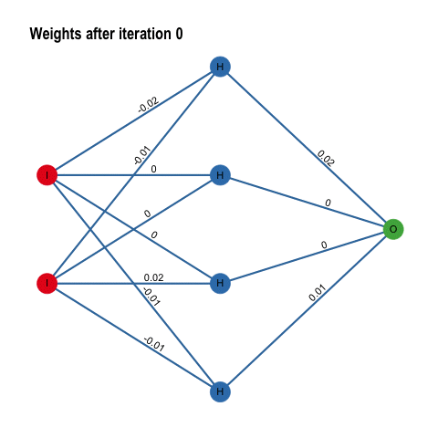
Inputs
Output
Image from https://histalk2.com/2018/11/14/a-machine-learning-primer-for-clinicians-part-5/

Slide 48
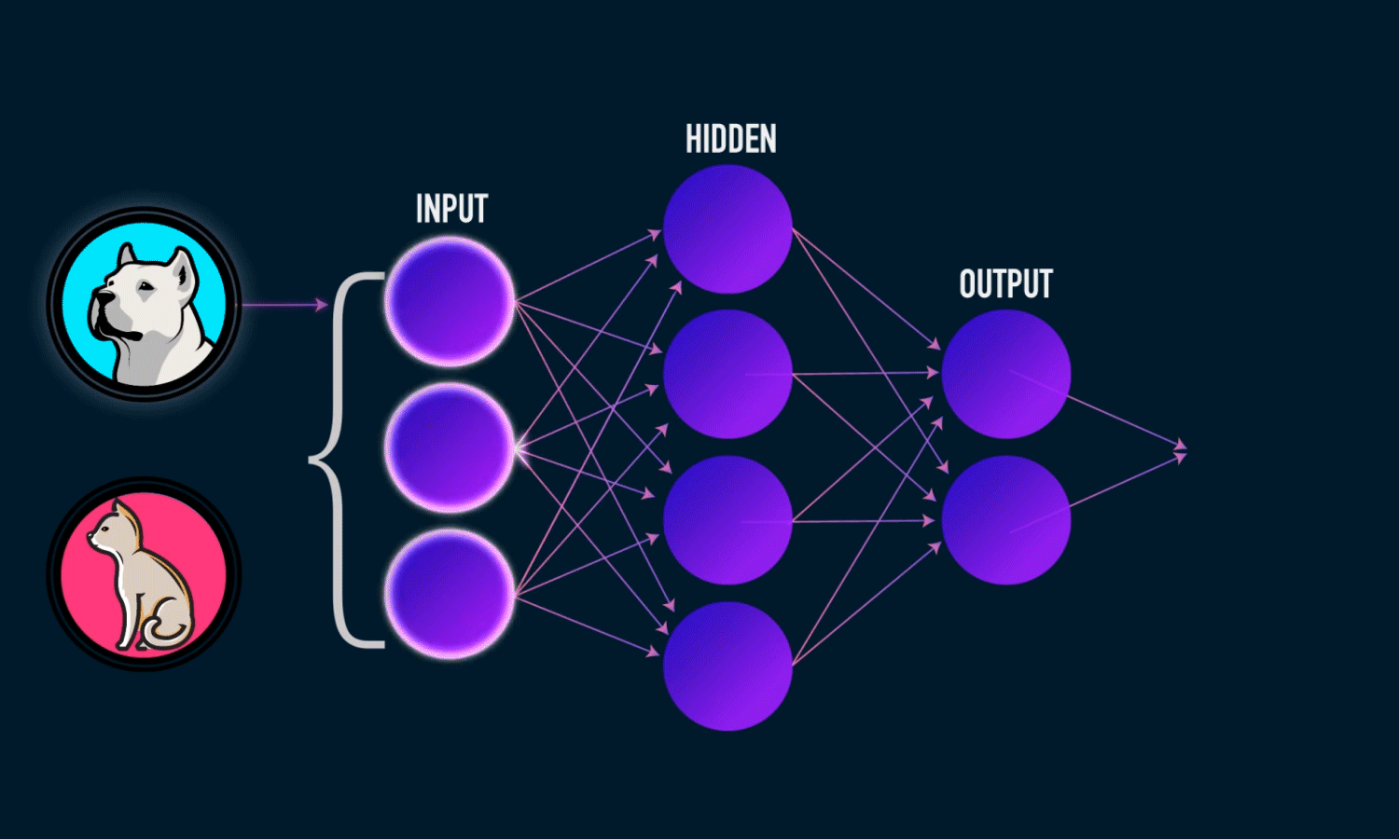
Image from https://towardsdatascience.com/everything-you-need-to-know-about-neural-networks-and-backpropagation-machine-learning-made-easy-e5285bc2be3a

Slide 49
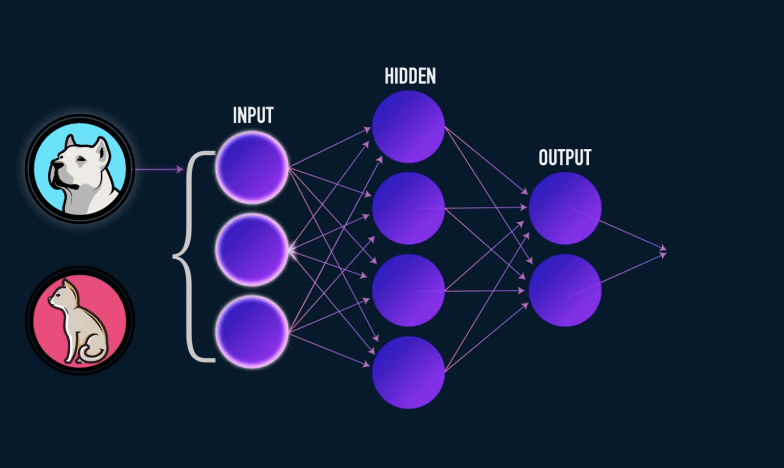
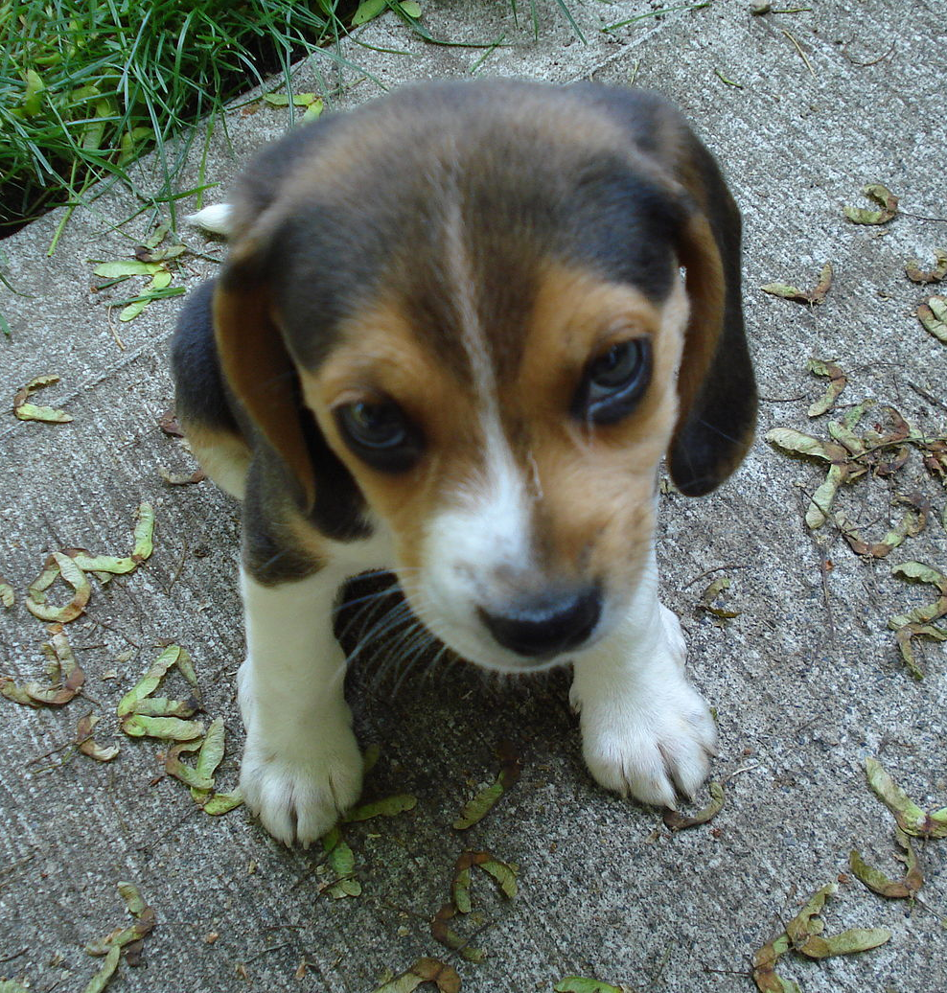
cat
cat
dog
dog
dog
dog
cat
dog
cat
cat
cat
cat
Once the network has seen enough training examples, it will begin to produce correct outputs
cat
cat
dog
dog
dog
dog
dog
cat
cat
cat
dog
cat
dog
dog
cat
dog
dog
cat
dog
cat

Slide 50
cat
cat
dog
dog
dog
cat
cat
cat
cat
cat
cat
cat
Some of the data might be incorrectly labeled. Neural network algorithms are robust to this as long as most of the information is correct
dog
cat
dog
dog
dog
dog
dog
cat
cat
cat
cat
cat
dog
dog
dog
dog
dog
cat
dog
cat

Slide 51
cat
cat
dog
dog
dog
cat
cat
cat
cat
cat
cat
cat
HOWEVER: Neural networks are notoriously finicky. They don’t always learn, or don’t always learn correctly, and as the complexity of the task increases, they get harder and harder to design and train.
dog
cat
dog
dog
dog
dog
dog
cat
cat
cat
cat
cat
dog
dog
dog
dog
dog
cat
dog
cat

