Slide 1
Data Visualization

Slide 2
Data visualization
When working with data, it is often useful to display that data in a graphical format.
This can often help us to see correlations, trends, or other relationships in the data that looking at the raw data doesn't make apparent.
The process of plotting or otherwise displaying data graphically is know as data visualization.
In this class we're going to look at some simple data visualizations using Python's Matplotlib library

Slide 3
Installing Matplotlib
Matplotlib is not a built-in library in Python so we need to install it
Matplotlib is a large library with lots of components. You can read the full documentation for the package at https://matplotlib.org/stable/index.html
We're going to just be using a portion of the package, the pyplot submodule that handles the simple plots we'll be making
We'll import this using an alias to save us some typing:
To use a function from the library, we just type:
pip install matplotlib
import matplotlib.pyplot as plt
plt.<function name>(<arguments>)

Slide 5
Simple plots

Slide 6
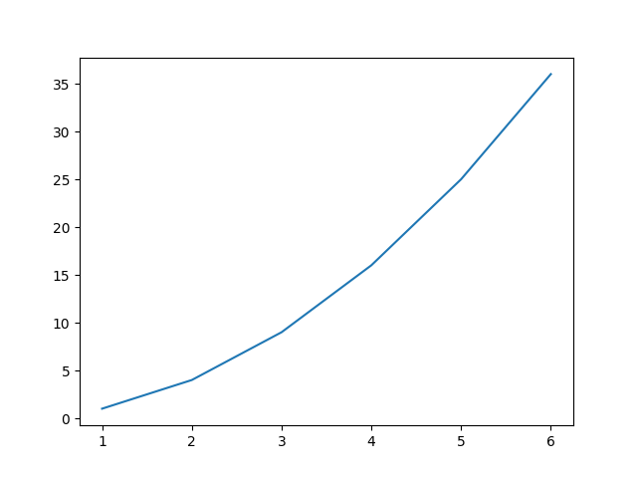
A simple line plot
The simplest plot to make is just a plot of some x and y data connected by a line
The two sets of data should be contained in lists.
You use the plot() function in matplotlib.pyplot
plt.show() causes the plot to be displayed.
import matplotlib.pyplot as plt
x_points = [1,2,3,4,5,6]
y_points = [1,4,9,16,25,36]
plt.plot(x_points, y_points)
plt.show()

Slide 7
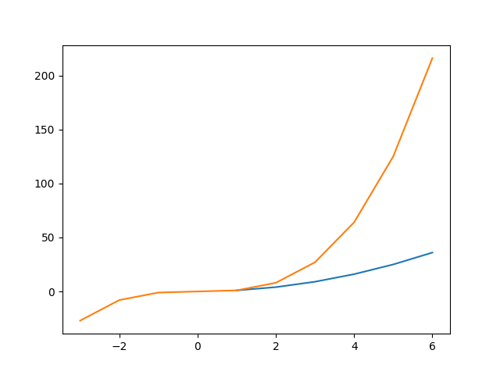
Plotting multiple datasets
If you have several different data sets that you want to plot on a single graph, you just call plot() multiple times with each data set
import matplotlib.pyplot as plt
x_points = [1,2,3,4,5,6]
y_points = [1,4,9,16,25,36]
x2_points = [-3,-2,-1,0,1,2,3,4,5,6]
y2_points = [-27,-8,-1,0,1,8,27,64,125,216]
plt.plot(x_points, y_points)
plt.plot(x2_points, y2_points)
plt.show()

Slide 8
Some things to be aware of
Python will adjust the axes of the plot to fit all the data plotted
It plots the data in the order the plot() commands are given so data in a later call will be "on top of" data from an earlier plot
If you have similar data in the data sets and want one to be highlighted/more visible, plot it last.
It arbitrarily picks the colors for the lines drawn
It arbitrarily picks tick values based on the range of each axis.
This is good if you just want a quick plot to see the shape of the data. But what if you want more control?

Slide 9
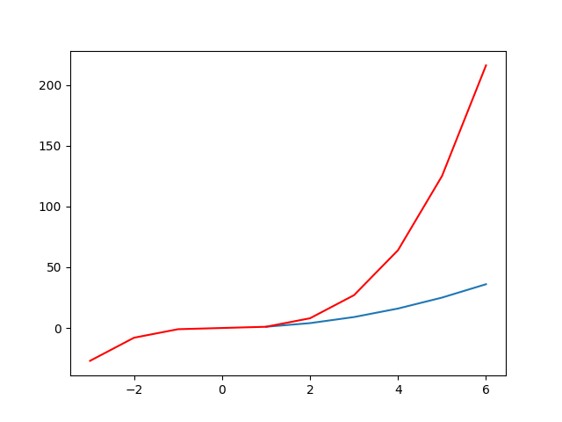
Picking colors
We can specify what color we want the line drawn in by passing the color as the next parameter after the x and y values:
where <color> is any RGB color code of the form #RRGGBB
In addition, matplotlib recognizes a few short-hands for common colors:
red – 'r', green – 'g', blue – 'b'
cyan – 'c', magenta – 'm', yellow – 'y'
black – 'k', white – 'w'
Let's make the cube plot red
plt.plot(x_points, y_points,'<color>')
plt.plot(x2_points, y2_points,'r')

Slide 10
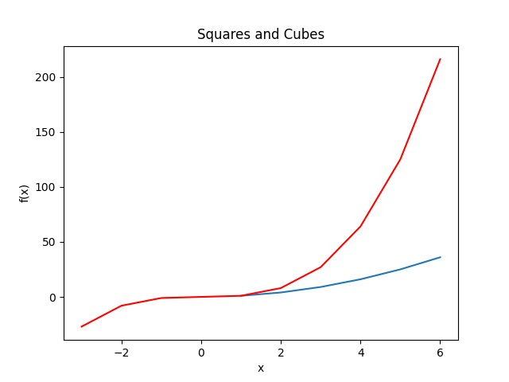
Adding labels
Another common need is to put a title on the plot and labels on our axes.
This is done with the title(), xlabel(), and ylabel() methods.
Adding titles and axis labels to our sample plot gives:
plt.title("Title text goes here")
plt.xlabel('Label text goes here')
plt.title("Squares and Cubes")
plt.xlabel("x")
plt.ylabel("f(x)")

Slide 11
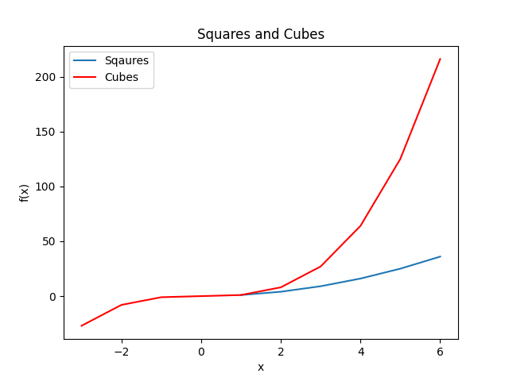
Legends
It's still not clear what the lines mean in our plot.
When we have multiple data sets plotted, we often
want to have a legend that briefly describes what data
each line represents.
We can add legends with the legend() method
This is done in two parts.
When we plot the data, we give the plot a name through the label parameter
Then we tell the plot to display the legend with the legend() method
plt.plot(x_points, y_points, label='Squares')
plt.plot(x2_points, y2_points, 'r', label="Cubes")
plt.legend()

Slide 12
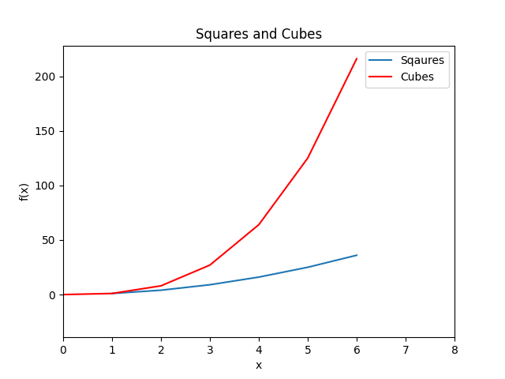
Axis Range
Another common desire is to specify a specific range for one or both of the axes to only show part of a data set.
You do this with the xlim() and ylim() methods
Both of these require two parameters: the lower and upper range for the axis:
plt.xlim(0,8)

Slide 14
Histograms

Slide 15
Histograms
Another common plot type is the histogram
This is a plot of the number of item that fall into some bin – e.g.
number of students whose birthday falls on a given day of the month
number of people that gave a specific response on a survey
number of words with 1, 2, 3, 4, etc. letters in them
number of web pages that were linked to 1, 2, 3, 4, etc. times on a site
Matplotlib has two different ways to make these plots depending on if you have the data binned already or not

Slide 16
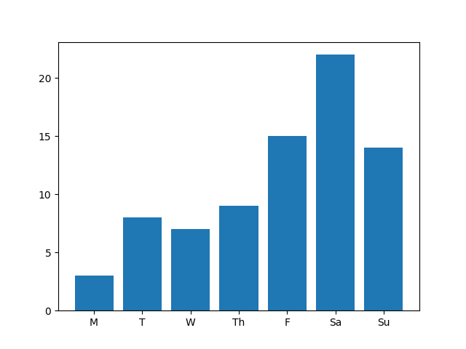
Bar Plots
The first method assumes you already know the value for each of your bins and have a name for each bin
If this is the case, you can use the bar() method to create a bar plot
The bar() method takes two parameters, the names for each bar (the x axis) and the counts for each bar (the y axis). Like with plot(), these are both lists.
labels = ["M","T","W","Th","F","Sa","Su"]
values = [3,8,7,9,15,22,14]
plt.bar(labels, values)
plt.show()

Slide 17
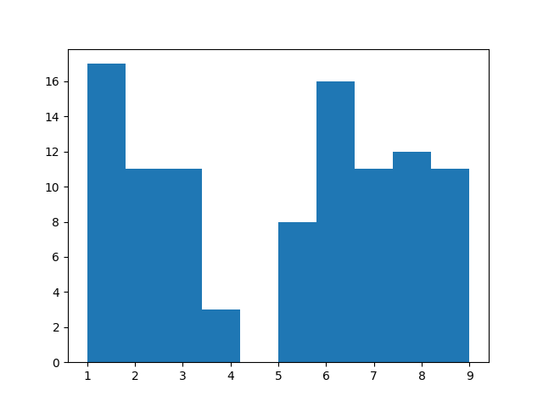
Unbinned data
If you just have a list of data, and it hasn't been separated into bins, you can have matplotlib do the binning for you before plotting.
This uses the hist() method
hist() just needs a single parameter, the list of data to plot.
Why is there a gap?
Matplot lib by default picks 10 bins between the minimum and maximum values in the list and divides the data into those bins
We have a lower value of 1 and upper value of 9 so each bin is only 0.8 wide – the bin from 4.2-5.0 is empty
numbers = [random.randrange(1,10) for i in range(100)]
plt.hist(numbers)

Slide 18
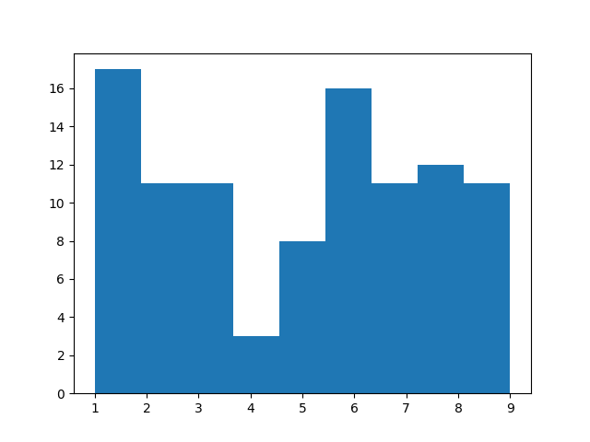
Picking bins
We can control the number of bins in two different ways
The first is to just set the number of bins we want to have using the bins parameter to the hist() method
But if we look closely, it's still not quite right
plt.hist(numbers, bins=9)

Slide 19
Picking bins
The second method, which gives us complete control, is to pass a list of bin boundaries
The list should be one longer than the number of bins desired
The values in the list are the boundaries for the values to be put into the bin.
The first bin will contain values >= element 1 and < element 2
The second bin will contain values >= element 2 and < element 3
etc.
bin_vals = [0.5,1.5,2.5,3.5,4.5,5.5,6.5,7.5,8.5,9.5]
plt.hist(numbers, bins=bin_vals)

Slide 21
Saving and clearing plots

Slide 22
Saving plots
So far, we've just been using the show() method to display the plot interactively while our script is running.
Often, we'll just want to have our program generate a plot and save it to disk as it is running so we don't need to interact with it.
This is done using the savefig() method.
This method just takes a path and filename to save the image as.
By default, it will save it in the local directory if no path is given
plt.savefig("myHistogram.png")

Slide 23
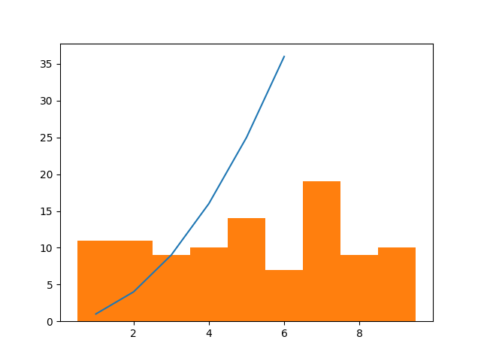
Making multiple plots
Imagine you want to make a plot, save it, then create and save a second plot:
What do the two figures look like?
???
plt.plot([1,2,3,4,5,6], [1,4,9,16,25,36])
plt.savefig("squares.png")
numbers = [random.randrange(1,10) for i in range(100)]
bins = [0.5,1.5,2.5,3.5,4.5,5.5,6.5,7.5,8.5,9.5]
plt.hist(numbers, bins=bins)
plt.savefig("counts.png")

Slide 24
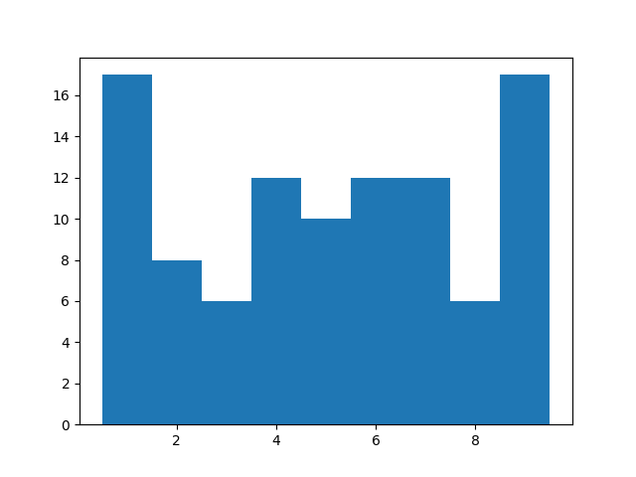
Clearing the plot
Just like plotting multiple lines on a single plot, matplotlib will continue to draw all the plots, bar plots, and histograms on the same canvas.
If you want to build multiple independent plots, you need to clear out the drawing canvas between each one.
This is done with the clf() method (clear figure)
plt.plot([1,2,3,4,5,6], [1,4,9,16,25,36])
plt.savefig("squares2.png")
plt.clf()
numbers = [random.randrange(1,10) for i in range(100)]
bins = [0.5,1.5,2.5,3.5,4.5,5.5,6.5,7.5,8.5,9.5]
plt.hist(numbers, bins=bins)
plt.savefig("counts2.png")

Slide 25
Last thoughts
Just like we could set the color, labels, and plot title on the line plots, you can do the same with the bar and histogram plots
Matplotlib provides ways to adjust the axis tick marks, make the axis logarithmic, and other manipulations
It's also possible to put multiple graphs side by side (or top to bottom or in a grid) within a single figure.
For all the details of what you can do, check out the full documentation at https://matplotlib.org/stable/index.html

