Slide 1
Cryptography

Slide 2

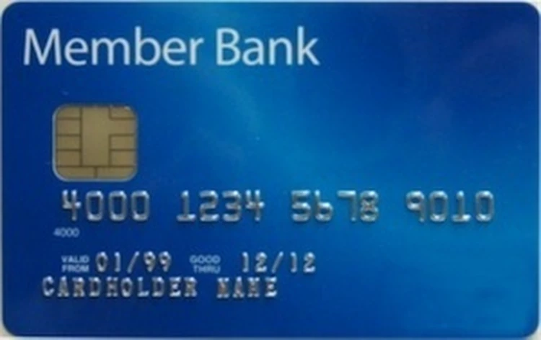

Why is it safe to share your credit card to Amazon over the internet?

Slide 3

What stops eavesdroppers from capturing your information?

Slide 4


Encryption!
Encryption lets us use a “key” to essentially lock up our message

Slide 5
How does encryption work?
Essentially you have some “function” and a “key” and that modifies data into something unreadable to people without the code.
function(message, key) = encrypted_message

Slide 6
How does decryption work?
To decrypt, you use the key to unlock or undo the encryption.
function(encrypted_message, key) = message

Slide 7
Simple example
Say we have a function that encrypts a string.
Our function “shifts” the letters by the amount specified by the key.
So a shifted “a” by ‘1’ would become “b”.
For example, for a key of ‘1’ our function would change “hello” to “ifmmp”
To decrypt we’d unshift an encrypted message by the key.

Slide 8
Simple example
Encrypt
encrypt(message, key) = encrypted_message
encrypt(“hello”, 1) == “ifmmp”
Decrypt
decrypt(encrypted_message, key) = message
decrypt(“ifmmp”, 1) == “hello”

Slide 9
A Simple Encryption
def simple_encrypt(message, key):
encrypted_letters = []
for letter in message:
encrypted_letters.append(chr(ord(letter) + key))
return ''.join(encrypted_letters)
print(simple_encrypt("hello", 0))
print(simple_encrypt("hello", 1))
print(simple_encrypt("hello", 2))
# "hello"
# "ifmmp"
# "jgnnq"

Slide 10
Is our simple example secure?
How could you crack it?
Maybe just try all possible keys and see what the resulting message would look like?
For our specific code there are really about 150,000 possible “letters” you could shift to. So a computer could easily run through all 150,000 “possible keys” to find the answer.
Maybe just figure out where the “spaces” are between words since it should be a letter that repeats in word sized intervals.

Slide 11
Secure Encryption Example
def encryption_example(message):
key = Fernet.generate_key()
fernet = Fernet(key)
encypted_message = fernet.encrypt(message.encode())
decrypted_messsage = fernet.decrypt(encypted_message).decode()
print("message: ", message)
print("encrypted: ", encypted_message)
print("decrypted string: ", decrypted_messsage)
message: hello
encrypted: b'gAAAAABlb1NmiBwzZ0Jj4z3MCtAyEGy9KW_6lBbwl8n3_XXzt2kqNLJ9ns35EWMXy4dZ8S06c5DsViIlWhsyL5sZyJ-CcZZMeQ=='
decrypted string: hello
Does not use a letter shift/swap/map. Uses current cryptography.
Take Math 485 for more details.

Slide 12
Back to our example….

Slide 13
Problem! How does Amazon “unlock” or “decrypt” the message and see what is in the box?

Slide 14
Amazon needs the same key!

Slide 15
How do we give Amazon a copy of the key?

Slide 16
If you sent the key over the internet
the eavesdropper could just store a
copy of the key
when they see it…

Slide 17
How can you securely give a key to someone else?
You could walk over to them and hand them the key?
You could send it in the mail?
You could use “Diffie-Hellman Key Exchange” and agree on a shared secret key!

Slide 19
Diffie-Hellman Key Exchange

Slide 20
Diffie-Hellman Key Exchange
This is a mathemagical process that lets two parties agree on a key in front of others, but nobody else but the two people agreeing know the resulting key.
This took years to figure out how to do. The mathematician who first thought of the idea didn’t actually figure out a solution. Later Whitfield Diffie and Martin Hellman figured out a solution on how to do this.

Slide 21
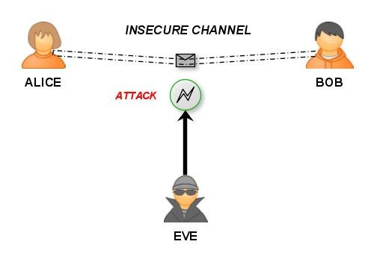
Introducing characters in the cryptography world
When talking about people in cryptography they usually refer to “Alice” and “Bob”. For this scenario they also would add “Eve” (for eavesdropper).

Slide 22
Activity
Two “volunteers” are going to come up from the class (you’ll need a computer/python).
They are going to agree on a secret key in front of all of us.
We will hear everything they say (we are “Eve” and will “eavesdrop”).
At the end the two volunteers will have a shared secret key, all the eavesdroppers will not have it!

Slide 23
https://en.wikipedia.org/wiki/Diffie%E2%80%93Hellman_key_exchange
Need two volunteers who can run a bit of python code.
First step agree on a “p” and a “g”. To speed this up let’s say “p=23” and “g=5”
Each volunteer secretly picks a number! Don’t tell anyone this number - but write it down. Calculate: (5**secret_number) % 23
Volunteers share the result of your calculation (5**secret_number) % 23, this is called your “public key”. They share with each other in front of everyone.
Each volunteer takes the other’s “public key” and does the following calculation: (other_volunteers_public_key ** secret_number) % 23
Each volunteer calculated result is a “shared key”, a secret number that only they know. It will be the *same* for both volunteers!
Can anyone guess what the shared number is? Have the volunteers both write the number on the board or something and reveal at same time.

Slide 24
Key values (g=5, p=23)
In real cryptography we need bigger numbers to make this secure.
  A ‘p’ value of 23 only allows for 23 unique shared keys.
An example 128-bit key could be 322057384927381029384759283747348193829 in decimal. Imagine raising that to a big power?
With bigger numbers we need to “modulo as we go” so the numbers don’t get too big (and to hide the original secret).
Python helps us with the pow() function!
  pow(123, 567, 123923) == (123 ** 567) % 123923

Slide 25
Try the example with a neighbor?

Slide 26
Diffie-Hellman Example
alice_secret = 12381283 # secret (not shared)
print(f"Alice's secret: {alice_secret}")
bob_secret = 83492833 # secret (not shared)
print(f"Bob's secret: {bob_secret}")
p = 23482348
print(f'p = {p} (seen by Eve)')
g = 5
print(f'g = {g} (seen by Eve)')
alice_public_key = pow(g, alice_secret, p) # shared to everyone
print(f"Alice's public key: {alice_public_key} (seen by Eve)")
bob_public_key = pow(g, bob_secret, p) # shared to everyone
print(f"Bob's public key: {bob_public_key} (seen by Eve)")
shared_key_via_alice = pow(bob_public_key, alice_secret, p) # result is secret
print(f"Shared key calculated and kept secret by Alice: {shared_key_via_alice}")
shared_key_via_bob = pow(alice_public_key, bob_secret, p) # result is secret
print(f"Shared key calculated and kept secret by Bob: {shared_key_via_bob}")
Alice's secret: 12381283
Bob's secret: 83492833
p = 23482348 (seen by Eve)
g = 5 (seen by Eve)
Alice's public key: 17214849 (seen by Eve)
Bob's public key: 4747437 (seen by Eve)
Shared key calculated and kept secret by Alice: 22803693
Shared key calculated and kept secret by Bob: 22803693

Slide 27
Khan Academy explanation on the math
https://www.youtube.com/watch?v=M-0qt6tdHzk

Slide 29
Final thoughts

Slide 30
SSL (HTTPS)
SSL (HTTPS) will use Diffie-Hellman key exchange to agree on a key. Then it will use less expensive encryption methods using the shared key to send all your data in securely encrypted packets.
There is more to this such as authentication and how setup the “handshake”. These details are captured in the TLS protocol standard.

Slide 31
Conclusion - Use SSL (HTTPS) to invoke a modern implementation of the Diffie-
Hellman Key exchange so Eve can’t see your
data!

Slide 32
Other interesting notes…
With big enough computers or data centers you can brute force your way to guessing what the secret keys are by trying lots of different keys+.
With encryption you’ll hear “64-bit encryption” or “128-bit encryption”. As computers get more powerful, they have to increase the “bits” so that contemporary computers cannot “crack” the code.
You can generally decrypt all messages using “brute force” from 10 years ago. So, if you “eavesdrop” on the internet now, you can decrypt saved messages about 10 years later without a key assuming computing power continues its growth.

Slide 34
Conclusion

Slide 35
What did we learn?

Slide 36
Programming paradigms
Imperative programming: using statements to change a program's state.
Functional programming: expressions, not statements; no side-effects; use of higher-order functions.
nums = [1, 2, 4]
for i in range(0, len(nums)):
nums[i] = nums[i] ** 2
list(map(lambda x: x ** 2, [1, 2, 4]))
(+ 3 (* 2 6) (- 10 7))

Slide 37
Programming paradigms #2
Data-centric and object-oriented programming.
Declarative programming: State goals or properties of the solution rather than procedures.
t = tree(3, [tree(1), tree(2, [tree(1), tree(1)])])
[b.label for b in branches(t)
innocent_bee = Bee(5)
horrible_ant = Ant(10)
innocent_bee.fend_off(horrible_ant)
(.+)@(.+)\.(.{3})
<body>
<p>This is a paragraph with <em>something emphasized</em>
and <a href="cs111.byu.edu">a link</a></p>
</body>

Slide 38
Programming Concepts
Data storage:
  Primitive/simple types: booleans, numbers, strings
  Compound types: lists, linked lists, trees
Environments: rules for how programs access and modify named objects
Higher-order functions: Functions as data values, functions on functions
Recursion: approaching a problem recursively, general recursive patterns
Mutability: mutable objects, mutation operations, dangers of mutation
Exceptions: Dealing with errors
Efficiency: Different programs have different time/space needs

Slide 39
Software Engineering
Abstractions, separation of concerns
Specification of a program vs. its implementation
  Syntactic spec (header) vs. semantic spec (docstring).
  Example of multiple implementations for the same abstract behavior
Testing: for every program, there is a test.
Coding style (Composition)

Slide 40
Some useful tools
Images and how to manipulate them
Introduction to HTML
How to surf the web programmatically
How to generate plots

Slide 41
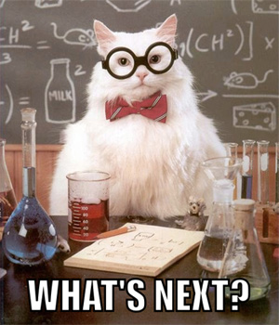
Congratulations!
You Survived CS 111.
Now what???

Slide 42
What's next?
In the short term

Slide 43
General CS Classes
After passing CS 111, you can now take the following CS courses:
  CS 235: Data Structures
    Next course needed for CS major or minor
    Language: C++
  CS 260: Web Programming
    Required for CS major, elective for CS minor
    Language: JavaScript (similar to Python)

Slide 44
Specialized CS Courses
Here are some other CS courses you could take:
  CS 202: Software Engineering Lab 1
    1 credit course for Software Engineering Emphasis
    Language: Java
  CS 180: Intro to Data Science
    Language: Python
  CS 270: Intro to Machine Learning
    Neural networks, decision trees, data mining, clustering, deep learning
    Language: Python

Slide 45
CS Courses Prerequisites
CS 235
CS 224
CS 236
CS 240
(All these courses are required for the CS Major. CS Minor requires 236 and 240. See BYU catalog for more course details: https://catalog.byu.edu/physical-and-mathematical-sciences/computer-science/

Slide 46
Emphases
Software engineering
Machine learning
Security
Graphics
HCI
Programming languages
Systems engineering

Slide 47







CS Emphases
Animation and Games
Software Engineering
Machine Learning
Bioinformatics
Computer Science
Computer/Human Interaction

Slide 48





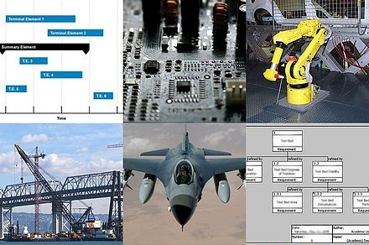
Other CS Areas
Graphics/Vision
Programming Languages
Security
Computational Linguistics
Data Science
Systems Engineering

Slide 49
What’s next?
In the long term

Slide 50

Internships!

Slide 51
Internships!
Why apply for an internship?
  $$$
  Experience
  Resume
  Perspective (would you like this job?)
  First step toward a full-time position

Slide 52

What if I don’t plan to work full-time?
Maybe you are planning to start a business…
Maybe you are planning to start a family…
An internship might still be a good idea!
  Keeps doors open
  Augments your education
  $$$
Also, it might be fun!

Slide 53
How do I get an internship?

Slide 54

Step 1:
Build a portfolio of personal projects
The number 1 comment we hear from recruiters is,
“Students need to work on something real”.
Assignments are artificial and we all know it.
Recruiters want students who know how to deal with real problems and all the messiness that goes with them.

Slide 55
Step 1:
Build a portfolio of personal projects
DON’T post solutions to class assignments
  It doesn’t help you, and professors don’t like it
DO collect your work on Github
  Code on individual projects, or on group projects that go beyond class assignments.
  Join clubs, volunteer in research labs, HAVE FUN.
DON’T wait until you’re a senior to think about your future.
DO apply to jobs even if you don’t match every qualification.

Slide 56

Step 2:
Create and maintain a resume

Slide 57
Rule #1: Your resume matters

Slide 58
Put time into your resume
On average, recruiters spend 7-10 seconds looking at each resume.
You, therefore, should spend 7-10 hours to make sure it’s perfect.
No typos, strong wording, use a good template. Make it fantastic.

Slide 59
Rule #2: Don’t sand-blast the internet

Slide 60

Don’t be one of 10,000 generic grains of sand.
Be the diamond by customizing your resume to each opportunity.
Resist the temptation to send out 500 resumes to random positions. Instead, send 5 carefully customized resumes to jobs that you are a really good match for. Be shiny, not noisy.

Slide 61
Step 2:
Create and maintain a resume
DO get feedback on your resume
  Try to get input from at least three people
  Ask your professors, the CS Mentors, and people who have jobs
DO watch for internship postings
  Ask the CS Mentors
  Watch bulletin boards in the TMCB
  Join #job-hunting channels in class Slack or Web sites
DO attend job fairs, mock interviews, and industry events
  Industry recruiters will give you job-hunting advice
  Many hires come directly from these recruiting events - you skip the line.
  Talk to people. Learn everything you can.

Slide 62
Step 3:
You’ll need letters of recommendation
DO work closely with professors
  The best recommend writers can speak about you as an employee, not just as a student
  Work as a TA, research assistant, or be an officer in a club the professor advises
  Be responsible and reliable! Professors can’t testify of attributes they didn’t observe.

Slide 63
Last Bits

Slide 64
Course Evaluation Survey
Please fill out the Course Completion Survey on Canvas.
Also don't forget to do your Student Evaluations for the course.

Slide 65
Free Coding Extra Credit
There is still time to submit the Free Coding assignment for extra credit.
Detail are on Canvas.

Slide 66
Final Exam
Don't forget to take the final.
Take it in the Testing Center anytime during Finals Week.
It's the same format as the midterms, just larger.
Yes, it is comprehensive.

Slide 67
Thank you!

